Slide 1
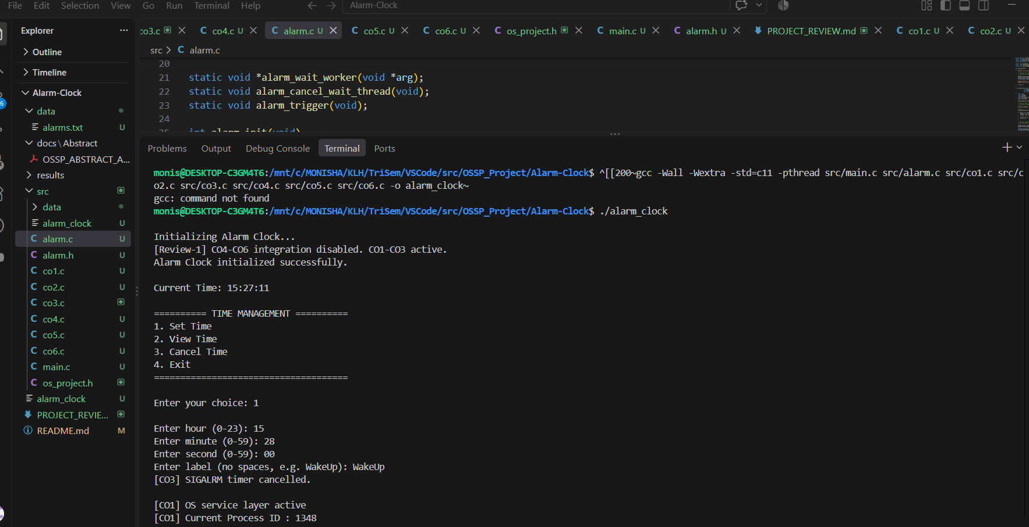
ALARM CLOCK
Time Management & Alarm Scheduling
Operating Systems Project
C • Signals • Processes • System Calls
Project Title: Alarm Clock
Section: 6
Team Number: 16
Team Members:
2520030537 – Monisha Raghini Chelle
2520030502 – Shaik Sabiya Tabassum
2520030453 – Kolipaka Siri Chandana
Project Guide: Dr. K. Anusha

Slide 2
ABSTRACT
02
The Alarm Clock is a menu-driven C application for managing a scheduled alarm.
It supports setting an alarm using hour, minute, second, and a user-defined label.
The application allows the stored alarm to be viewed and cancelled.
The project demonstrates operating-system concepts including SIGALRM, process creation, process identification, kill(), SIGTERM, and process termination.
The terminal output also reports OS and kernel information and demonstrates resource cleanup during exit.
ALARM CLOCK • OPERATING SYSTEMS PROJECT

Slide 3
INTRODUCTION & OBJECTIVES
03
INTRODUCTION
OBJECTIVES
A practical OS project implemented in C.
Uses a terminal-based interface for time management.
Connects user interaction with alarm and process mechanisms.
Set and store an alarm.
View the active alarm and current time.
Trigger the alarm at the scheduled time.
Cancel an active alarm.
Demonstrate signals and process control.
Exit with resource cleanup.
ALARM CLOCK • OPERATING SYSTEMS PROJECT

Slide 4
IMPLEMENTATION / SYSTEM DESIGN
04
USER
→
MAIN MENU
→
ALARM MODULE
→
OS / SIGNALS
→
PROCESS CONTROL
main.c controls the menu and application flow.
alarm.c / alarm.h handle alarm initialization, waiting, cancellation, and trigger logic.
co1.c reports OS/process/system-call information.
co3.c schedules SIGALRM and maintains background alarm waiting.
co2.c demonstrates child-process creation and termination.
Other project modules are present in the source tree.
ALARM CLOCK • OPERATING SYSTEMS PROJECT

Slide 5
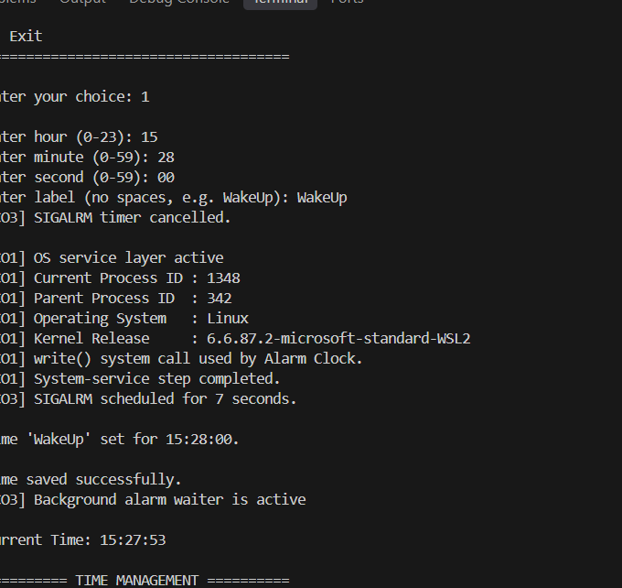
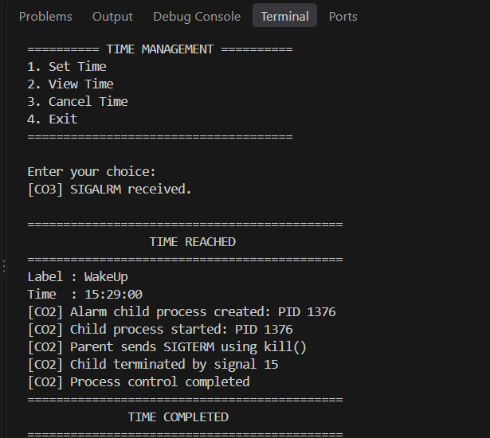
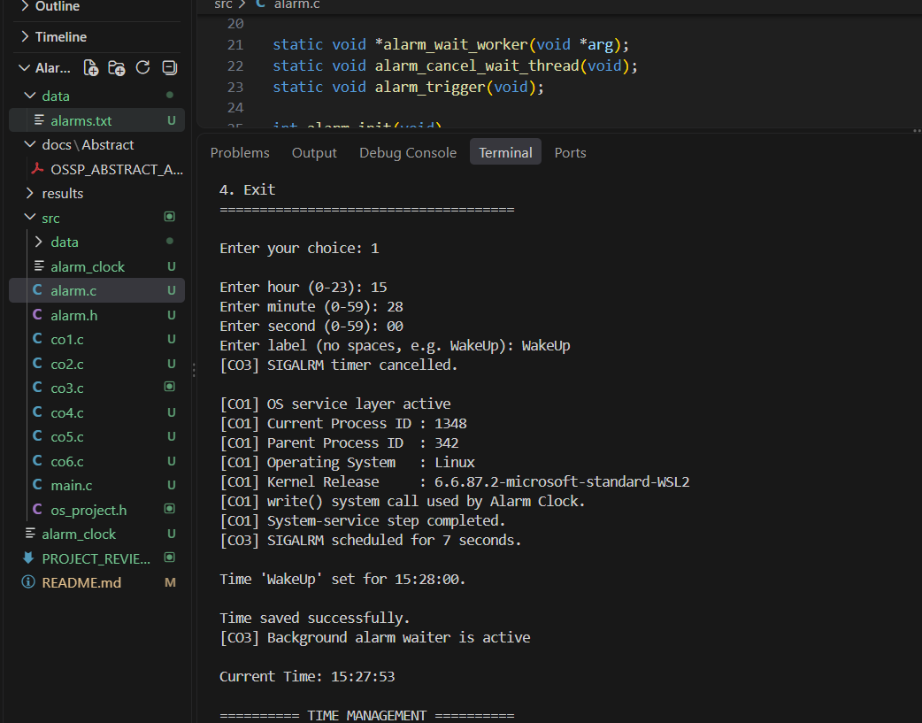
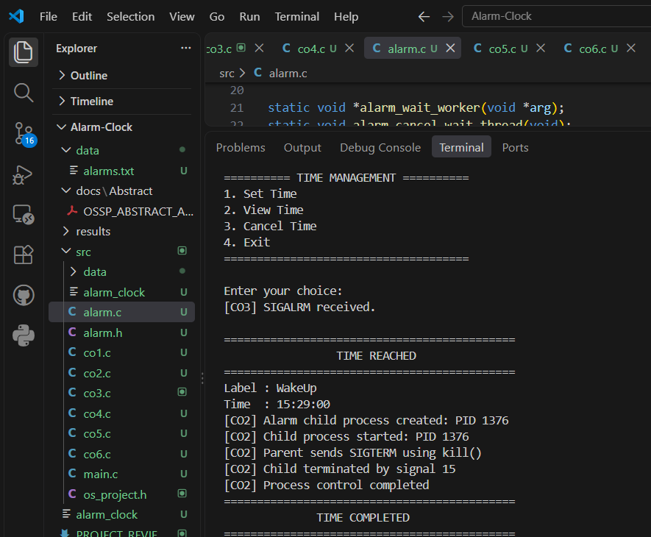
KEY FEATURES — SET & VIEW
05
ACTUAL TERMINAL OUTPUT
SET TIME
VIEW STORED TIME
ALARM CLOCK • OPERATING SYSTEMS PROJECT

Slide 6
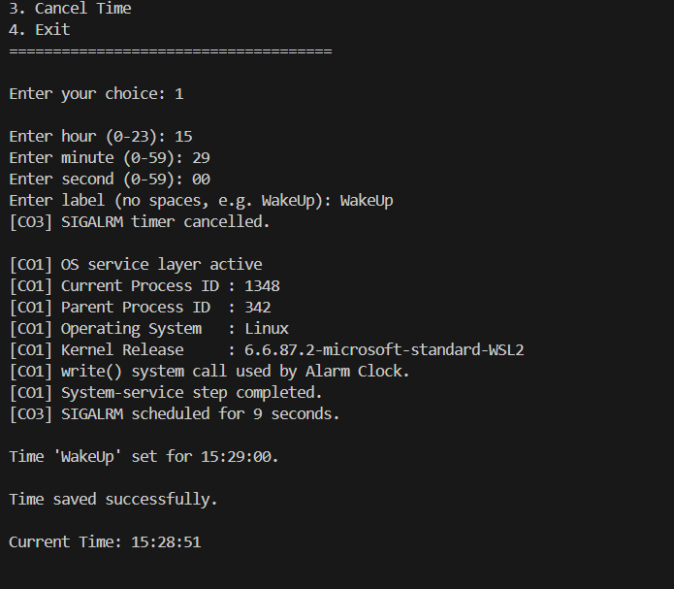
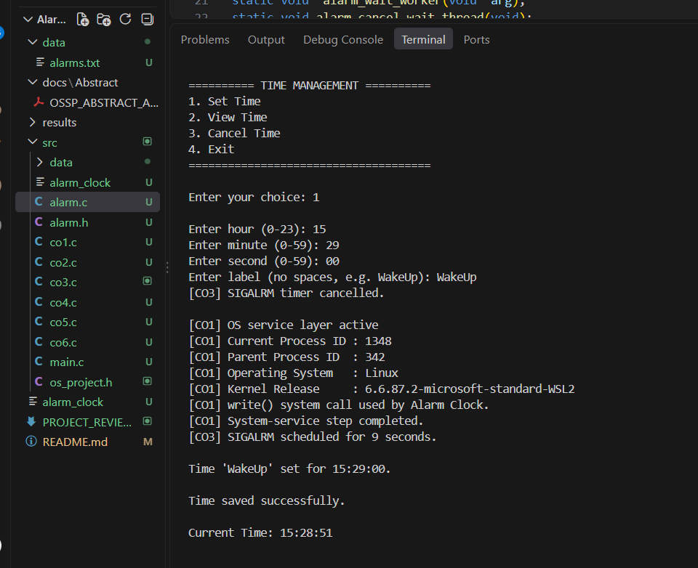
OPERATING SYSTEM CONCEPTS
06
SIGALRM — asynchronous alarm notification.
Process creation — alarm child process is created.
PID / PPID — process identification is displayed.
kill() — parent sends SIGTERM to the child.
Signal 15 — child termination is observed.
write() — system-call usage is reported.
Linux / kernel information is displayed during execution.
ACTUAL SIGNAL OUTPUT
ALARM CLOCK • OPERATING SYSTEMS PROJECT

Slide 7
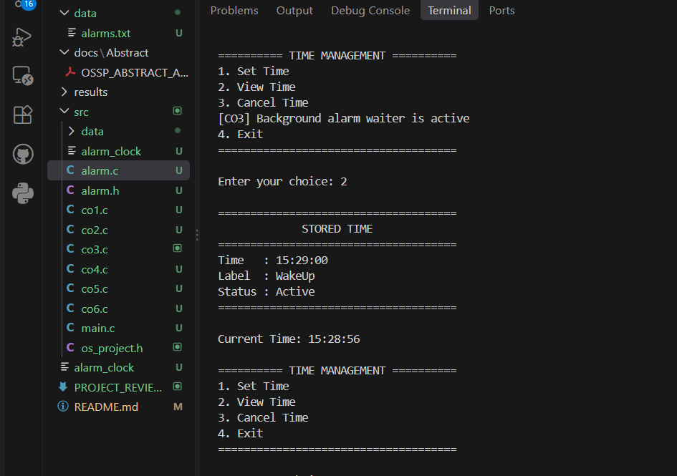
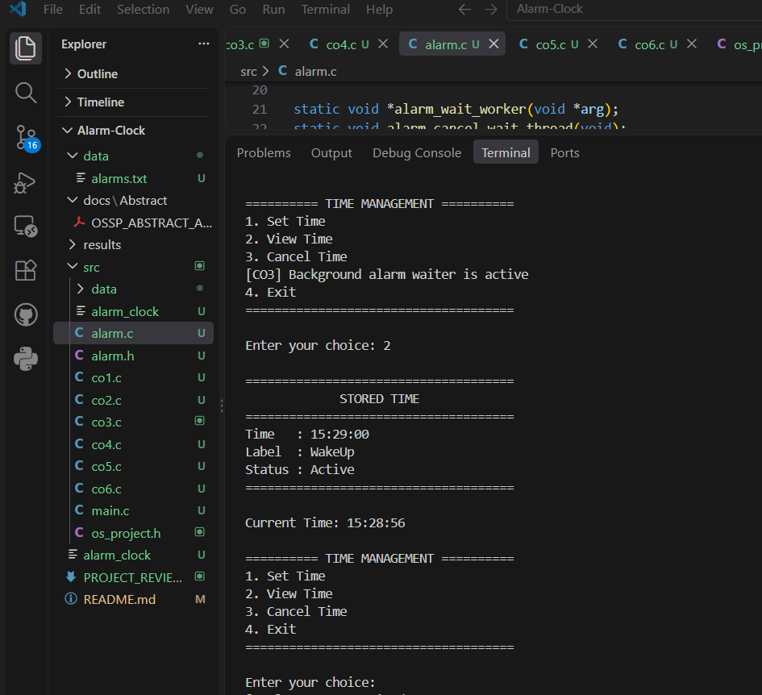
RESULTS / LIVE EXECUTION
07
✓ SIGALRM received
✓ TIME REACHED displayed
✓ Child process created
✓ Parent sends SIGTERM
✓ Child terminates by signal 15
✓ Process control completed
ACTUAL ALARM OUTPUT
ALARM CLOCK • OPERATING SYSTEMS PROJECT

Slide 8
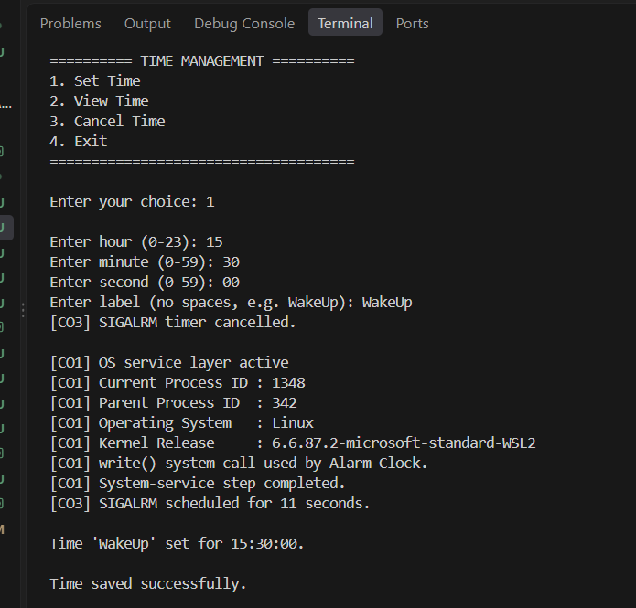
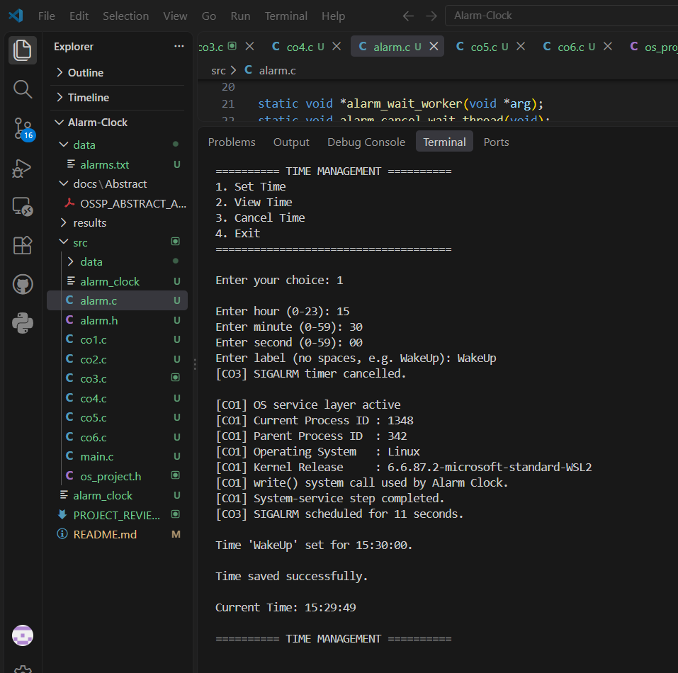
TESTING & VERIFICATION
08
Test 1 — Start application and verify menu.
Test 2 — Set WakeUp alarm with valid time.
Test 3 — View stored time and active status.
Test 4 — Observe SIGALRM scheduling/background waiting.
Test 5 — Wait for TIME REACHED and verify process output.
Test 6 — Cancel the alarm and verify success.
Test 7 — Exit and verify resource cleanup.
ACTUAL CANCEL OUTPUT
ALARM CLOCK • OPERATING SYSTEMS PROJECT

Slide 9
CONCLUSION & FUTURE SCOPE
09
CONCLUSION
FUTURE SCOPE
The application successfully manages a scheduled alarm.
The project demonstrates practical OS concepts through a working C program.
Setting, viewing, triggering, cancelling, and exiting were demonstrated.
Support multiple saved alarms.
Add recurring/daily alarms.
Add sound/notification output.
Provide a graphical user interface.
Add richer alarm history and scheduling options.
ALARM CLOCK • OPERATING SYSTEMS PROJECT

Slide 10
THANK YOU
10
ALARM CLOCK
Time Management & Alarm Scheduling
Questions & Discussion
C • Signals • Processes • Operating Systems
ALARM CLOCK • OPERATING SYSTEMS PROJECT
C • Signals • Processes • Operating Systems

