Slide 1



ALARM CLOCK
Operating Systems and Systems Programming Project
Section: 6
Team No.: 16 Team Members:
Monisha Raghini Chelle — 2520030537 Shaik Sabiya Tabassum — 2520030502 Kolipaka Siri Chandana — 2520030453

Slide 2
ABSTRACT
A C-based, terminal-oriented Alarm Clock application for Linux/Ubuntu.
Allows the user to set, view and cancel an alarm.
Uses Linux/POSIX system programming concepts.
Uses time() and localtime_r() for time processing.
Uses SIGALRM-based signal handling for timed notification.
Uses process-control mechanisms for alarm notification.
Provides terminal output when the scheduled time is reached

Slide 3



INTRODUCTION
ALARM FLOW
User Input
Linux terminal-based Alarm Clock developed using C.
Provides:
Set Time,
View Time,
Cancel Time and
Exit.
Obtains the current system time.
Calculates the waiting duration until the selected time.
Uses signal-based alarm handling.
Uses process control for alarm notification.
Validate Time
Get Current Time
Calculate Waiting Duration
Schedule Alarm
SIGALRM
Alarm Notification

Slide 4
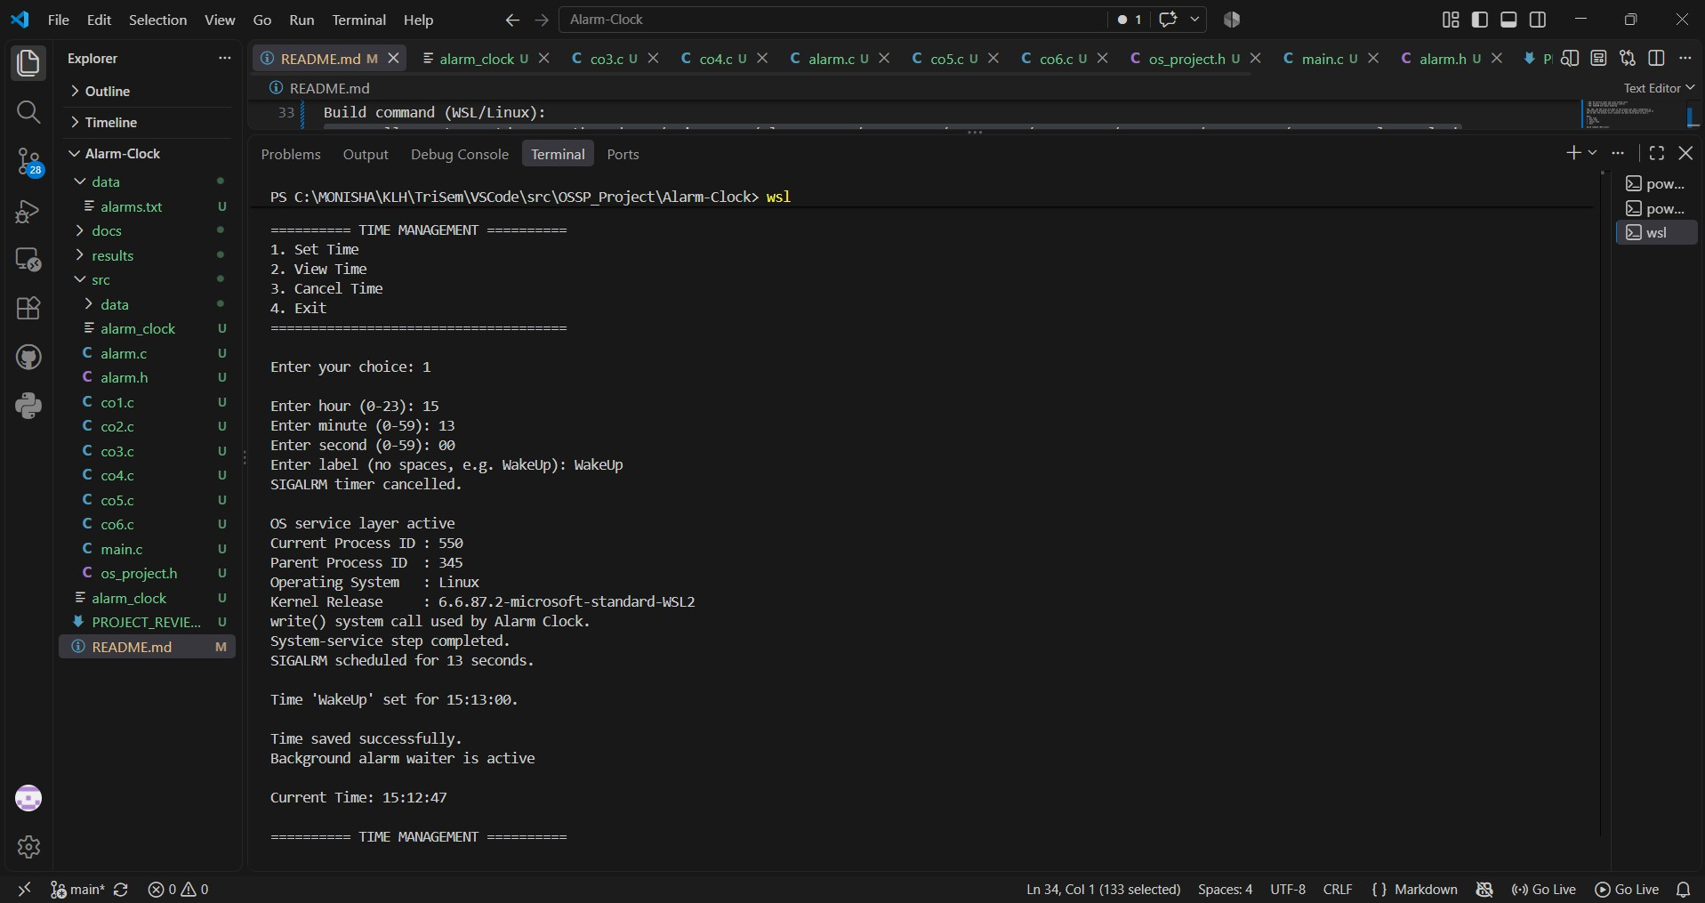

RESULTS — SET TIME
SET TIME
Selected Set Time.
Entered 15:13:00 and label WakeUp.
OS service information was displayed.
SIGALRM was scheduled for 13 seconds.
Alarm time was successfully set.

Slide 5
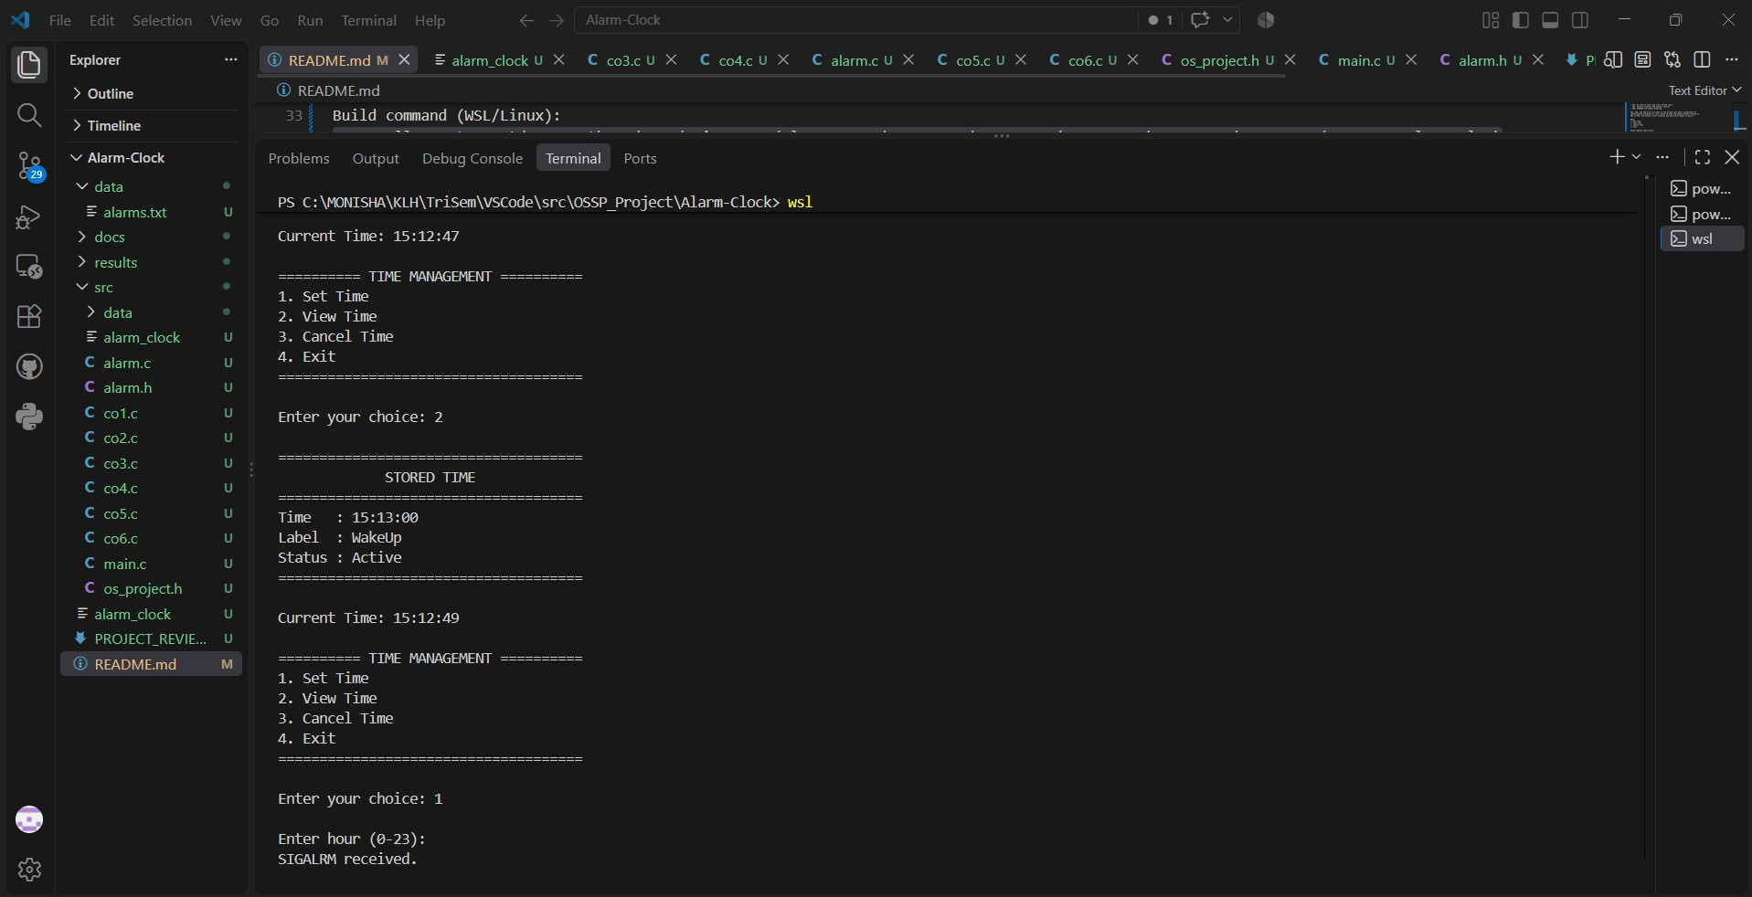
RESULTS — VIEW TIME
VIEW TIME
Selected View Time.
Stored time: 15:13:00.
Alarm label: WakeUp.
Alarm status: Active.

Slide 6

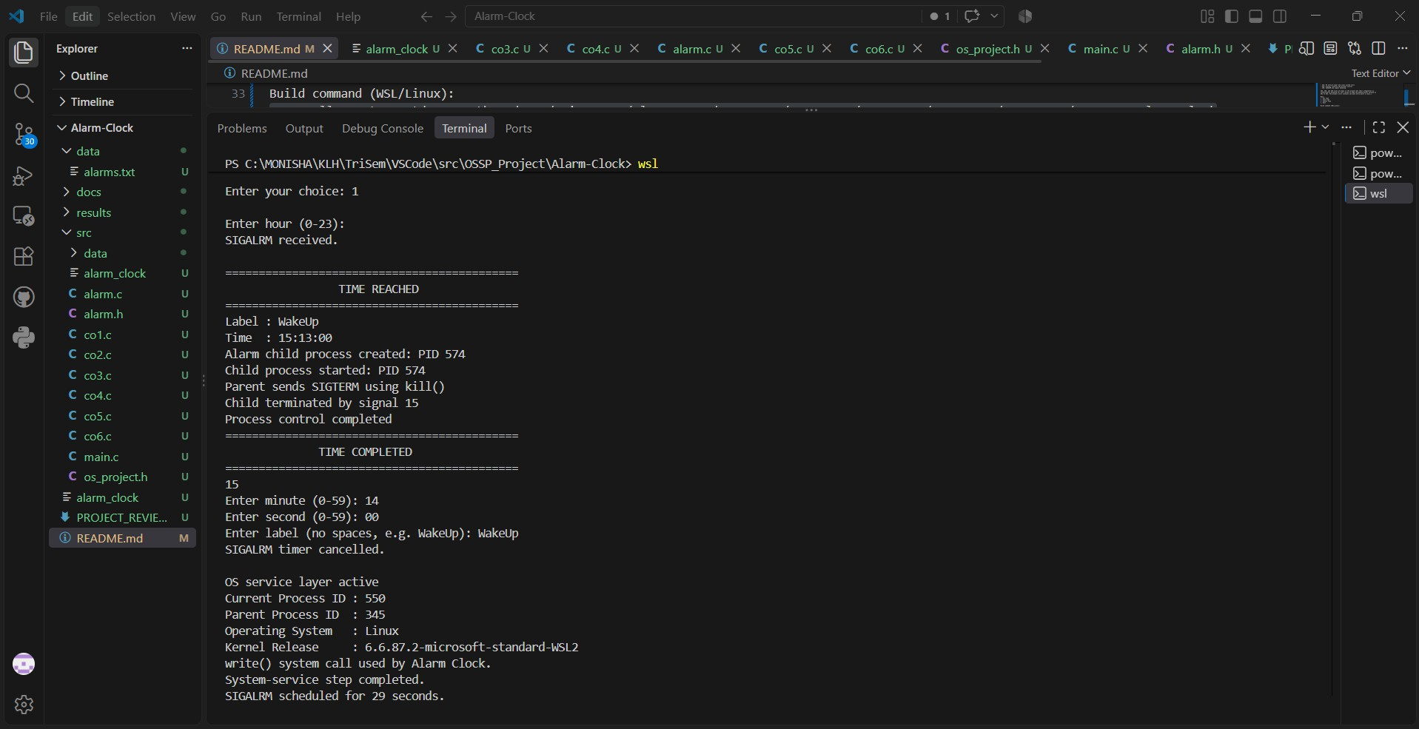
RESULTS — ALARM TRIGGER
SIGNAL HANDLING
SIGALRM was received.
The scheduled time was reached.
Alarm notification was displayed.
PROCESS CONTROL
fork() created the alarm child process.
kill() sent SIGTERM.
waitpid() synchronized with the child process.
Child-process termination was reported.

Slide 7
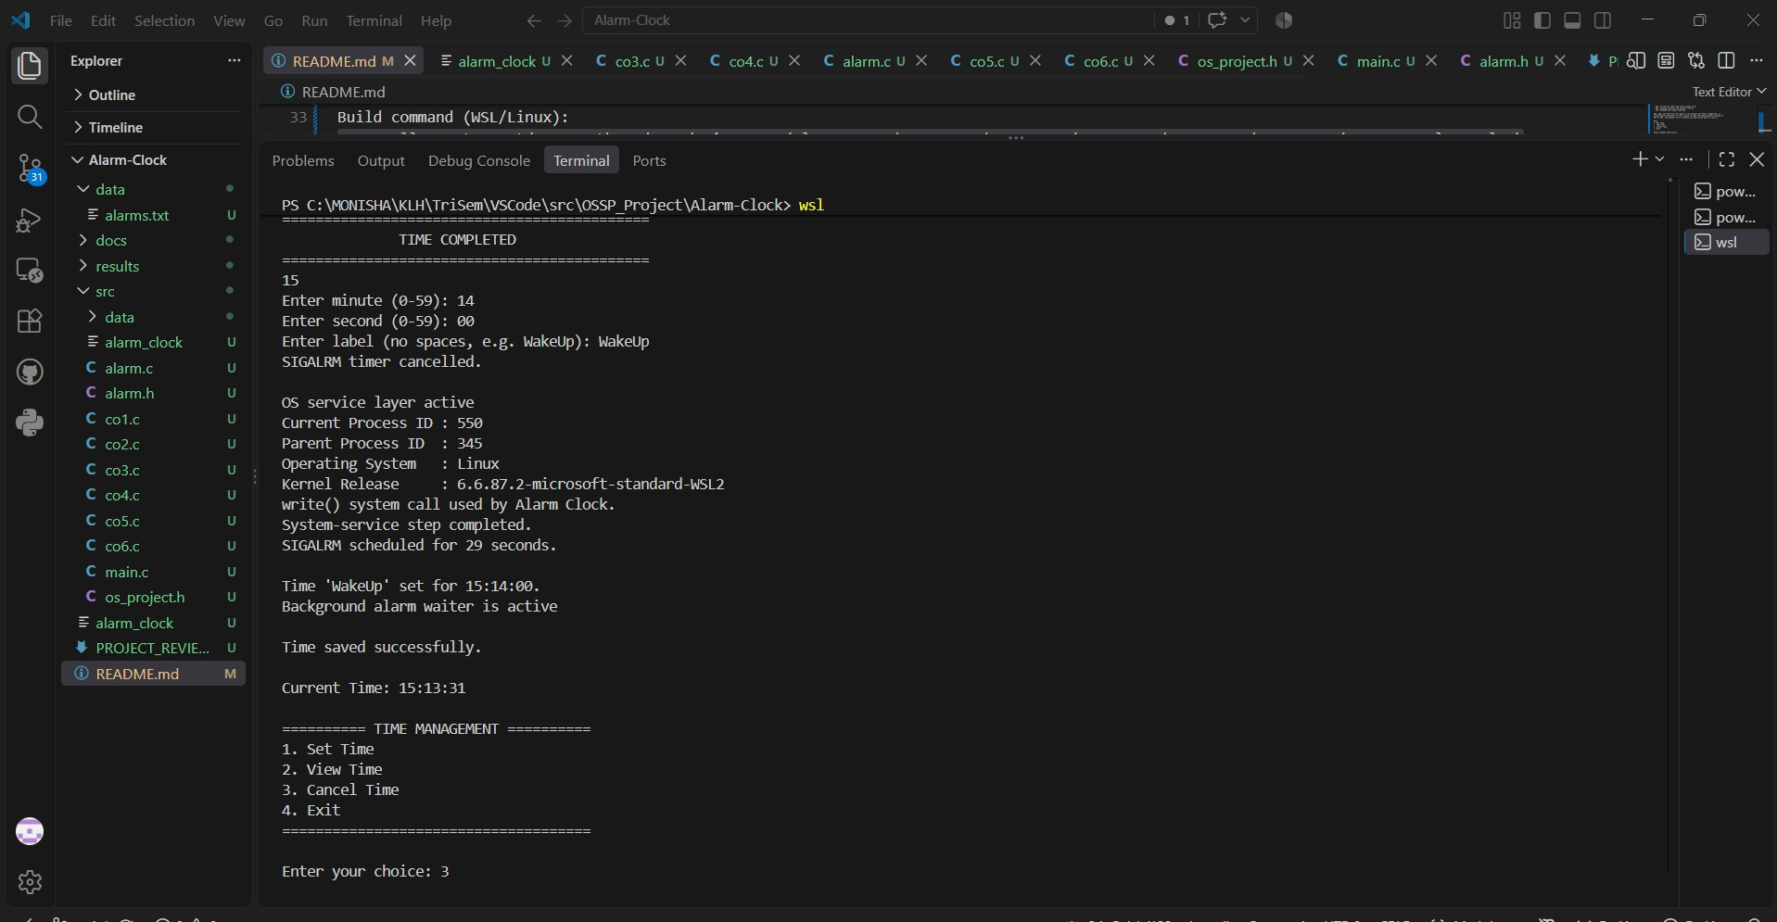
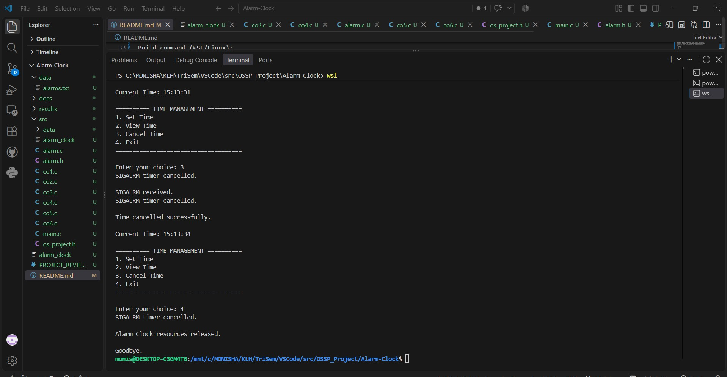
RESULTS — CANCEL G EXIT
CANCEL TIME
User selects Cancel Time.
Active alarm is cancelled.
"Time cancelled successfully." is displayed.
EXIT
User selects Exit.
Alarm Clock resources are released.
Program terminates normally.

Slide 8
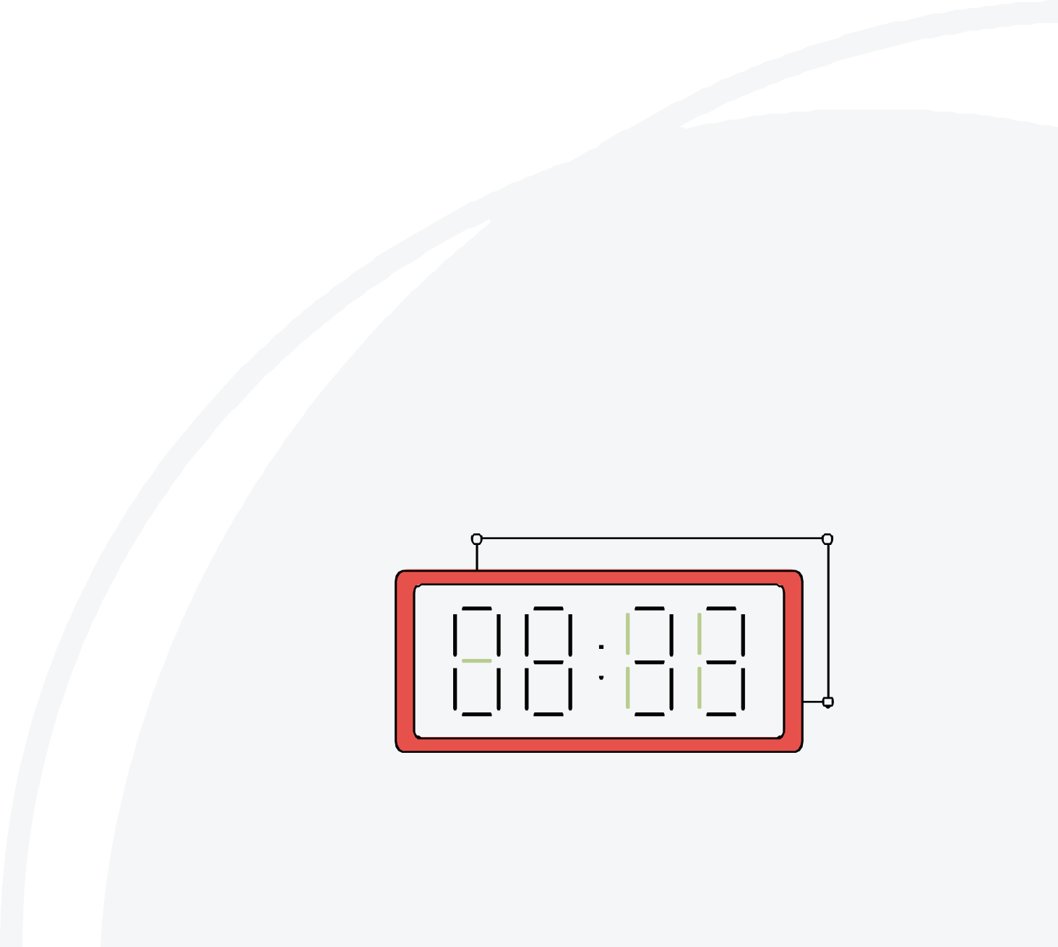
HARDWARE G SOFTWARE
01
HARDWARE
Computer / Laptop
Keyboard
Display
02
SOFTWARE
Operating System: Linux / Ubuntu / WSL2
Programming Language: C
Compiler: GCC
Interface: Linux Terminal
Editor: Visual Studio Code
System Programming: Linux/POSIX APIs
Version Control: Git / GitHub

Slide 9
CONCLUSION
Developed a Linux-based terminal Alarm Clock using C.
Implemented Set Time, View Time, Cancel Time and Exit.
Demonstrated CO1 — OS services and Linux system calls.
Demonstrated CO2 — process creation and process control.
Demonstrated CO3 — SIGALRM and signal handling.
Successfully tested alarm setting, viewing, triggering, cancellation and program termination

Slide 10

FUTURE SCOPE
SCALABILITY
Support multiple alarms.
Add recurring or daily alarms.
Maintain alarm history.
USER EXPERIENCE
Add customizable alarm sounds.
Add snooze functionality.
Improve notification options.
EXTENSION
Develop a graphical user interface.
Extend the application with additional Linux/POSIX features.

Slide 11

THANK YOU
Questions?
Alarm Clock — Team 16 | Section 6
Monisha Raghini Chelle — 2520030537 Shaik Sabiya Tabassum — 2520030502 Kolipaka Siri Chandana — 2520030453

