Slide 1

SMART INDIA HACKATHON 2026
MINIATURE CIRCUIT BREAKER (MCB) ANALYSER
Problem Statement ID – 26029
Problem Statement Title- Automated High-Current Short-Circuit Test System for IEC 60898-1:2015 MCB Compliance.
Theme- Smart Automation
PS Category- Hardware
Team ID- 168797
Team Name - VOLTRA

Slide 2
VOLTRA
MINIATURE CIRCUIT BREAKER (MCB) ANALYSER
MCB ANALYSER is an automated MCB testing system that measures current, detects tripping, calculates trip time, and logs the test results for IEC 60898-1:2015-based demonstration.
Problem Statement :
Idea :
The problem is to develop an automated system that can perform and monitor these MCB short-circuit tests accurately, safely, and repeatedly.Existing MCB testing methods can involve complex manual setup and repeated wiring, making the testing process time-consuming and difficult to maintain consistently.
Automated MCB Testing : Automatically applies controlled load conditions and monitors MCB operation.
Real-Time Measurement : Measures voltage and current using sensors and detects the trip condition.
IEC 60898-1:2015 Reference : Demonstrates the MCB testing and trip-time monitoring concept based on the standard.
Proposed Solution :
Uniqueness :
A smart test system that automates fault generation and MCB trip detection with controlled switching.
It monitors voltage, current, waveforms, and response time during the test.
The system automatically isolates the supply after fault detection and records the test results.
Automated fault application and MCB tripping without manual intervention.
Modular R/XL selection with real-time monitoring of voltage, current, waveform, and trip response time.
Integrated safety control with automatic shutdown during abnormal conditions, reducing operator involvement.

Slide 3
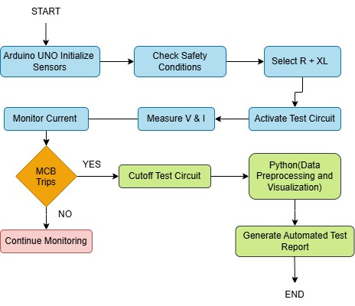
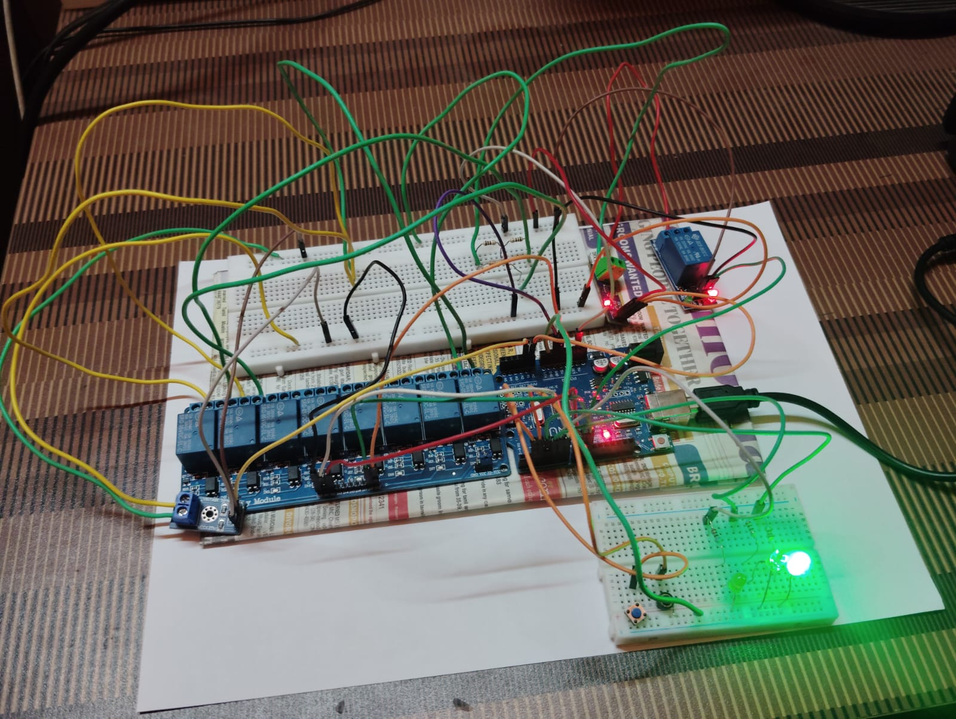
VOLTRA
Technologies Involved :
System Architecture :
Arduino UNO : Main controller for automated test sequencing and relay control.
Relay-based switching : Automated R/XL selection, fault generation, and MCB trip simulation
Proteus 8 : Circuit design and simulation of the complete prototype.
Python : Data analysis, visualization, and test-result processing.
Prototype :
GitHub Link : https://github.com/ShaikSadh912/SIH2026_VOLTRA.git
Video Link : https://youtu.be/iz6N5fo75uA?si=RvOdJQqPJj75Z5D6
Product Status : 80% of work has been completed and remaining work is still in progress

Slide 4

VOLTRA
Technical Feasibility :
Economical Feasibility :
The system is technically feasible using embedded control, automated relay switching, voltage/current sensing, and real-time data acquisition, with a scalable architecture for future high-current laboratory implementation and IEC-based testing.
Scalable : Modular design supports future expansion to higher-current testing.
Reliable : Automated switching and real-time sensing ensure consistent operation.
Resources : Required components and development resources are readily available and cost-effective.
Feasible : Embedded control enables monitoring, protection, and data acquisition.
Lower Cost : Uses affordable, reusable components and simple circuitry.
Lower Labour : Automation reduces manual testing and operator effort.
Lower Operating Cost : Reduces testing time and resource usage.
SDG 9 – Promoting innovation in safer and smarter electrical infrastructure.
SDG 7 - Supporting safer and more reliable electrical energy systems.
Challenges :
Strategies :
Achieving precise and repeatable high-current test conditions while controlling R/XL combinations.
Ensuring safe fault generation and rapid isolation during high-energy short-circuit events.
Accurately capturing high-speed voltage, current, waveform, and MCB response-time data.
Automate : R/XL selection and fault generation
Monitor : voltage, current, waveform, and trip response in real time.
Ensure safety : through automatic fault isolation and protection mechanisms.

Slide 5
VOLTRA
Direct Beneficiaries who are Impacting :
Strategic Benefits :
MCB Manufacturers : Faster and more consistent product testing.
Testing & Certification Laboratories : Automated testing and reliable data collection
Electrical Safety Authorities : Improved verification and safety assurance.
Service Delivery : Faster, reliable, and consistent MCB testing.
Long-Term Impact : Scalable platform for future testing and laboratory applications.
Technology Transfer: Supports training, research, and laboratory development in automated testing.
Strategic Impact :
Economical Impact :
Sustainability : Reusable components and controlled testing reduce material and energy wastage.
Efficiency : Automation enables faster, consistent, and repeatable testing.
Safety : Automatic fault detection and shutdown reduce operator exposure.
Accessibility : Uses readily available, affordable components for easy adoption.
Employment : Creates opportunities in automation, testing, and electrical system development.
Cost Benefit : Reduces equipment, labour, and testing costs through automation.

Slide 6
REFERENCE :
VOLTRA
IEEE – Design and Construction of an Automated Test Bench for MCB Testing
https://ieeexplore.ieee.org/document/7480150
Times of India – CEA urges power utilities to use IoT technology to prevent short-circuit fires
https://timesofindia.indiatimes.com/india/cea-urges-power-utilities-to-use-iot-tech-to-prevent-fires-caused-by-short-circuits/articleshow/132078151.cms
IEC 60898-1:2015 — Short-circuit test section reference
https://webstore.iec.ch/en/publication/21972
High-Performance Breaking and Intelligent of Miniature Circuit Breakers
https://www.semanticscholar.org/paper/High-Performance-Breaking-and-Intelligent-of-Yin-Lang/870529d8d48067bc4c9da7f55cc78739b85c1be3
Automated High-Current Short Circuit Test System for MCB
https://www.sihbuddy.in/ps/SIH26029
Circuit-Breaker Automated Failure Tracking Based on Coil Current Signature
https://ieeexplore.ieee.org/document/6587111
IEEE Guide for Power System Protection Testing (C37.233-2023)
https://ieeexplore.ieee.org/document/10258048

