Slide 1
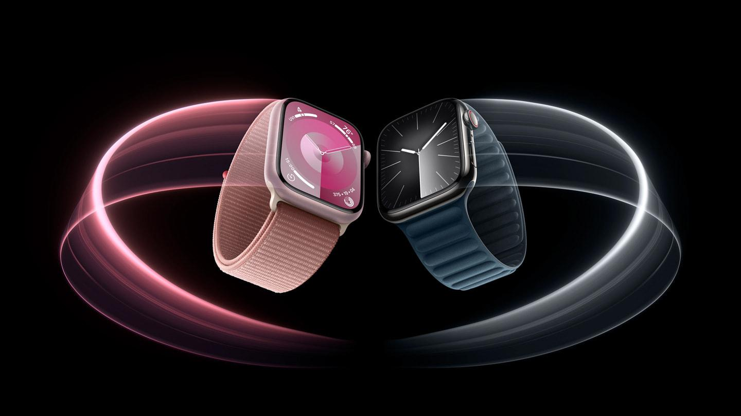
Acoustic Collision Detection Smart Watch Feature For Pedestrians using Smart Phone
ISE 222 Advanced Systems Engineering
Group Num: 20
Shaik Salma Aga ID: 016764644
Komal Devi ID: 016805295
Shaista Fathima Basheeruddin. ID: 016559907
Pooja Shegakula Nagaraj ID: 016804554

Slide 2

Problem Identification
Rising Trend: Increased smartphone use by pedestrians and drivers.
Safety Concerns: Escalation in accidents, injuries, and fatalities.
Distractions: Primary cause of safety issues.
Urgency for Mitigation: Immediate need for effective safety measures.
A juvenile male driving a stolen Hyundai in Greentree, San Jose, struck and killed a pedestrian in the 33rd fatal crash of 2023.

Slide 3
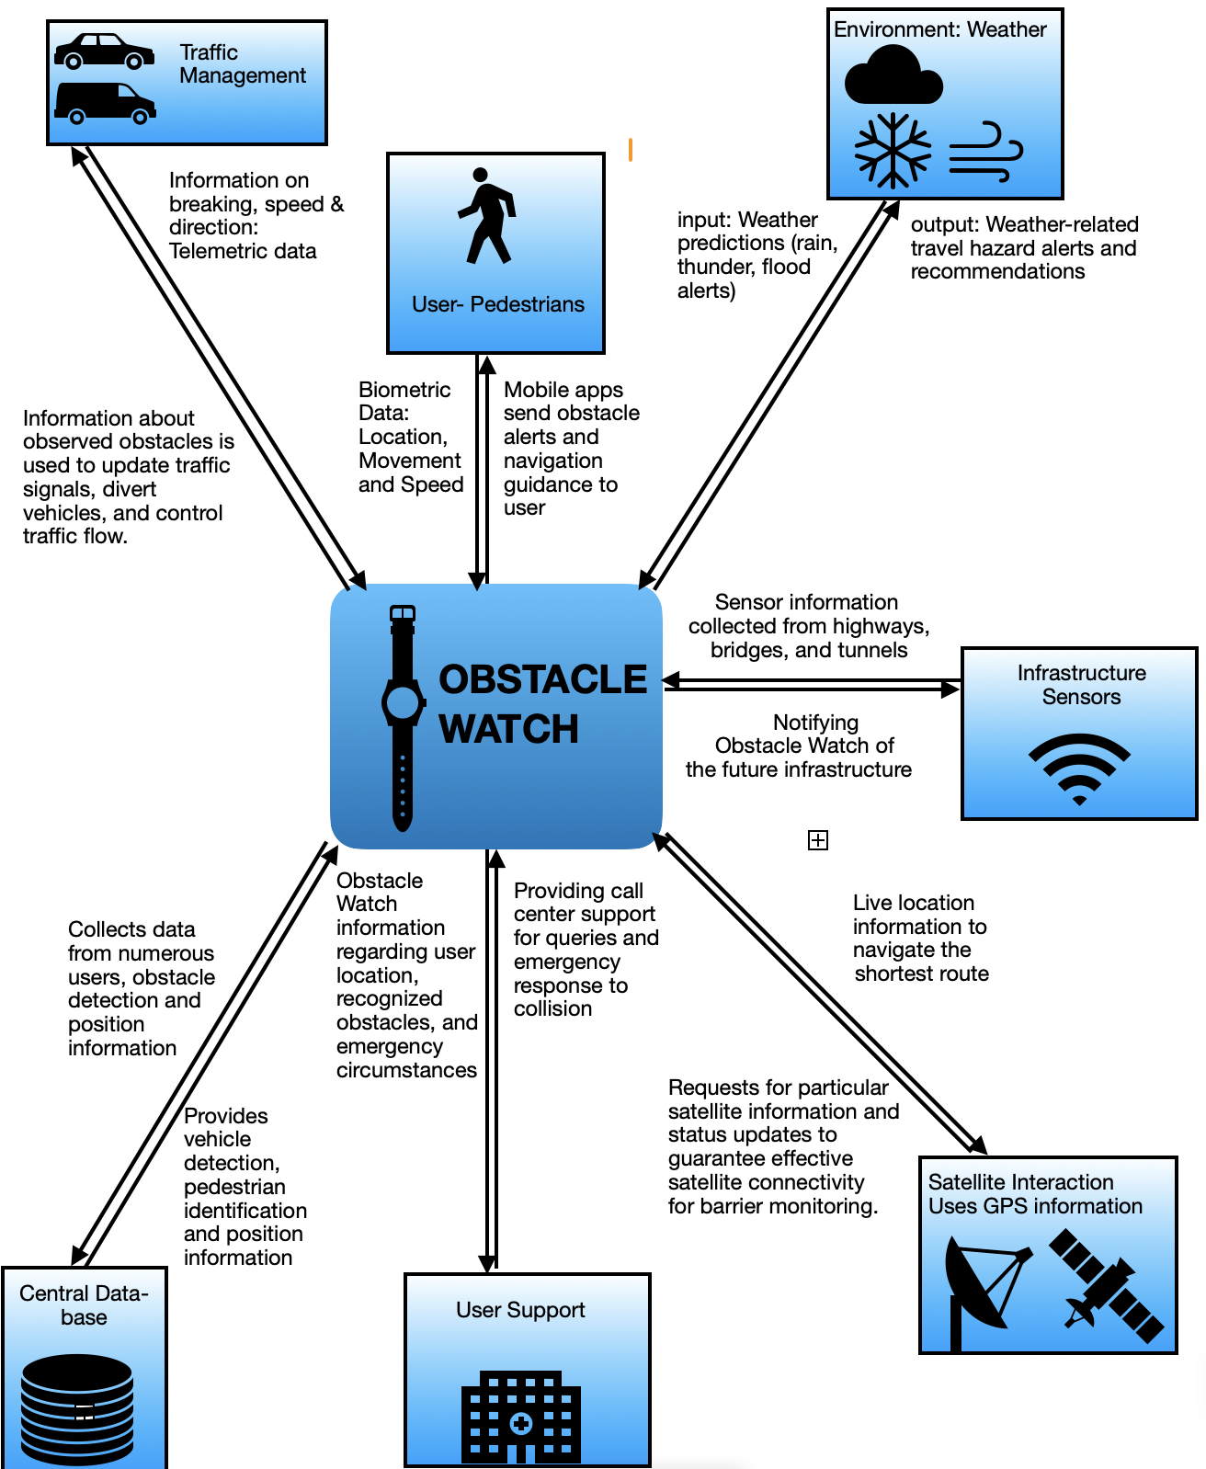
System Context Diagram

Slide 4
Interfaces
Interface | Input/Output | Type | Description
Infrastructure sensors | Input & Output | Analog | Sensors to capture ambient sounds, motions to detect potential hazards
Bluetooth/Wi-Fi Module | Input & Output | Wireless | Communicate with the paired smartphone and receive/send data.
Sensor Analysis software | Input & Output | Software | Analyze data to determine user motion direction and sound.
Smartphone Interfacing App | Input & Output | Software | Communicate between the smartwatch and smartphone, relay alerts, and possibly pause distractions.
User Preferences | Input & Output | Software | Customization settings like alert sensitivity, notification preferences, etc.
Feedback Algorithm | Input & Output | Software | Determine vibration patterns based on the level of threat
Visual Alerts | Output | Alert | Color-coded warnings on the watch display indicating the threat level.
Audible Alerts | Output | Alert | Beeps or voice warnings for hazards, played through earphones or the phone's speakers.
Battery & System Health | Output | Safety Protocol | Check system health and warn users if the battery is low or a malfunction is detected.

Slide 5
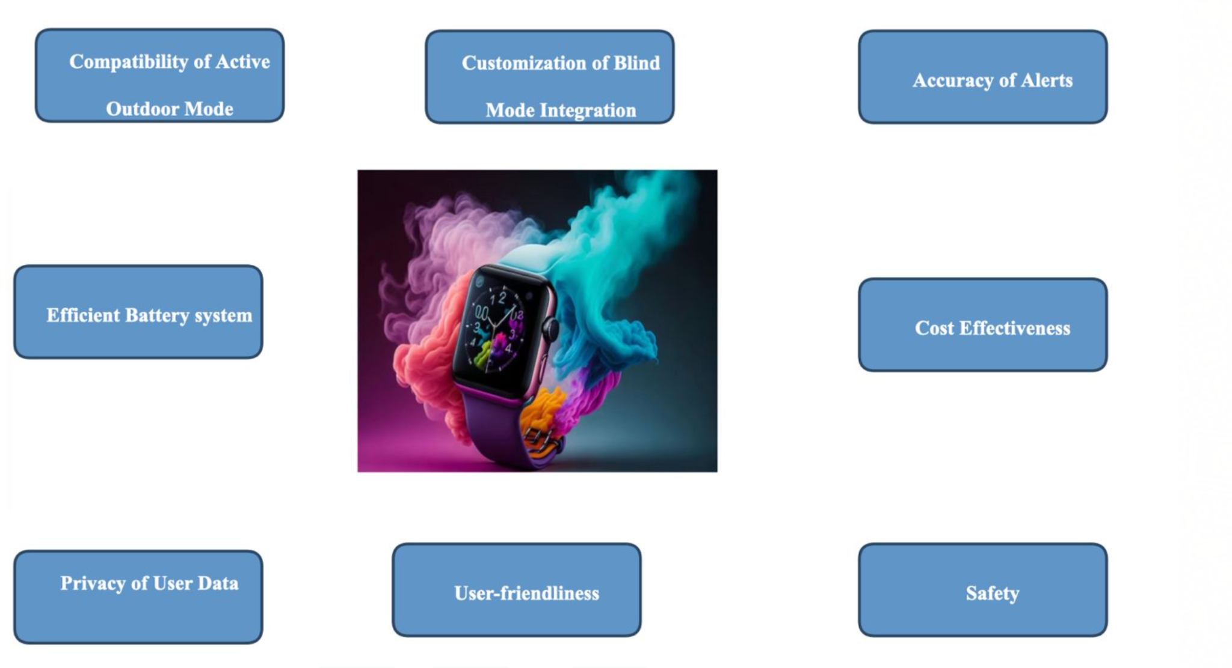
Customer Requirements

Slide 6
Operational Requirements and TPMs
Operational Requirement | TPM | Unit | Target Value
Sensor Technology | Range for Accuracy | Meters | 2-5 meters
Auditory feedback - Virtual Assistance | Clarity and Sound Quality | THD (Total Harmonic Distortion) | ≤ 1% is Excellent
Real-Time Processing | Latency | Milliseconds | < 100 milliseconds
Machine Learning Algorithms | Measures how well the model fits the data | R^2 | 0-1, Better Fit of data
Smartwatch Battery Optimization | Battery Life | Hours | 2-3 days
Bluetooth Connectivity | Data Transfer Speed | Megabits per second | ≥ 2 Mbps
App Integration | Compatibility | None | iOS and Android compatibility
Privacy Controls | User Consent | None | Clear and informed consent
Alert Filtering | Precision | Percentage | ≥ 90%
Cost Management | Budget Adherence | Currency (e.g., USD) | .≤ 8,000,000/year

Slide 7
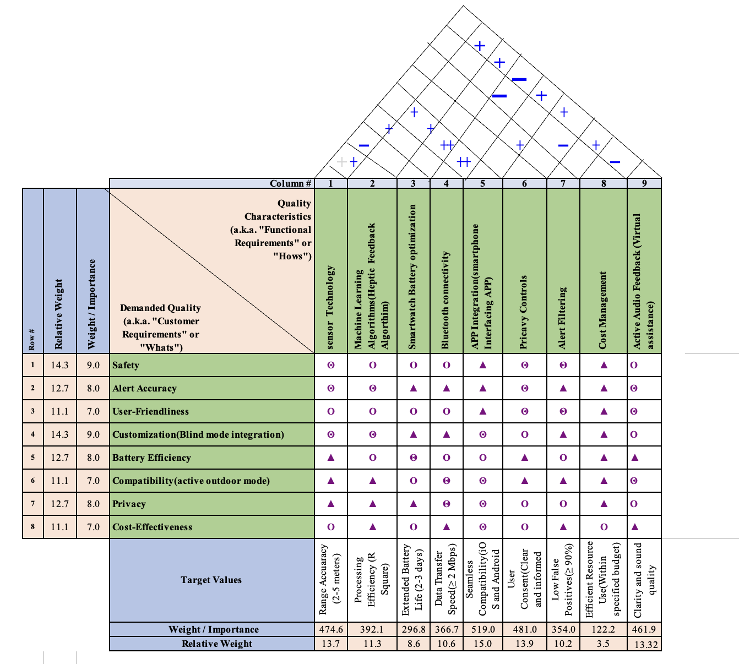
House Of Quality
The operational requirement of highest priority is seamless compatibility(15) followed by range accuracy of crash detection(13.7).Lowest on the scale is cost management (3.5).

Slide 8
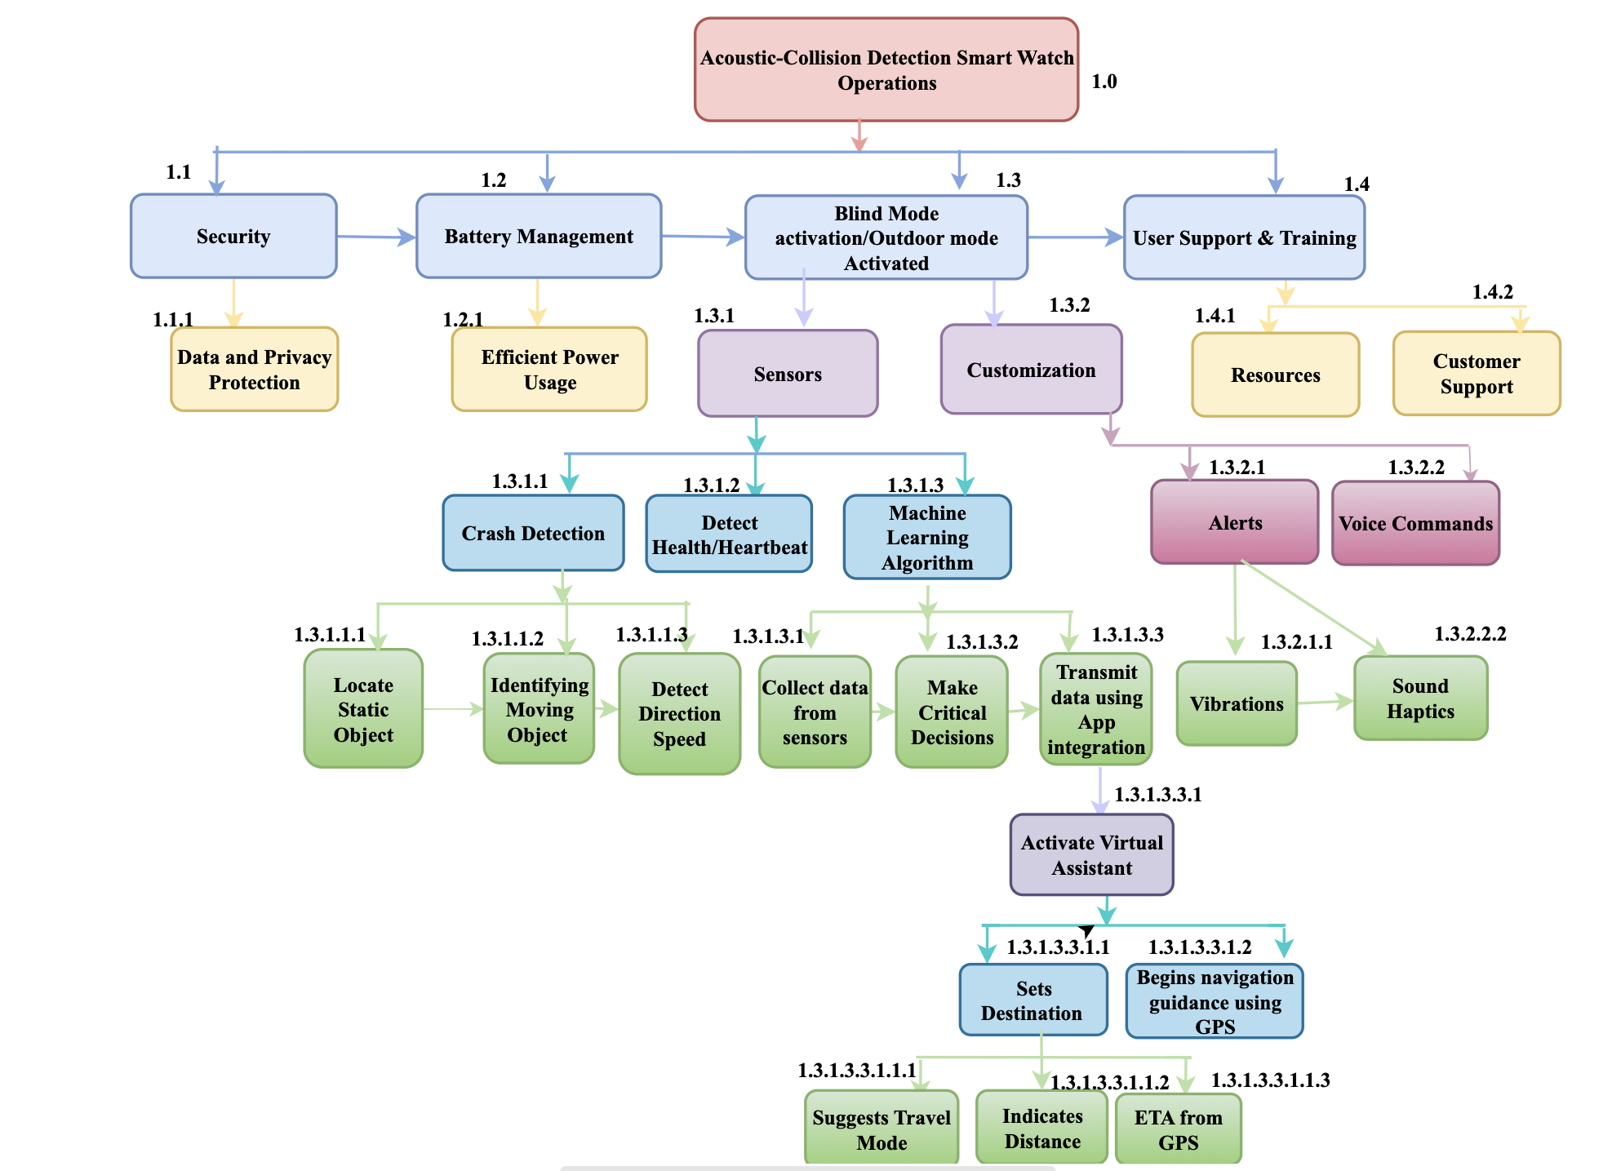

Functional Analysis and Allocations

Slide 9
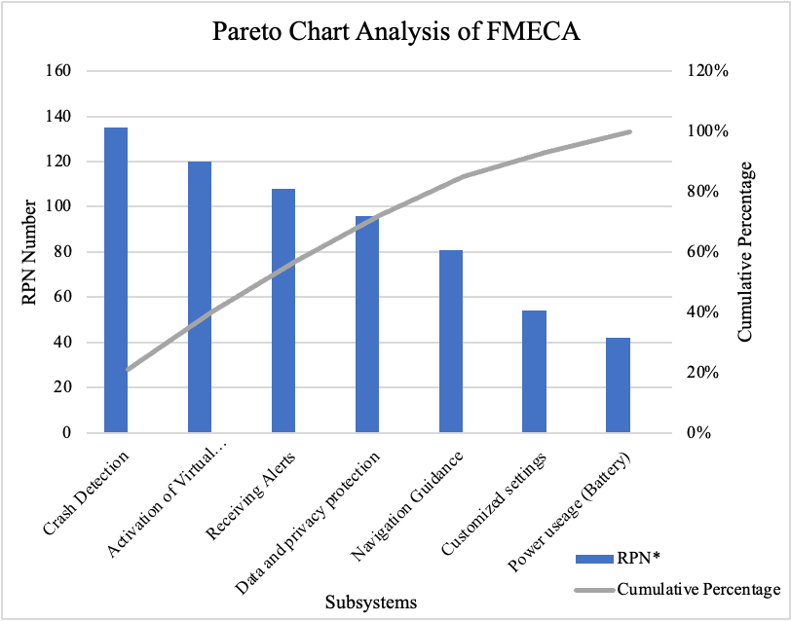
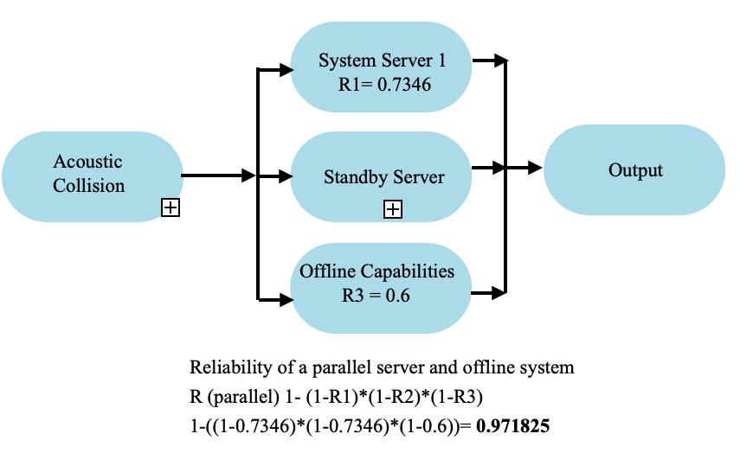
Measures of Effectiveness: Reliability
Subsystem | Operating Cycle (hrs/yr) | Downtime (hrs/yr) | Actual Operating Time (hrs/yr) | No of Failures (per yr) | Lambda (Failure rate) | MTBF (hrs) | Reliability
Crash Detection | 8760 | 73 | 8687 | 0.023 | 2.64763E-06 | 377,696 | 0.977073619
Virtual Assistance | 6240 | 182.5 | 6057.5 | 0.040 | 6.60338E-06 | 151,438 | 0.959632272
Alert System | 8395 | 219 | 8176 | 0.091 | 1.11546E-05 | 89,649 | 0.910607921
Navigation Guidance | 2920 | 164.25 | 2755.75 | 0.138 | 5.00771E-05 | 19,969 | 0.863963147
Power output (Battery) | 6750 | 164.25 | 6585.75 | 0.004 | 6.07372E-07 | 1,646,438 | 0.995908632
 |  |  |  |  |  | Reliability in Series | 0.734646257

Slide 10
Measures of Effectiveness: Design for Maintainability
Maintainability parameters | Formulas | Results
Application failure rate | ƛ = ƛa + ƛb + … | 7.10901E-05
Mean Corrective Maintenance (MCT) | Mct = ƛa*Mct_a + ƛb*Mct_b+ … )/(ƛa+ ƛb+…) | 171.1374485
Mean Preventive Maintenance (MPT) | Mpt = ∑ (fpt_{i})(Mpt_{i}) / ∑fpt_{i} | 4.026
Mean Active Maintenance(M) | M = ((ƛ*Mct) + (fpt*Mpt)) / (ƛ + fpt) | 12.74921266
Mean time Between Failure (MTBF) | MTBF = 1/(ƛa + ƛb + …) | 14066.65607
Mean time Between Preventive Maintenance (MTBS) | MTBS = 1/(fpt1 + fpt2+ … ) | 774.7193579
Mean Time Between Maintenance (MTBM) | MTBM =1/(1/MTBF+1/MTBS) | 734.2790304
Mean Downtime (MDT) | MDT = ADT + M | 17.74921266
Inherent Availability (Ai) | Ai=MTBF/(MTBF+Mct) | 0.987980058
Achieved Availability (Aa) | Aa=MTBM/(MTBM+M) | 0.982933426
Operational Availability (Ao) | Ao=MTBM/(MTBM+MDT) | 0.97639821
Preventive Maintenance | Maintenance Time(Hrs.) | MTBS
Software update | 5 | 2160
Battery | 1 | 8000
Data Security | 4 | 3500
Calibration of Sensors | 3 | 4250
Replacing components e.g. Microphone, straps | 5 | 5500

Slide 11
Measures of Effectiveness - Design for Sustainability
Lifecycle Stage | Sustainability consideration | Sustainability strategy | Resources Affected | Metrics | Emissions Affected
Resource extraction and processing materials | Enhancing product life, by reducing the need for replacements | Recycled plastic- watch straps Reused metal to make alloys for watch casing | Recycled titanium metal alloy. | Percentage of recycled materials used | Emissions associated with manufacturing and assembly
Construction & production | Renewable energy for charging | Mini solar filaments on straps absorbs sunlight for wireless charging | Electricity | Kilowatt generated per charge | Emissions related to the watch's energy consumption
Disposal at end of life | Transient electronic components for watch. | Materials made of transient nanocomposite disintegrate in water enabling collection of recyclable components | Cost of recycling. | Percentage of materials recycled | Emissions from disposal or recycling
Design & Packaging | Diminish packaging waste. | Surlyn lonomer packaging produced using plastic waste | Plastic material | Percentage of plastic reduced for packaging. | Reduced carbon and pollutants emission
Product Use | Promote sustainable usage and maintenance to prolong the watch's life | Increase device lifespan through user education, efficient charging, software updates, and maintenance | Education materials, software updates, maintenance tools | Rate of user engagement with energy-saving features or practices | Reduced emissions from extended product lifespan

Slide 12
Life Cycle Costing – CBS
Phase 1 | Designation |  | 1 | 2 | 3 | 4 | 5
Research and Development | Cr | Market Research And Analysis | $ 50,000.00 |  |  |  |  | 50,000.00
 |  | Feasibility Studies | $ 20,000.00 |  |  |  |  | 20,000.00
 |  | Concept Development | $ 80,000.00 |  |  |  |  | 80,000.00
 |  | Business Case Development | $ 30,000.00 |  |  |  |  | 30,000.00
Phase 2
Design and Manufacturing Setup | Cd | Designing and Prototyping | $300,000.00 | $350,000.00 | $400,000.00 | $500,000.00 | 600,000 | $2,150,000.00
 |  | Intellectual Property | $50,000.00 | $60,000.00 | $70,000.00 | $90,000.00 | 110,000 | 380,000.00
 |  | Engineering and Development | $500,000.00 | $600,000.00 | $700,000.00 | $900,000.00 | 1,100,000 | 3,800,000.00
 |  | Regulatory Compliance | $60,000.00 | $75,000.00 | $90,000.00 | $120,000.00 | 150,000 | 495,000.00
Phase 3
Production and construction | Cp | Materials and Components | $200,000.00 | $220,000.00 | $240,000.00 | $280,000.00 | 320,000 | 1,260,000.00
 |  | Manufacturing and Production | $500,000.00 | 1,600,000.00 | 1,320,000 | $2,730,000.00 | $3,040,000.00 | 9,190,000.00
 |  | Software Development and Integration | $100,000.00 | $190,000.00 | $270,000.00 | $290,000.00 | 350,000 | 1,200,000.00
Phase 4 |  |  |  |  |  |  |  | -
Operations and Support | Co | Marketing and Sales | $660,000.00 | $777,000.00 | $945,000.00 | $1,091,000.00 | 1,450,000 | 4,923,000.00
 |  | Overhead and adminitrative Expenses | $430,000.00 | 458,000.00 | $559,000.00 | 572,000.00 | $602,000.00 | 2,621,000.00
 |  | Miscellaneous Costs | $80,000.00 | $96,000.00 | $120,000.00 | $144,000.00 | 160,000 | 600,000.00
 |  | Project Management and Contingency | $80,000.00 | $96,000.00 | $120,000.00 | $144,000.00 | 160,000 | 600,000.00
 |  | Total Actual Cost | 3,140,000.00 | 4,522,000.00 | 4,834,000.00 | 6,861,000.00 | 8,042,000.00 | 27,399,000.00
 |  | Total Present Value of Cost | $17,012,623.33 | 18,713,885.6 | 20,585,274.23 | $22,643,801.65 | 24,908,181.82
 |  | Income (20% of Actual Costs) | $3,768,000.00 | 5,426,400.00 | 5,800,800.00 | 8,233,200.00 | $9,650,400.00 | $32,878,800.00
 |  | Total Present Value of Income | $20,415,148.00 | 22,456,662.8 | 24,702,329.08 | 27,172,561.98 | 29,889,818.1
 |  | Net Present Value | $3,402,524.67 | 3,742,777.13 | 4,117,054.85 | 4,528,760.33 | 4,981,636.36

Slide 13
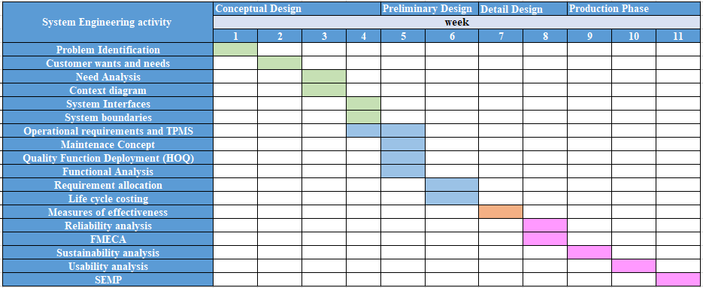
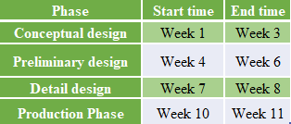
System Engineering Management Plan

Slide 14


