Slide 1
Design and Development

Slide 2
What is Development Stage of ML Workflow
1. Problem Definition
Understand the business problem or use case.
Define the goals, success metrics, and constraints.
Identify whether ML is the right approach for the problem.
2. Data Collection
Gather raw data from various sources such as databases, APIs, web scraping, or IoT devices.
Ensure data volume, variety, and velocity meet the needs of the project.
3. Data Preprocessing
Data Cleaning: Handle missing values, outliers, and inconsistent data.
Feature Engineering:
  Create new features from raw data.
  Encode categorical data and normalize numerical features.
Data Splitting: Divide the dataset into training, validation, and testing sets.

Slide 3
What is Development Stage of ML Workflow
4. Model Selection
Choose the type of model(s) to use (e.g., regression, classification, clustering, neural networks).
Consider trade-offs between performance, interpretability, and complexity.
5. Model Training
Train the model using the training dataset.
Optimize model parameters (e.g., weights in neural networks).
6. Hyperparameter Tuning
Adjust hyperparameters to improve model performance (e.g., learning rate, number of layers).
Use techniques such as grid search, random search, or Bayesian optimization.

Slide 4
What is Development Stage of ML Workflow
7. Model Evaluation
Evaluate the trained model on the validation or test set.
Use metrics appropriate for the problem (e.g., accuracy, precision, recall, F1-score, RMSE).
Perform error analysis to understand areas of model weakness.
8. Model Iteration
Refine the model based on evaluation feedback.
Iterate through the above steps (e.g., modify features, try different models) to improve performance.
9. Documentation and Reporting
Document model architecture, data pipeline, performance metrics, and design choices.
Communicate findings to stakeholders.

Slide 5
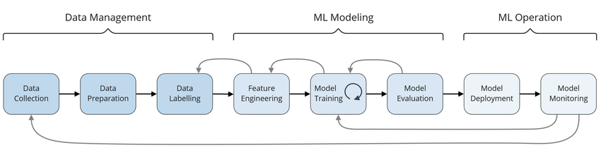

Slide 6
Pipelines in ML
Data Collection and Ingestion
Gather raw data from various sources like databases, APIs, or files.
Data Preprocessing
Handle missing values, outliers, and noise.
Perform data transformations such as normalization, scaling, encoding, etc.
Feature Engineering
Extract meaningful features from raw data.
Select or create features that improve model performance.
Model Training
Split the data into training, validation, and test sets.
Train ML algorithms on the training set.
Optimize hyperparameters using validation data.

Slide 7
Pipelines in ML
Model Evaluation
Assess model performance using metrics like accuracy, precision, recall, F1 score, etc.
Compare different models to select the best-performing one.
Model Deployment
Deploy the model into a production environment for inference.
Expose the model through APIs or integrate it into applications.
Monitoring and Maintenance
Track model performance in production.
Retrain or update models as needed to handle concept drift.

Slide 8
Pipelines in ML
Tools to Build ML Pipelines
1. Python Libraries
  - Scikit-learn: Includes a Pipeline class for chaining preprocessing and modeling steps.
  - Kedro: Organizes workflows for reproducibility.
  - TensorFlow Extended (TFX): End-to-end pipelines for deep learning.
2. Cloud Platforms
  - AWS SageMaker Pipelines
  - Google AI Platform Pipelines
  - Azure ML Pipelines
3. Orchestration Tools
  - Airflow, Kubeflow: Manage complex workflows.

Slide 9
Pipelines in ML
Tools to Build ML Pipelines
1. Python Libraries
  - Scikit-learn: Includes a Pipeline class for chaining preprocessing and modeling steps.
  - Kedro: Organizes workflows for reproducibility.
  - TensorFlow Extended (TFX): End-to-end pipelines for deep learning.
2. Cloud Platforms
  - AWS SageMaker Pipelines
  - Google AI Platform Pipelines
  - Azure ML Pipelines
3. Orchestration Tools
  - Airflow, Kubeflow: Manage complex workflows.

Slide 10
Artifacts
1. Model Artifacts
Trained Models: Serialized versions of trained models (e.g., .h5, .pth, .joblib).
Pre-trained Models: Models trained on a different dataset or task, used for transfer learning.
Model Weights/Parameters: Checkpoints or snapshots of a model's weights during or after training.
2. Data Artifacts
Raw Data: Original datasets used for training, validation, and testing.
Processed Data: Data that has undergone cleaning, transformation, or augmentation.
Feature Stores: Reusable, versioned datasets with engineered features.
Synthetic Data: Artificially generated data for scenarios where real data is scarce or sensitive.
3. Code Artifacts
Training Scripts: Code for training the model, including hyperparameter configurations.
Inference Scripts: Code for deploying and serving the model for predictions.
Preprocessing Pipelines: Scripts or configurations for data transformation steps.

Slide 11
Artifacts
4. Configuration Artifacts
Pipeline Configurations: YAML, JSON, or other files defining the structure of ML pipelines.
Hyperparameters: Parameter settings used during training (e.g., learning rate, batch size).
5. Evaluation Artifacts
Metrics: Accuracy, precision, recall, F1-score, loss, etc., used to evaluate models.
Confusion Matrices: Tables summarizing the performance of classification models.
Validation Curves: Graphs showing performance trends over training epochs.
6. Versioning and Logging Artifacts
Experiment Logs: Records of training runs, configurations, and results.
Model Versions: Multiple iterations of models stored in version control systems.
Pipeline Logs: Execution logs for tracking and debugging ML workflows.

Slide 12
Artifacts
7. Deployment Artifacts
Serialized Models: Packaged models ready for deployment in production.
Docker Images: Containerized environments for consistent deployment.
APIs: Endpoints for serving predictions or interacting with models.
8. Visualization Artifacts
Graphs and Plots: Learning curves, feature importances, or t-SNE plots for insights.
Dashboards: Interfaces for monitoring model performance and system health.
9. Security Artifacts
Encryption Keys: Keys for securing data and models.
Access Logs: Records of access and usage in production systems.

Slide 13
Materializers
Materializers in MLOps (Machine Learning Operations) are tools or components responsible for converting data or artifacts into a format suitable for a specific stage in the machine learning pipeline. They enable the seamless transformation, loading, and preparation of inputs and outputs across different steps, ensuring consistency and reproducibility.
Key Functions of Materializers
- Data Transformation: Materializers transform raw data or intermediary outputs into the format required for the next stage of processing or consumption.
- Standardization: They enforce consistent data formats and structures, which is crucial for pipelines that operate on diverse data sources or involve multiple teams.
- Interoperability: By abstracting underlying formats, materializers allow integration between heterogeneous tools or frameworks within the MLOps ecosystem.
- Versioning and Reproducibility: Materializers often integrate with data versioning systems to ensure that specific data or artifact versions can be tracked and reproduced for debugging or compliance.

Slide 14
Materializers
Popular Frameworks with Materializer Concepts
Some MLOps frameworks and tools use materializers or similar concepts:
- ZenML: ZenML materializers handle inputs/outputs of pipeline steps, ensuring that data artifacts are appropriately serialized and deserialized.
- TFX (TensorFlow Extended): Components like ExampleGen and Transform serve as functional equivalents of materializers by standardizing and transforming input data for pipelines.
- Kubeflow Pipelines: Artifacts and components in Kubeflow serve similar purposes, managing data exchange and transformations between pipeline steps.
- MLflow: While MLflow does not explicitly call them materializers, its model registry and artifact tracking can be seen as facilitating materialization of models and data.

Slide 15
Parameters & Settings
1. Model Versioning
Version Control: Track different versions of models to ensure the latest version is used and older models are preserved for comparison.
Model Registry: Store and manage different versions of the model, along with associated metadata (e.g., training datasets, performance metrics).
2. Data Management
Data Versioning: Track changes in the training, validation, and test datasets, ensuring consistency in the model's training environment.
Data Preprocessing Pipelines: Automate the data cleaning, feature engineering, and transformations applied to the datasets.
3. Model Training Parameters
Learning Rate: Controls the step size in updating model parameters during training.
Batch Size: Number of training examples used in one iteration.
Epochs: Number of times the entire dataset passes through the model during training.
Loss Function: Defines the error measure used to train the model.
Optimizer: Algorithm used to minimize the loss function (e.g., SGD, Adam).

Slide 16
Parameters & Settings
4. Hyperparameter Tuning
Hyperparameter Search Space: Define the range of hyperparameters (e.g., learning rate, number of layers, etc.) for optimization.
Search Strategy: Methods like grid search, random search, or Bayesian optimization for finding optimal hyperparameters.
5. Model Monitoring and Evaluation
Model Performance Metrics: Metrics such as accuracy, precision, recall, F1-score, AUC, etc., to evaluate model performance.
Drift Detection: Monitor shifts in the input data distribution (data drift) or the model’s predictions (concept drift) over time.
Error Tracking: Capture and categorize errors to diagnose performance issues in real-time.
6. Deployment Settings
Deployment Framework: Kubernetes, Docker, or serverless solutions for model deployment.
Scalability: Parameters for scaling the model serving infrastructure, such as auto-scaling configurations.
Latency and Throughput: Performance requirements, such as maximum acceptable latency and required throughput.
API Endpoints: Define the endpoint configurations for model inference services.

Slide 17
Parameters & Settings
7. Pipeline Automation
CI/CD for ML: Continuous integration and delivery pipeline for automating the training, testing, and deployment of ML models.
Model Retraining Triggers: Conditions under which the model should be retrained (e.g., performance degradation or new data).
Artifact Management: Manage and store model artifacts (e.g., weights, model checkpoints) for reproducibility.
8. Security and Compliance
Access Control: Define user roles and permissions for access to the model and data.
Audit Trails: Track and log changes in models, parameters, data, and deployments to maintain compliance.
Model Interpretability: Ensure that models can be understood and explained, especially for regulatory compliance.
9. Resource Management
Compute Resources: Specify CPU/GPU configurations, memory limits, and other infrastructure-related parameters for training and inference.
Cost Management: Track and optimize resource usage to avoid unnecessary costs, especially in cloud environments.

Slide 18
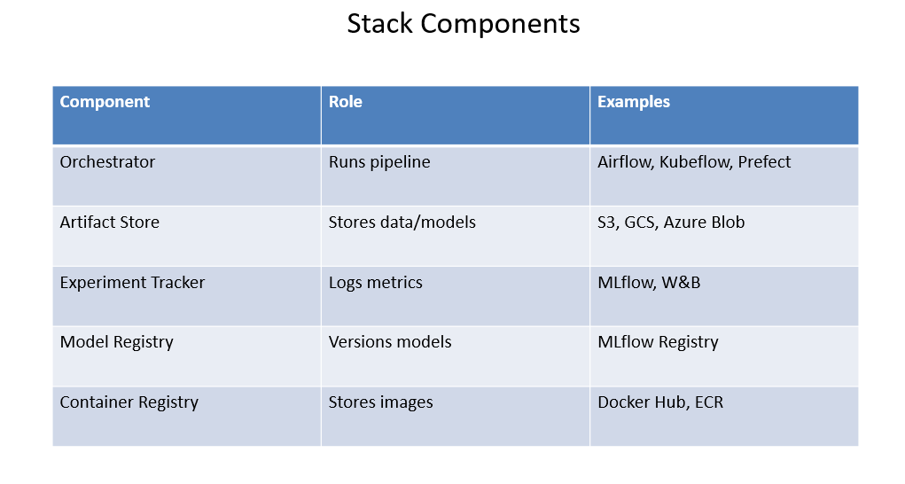

Slide 19
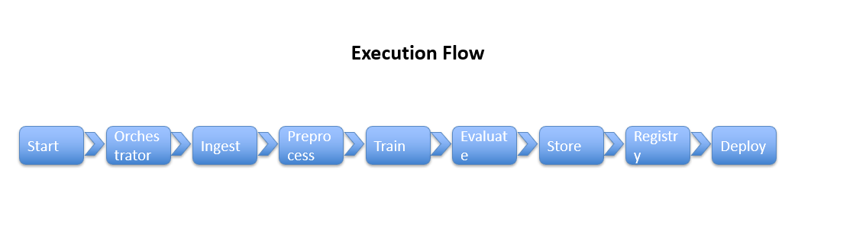

Slide 20
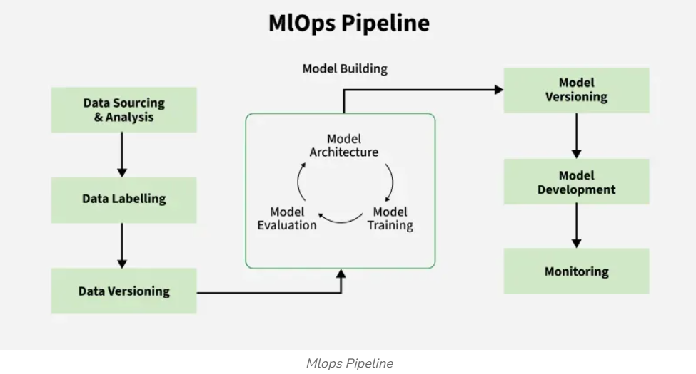

Slide 21
Thank you

