Slide 1
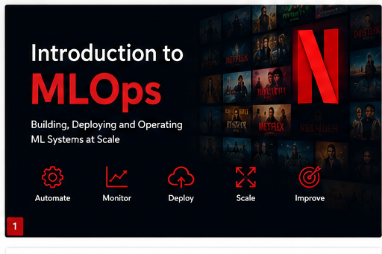
Introduction to MLOps

Slide 2
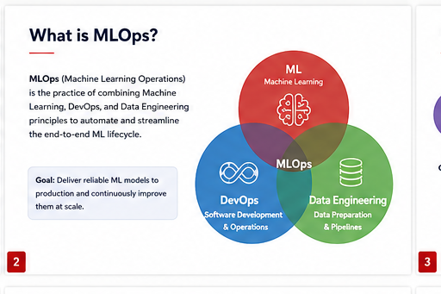
What is MLOps?

Slide 3
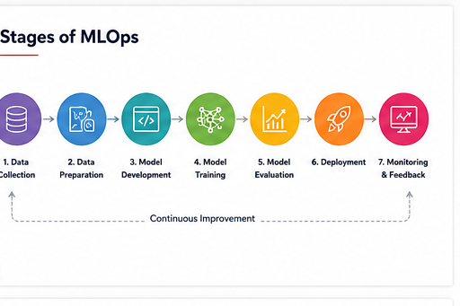
Stages of MLOps

Slide 4
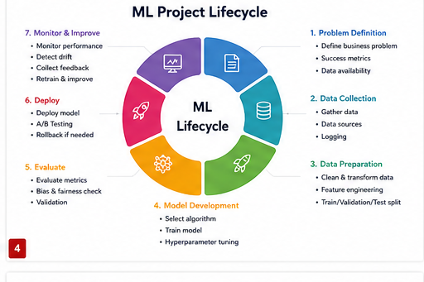
ML Project Lifecycle

Slide 5
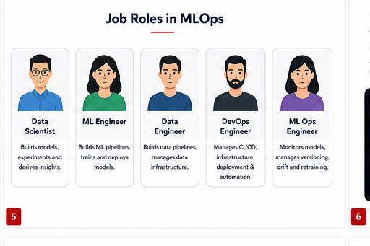
Job Roles in MLOps

Slide 6
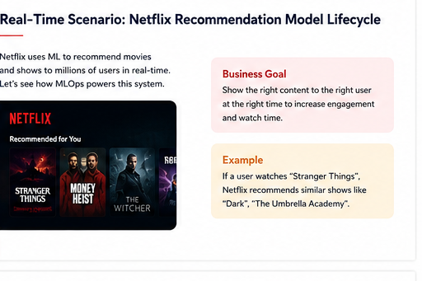
Netflix Recommendation Lifecycle

Slide 7
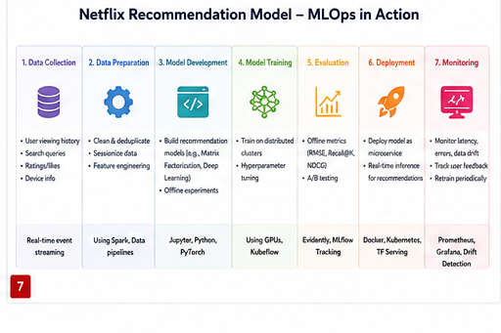
MLOps in Action

Slide 8
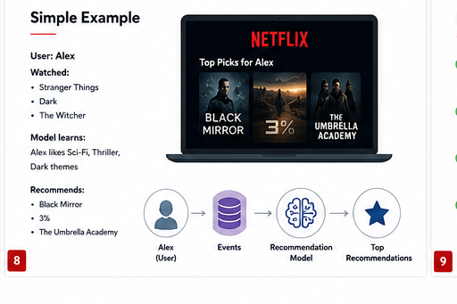
Simple Example

Slide 9
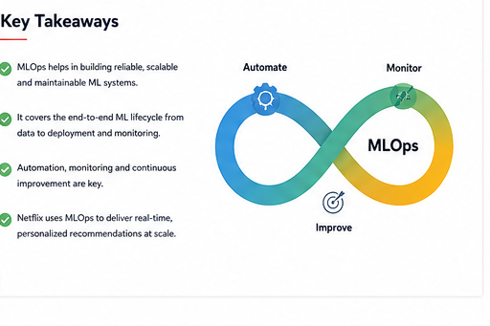
Key Takeaways

