Slide 1
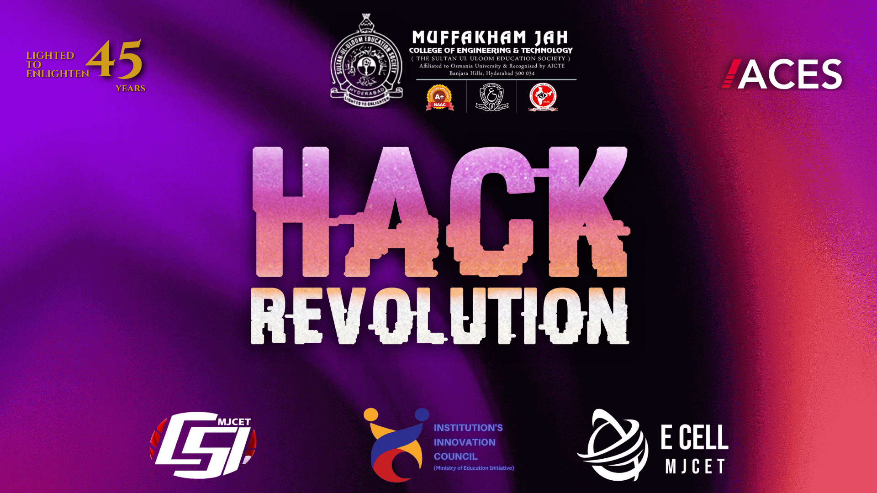

Slide 2


Team Details
1
Selected Track - Waste Management and Rural Developmenet
Project Name - SolarWaste: Mobile Plastic-to-Fuel Converter
2
Team Name - Syntax Squad
3
Team Lead - Shaik Sameer hussain
4
5
Institute Name - CMR Technical Campus

Slide 3
Mobile solar-powered pyrolysis unit to convert plastic waste into fuel (diesel, gasoline, char).
Operates in remote areas, reducing plastic pollution and producing valuable resources.
Fully solar-powered, minimizing environmental impact and operational costs.
Locals bring plastic waste to the unit, which is processed for use or sale.
Solar Panels: Capture sunlight and convert it into electricity to power the unit.
Energy Storage: Batteries store solar energy for night operations.
Pyrolysis Chamber: Thermally decomposes plastic waste into fuel, gas, and char.
Emission Control: Filters harmful gases to ensure eco-friendly operation.
Describe Your Idea or Project
Describe the Technology Stack Required:

Slide 4
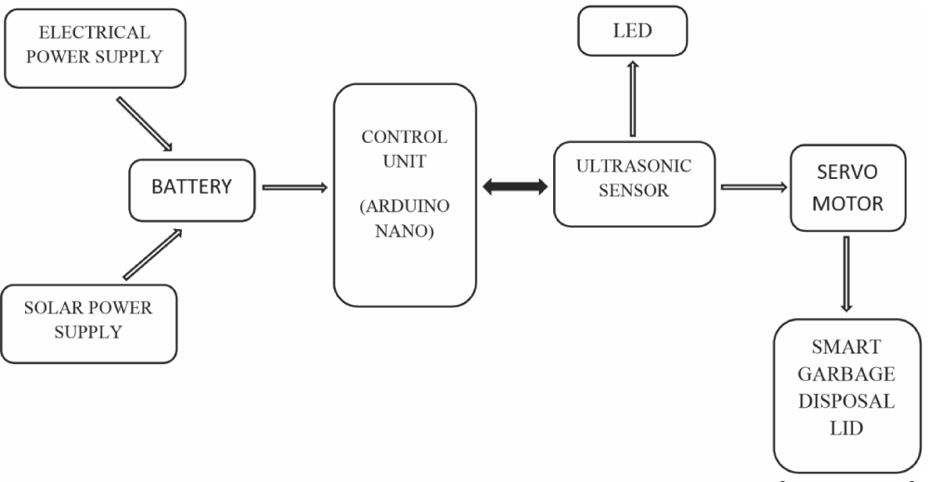
TECHNICAL APPROACH
Syntax Squad
METHODOLOGIES
ARCHITECTURE
INPUT
Biodegradable Plastic
YOLOv5 (Plastic Collection Stage): Detects plastic waste types to ensure efficient collection from local areas
Mask (Pyrolysis Stage): Segments and monitors the plastic conversion process into fuel, ensuring optimal pyrolysis.
ResNet-50 (Fuel Separation Stage): Classifies and verifies the separation of fuel types (diesel, gasoline, char) for proper distribution.
EfficientNet (Energy Storage Stage): Identifies energy storage efficiency, ensuring adequate solar power is stored for continuous operation.
DeepLabV3+ (Emission Control Stage): Segments and monitors the emission levels to confirm proper filtration and eco-friendly operations.
Plastic Materials
Raw Materials
Plastic Cover
Site Created
Activities

Slide 5
Describe your use cases
Community Engagement: Locals bring plastic waste to the mobile unit for conversion into fuel.
Eco-Friendly Process: The unit operates entirely on solar power, reducing carbon emissions.
Waste-to-Energy: Converts plastic waste into valuable fuels like diesel and gasoline.
Local Impact: The produced fuel can be used for local transportation, farming, or sold for revenue.
Mobile Solution: The unit's mobility ensures it can be deployed to different areas as needed.
Sustainable Model: Creates a self-sustaining system for waste management and energy generation.
Cost-Effective: Uses free solar energy, reducing operational costs and reliance on external power sources.
Economic Empowerment: Offers a new revenue stream and potential job creation in underserved areas.

Slide 6


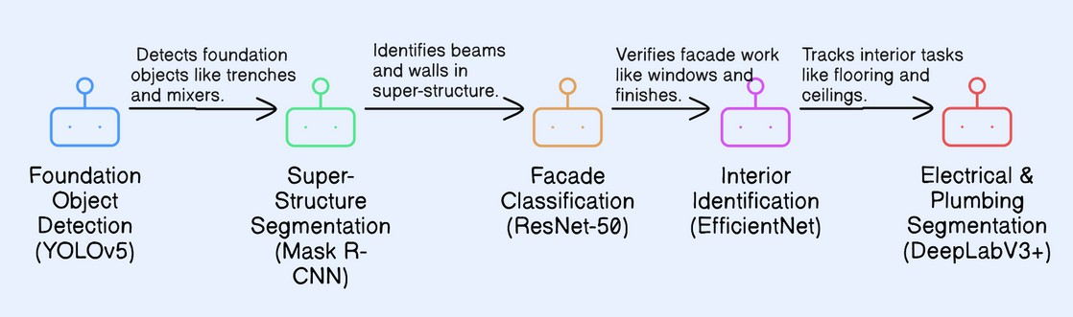

InfraSnap
Syntax Squad
Idea/Solution/Prototype
Innovation & Uniqueness
Automated Plastic Waste Collection: Implement a mobile, solar-powered unit to automatically collect plastic waste from local communities, reducing plastic pollution and promoting recycling.
Pyrolysis Process: Utilize solar energy to power a pyrolysis reactor that thermally decomposes plastic waste into usable fuel, including diesel, gasoline, and char.
Community-Driven Model: The system allows local users to bring plastic waste, with incentives provided, ensuring continuous participation and promoting sustainable energy production
Mobile Waste Collection: The solar-powered unit is mobile, allowing it to travel to remote areas and collect plastic waste directly from locals, making waste management accessible and efficient.
Energy Production from Plastic: Converts non-biodegradable plastic into valuable resources like diesel, gasoline, and char using solar energy, reducing plastic pollution while generating fuel.
Community Engagement & Incentives: Encourages local participation by offering incentives, such as discounts on fuel or essential goods, for plastic waste contributions, promoting sustainability and circular economy principles.
Solution Approach
Flow of construction activities & ML model used -
Mobile Collection & Conversion: Solar-powered unit collects and converts plastic waste into fuel directly from local areas.
Real-Time Monitoring: Tracks the conversion process to optimize energy production and efficiency.
Centralized Dashboard: Monitors waste collection, fuel production, and distribution in one interface for easy management.

Slide 7


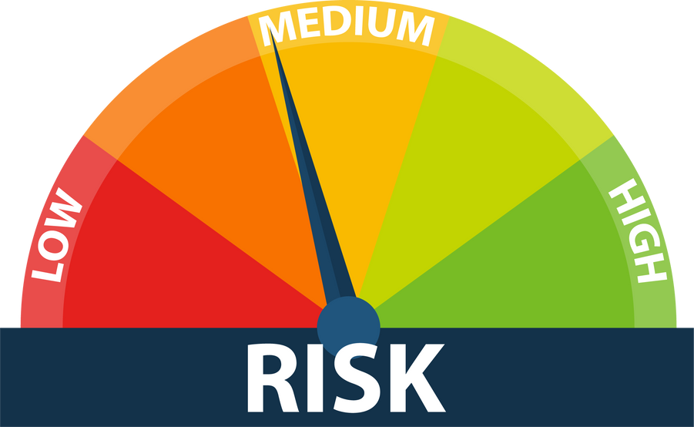

FEASIBILITY AND VIABILITY
Syntax Squad
Potential Challenges & Risks
Overcoming Challenges
Feasibility Analysis
Technological Feasibility: Utilizes solar power and pyrolysis technology for efficient plastic-to-fuel conversion.
Integration with Existing Systems: Can be integrated with local waste management systems for smooth operations.
Scalability: The mobile unit can be scaled to different regions, with modular components to expand capacity as needed
Accuracy Concerns: Ensuring consistent pyrolysis output quality across diverse types of plastic waste.
Material Variability: Variations in plastic waste quality may affect fuel yield and efficiency.
Regulatory Compliance: Navigating local regulations for waste management and emissions, ensuring adherence to environmental laws.
Diverse Model Training: Regularly update the pyrolysis models with data from various types of plastic waste for improved fuel production accuracy.
Quality Assurance: Conduct routine quality checks on the plastic waste before processing to ensure optimal pyrolysis efficiency.
User Training: Educate locals on proper waste segregation and safe handling practices for effective waste input.
REVENUE RESOURCES
Subscription Fees Recurring revenue generated through monthly or yearly subscriptions for access to the solar-powered pyrolysis service.
Consultation and Customization: One-time fees charged for consulting and tailoring the solution for specific client needs, such as customizing pyrolysis units or waste collection strategies.
By-Product Sales: Revenue from selling by-products like char, syngas, or fuel to local industries or energy producers.

Slide 8
Block Diagram and List of Hardware Components
(Only for teams who have opted for generic hardware track).

Slide 9
Team Members' Information
Team Leader Name: (Shaik Sameer Hussain)
Year: 3rd Department: CSE College Name: CMR Technical Campus
Team Member 1 Name: (Mohammed Sufiyan)
Year: 3rd Department: CSE College Name: CMR Technical Campus
Team Member 2 Name: (Syed Afzal)
Year: 3rd Department: CSE College Name: CMR Technical Campus
Team Member 3 Name: (Muzammil Shareef)
Year: 3rd Department: CSM College Name:Vageshwari Institute of Technology
Team Member 4 Name: (MD Farman)
Year: 3rd Department: CSC College Name:CMR CET
Team Member 5 Name: (Jawad ul Hassan)
Year:3rd Department: CSC College Name:Sri Chaitanya

