Slide 1

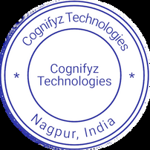


Cognifyz Where Data Meets Intelligence Congratulations! We are pleased to inform you that you have been selected for the position of Full Stack Development Intern at Cognifyz Technologies. We were impressed by your qualifications, skills, and enthusiasm for Full Stack Development, and we are excited to have you join our team. As a Full Stack Development Intern, you will have the opportunity to work on various projects and tasks related to full-stack development. Your comprehensive understanding of full-stack development and your creativity in problem-solving made you stand out among the candidates. Whether it's front-end or back-end development, your proficiency in full-stack development will play a crucial role. We would like to take this opportunity to congratulate you once again and welcome you to Cognifyz Technologies. We look forward to working with you! Best Regards, Cognifyz Technologies Nagpur, Maharashtra, India cognifyztechnologies@gmail.com www.cognifyz.com Date - 05/11/2024 INTERNSHIP OFFER LETTER Shaik sameer hussain Ref. : CTI/A1/C66767 Dear

