Slide 1


SMART INDIA HACKATHON 2024
TITLE PAGE
Problem Statement ID – 1703
Problem Statement Title- Let’s Learn Constitution in a Simpler Manner-Institution Perspective
Theme- Miscellaneous
PS Category- Software
Team ID-
Team Name –CODE BERRY

Slide 2
LET’S LEARN CONSTITUTION IN A SIMPLER MANNER- CITIZEN PERSPECTIVE
Code Berry
Innovation And Uniqueness Of The Solution:
1. Constitutional Scenarios Simulation: Create interactive simulations where users make decisions as a judge, legislator, or executive.
2. AI-Driven Customization: An AI-based recommendation engine suggests games and quizzes based on user progress, enhancing personalized learning experiences.
3. Blockchain for Trust: Secure blockchain technology is used to store progress and certifications earned by users,
4. Virtual Reality (VR) Features: Integrates VR to offer immersive learning experiences where users can interact with 3D models of historic events.
Proposed Solution
The "Nagrik Aur Samvidhan" platform is an advanced, AI-powered, and gamified digital solution aimed at enhancing constitutional literacy among citizens. Leveraging cutting-edge technologies.
1. Gamified Learning with AI :suite of engaging games such as Spin the Wheel, Trivia Cards, and Interactive Story Games that teach constitutional concept. These games are enhanced by AI
2. A Natural Language Processing (NLP) engine parses the original text of the Constitution and simplifies complex legal jargon. Using Machine Learning models trained on constitutional .Multimedia Integration: Incorporates videos, infographics, and quizzes to enhance user engagement and retention.
3. Language Translation and Accessibility: Available in multiple regional languages and designed for easy navigation, including options for those with disabilities.
How it Addresses the Problem:
1.Briging the Knowledge Gap
2.Engaging Youth and Adults Alike
3.Promoting Active Citizenship:

Slide 3
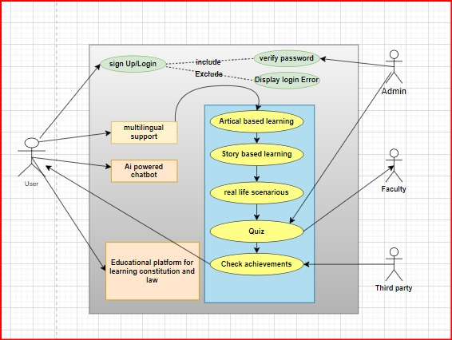
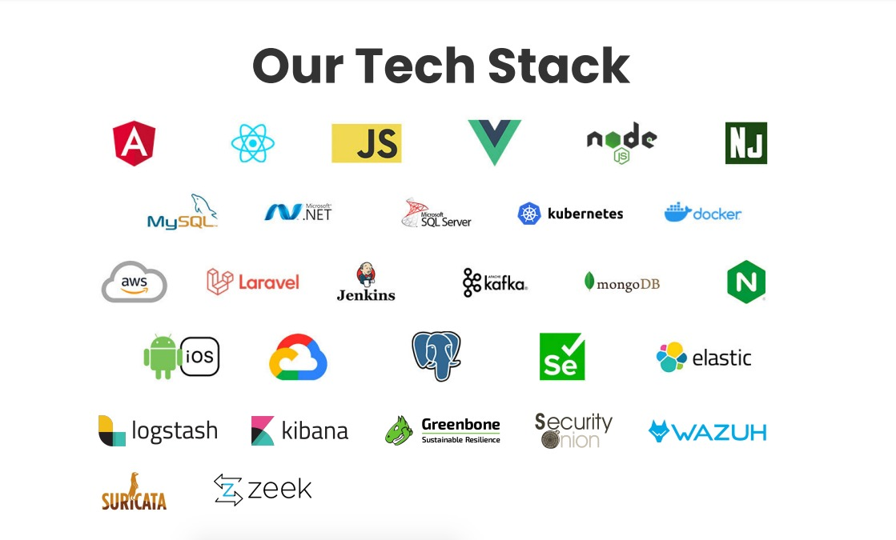
TECHNICAL APPROACH
Code Berry
Architecture and Platform Design:
Cloud and Infrastructure: AWS and GCP For cloud storage, hosting, and scalability. GCP will be used for deploying AI and machine learning models, and AWS will handle data storage and server-side processing.
Natural Language Processing (NLP): Simplifies legal jargon and powers the translation system, making the content accessible to users in multiple languages.
Recommendation Engine: AI-based model that tracks user engagement and suggests games or quizzes tailored to their knowledge level.
Blockchain technology will be used to securely store user certifications and progress, ensuring data integrity
OAuth 2.0 and JWT (JSON Web Token) protocols will handle secure authentication and authorization.
VR.js or Three.js: To create interactive VR experiences where users can visualize important events in constitutional history.
Frontend and backend:

Slide 4
FEASIBILITY AND VIABILITY
Code Berry
Analysis of the feasibility of the idea:
Scalable Tech Stack: Utilizing cloud infrastructure (AWS/GCP) ensures that the platform can scale to accommodate millions of users, maintaining performance even during high traffic.
Cross-Platform Compatibility: Using React Native allows for seamless deployment across web, iOS, and Android devices.
AI-Driven Personalization: AI models (TensorFlow, OpenAI GPT) can personalize quizzes and learning paths based on user performance, enhancing engagement.
Blockchain Integration: Employing blockchain for storing user achievements ensures secure, tamper-proof credentials.
Cloud-Based Multiplayer System: Implementing a real-time multiplayer option with Firebase enhances interactivity, allowing users to challenge each other in quiz battles or collaborate on constitutional challenges.
Potential challenges and risks:
Content Simplification: Maintaining accuracy while simplifying complex constitutional articles.
User Engagement: Ensuring long-term retention with compelling content.
Technological Integration: Optimizing advanced features like AR and AI for all device types.
Strategies for overcoming these challenges:
Expert Collaboration: Partner with legal professionals for content accuracy.
AI for Translation & Content: Leverage NLP and AI to simplify and translate content efficiently.
Gamification & Blockchain Rewards: Use blockchain-based rewards to incentivize continuous learning.

Slide 5
IMPACT AND BENEFITS
Code Berry
Potential impact on the target audience:
Empowering Youth: With its gamified structure, the platform targets 8th-grade students and above, ensuring early engagement with civic duties and constitutional rights, fostering responsible future citizens.
Widespread Civic Awareness: The platform will play a key role in bridging the constitutional literacy gap across rural and urban populations by providing multilingual access to constitutional knowledge.
Community Engagement: By incorporating interactive elements like community challenges and leaderboards, users will not only learn but also engage in local civic discussions, fostering a stronger democratic mindset.
Benefits of the Solution:
Social Benefits:
Reducing Social Inequality: By making the Constitution understandable for the common man, the platform can bridge educational and informational divides across socioeconomic.
Multilingual and multimedia support will ensure the platform is accessible to people of all backgrounds, including individuals with disabilities.
Environmental Benefits:
Digital Transition: The gamified platform reduces the need for paper-based educational materials, contributing to environmental conservation.
Reduced Carbon Footprint: The online nature of the platform eliminates the need for physical gatherings or seminars, cutting down on transportation emissions.
Economic Benefits:
Upskilling & Employment Opportunities.
Cost-Effective Education: The platform eliminates the need for expensive textbooks or private tuitions, providing affordable or free education to millions.

Slide 6

RESEARCH AND REFERENCES
Code Berry
RESEARCH AND REFERENCES
India Code Documentation:
Link: https://www.indiacode.nic.in
Use: Provides access to the full text of the Constitution of India, useful for content extraction and simplification.
Legislative Department:
Link:https://legislative.gov.in/
Use:Provides access to legal documents, Central Acts, and Constitutional amendments of India
Google Cloud Firebase:
Link: https://firebase.google.com/docs
Use: Backend service for real-time databases, authentication, and hosting. Can be used to build and maintain your platform’s database.
National Digital Library of India (NDLI):
Link: https://ndl.iitkgp.ac.in/
Use: A comprehensive digital repository of educational resources, potentially useful for referencing detailed constitutional information.
VR TECH

