Slide 1
SENTRY AI SECURITY
NIST AI RMF & OWASP LLM TOP 10
FRAMEWORK SPECIFICATION
SENTRY: Security Evaluation & Red-Teaming for Transformers
Automated stress-testing, goal-misalignment probing, and defense verification for enterprise neural architectures.
TARGET DEPLOYMENT
PRIMARY DOMAIN
EVALUATION CADENCE
Neural Transformer Systems
Adversarial AI Safety & Security
Continuous CI/CD Red-Teaming

Slide 2




THREAT SURFACE ANALYSIS
Transformer Vulnerability Matrix
SENTRY targets key structural attack surfaces in transformer-based inference models.
Prompt Injection
Data Poisoning
Model Inversion
Tool Misuse
Direct system prompt overrides.
Corrupted fine-tuning corpuses.
Training set data extraction.
Unsanitized API call execution.

Slide 3
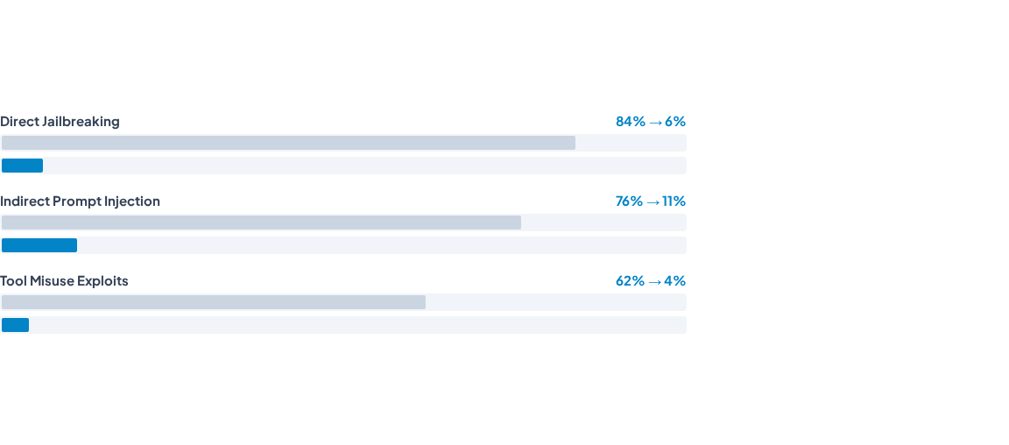
EVALUATION BENCHMARK
Attack Success Rate (ASR) Reduction
Baseline
Post-SENTRY
91%
Overall ASR Reduction
Measured across 10,000 automated red-team evaluation runs.

Slide 4
METHODOLOGY
3-Stage Red-Teaming Workflow
Structured execution from discovery to automated mitigation.
STAGE 01
STAGE 02
STAGE 03
Automated Probing
Guardrail Stressing
Risk Mapping
Multi-modal adversarial test prompt generation.
Evaluation of safety filter pass-through rates.
Direct mapping into MITRE ATT&CK matrix.

Slide 5

ENTERPRISE ROADMAP
Securing Transformer Systems at Production Scale
100%
Zero-Trust
< 24 hrs
Automated Probing
Inference Pipeline
Remediation Loop
Continuous threat surface scan.
Strict input-output sanitization.
Rapid security patch deployment.
SENTRY Security Framework — Neural Transformer Evaluation Standard

