Slide 1

Adult Income Dataset using Machine Learning
Project Supervisor: Dr. J. Albert Mayan, M.E., Ph.D.,
Name of the Student: Mr. SHAIK SHEERU ALI MOULALI
Register Number: 39110932
7 December 2021
Department of CSE
1

Slide 2
Presentation Outline
Course Certificate
Domain
Introduction
Objective
Simple Logistic Regression
Methodology & Project Implementation
Module Implementation
System Architecture / Ideation Map
Application Snapshots
Results and Discussions
Conclusion
References
7 December 2021
Department of CSE
2

Slide 3

Course Certificate
7 December 2021
Department of CSE
3

Slide 4
Domain
Machine Learning
Machine Learning is the art of enabling machines to learn things which are not explicitly programmed.
Python is widely used general purposes, high level programming language.
Python is a programming language that lets you work quickly and integrate systems more efficiently.
Python can be used Windows, Mac, Linux, etc.
7 December 2021
Department of CSE 4

Slide 5
Introduction
In this project, we will use a number of different supervised algorithms to precisely predict individuals’ income using Adult data Set collected from the UCI machine learning repository. We will then choose the best candidate algorithm from preliminary results and further optimize this algorithm to best model the data.
Our goal with this implementation is to build a model that accurately predicts whether an individual makes more than 50K.
Predicting Salaries using Logistic regression.
In supervise machine learning
Regression algorithms helps us to build a model by which we can predict the values of a department variables from the values of one or more independent variables.
For example Predicting future demand for a product based on previous demand. Similarly predicting the salary
based on years of experience.
7 December 2021
Department of CSE 5

Slide 6
Objective
The main aim is predicting salary and making a suitable user-friendly graph. From this prediction the salary of an employee can be observed according to a particular field according to their qualifications and experience.
It helps to see the growth of any field. It can produce a person’s salary by clustering and predict the salary through the graph using logistic regression technique.
This graph helps to predict the salary of an employee based on his position level.
7 December 2021
Department of CSE 6

Slide 7
Simple Logistic Regression
Simple logistic regression assumes that the observations are independent; in other words, that one observation does not affect another. Simple logistic regression assumes that the relationship between the natural log of the odds ratio and the measurement variable is linear.
One variable , denoted as X , is regarded as the predictor or independent variable.
The other variable , denoted as y , is regarded as the response or dependent variable.
To predict the salary of employees from their years of experiences.
7 December 2021
Department of CSE 7

Slide 8
Methodology & Project Implementation
The modified dataset consists of approximately 48,841 data points, with each data point having 15 features.
Target Variable : salary (<=50K, >50K)
The methodology follows the best practices in the literature and in the industry, including different phases:
Importing required libraries
importing data file
first 5 rows of the dataframe
last 5 rows of the dataframe
number of rows and columns
getting some information about the dataset
Dataset description
Feature selection
Model selection
Model training and validation
Finally finding the values of accuracy, precision and recall
7 December 2021
Department of CSE 8

Slide 9
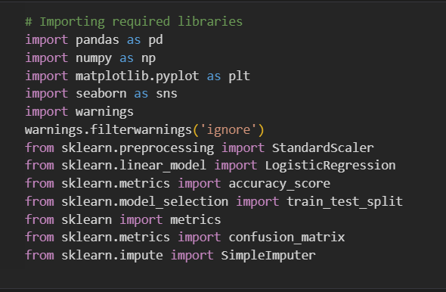

Module Implementation
1) Importing required libraries
(# this libraries are used for fundamental scientific computation in machine learning.)
2) importing data file
7 December 2021
Department of CSE 9

Slide 10
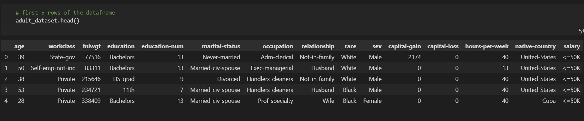
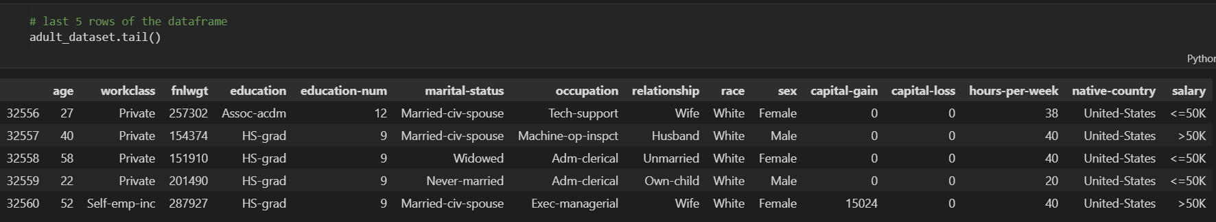
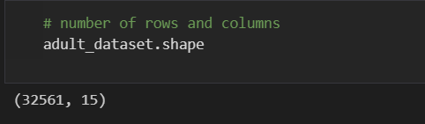
3) first 5 rows of the dataframe (# this function shows the
first 5 rows of the datafile.)
4) last 5 rows of the dataframe (# this function shows the last 5
rows of the datafile.)
5) number of rows and columns (# this function shows the shape of the dataset.)
7 December 2021
Department of CSE 10

Slide 11
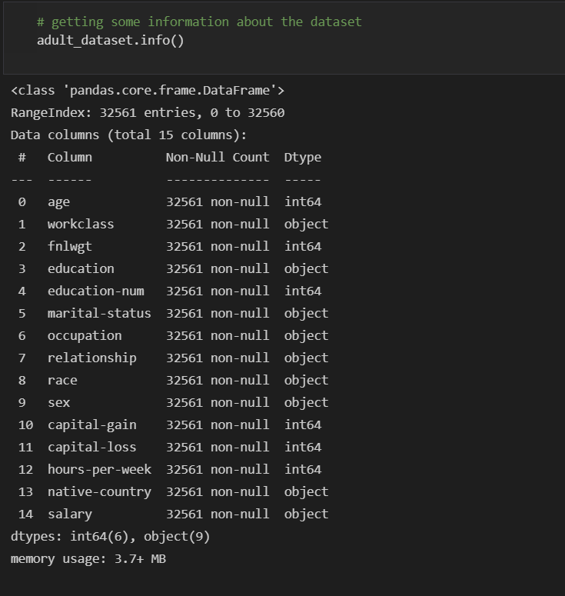
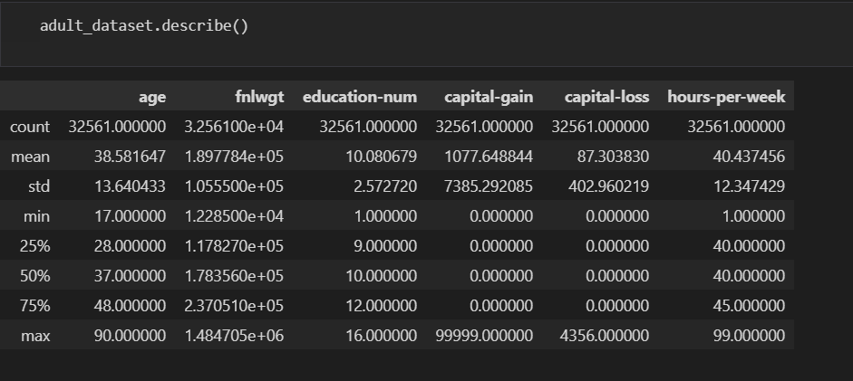
6) Getting some information about the dataset
(# this function shows info about dataset.)
7) Dataset description (# this function describe the dataset.)
7 December 2021
7 December 2021
Department of CSE 11

Slide 12
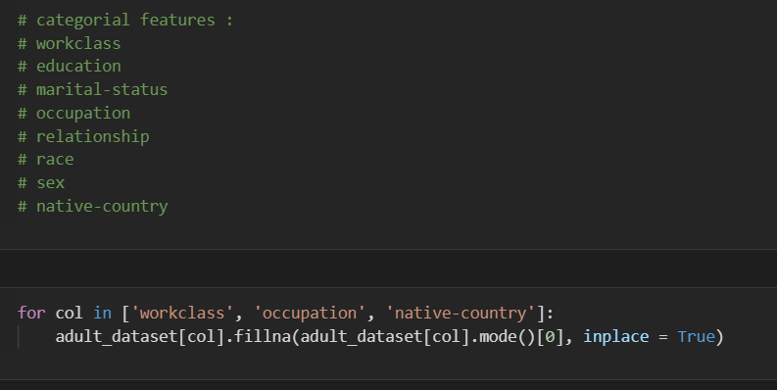
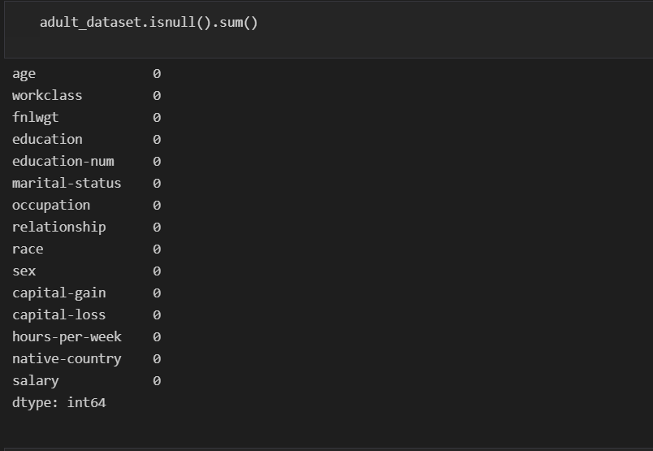
8) Feature selection (# this shows the all features in the dataset.)
9) null values exist or not (# this function show Null values present or not.)
7 December 2021
Department of CSE
12

Slide 13
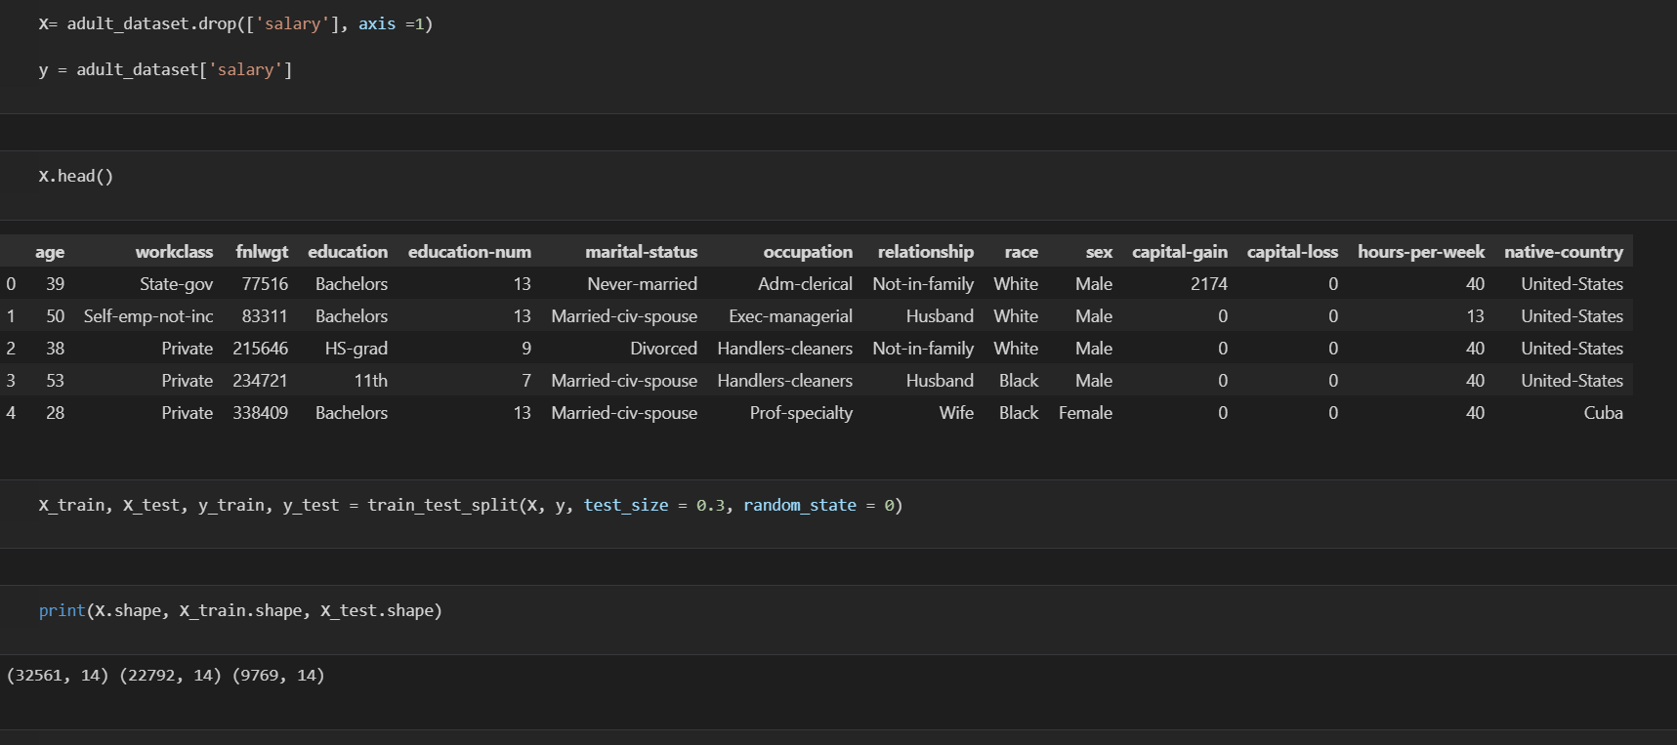
10) Model selection (# Here we use two types of models)
1. Training and Testing model. (# from sklearn.model_selection import train_test_split.)
2. Logistic Regression. (# from sklearn.linear_model import LogisticRegression.)
10.1) Model training and validation
10.1.1) Training and Testing model:(# this method divides features and target variables as X as feature variables & y as target variable
7 December 2021
Department of CSE
13

Slide 14
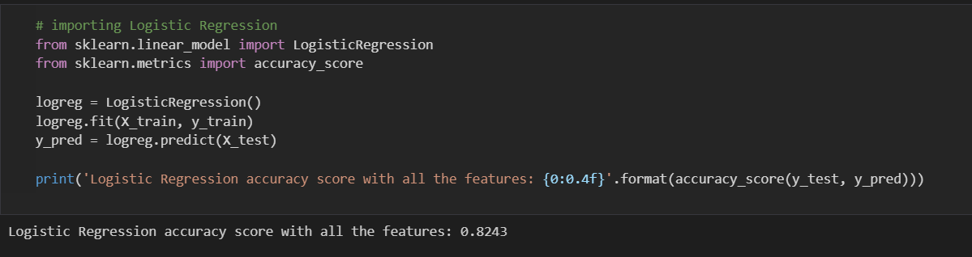
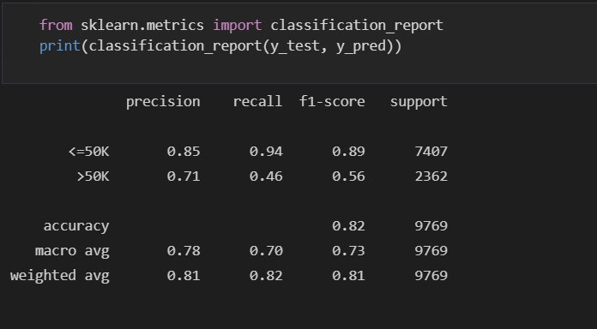
10.1.2) Logistic Regression & Accuracy Score:
11) Finally finding the values of accuracy, precision and recall
7 December 2021
Department of CSE
14

Slide 15
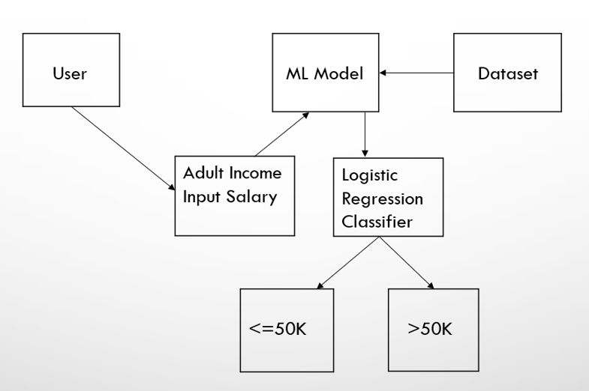
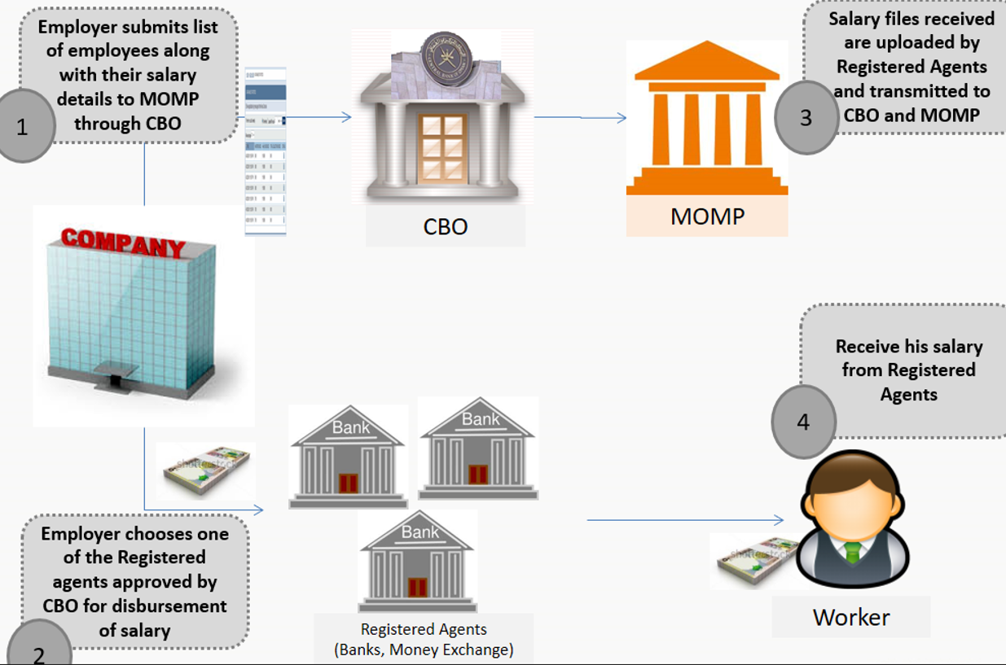
System Architecture / Ideation Map
SOFTWARE REQUIREMENT
• Operating System - Windows OS
• Coding Language - Python
• Tool - Jupyter Notebook
• Libraries - pandas, matplotlib, sklearn
ARCHITECTURE OF MODEL :
The approach that this paper proposes, uses the latest machine learning algorithms to detect anomalous activities, called outliers. When looked at in detail on a larger scale along with real life elements, the full architecture diagram can be represented as follows:
Architecture of the System
7 December 2021
Department of CSE
15

Slide 16
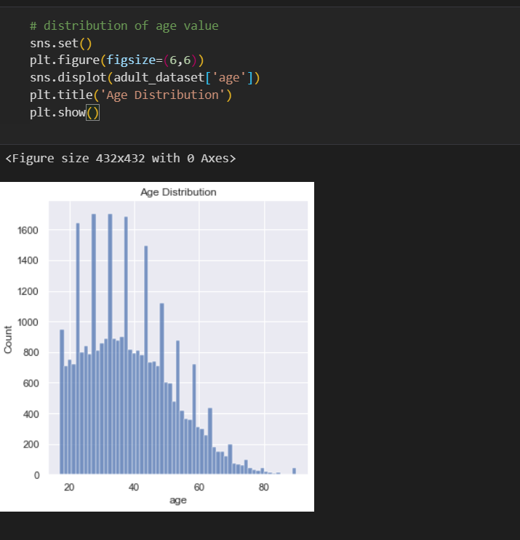
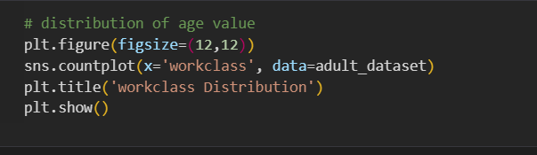
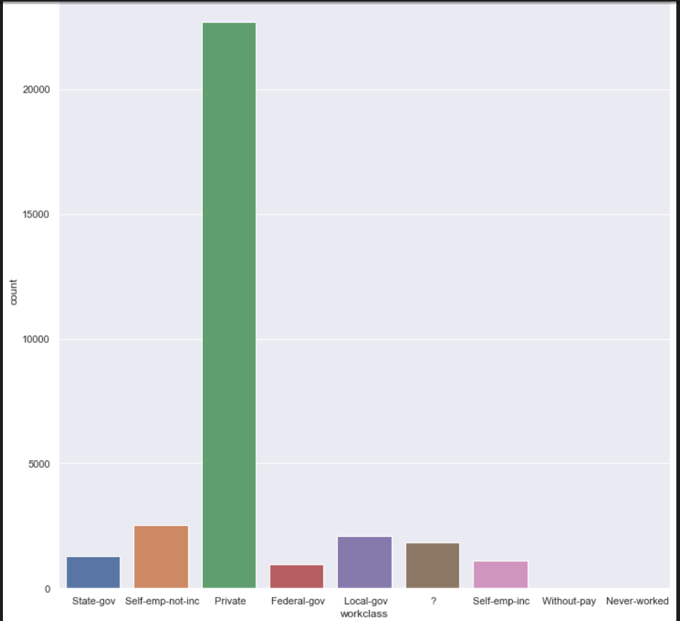
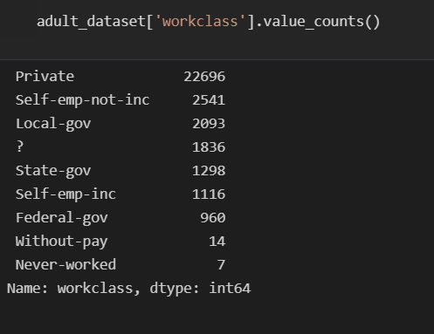
Feature selection (# this shows the all features in the dataset.)
1) Age column (Distribution of Age)
2) workclass column (Distribution of workclass)
7 December 2021
Department of CSE
16

Slide 17
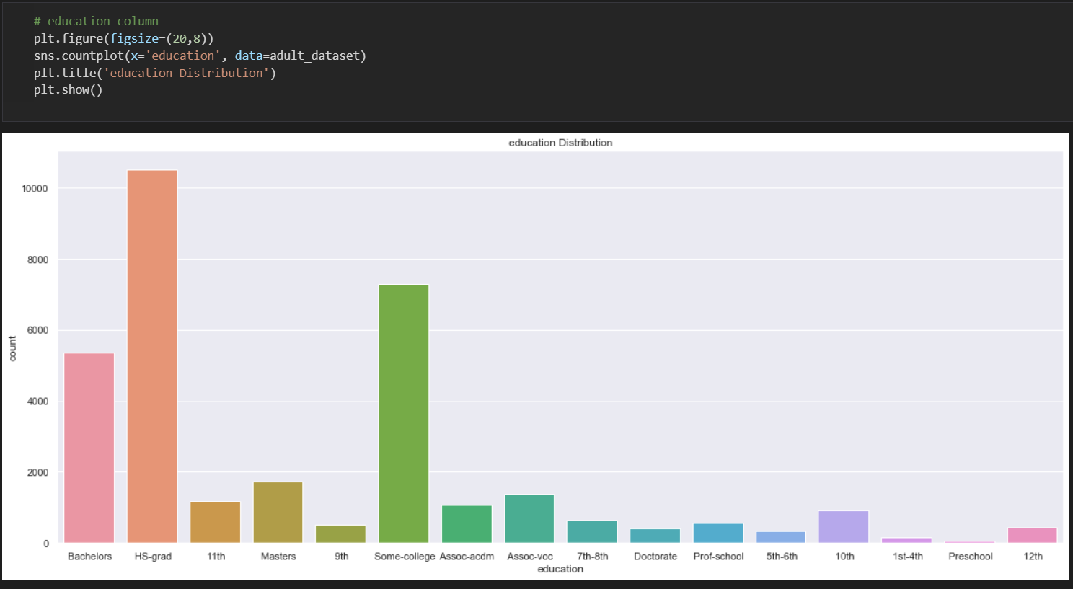
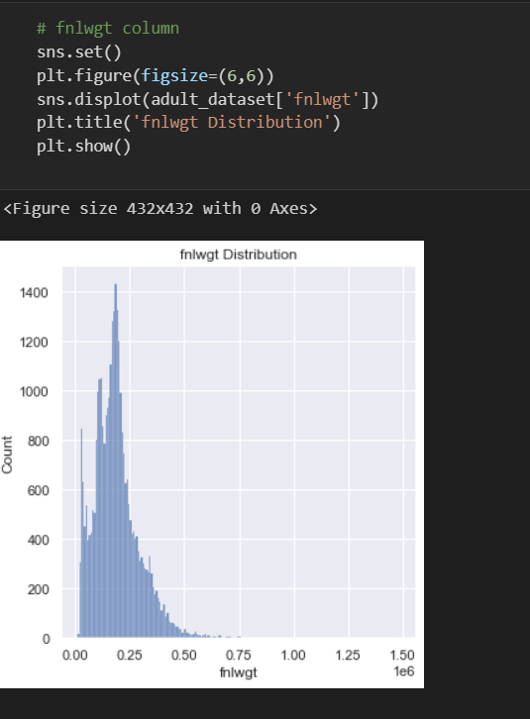
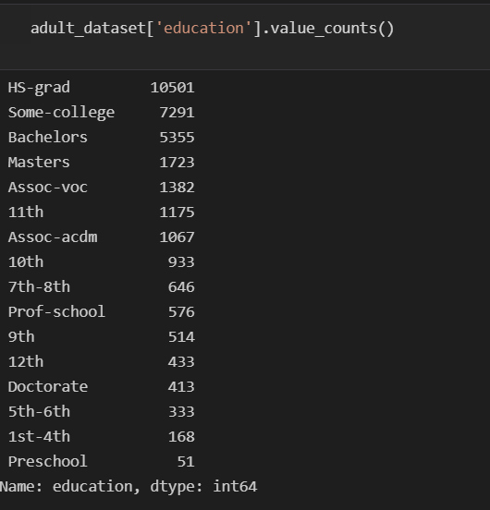
4) Education column (Distribution education)
3) Fnlwgt column (Distribution fnlwgt)
7 December 2021
Department of CSE
17

Slide 18
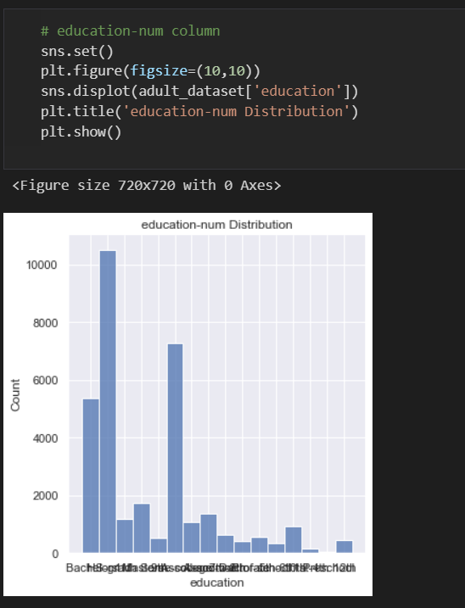
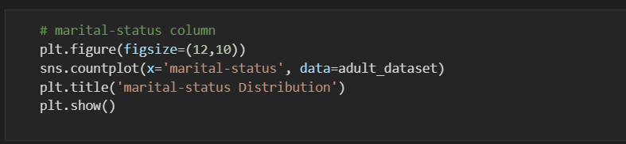
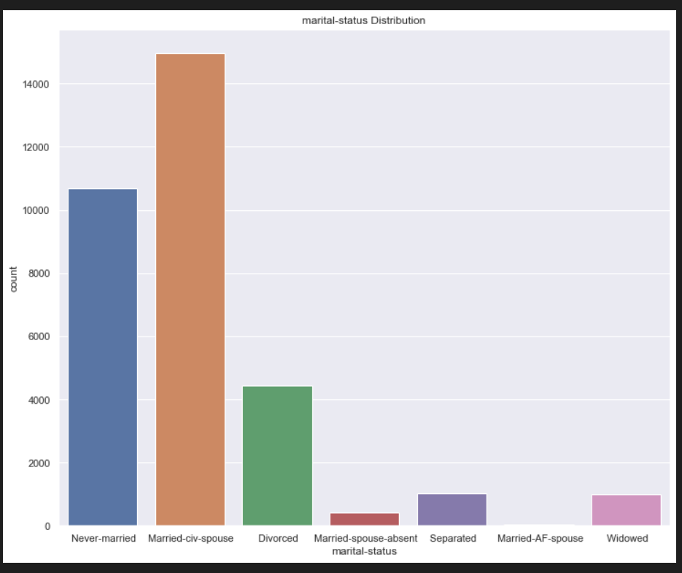
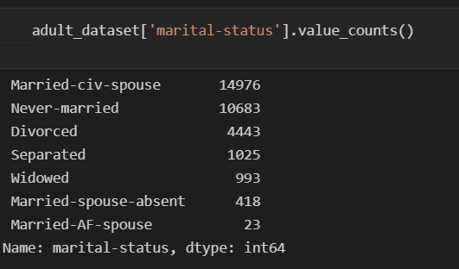
5) Education-num column (Distribution education-num)
6) marital-status column (Distribution marital-status)
7 December 2021
Department of CSE
18

Slide 19
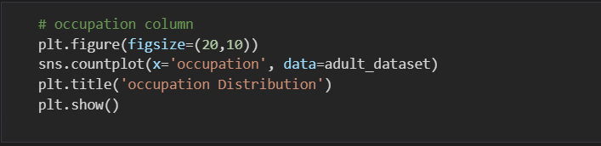
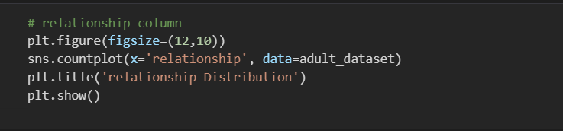
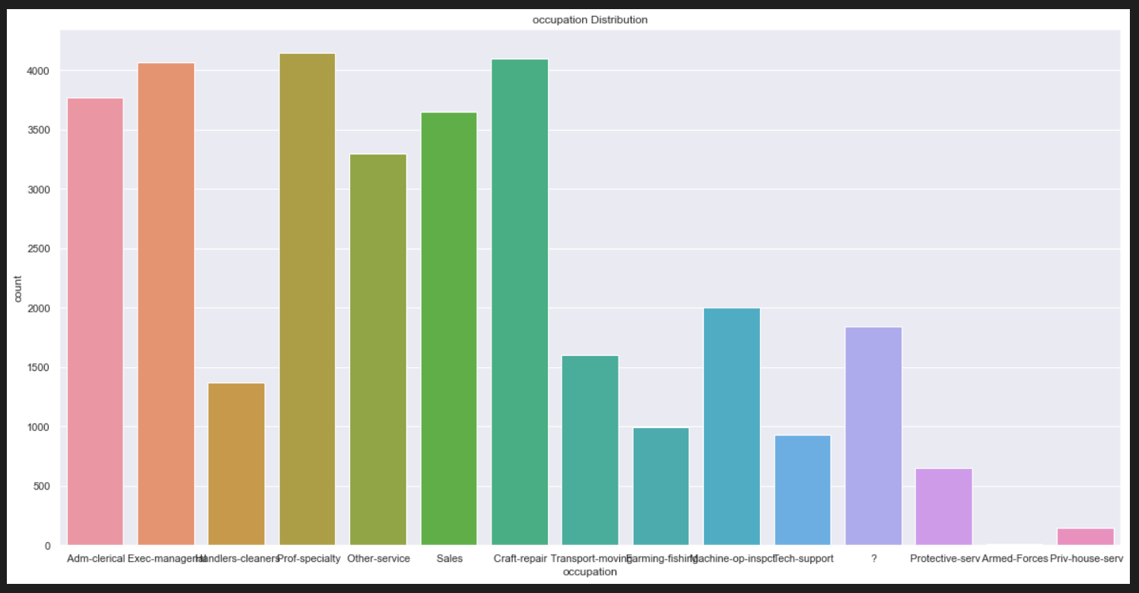
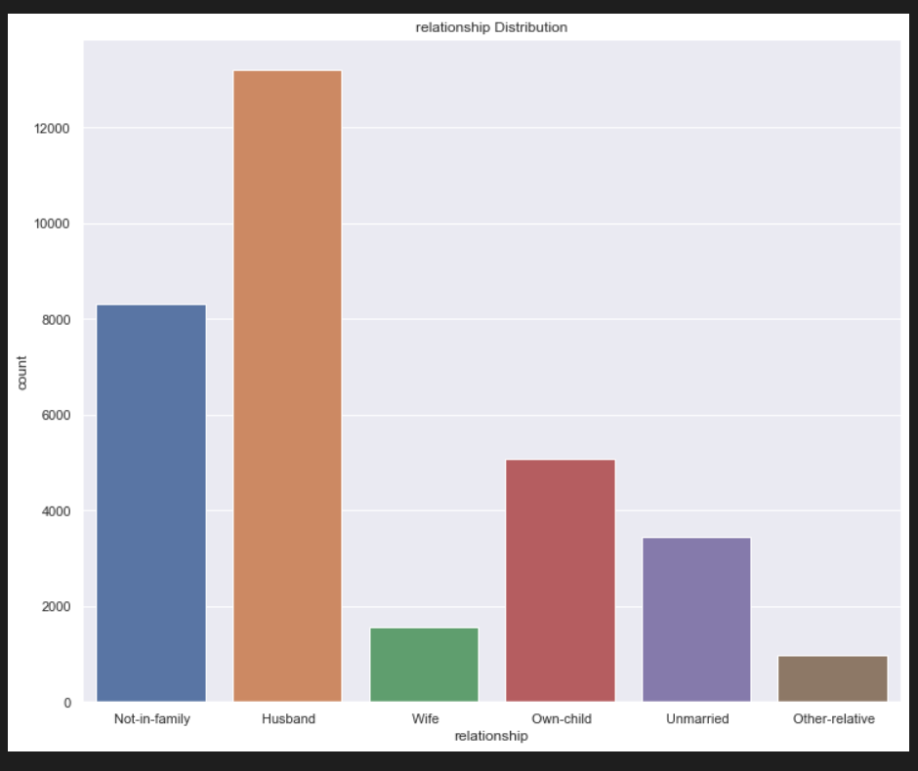
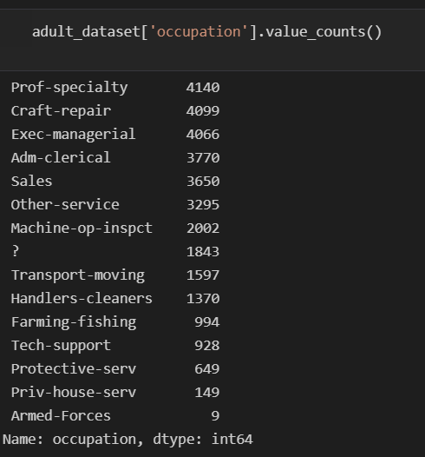
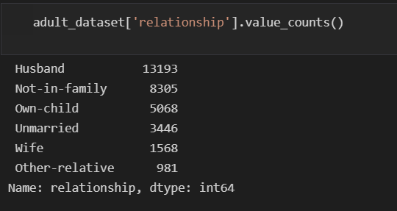
7) Occupation column (Distribution of Occupation)
8) Relationship column (Distribution of relationship)
7 December 2021
Department of CSE
19

Slide 20
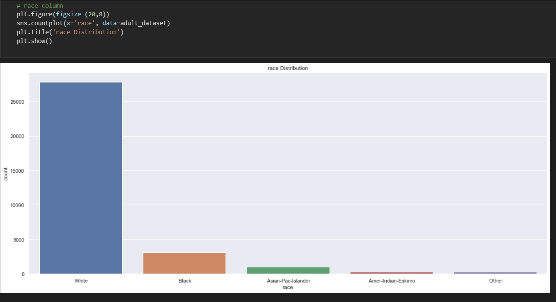
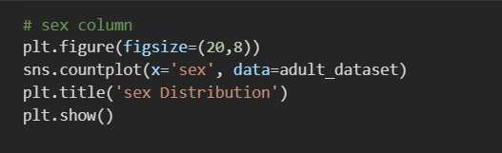
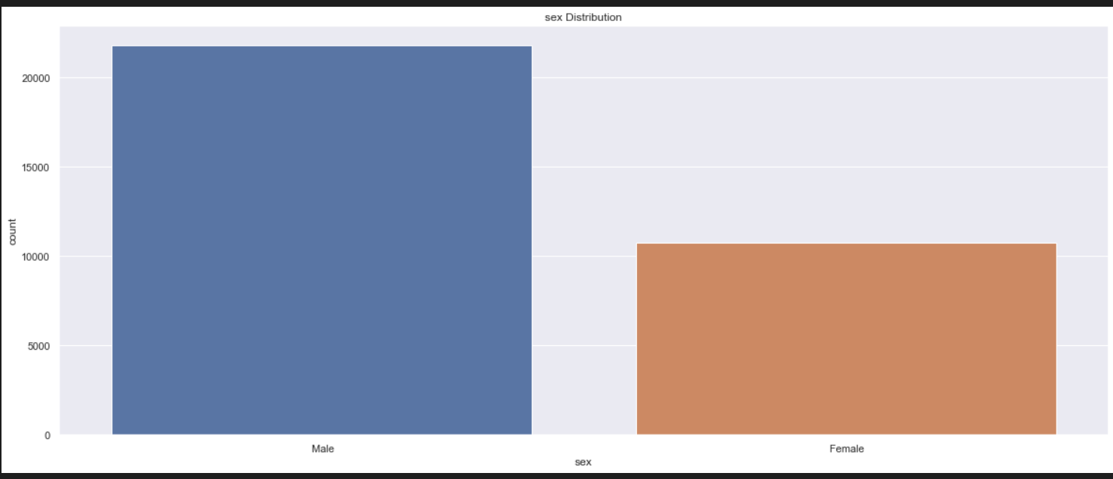
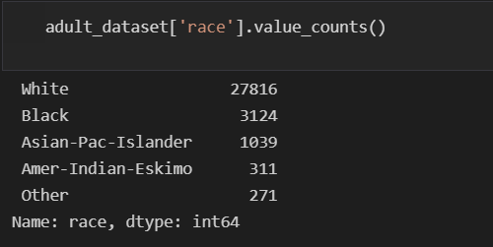
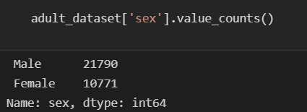
9) Race column (Distribution of race)
10) sex column (Distribution of sex)
7 December 2021
Department of CSE
20

Slide 21
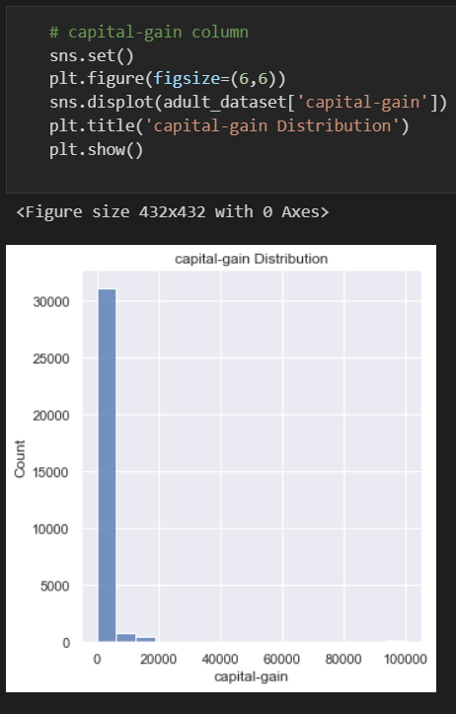
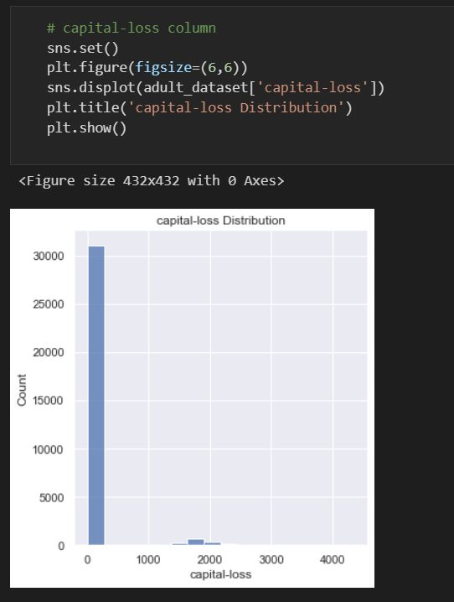
11) capital-gain column (Distribution of capital-gain)
12) capital-loss column (Distribution of capital-loss)
7 December 2021
Department of CSE
21

Slide 22
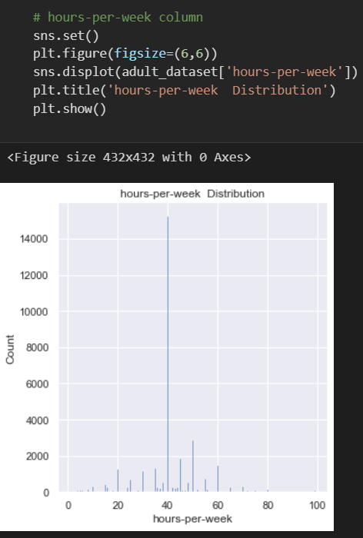
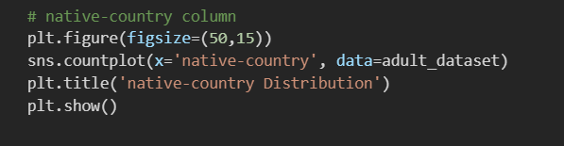
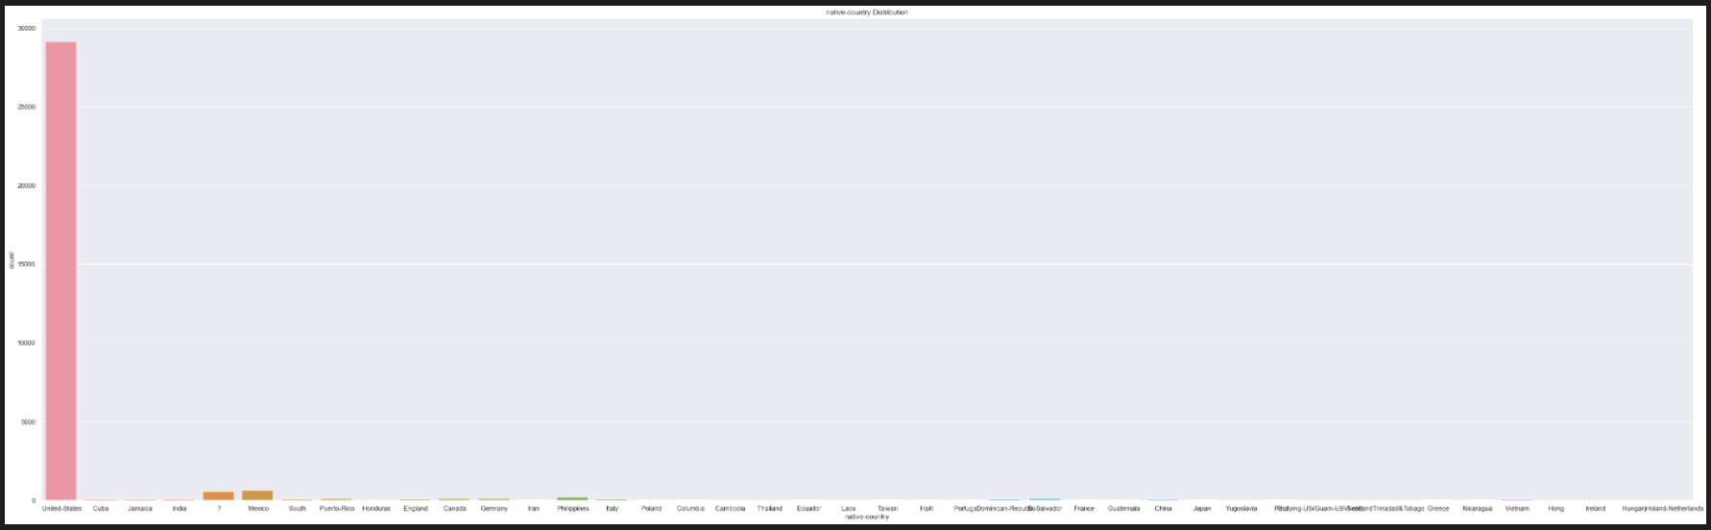
13)hours-per-week column (Distribution of hours-per-week)
14)Native-country column (Distribution of native-country)
7 December 2021
Department of CSE
22

Slide 23
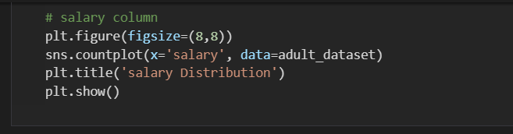
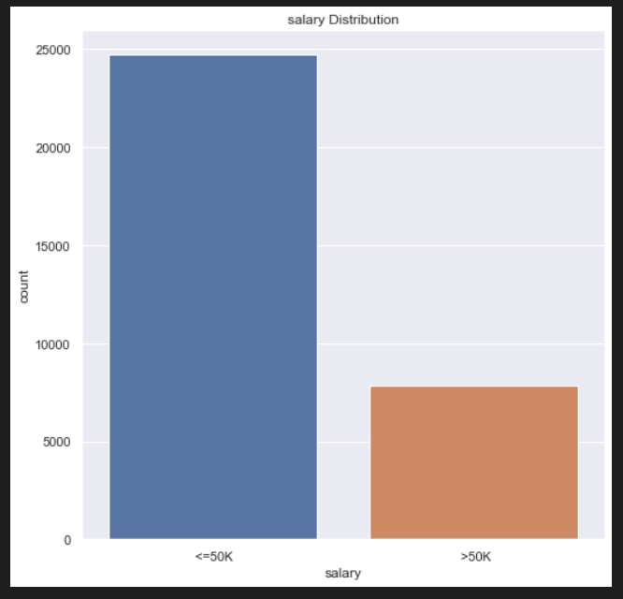
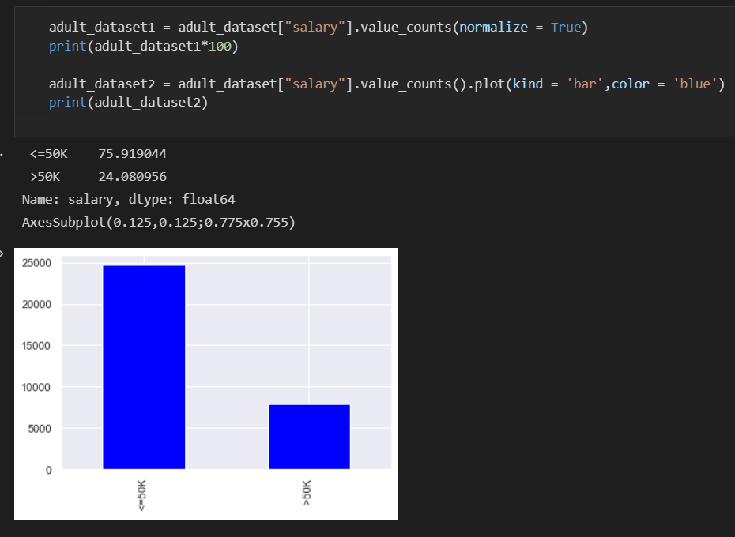
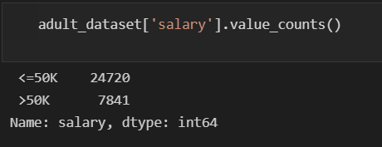
15)Salary column (Distribution of salary)
7 December 2021
Department of CSE
23

Slide 24
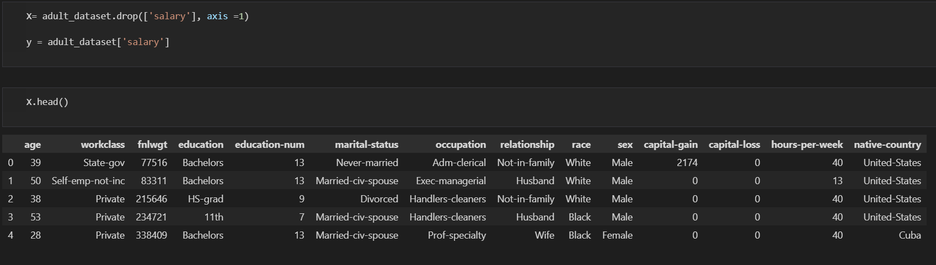
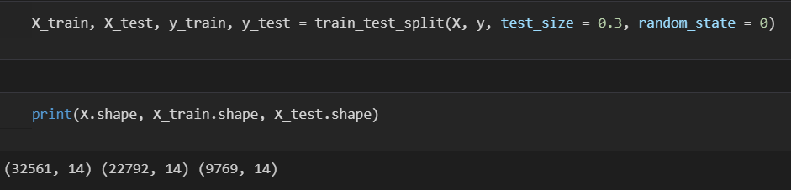
16)Separating Salary column into X and y values
7 December 2021
Department of CSE
24

Slide 25
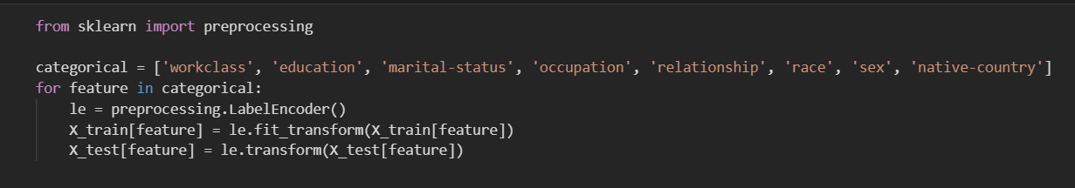
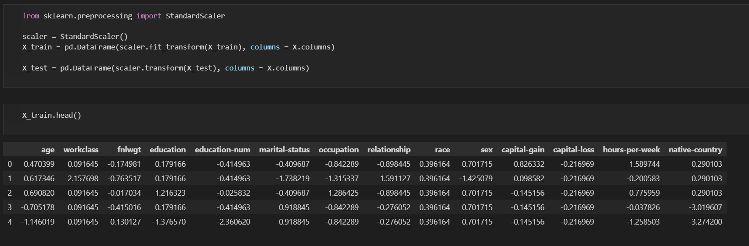
17) Preprocessing the categorical features values
18) Conversion of StandardScalar
7 December 2021
Department of CSE
25

Slide 26
Application Snapshots
The modelling speed is fast and it does not require very complicated calculation.
Runs fast when the amount of data is large.
The understanding & interpretation of each variable can be given according the co-efficient.
IT companies :
It is powerful statistical technique that can generate to understand business better.
7 December 2021
Department of CSE
26

Slide 27
Results and Discussions
In this project we have got “The Adult dataset” is from the Census Bureau and we have predict the task is to whether a given adult makes more than 50K a year based attributes such as education, hours of work per week, etc.,
7 December 2021
Department of CSE
27

Slide 28
Conclusion
This work focuses on the challenges of predicting the salary Offered by companies through job post on the web.
Instead of focusing on international and multi domain web portals, which are abundant In terms of number of posts, this works analysis job posts collected from techno employee, an e-Recruitment website specialized in jobs for young people.
Finally, We made a machine learning classification analysis from end-to-end and we learned and obtained several insights about classification models and the keys to develop one with a good performance.
7 December 2021
Department of CSE
28

Slide 29
References
1] UCI ADULT DATASET Lichman, M. (2013). UCI Machine Learning Repository [http://archive.ics.uci.edu/ml]. Irvine, CA: University of California, School of Information and Computer Science.
2] SMOTE: Synthetic Minority Over-sampling Technique -Nitesh V. Chawla - Journal of Artificial Intelligence Research 16 (2002) 321–357
3] www.kaggle.com
4] www.stackoverflow.com
5] Vidya Chockalingam, Sejal Shah and Ronit Shaw: “Income Classification using Adult Census Data”,
https://cseweb.ucsd.edu/classes/wi17/cse258- a/reports/a120.pdf.
6] Sisay Menji Bekena: “Using decision tree classifier to predict income levels”, Munich Personal RePEc Archive 30th July 2017
7] Mohammed Topiwalla: “Machine Learning on UCI Adult data Set Using Various Classifier Algorithms And Scaling Up The Accuracy Using Extreme Gradient Boosting”, University of SP Jain School of Global Management.
7 December 2021
Department of CSE
29

Slide 30
References
8] Alina Lazar: “Income Prediction via Support Vector Machine”, International Conference on Machine Learning and Applications - ICMLA 2004, 16-18 December 2004, Louisville, KY, USA.
9] S.Deepajothi and Dr. S. Selvarajan: “A Comparative Study of Classification Techniques On Adult Data Set”, International Journal of Engineering Research Technology (IJERT), ISSN: 2278-0181 Vol. 1 Issue 8, October 2012.
7 December 2021
Department of CSE
30

Slide 31
Thank you

