Slide 1
BOYS HOSTEL MANAGEMENT SYSTEM
A Desktop-Based Hostel Administration and Resident Management System
Core Java • Java Swing • JDBC • MySQL
Presented by: Your Name
Department of Computer Science and Engineering
Mohan Babu University | Academic Year 2025–2026
Notes:
Good morning everyone.
Today I am going to present my project titled "Boys Hostel Management System".
This is a desktop-based application developed using Core Java, Java Swing, JDBC and MySQL.
The main purpose of this project is to simplify hostel administration by managing residents, rooms, beds, fees, payments and other hostel-related activities through a centralized system.

Slide 2
Introduction
▸ Desktop application to digitize hostel administration
▸ Provides separate interfaces for:
  • Owner / Admin
  • Resident
▸ Manages the complete hostel lifecycle:
  • Resident information
  • Rooms and beds
  • Fees and payments
  • Attendance & In/Out records
  • Complaints, maintenance & feedback
  • Reports
Why Digitize?
▸ Traditional registers make searching slow
▸ Payment tracking becomes unreliable
▸ Room / bed availability is hard to know
▸ A centralized system solves all of this
2
Notes:
In a traditional hostel, many activities may be maintained manually using registers or separate files.
This can make it difficult to search records, track payments and know room or bed availability.
My system provides a centralized application where the owner can manage hostel operations and residents can access their own information.

Slide 3
Problem Statement
▸ Manual record maintenance
▸ Difficulty tracking resident information
▸ Room and bed allocation problems
▸ Difficulty tracking pending fees
▸ Separate, scattered payment records
▸ Time-consuming searching
▸ Lack of centralized information
▸ Residents cannot access their own data
Main Problem
There is a need for a centralized computerized system to manage hostel operations efficiently.
3
Notes:
The main problem I identified is that hostel administration involves many types of information.
For example, resident details, rooms, beds, fees and payments all need to be maintained.
If these records are maintained manually, searching and updating information becomes time-consuming.
So I developed this system to centralize these operations.

Slide 4
Objectives
▸ Digitize hostel management
▸ Maintain resident information
▸ Manage rooms and beds
▸ Track fee invoices and pending dues
▸ Record payment transactions
▸ Provide resident self-service
▸ Maintain attendance and In/Out records
▸ Manage complaints and maintenance
▸ Provide feedback functionality
▸ Generate useful reports
▸ Reduce manual paperwork and errors
4
Notes:
The first objective is to replace manual record management with a computerized system.
The system should allow the administrator to manage residents, rooms, beds and financial records.
It should also provide residents with their own portal where they can view information such as their room and fee details.

Slide 5
Existing System
The Traditional Approach
▸ Paper-based records
▸ Manual room allocation
▸ Manual fee calculation
▸ Separate payment records
▸ Manual searching
▸ Difficult data updating
▸ Higher possibility of human errors
▸ Limited reporting
Limitations
Time-consuming
+
Difficult to maintain
+
Difficult to access
5
Notes:
In the existing or traditional system, information may be maintained in registers or separate files.
For example, if the administrator wants to find a particular resident, they may have to search through records manually.
Similarly, tracking pending fees and available beds can become difficult.
These limitations motivated the development of my proposed system.

Slide 6
Proposed System
A Centralized Desktop Application
Owner / Admin can:
Residents can:
▸ Manage residents, workers, rooms & beds
▸ Manage fees, payments & expenses
▸ Manage attendance & In/Out records
▸ Handle complaints & maintenance
▸ View reports and feedback
▸ View profile & room information
▸ View fees & attendance
▸ View In/Out records
▸ Submit complaints
▸ Submit feedback
6
Notes:
The proposed system provides separate functionality for administrators and residents.
The owner has access to administrative functions.
Residents have access to a self-service portal.
This separation makes the system easier to use because each user gets the functionality relevant to their role.

Slide 7
Technology Stack
Technology | Purpose
Core Java | Application logic
Java Swing | GUI development
JDBC | Database connectivity
MySQL | Data storage
Eclipse / IDE | Development environment
Windows Desktop | Application environment
▸ Why Java? → OOP, exception handling, JDBC connectivity and GUI support in one platform
▸ Why Swing? → JFrame, JPanel, JButton, JTextField, JTable, JComboBox and more
▸ Why MySQL + JDBC? → Reliable relational storage with a standard Java bridge
7
Notes:
I selected Java because it provides object-oriented programming, exception handling, database connectivity through JDBC and GUI support through Swing.
Swing provides components such as JFrame, JPanel, JButton, JTextField, JTable, JComboBox and other components required for developing a desktop GUI.
MySQL provides relational database storage for maintaining hostel information.
JDBC acts as a bridge between the Java application and the MySQL database.

Slide 8
System Architecture
USER — Owner / Admin or Resident
▸ Layered design
▸ User interacts with GUI
▸ Logic processes input
▸ JDBC talks to DB
▸ Result shown back on GUI
▸ Each layer has one job
▸ Easy to maintain
▸ Easy to debug
▸ Database can be replaced later
▼
Java Swing GUI (JFrame, JTable, Forms)
▼
Application Logic — Event Handling & Validation
▼
JDBC — Driver, Connection, SQL Queries
▼
MySQL Database — boys_hostel
8
Notes:
The architecture of my project follows a layered approach.
The user interacts with the Java Swing graphical interface.
When the user performs an operation, such as adding a resident, the application processes the input and uses JDBC to communicate with MySQL.
The database stores the information and the result is displayed back through the Swing interface.

Slide 9
System Modules
Owner / Admin Modules
Resident Modules
▸ Resident Management
  • Add / update / delete / search residents
▸ Room & Bed Management
  • Rooms, floors, capacity, assign / vacate beds
▸ Finance
  • Fees, payments, expenses, reports
▸ Operations
  • Attendance, In/Out, maintenance, complaints, feedback
▸ My Profile
  • View and manage personal information
▸ My Room
  • Room number, floor, category, bed status
▸ My Fees
  • Invoices, amounts, due dates, paid / pending
▸ Services
  • Attendance, In/Out log, complaints, feedback
9
Notes:
The system is divided into two major user areas.
The first is the Owner or Admin module.
The second is the Resident module.
The administrator has complete management functionality, while the resident has access to personal hostel information and support services.

Slide 10
Database Design
Database: boys_hostel (MySQL)
User Management
Accommodation
Finance
Operations
owner
owner_login
residents
workers
rooms
beds
fees
payments
expenses
attendance
in_out
maintenance
complaints
feedback
Key Relationships
Room → Beds → Resident | Resident → Fees → Payments → Attendance → In/Out → Complaints → Feedback
10
Notes:
I used MySQL as the backend database. The database name is boys_hostel.
The database contains separate tables for residents, rooms, beds, fees, payments and operational activities.
These tables allow the application to store and retrieve information systematically.
Primary keys like resident_id, room_id, bed_id uniquely identify records, and foreign keys connect related tables — for example a payment record is associated with a resident.

Slide 11
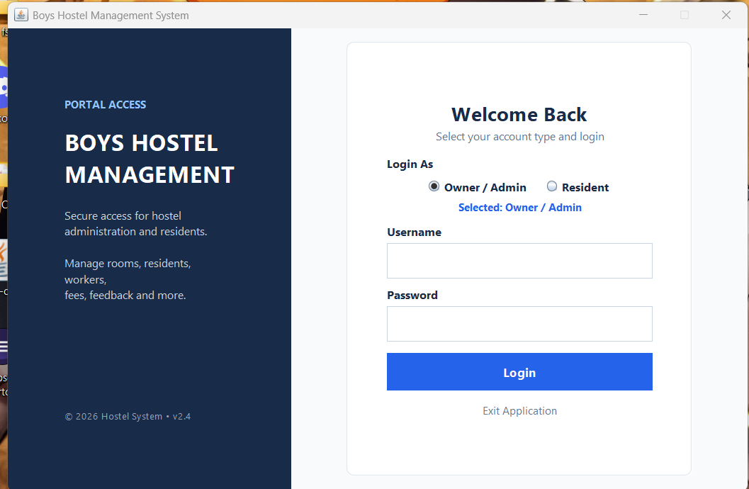
Role-Based Login
Application Entry Point
▸ Owner / Admin login
▸ Resident login
▸ Username & password validation
▸ Separate dashboards open based on role
▸ Exit application option
11
Notes:
This is the login screen of my application.
The user can select whether they are an Owner/Admin or Resident.
Based on the selected role and valid credentials, the application opens the corresponding dashboard.

Slide 12
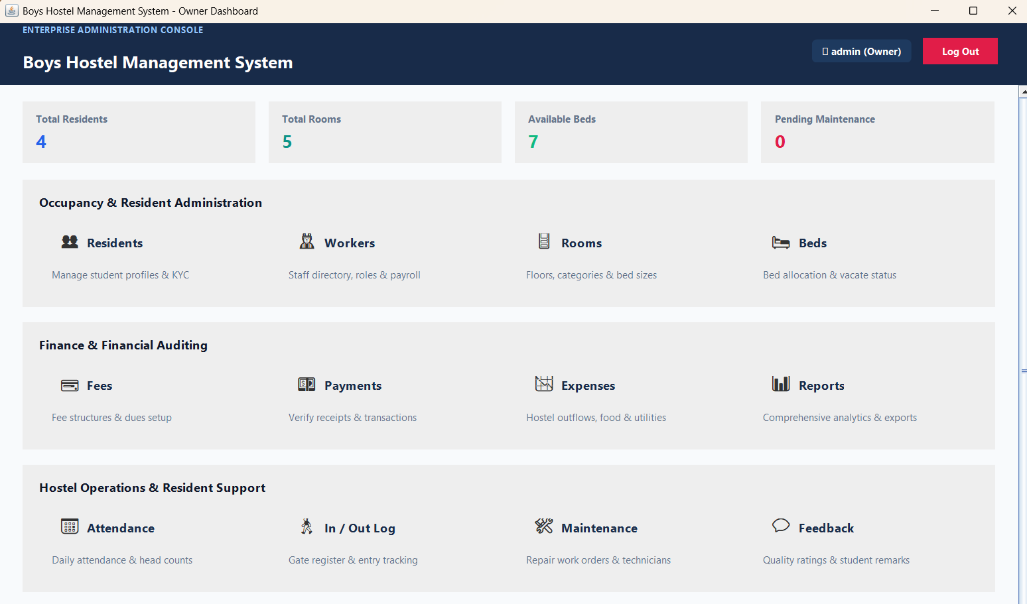
Owner Dashboard
Administrative Overview
▸ Dashboard statistics at a glance
▸ Occupancy & Resident Administration
▸ Residents • Workers • Rooms • Beds
▸ Finance & Financial Auditing
▸ Fees • Payments • Expenses • Reports
▸ Hostel Operations & Resident Support
▸ Attendance • In/Out Log • Maintenance • Feedback
12
Notes:
This is the Owner Dashboard.
The dashboard provides an overview of important hostel information.
At the top, we can see statistics such as total residents, total rooms and available beds.
The remaining sections provide access to resident management, accommodation, financial management and hostel operations.

Slide 13
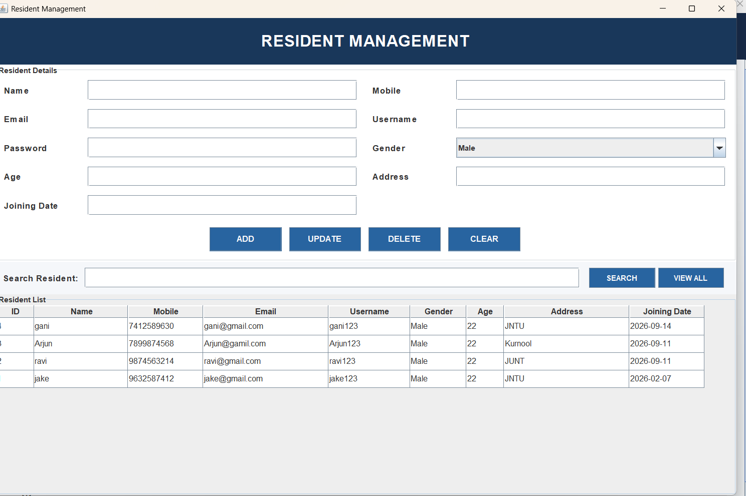
Resident Management
CRUD Operations on Residents
▸ Fields: Name, Mobile, Email, Username, Password
▸ Gender, Age, Address, Joining Date
▸ Operations: ADD • UPDATE • DELETE • CLEAR
▸ SEARCH to locate a resident quickly
▸ VIEW ALL displays the complete resident list
▸ Table shows ID to Joining Date for every resident
13
Notes:
This is the Resident Management module.
The administrator can enter resident information and perform CRUD operations.
CRUD stands for Create, Read, Update and Delete.
The search function allows the administrator to locate a particular resident quickly, while View All displays the complete resident list.

Slide 14
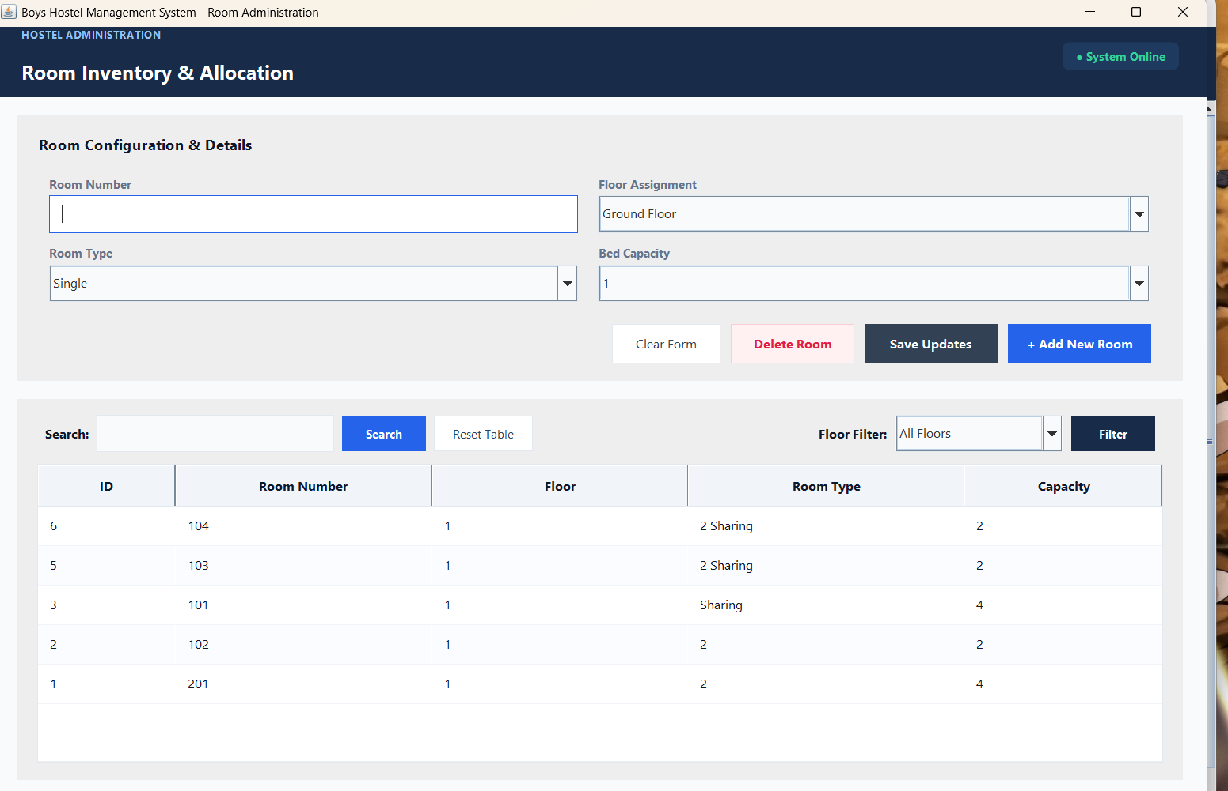
Room Management
Hostel Room Administration
▸ Room Number & Floor Assignment
▸ Room Type selection
▸ Bed Capacity definition
▸ Add Room • Update Room • Delete Room
▸ SEARCH and Floor Filter for quick lookup
▸ Table: ID, Room Number, Floor, Type, Capacity
14
Notes:
This module is used to manage hostel rooms.
The administrator can define the room number, floor, room type and capacity.
The system also provides searching and floor filtering so that rooms can be located easily.

Slide 15
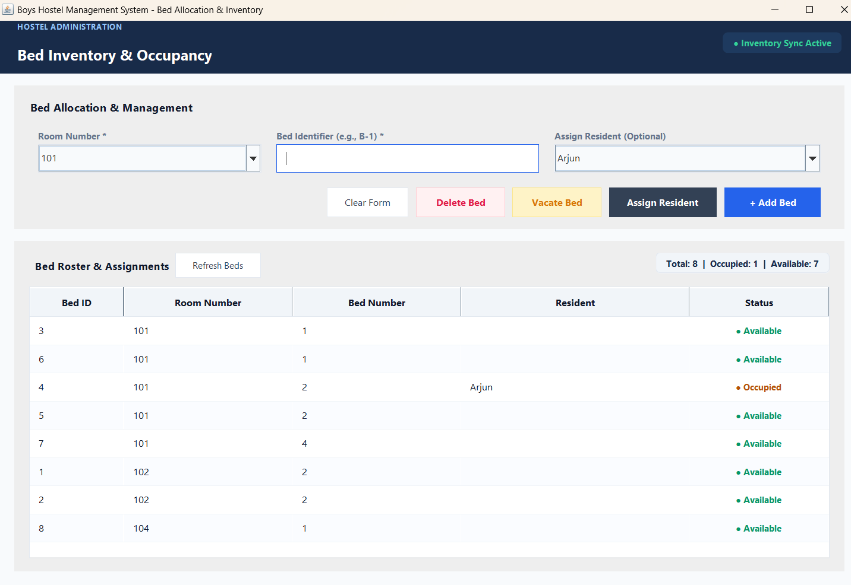
Bed Management
Bed Allocation & Status Tracking
▸ Room selection and Bed identifier
▸ Assign resident to a bed
▸ Vacate an occupied bed
▸ Refresh bed status in real time
▸ Statuses: Available / Occupied
▸ Connected with rooms and residents
15
Notes:
The Bed Management module is connected with rooms and residents.
Each bed can have a unique identifier.
The administrator can assign a resident to a bed or vacate an occupied bed.
The system also displays whether each bed is available or occupied.

Slide 16
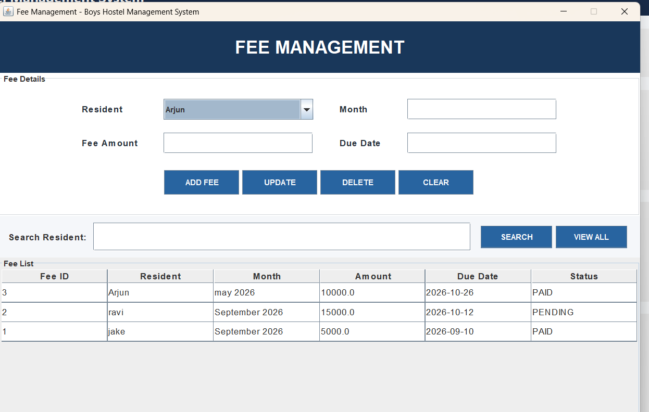
Fee Management
Fee Invoices & Dues Tracking
▸ Select Resident, Month, Fee Amount, Due Date
▸ Operations: ADD FEE • UPDATE • DELETE • CLEAR
▸ SEARCH and VIEW ALL fee records
▸ Status tracking: PAID / PENDING
▸ Clear view of pending dues per resident
16
Notes:
This is the Fee Management module.
The administrator can create fee records for residents.
Each fee record contains the resident, billing month, amount and due date.
The system can also show whether the fee is paid or pending.

Slide 17
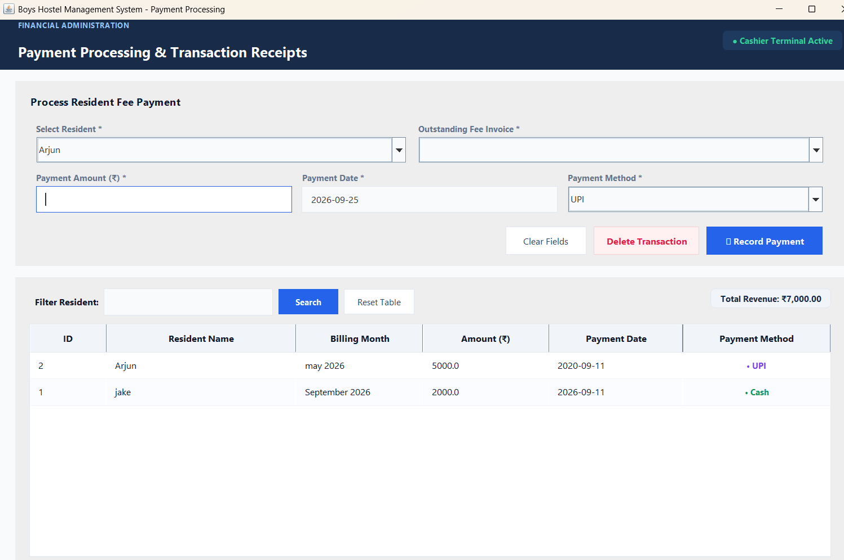
Payment Processing
Recording Fee Payments
▸ Select Resident → Outstanding Fee Invoice
▸ Enter Payment Amount & Payment Date
▸ Payment Method: UPI / Cash
▸ Transaction stored in the database
▸ History table: ID, Resident, Month, Amount, Date, Method
17
Notes:
This module handles fee payment transactions.
The administrator selects the resident and outstanding fee invoice.
Then the payment amount, payment date and payment method are recorded.
The transaction is stored in the database and displayed in the payment history.

Slide 18
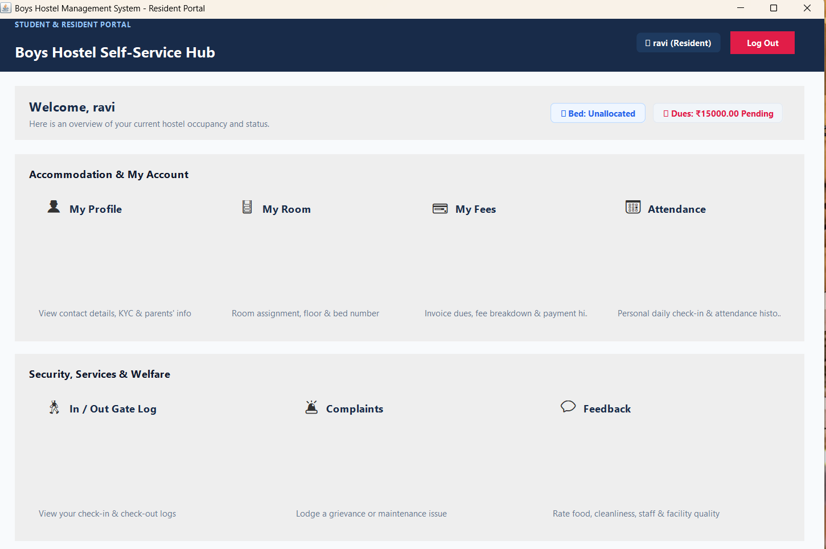
Resident Dashboard
Resident Self-Service Portal
▸ Accommodation & My Account:
  • My Profile • My Room • My Fees • Attendance
▸ Security, Services & Welfare:
  • In/Out Gate Log • Complaints • Feedback
▸ Focused on the resident's personal information only
18
Notes:
This is the Resident Dashboard.
Unlike the admin dashboard, this dashboard focuses on the resident's personal information.
Residents can view their profile, room, fees and attendance.
They can also access In/Out records, submit complaints and provide feedback.

Slide 19
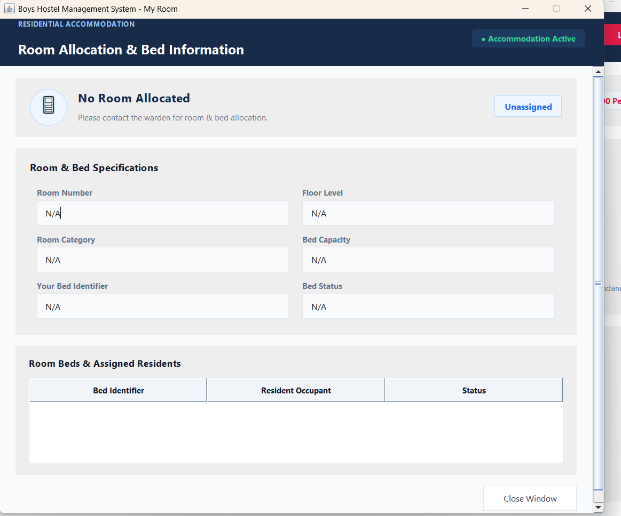
My Room
Room & Bed Information for the Resident
▸ Room Number, Floor Level, Room Category
▸ Bed Capacity & Bed Identifier
▸ Bed Status: Available / Occupied
▸ Bed Identifier + Resident Occupant list
▸ If not allocated → shows 'No Room Allocated'
▸ Resident is asked to contact the administrator
19
Notes:
This screen displays the room and bed information assigned to the resident.
If a resident has not yet been allocated a room, the system displays an unassigned status and asks the resident to contact the administrator.

Slide 20
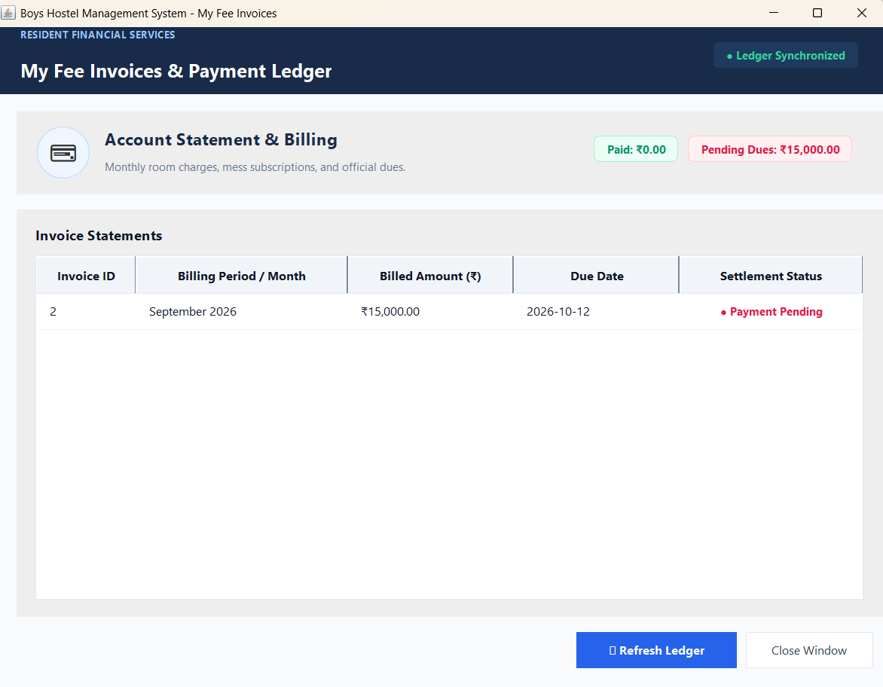
My Fees
Fee Invoices for the Resident
▸ Summary cards: Paid vs Pending Dues
▸ Invoice ID & Billing Period
▸ Billed Amount & Due Date
▸ Settlement Status for every invoice
▸ Example: Paid ₹0.00 • Pending Dues ₹15,000.00
20
Notes:
Residents can view their fee invoices through this module.
The screen shows billing period, billed amount, due date and settlement status.
This allows residents to know whether their hostel fee is paid or pending.

Slide 21
Key Functionalities
CRUD + Search + Database Integration + Role-Based Access
C — Create
R — Read
U — Update
D — Delete
Add a new record — e.g., Add Resident
Retrieve records — e.g., View All Residents
Change existing info — e.g., Update Resident
Remove a record — e.g., Delete Resident
▸ Search — locate any record quickly (residents, rooms, fees…)
▸ Filtering — floor filter for rooms, status filters for beds and fees
▸ Database Integration — Java communicates with MySQL through JDBC
▸ Role-Based Access — Admin and Resident see different dashboards
21
Notes:
CRUD stands for Create, Read, Update and Delete — the four basic operations on data.
Create: adding a new record, for example Add Resident.
Read: retrieving existing records, for example View All Residents.
Update: changing existing information, for example Update Resident.
Delete: removing a record, for example Delete Resident.
Along with CRUD, the system provides search, filtering, JDBC database integration and role-based access.

Slide 22
JDBC Database Flow
How Java Talks to MySQL
Java Application
▸ JDBC = Java Database Connectivity
▸ Standard Java API for databases
▸ PreparedStatement prevents SQL injection
▸ Connection closed after use
▼
▸ Used in every module
▸ Same pattern for CRUD
▸ Try-catch for exceptions
▸ Commit after transactions
JDBC Driver Loading
▼
Connection (DriverManager)
▼
SQL Query (Statement / PreparedStatement)
▼
MySQL Database executes
▼
ResultSet returned
▼
Result displayed on GUI
22
Notes:
JDBC stands for Java Database Connectivity.
It allows my Java application to communicate with the MySQL database.
The application loads the JDBC driver, establishes a database connection, executes SQL operations using Statement or PreparedStatement, processes the ResultSet, and closes the connection.

Slide 23
Advantages & Current Limitations
Advantages
Current Limitations
▸ Easy to use with a graphical interface
▸ Centralized data management
▸ Faster record searching
▸ Easy room and bed tracking
▸ Better fee management
▸ Separate admin and resident interfaces
▸ Reduces manual paperwork
▸ Supports future expansion
▸ Desktop-based application
▸ Requires MySQL database setup
▸ Requires Java Runtime Environment
▸ Limited to configured hostel environment
▸ Notifications not yet automated
▸ Online / cloud access not implemented
23
Notes:
Being honest about limitations is important.
The current version is a desktop-based application and requires Java and MySQL to be installed.
Cloud access, automated notifications and some advanced reporting features can be added in future versions.
Despite these, the system offers easy use, centralized data, fast searching and better fee management.

Slide 24
Future Enhancements
💳 Online Payment
🔔 Notifications
Integrate payment gateways
Fees, due dates, complaints, maintenance
📊 Advanced Reports
☁️ Cloud Database
PDF, Excel, monthly & financial reports
Access from multiple locations
📱 Mobile Application
🔒 Improved Security
Android / iOS version for residents
Password hashing, roles, audit logs
24
Notes:
The current project provides the core hostel management functionality.
In future, I can extend the system by adding online payments, notifications, cloud database support, mobile applications and advanced reporting.
Security can also be improved with password hashing, role permissions and audit logs.

Slide 25
Conclusion
The Boys Hostel Management System provides a centralized solution for:
▸ Resident, room and bed management
▸ Fee management and payment tracking
▸ Resident self-service portal
▸ Attendance, In/Out, complaints and maintenance operations
"The system reduces manual work and provides an organized platform for hostel administration."
25
Notes:
To conclude, the Boys Hostel Management System provides a centralized platform for managing hostel administration.
The system connects the Java Swing application with MySQL using JDBC.
It provides separate interfaces for administrators and residents and supports important hostel activities such as residents, rooms, beds, fees and payments.
The system can also be extended with additional features in the future.

Slide 26
THANK YOU
Any Questions?
Boys Hostel Management System • Java Swing • JDBC • MySQL
Notes:
Thank the audience and invite questions from the examiner.

