Slide 1
INTERPOLATION

Slide 2
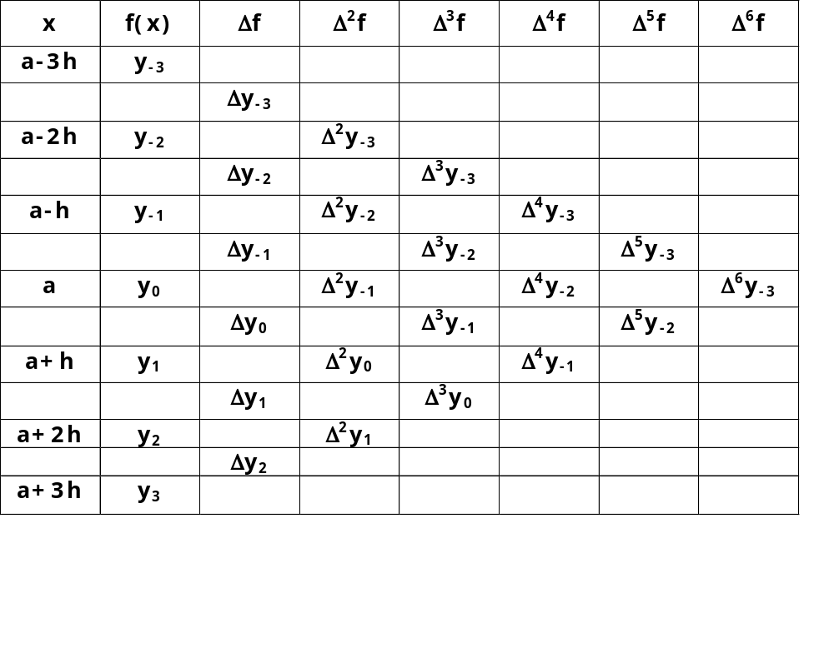
INTERPOLATION USING CENTRAL DIFFERENCES
Suppose the values of the function f (x) are known at the points a -3h, a – 2h, a – h, a, a +h, a + 2h, a + 3h, ... etc. Let these values be y₋₃, y₋₂, y₋₁, y₀, y₁, y₂, y₃ ..., and so on. Then we can form the central difference table as:
We can relate the central difference operator δ with Δ and E using the operator relation δ = ΔE½.

Slide 3
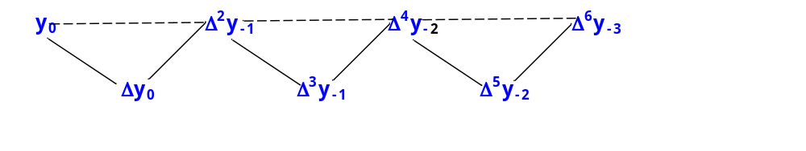
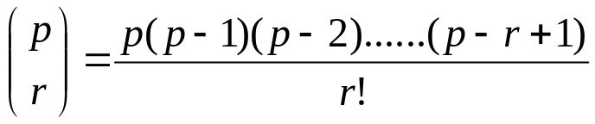
GAUSS FORWARD INTERPOLATION FORMULA
The value p is measured forwardly from the origin and 0<p<1.
The above formula involves odd differences below the central horizontal line and even differences on the line. This is explained in the following figure.
Formula is:
where

Slide 4
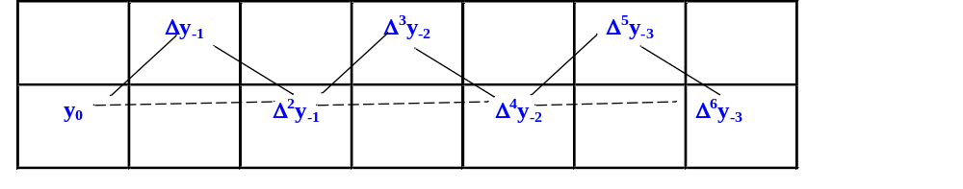
GAUSS BACKWARD INTERPOLATION FORMULA
The value p is measured forwardly from the origin and -1<p<0.
The above formula involves odd differences above the central horizontal line and even differences on the line.
Formula is:
where

Slide 5
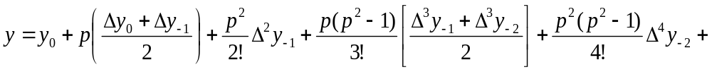
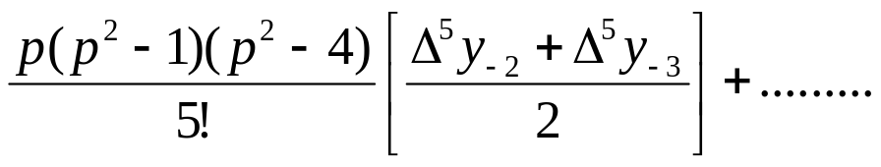
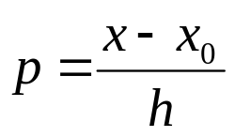
STIRLING’S FORMULA
This formula gives the average of the values obtained by Gauss forward and backward interpolation formulae. For using this formula we should have – ½ < p< ½.
We can get very good estimates if - ¼ < p < ¼.
The formula is:
where

Slide 6
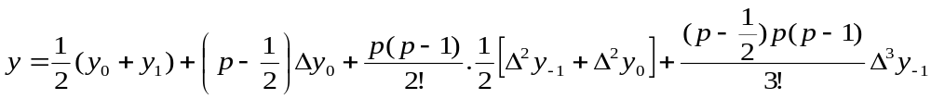
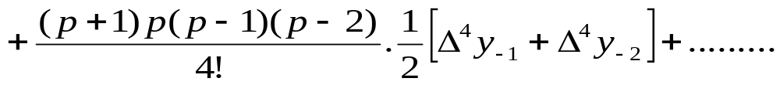
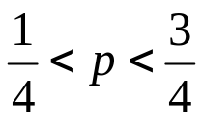
BESSEL’S INTERPOLATION FORMULA
This formula involves means of even difference on and below the central line and odd difference below the line.
The formula is:
where
Bessel’s formula gives better result for

