Slide 1

PROJECT_TITLE:- FastAST-NeuroSym: An Efficient, Neuro-Symbolic Audio Spectrogram Transformer for Interpretable Acoustic Surveillance
ENGINEERING DESIGN AND INNOVATION_PPT FOR
END SEMESTER EXAMINATION - MAY 2026
Branch Div:-CS-K GROUP No:- 04 Day: Saturday Date:- 23/05/2026
Project Guide: Prof. Smita Mande
Sr. No. | Roll No. | Name | Div | Batch | PRN
1 | 4 | Anas Shaikh | CS-K | K1 | 12412236
2 | 18 | Rajwardhan Shinde | CS-K | K1 | 12414561
3 | 19 | Roshan Shinde | CS-K | K1 | 12411129
4 | 26 | Amey Shirbhate | CS-K | K1 | 12410665
BRACT’S, Vishwakarma Institute of Technology, Pune-37
(An Autonomous Institute affiliated to Savitribai Phule Pune University)
(NBA and NAAC accredited, ISO 21001:2018 certified)

Slide 2
INTRODUCTION:
Peerity is a web platform where students submit work, review classmates, and share team feedback without exposing identities by default.
Personal bias and fear of retaliation during peer evaluation.
Differences in scoring due to subjective judgment.
Unauthorized access to student identities and submitted files.
Lack of verifiable records for important evaluation and disclosure decisions.
Department of Computer Engineering, VIT, Pune-37

Slide 3
Problem Statement
Traditional peer evaluation systems can be affected by personal bias, limited reviewer anonymity, inconsistent scoring, and concerns about the security of student submissions. They may also lack reliable audit trails and controlled procedures for resolving evaluation disputes. Therefore, there is a need for a secure, transparent, and privacy-preserving peer evaluation platform that promotes fair assessment, maintains accountability, and protects student identities through structured review and committee-based governance.
Our Aim is to Develop , a web-based peer evaluation platform that protects student identities during normal reviews, provides rubric-based scoring and expert-benchmark reviewer calibration, secures submitted files using AES-256-GCM encryption, and controls identity disclosure through committee approval and tamper-evident audit records.
Department of Computer Engineering, VIT, Pune-37

Slide 4
Objectives:-
Proposed Solution
Develop Role-Based Workflows: Implement separate access and operations for students, instructors, committee members, and administrators.
Implement Dual-Mode Assessment: Support level-based rubrics and question-based criteria, with scores converted to a common 0–10 scale.
Measure Reviewer Reliability: Compare student evaluations with expert benchmarks using weighted Mean Absolute Error (MAE) and classify reviewers into reliability tiers.
Establish Controlled Identity Disclosure: Implement five disclosure levels, sealed committee voting, and conflict-of-interest checks for dispute resolution.
Maintain Evaluation Integrity: Implement encrypted file storage, tamper-evident audit records, and a minimum three-reviewer rule for releasing written group feedback.
Department of Computer Engineering, VIT, Pune-37

Slide 5
Literature Survey :-
SR. NO. | TITLE OF RESEARCH PAPER | AUTHOR | NAME OF JOURNAL / CONFERENCE | DATE OF PUBLICATION | METHODOLOGY | LIMITATIONS
1 | Neuro-Symbolic Frameworks for Context-Aware Audio Surveillance | S. Kumar, A. Desai | IEEE Internet of Things Journal | 2025 | Combines deep audio classification with symbolic logic rules for smart city monitoring. | High latency; the architecture is too heavy for real-time edge processing.
2 | Edge-Optimized Audio Spectrogram Transformers via Dynamic Token Pruning | M. Chen, L. Wang, et al. | IEEE ICASSP | 2024 | Reduces transformer complexity and speeds up audio processing using token merging techniques. | Functions as a "Black Box" lacking visual interpretability for security audits.
3 | Explainable AI in Acoustic Threat Detection: Visualizing Attention | J. Smith, R. Gupta | ACM Multimedia | 2024 | Introduces Attention Rollout to generate heatmaps showing which audio frequencies triggered AI alerts. | Does not address contextual reasoning (time/location), leading to false alarms.
4 | FastAST: Accelerating Audio Spectrogram Transformer via Token Merging | S. R. Behera, A. Dhiman, et al. | INTERSPEECH | 2023 | Improves efficiency using Cross-Model Knowledge Distillation to reduce redundant tokens. | While faster, it lacks contextual reasoning and explainability in safety-critical systems.
5 | AST: Audio Spectrogram Transformer | Yuan Gong, Yu-An Chung, James Glass | Interspeech | 2021 | Introduced the foundational Transformer-based architecture for processing audio spectrograms. | High computational complexity (O(N^2)) makes it unsuitable for real-time edge devices.
Department of Computer Engineering, VIT, Pune-37

Slide 6

Literature Survey
SR.
NO.
TITLE OF RESEARCH PAPER
AUTHOR
JOURNAL / CONFERENCE
YEAR
METHODOLOGY
LIMITATION / GAP RELEVANT TO PEERITY
1
A Systematic Review of Peer Assessment Design Elements [2]
M. Alqassab et al.
Educational Psychology Review
2023
Reviewed 424 peer-assessment studies and identified 28 recurring design elements across six instructional clusters, including anonymity, rubric design and reviewer training.
Synthesizes prior studies; it does not itself implement a platform combining encrypted files, controlled identity disclosure and auditable decisions.
2
Investigating Anonymity in Formative and Summative Peer Assessment [4]
J. Fraile et al.
Studies in Educational Evaluation
2024
Examined how anonymity relates to university students’ social-affective factors, perceptions and preferences in formative and summative assessment.
Focuses on students’ responses to anonymity; staged identity disclosure and committee-controlled access are not the reported contribution.
3
Mechanical TA 2: Peer Grading with TA and Algorithmic Support [9]
H. Zarkoob, K. Leyton-Brown
ACM SIGCSE Technical Symposium
2024
Combines teaching-assistant oversight with algorithmic peer-grading support to address grading consistency across many submissions.
The cited work focuses on grading support; this review does not describe Peerity-style identity disclosure tiers or HMAC-chained audit records.
4
(r, k, ε)-Anonymization: Privacy-Preserving Data Publishing Algorithm [6]
B. C. Kara et al.
IEEE Access
2025
Combines multidimensional outlier detection with k-anonymity and differential privacy for privacy-preserving data publishing.
Targets data publishing; it does not directly define release rules for live peer-review comments or committee approval for identity disclosure.
5
Rethinking Tamper-Evident Logging: A High-Performance, Co-Designed Auditing System [11]
R. Zhao et al.
ACM SIGSAC Conference on Computer and Communications Security
2025
Studies a performance-focused auditing system using cryptographically chained logs to support tamper-evident record verification.
Addresses audit logging; education-specific scoring, reviewer anonymity and committee-governed identity disclosure are outside the cited contribution.
Table 1. Summary of sleected studies

Slide 7
OBJECTIVE :-
Develop Role-Based Workflows: Provide separate access and operations for students, instructors, committee members, and administrators.
Implement Dual-Mode Assessment: Support level-based rubrics and question-based criteria, converting scores to a common 0–10 scale.
Measure Reviewer Reliability: Compare student evaluations with expert benchmarks using weighted Mean Absolute Error (MAE) and classify reviewers into reliability tiers.
Establish Controlled Identity Disclosure: Implement five disclosure levels, committee voting, and conflict-of-interest checks for dispute resolution.
Maintain Evaluation Integrity: Encrypt submitted files, maintain tamper-evident audit records, and release written group feedback only after reviews from at least three distinct group members.
Department of Computer Engineering, VIT, Pune-37

Slide 8
Software & Requirements :-
Area / Component | Technology Stack | Where It Runs | Purpose
Frontend UI & Charts | React 18, TypeScript, Tailwind, Recharts | Client (Web Browser) | Renders dashboards, forms, dark mode, and analytics charts.
Document Sandbox | pdfjs-dist (`DocViewer.tsx`) | Client (Browser) | Renders student PDFs safely in browser memory without external plugins.
Backend & Access | Spring Boot 3.3.4, Spring Security 6 | Application Server (JVM) | Runs REST APIs, business rules, and role checks (`@PreAuthorize`).
Auth & Passwords | Argon2id + SHA-256 Tokens | Application Server (JVM) | Hashes passwords securely and verifies 30-min single-use reset tokens.
Sessions & Cookies | Spring Session JDBC + CSRF Cookie | Browser ↔ Server ↔ MySQL | Links browser `JSESSIONID` to DB session and checks `X-XSRF-TOKEN`.
File Encryption | In-Process JCE AES-256-GCM | Server JVM ↔ Local Disk | Checks file signatures and saves encrypted `.enc` files on server disk.
Audit & Database | HMAC-SHA-256 + MySQL 8.0 + Flyway | Server JVM ↔ Database Server | Chains audit logs and applies versioned SQL schema migrations.
Testing & Delivery | JUnit 5, H2, Vitest, Docker, GitHub CI | CI Runner & Containers | Runs 217 automated tests and builds repeatable Linux containers.
Department of Computer Engineering, VIT, Pune-37

Slide 9
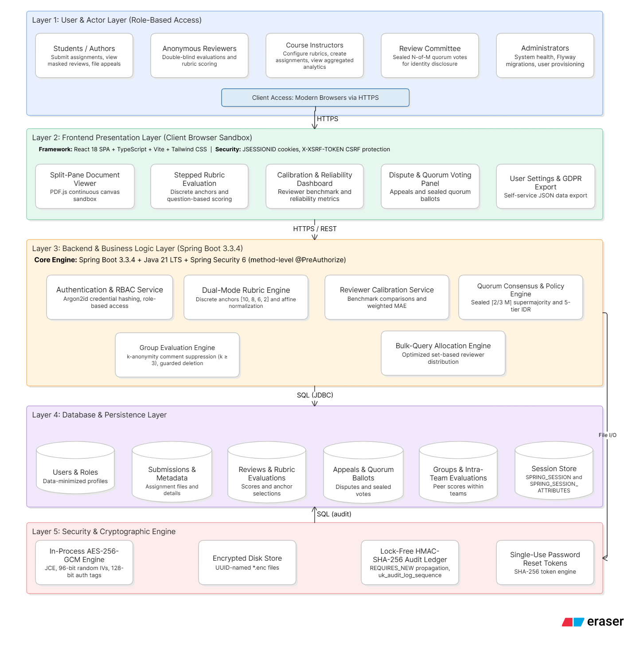
Department of Computer Engineering, VIT, Pune-37

Slide 10
Methodology:-
Module: Secure Submission Upload & Double-Blind Review
• FILECRYPTOSERVICE (SERVER JVM)
• REVIEWSERVICE & DOCVIEWER
In-Process AES-256-GCM Encryption
Double-Blind Peer Isolation
•
Magic-Byte Check: Inspects real file headers (`%PDF-`, `PK`) to block fake extensions.
•
DTO Identity Stripping: Server removes `authorId`, `authorName`, and `reviewerEmail` before sending JSON to browsers.
•
Envelope Encryption: Encrypts files in Java using a 96-bit random IV and 128-bit GCM tag.
Pseudonym Display: Students only see labels like `Anonymous Reviewer Alpha`.
•
•
Safe Disk Format: Saved as `[12B IV][16B Tag][Ciphertext]` in `storage/encrypted/*.enc` plus a SHA-256 hash in MySQL.
Fast Allocation: Bulk SQL pre-fetching assigns 3 reviewers per file 53× faster without self-reviews.
•
Department of Computer Engineering, VIT, Pune-37

Slide 11
Methodology:-
Dual-Mode Rubrics & Reviewer Calibration
RUBRICSUPPORT ENGINE
CALIBRATIONSERVICE ENGINE
Two Rubric Modes, One 0–10 Scale
Pre-Review Gold-Standard Calibration
Replaces confusing numeric sliders with clear choices that map to the same 0–10 score:
Students grade instructor-scored sample work first to measure their grading accuracy:
1. Level Cards: Exemplary (10), Proficient (8), Developing (6), Needs Improvement (2).
Error Check (MAE): Compares student score to instructor benchmark across criteria.
2. Question-Based: 5 descriptive options (1–5) converted via 2.5 × (v − 1) onto 0–10.
Reliability Score: R = max(0, 100 − 10 × MAE) groups reviewers into High (≥85%), Moderate, or Low tiers.
Department of Computer Engineering, VIT, Pune-37

Slide 12
Methodology:-
08 • FEATURE 4
Group Member Evaluation & k-Anonymity Protection
Teammates rate each other's project contribution, while the server prevents identity guessing in small teams.
When Evaluations < 3
When Evaluations ≥ 3 (k ≥ 3)
Record Safety
Written Comments Hidden
Comments Safely Released
Guarded Group Deletion
If only 1 or 2 teammates have submitted feedback, `GroupService` masks written comments (`null`) so the recipient cannot guess who wrote them.
Once at least 3 distinct group members evaluate a teammate, written comments become visible while numeric averages show right away.
Deleting a student group is blocked (`409 Conflict`) once peer evaluations exist, protecting student grading records from accidental loss.
Department of Computer Engineering, VIT, Pune-37

Slide 13
Methodology:-
Quorum Dispute Voting & 5-Tier Identity Disclosure
QuorumService • Sealed 2-of-3 Voting
PolicyEngineService • Minimum Necessary Reveal
No Single Admin Can Unmask Alone
Step-by-Step Attribute Unmasking
Unmasking requires a 2-of-3 Ethics Committee supermajority. Conflicted members are auto-recused, and the old single-admin `/resolve` bypass was deleted.
Instead of exposing full names for minor complaints, the policy engine caps disclosure to the lowest tier needed for the dispute type.
5 PROGRESSIVE DISCLOSURE LEVELS (CONTROLLED BY COMMITTEE VOTE)
LEVEL 0
LEVEL 1
LEVEL 2
LEVEL 3
LEVEL 4
Pseudonym Only
Role & Eligibility
Institution & Dept
Academic Standing
Full Name & Email
Department of Computer Engineering, VIT, Pune-37

Slide 14
Methodology:-
Audit Ledger, SQL Analytics & Account Privacy Tools
AuditLedgerService
AnalyticsService
UserService & ResetService
Tamper-Evident Audit Chain
Fast Instructor Analytics
GDPR Export & Safe Reset
Every login, upload, review, and vote is linked with `HMAC-SHA-256` (`prevHash` → `currentHash`). Uses DB sequence uniqueness instead of slow JVM locks.
Calculates course summaries using direct SQL `COUNT`, `AVG`, and `GROUP BY` queries—cutting queries by 99.3% without loading thousands of objects into RAM.
Users can download a JSON archive of their data (`/api/users/me/export`) and reset passwords via single-use, 30-minute SHA-256 hashed tokens.
Department of Computer Engineering, VIT, Pune-37

Slide 15
Methodology:-
12 •
Testing Summary & Measured Benchmark Results
180 / 180
37 / 37
53.33×
Backend JUnit Tests (119 Security + 61 Functional)
Frontend Vitest Tests
Faster Reviewer Distribution (1,724 ms → 32.3 ms)
Used a Risk Driven Agile Model with priority iterations (P0 -> P3)
Iteration 1 (P0): High-stakes security fixes (closing quorum bypasses, identity leak protection).
Iteration 2 (P1): Architectural & cryptographic overhaul (in-process AES-256-GCM, lock-free audit ledger).
Iteration 3 (P2/P3): Features, migrations , and frontend design system.
Iteration 4 (UX): Dark mode shell, global toast notifications, and responsive mobile review layout.
Measured Latencies (Test Environment)
•
5 MiB File Encryption: 149.41 ms median (Decryption: 169.08 ms).
•
Core APIs (p50): Upload 31.6 ms, Review 26.5 ms, Quorum Vote 30.2 ms.
•
Analytics SQL Optimization: Queries cut by 99.3% (1,716 → 12 queries).
•
Department of Computer Engineering, VIT, Pune-37

Slide 16
Methodology:-
12 •
Current Limitations & Future Scope
Current Limitations
Future Scope
•
No Live Classroom Study Yet: Benchmarks measure software speed, not live student learning outcomes
.
•
Run Classroom Pilots: Measure student trust, grading fairness, and learning impact in real courses.
•
Testbed Benchmarks: Timings were recorded on a single developer machine, not under 500-user deadline load.
•
Horizontal Scaling & Redis: Move session storage and rate limits to Redis for multi-server load.
•
Context Guessing: Pseudonyms and k≥3 rules hide names, but writing style can still hint at authorship.
•
LMS Integration (LTI 1.3): Connect directly with Canvas and Moodle for roster sync and grade passback.
•
Key Management: Production rollout needs external KMS key rotation and backup workflows.
•
Stronger Key & Bias Tools: Add automated key rotation and outlier review flagging.
Department of Computer Engineering, VIT, Pune-37

Slide 17
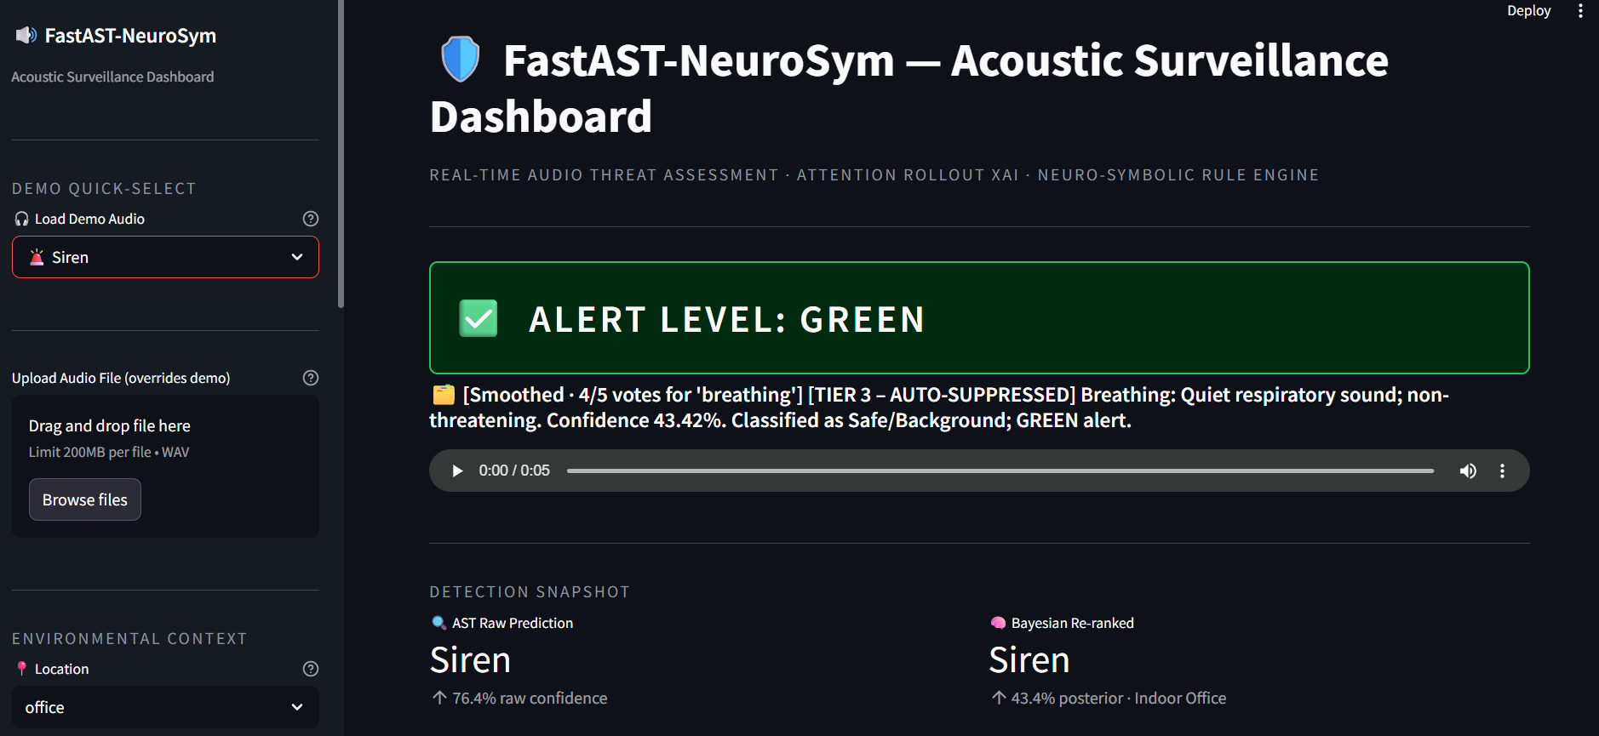
RESULT& OUTPUT :-
Department of Computer Engineering, VIT, Pune-37

Slide 18
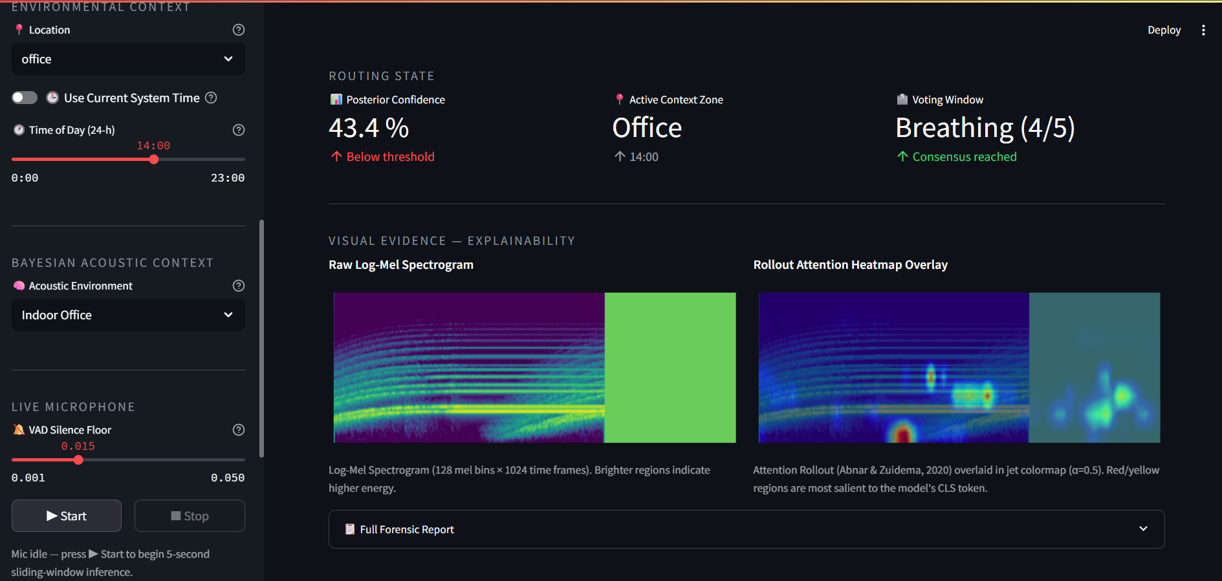
Department of Computer Engineering, VIT, Pune-37

Slide 19
REFRENCES :-
Vaswani, A. et al., “Attention Is All You Need”, NeurIPS, 2017.
Link: Attention Is All You Need Paper
Yuan Gong et al., “AST: Audio Spectrogram Transformer”, Interspeech, 2021.
Link: AST Research Paper
Daniel Bolya et al., “Token Merging: Your ViT But Faster”, ICLR, 2023.
Link: Token Merging Paper
Karol J. Piczak, “ESC-50: Environmental Sound Classification Dataset”, ACM Multimedia, 2015.
Link: ESC-50 Dataset
Samira Abnar et al., “Quantifying Attention Flow in Transformers”, ACL, 2020.
Link: Attention Rollout Paper
Mingxing Tan et al., “EfficientNet: Rethinking Model Scaling for CNNs”, ICML, 2019.
Link: EfficientNet Paper
PyTorch Official Documentation
Link: PyTorch Documentation
FastAPI Official Documentation
Link: FastAPI Documentation
Streamlit Official Documentation
Link: Streamlit Documentation
Department of Computer Engineering, VIT, Pune-37

Slide 20
Thank You!!!
Department of Computer Engineering, VIT, Pune-37

