Slide 1


Dev Mode
Portfolio Department My Work Goal Content Project Task Sub Task

Slide 2
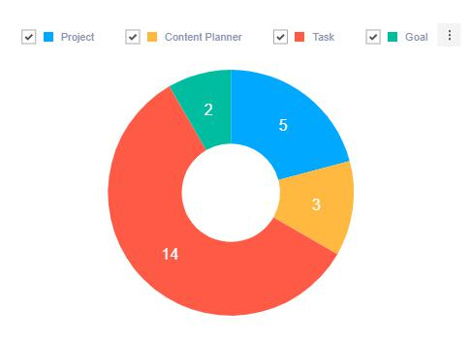
Portfolio

Slide 3
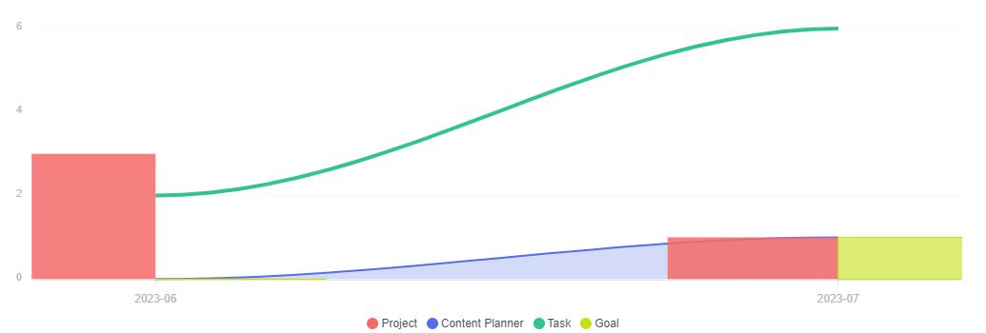
Department
Research & Development

Slide 4
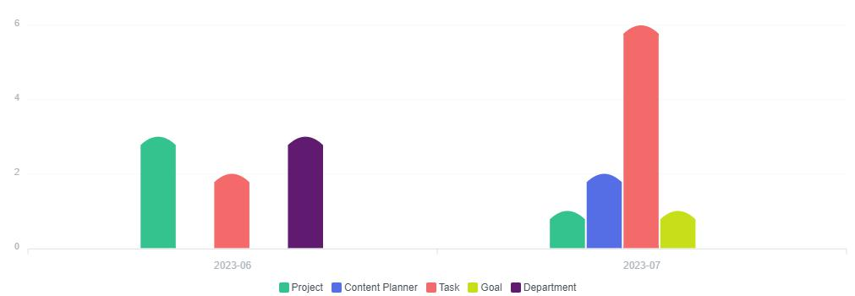
My Work

Slide 5
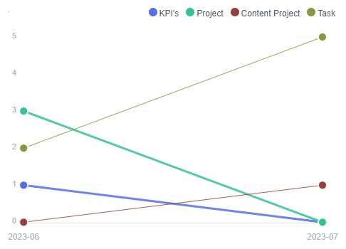
Goal
july goal

Slide 6
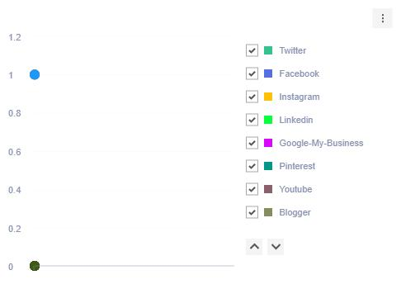
Content
july regular content

Slide 7
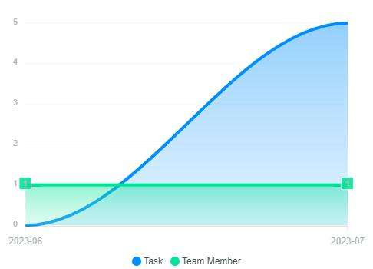
Project
jg k1 p1

Slide 8
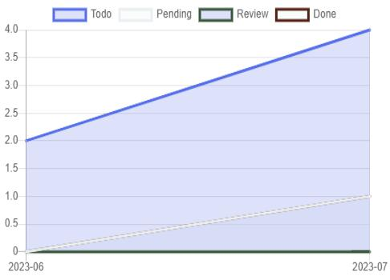
Task

Slide 9
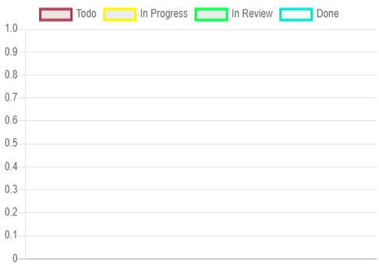
Sub Task

Slide 10
Thank you !

