Slide 1

INDUSTRIAL TRAINING-II PRESENTATION ON WALL OF FAME AND CUSTOMER REVIEW ANALYSIS
Presented By: Shaikh Eajajuddin (EN16CS301241)
Shubham Sharma (EN16CS301256)
Suryansh Singh Tomar (EN16CS301271)
Class: CS-E SEM: VIII Medi-Caps University, Indore
Internal guide: Prof. Ruchi Patel and Prof. Sachin Solanki
Company Name Or Internship Provider: IBM (ICE) Pvt. Ltd.
External guide: Mr. Nitesh Karmakar (ML developer at IBM (ICE))
Starting Date : 06 January, 2020 End Date : 06 May,2020

Slide 2
Technologies used in Projects:
FRONTEND : Programming Language: Libraries:
TKINTER (PYTHON) PYTHON DJANGO
HTML PYGAME
CSS NUMPY
JAVASCRIPT DATABASE : OPENCV
PYGAME MYSQL FACEPPLIB etc.
SQLITE

Slide 3
Introduction of Wall of Fame and Customer review analysis
Wall of Fame and Customer review analysis are two separate modules. Wall of Fame is based on Facial recognition and Customer review analysis is sentiment analysis of customer reviews using neural network (Deep learning).
These modules are not connected with each other but these are the parts of Options Technika.
We have worked on these two modules of Options Technika.
So, basically we will discuss three things in our presentation:
Wall of Fame
Options Technika
Customer review analysis

Slide 4
Shubham Sharma (EN16CS301256)

Slide 5
What is Wall of Fame?
“Wall of Fame” is an online platform in which a person can get details of employee of the company by capturing image of that employee. This system only gives information of those people who works in the company or organization otherwise it shows an error message.
This system stores images and information of employee. User captures image of an employee using camera and then he get the details of that employee or an error message. This system compares captured image with stored image in database and then bring results.

Slide 6
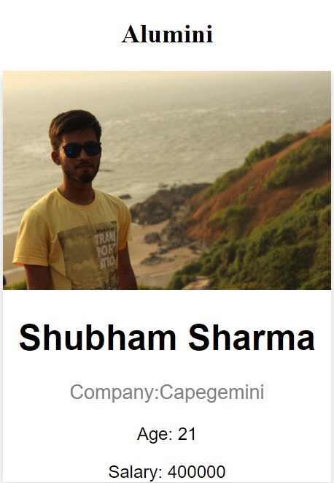
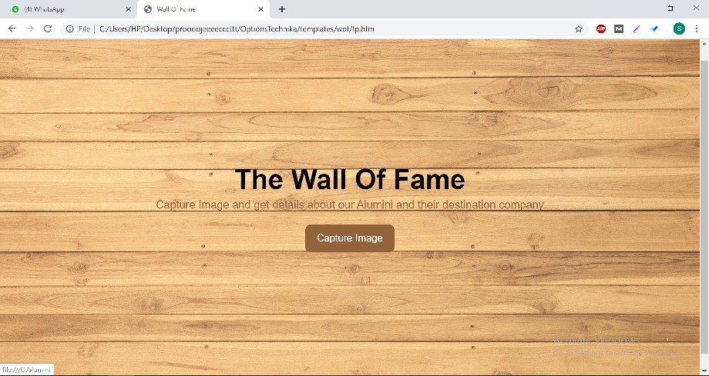
Screenshots of Wall of Fame:
Fig. 1 Front page of Wall of Fame
Fig. 2 Profile Page

Slide 7
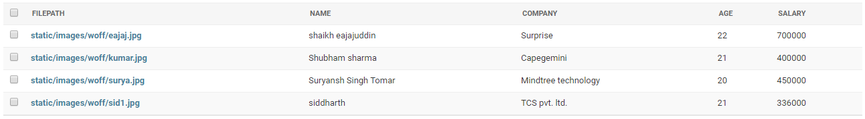
Database of Wall of Fame:
Fig. 3 Database table of Wall of Fame

Slide 8
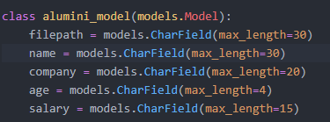

Database creation in Django:
Fig. 5 Code in admin.py
Fig. 4 Code in model.py

Slide 9
What is Options Technika?
Options Technika is a combined platform of MAAC (Maya Academy of Advanced Cinematic), Aptech Solutions, Aptech Aviation and etc. Basically Options Technika provides software solutions, education and other services in India. Through Wall of Fame, Options Technika can track their employees. Through Customer review analysis, Options Technika can improve their services.

Slide 10
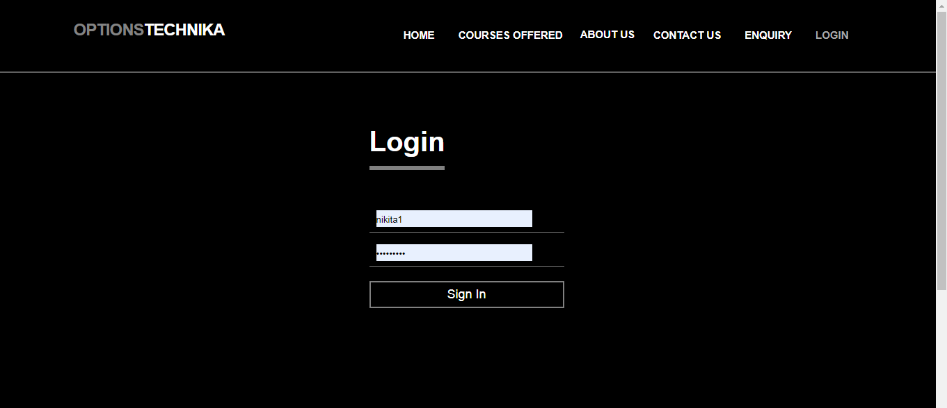
Snapshots of Teacher dashboard:
Fig. 6 Login page

Slide 11
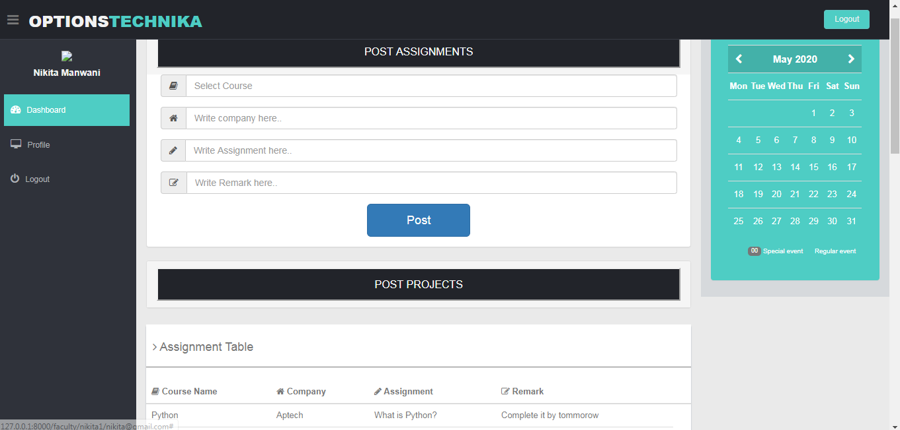
Snapshots of Teacher dashboard:
Fig. 7 Teacher dashboard

Slide 12
Suryansh Singh Tomar (EN16CS301271)

Slide 13
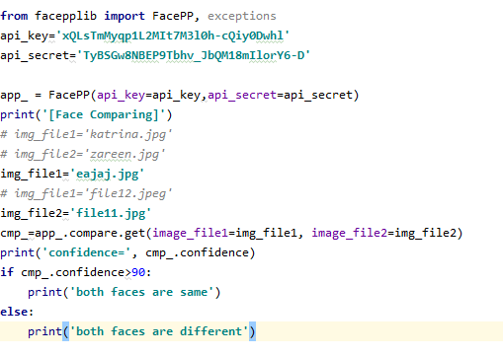
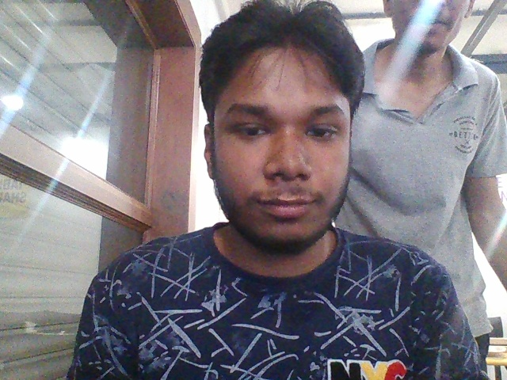
Face comparison module:
Fig. 9 eajaj.jpg
Fig. 8 Facepp code for Face comparison

Slide 14

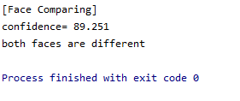
Result of Face comparison:
Fig. 11 Result
Fig. 10 file11.jpg

Slide 15

Screenshots of Options Technika:
Fig. 12 Front page of Options Technika

Slide 16

Screenshots of Options Technika:
Fig. 13 Collaborations of groups in Options Technika

Slide 17
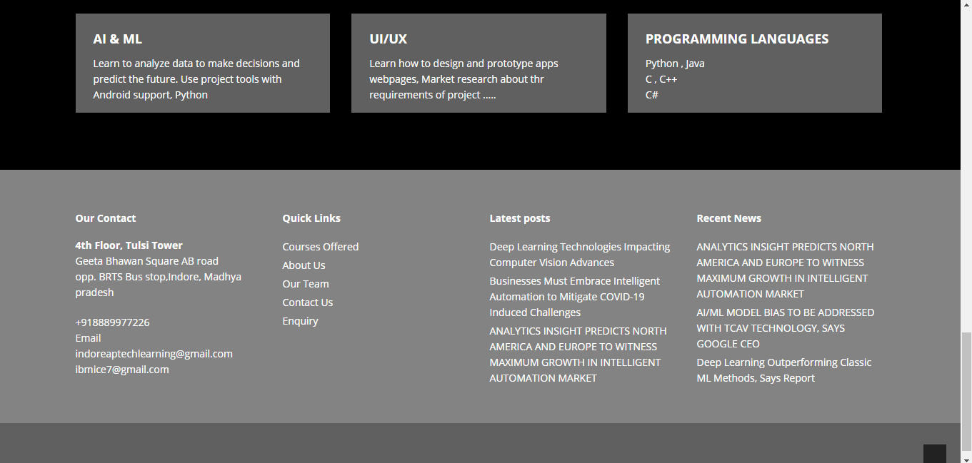
Screenshots of Options Technika:
Fig. 14 Footer of Options Technika Website

Slide 18
Shaikh Eajajuddin(EN16CS301241)

Slide 19
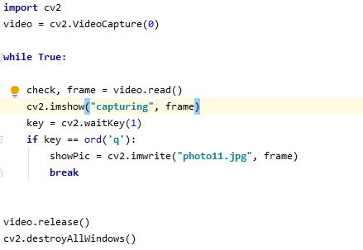
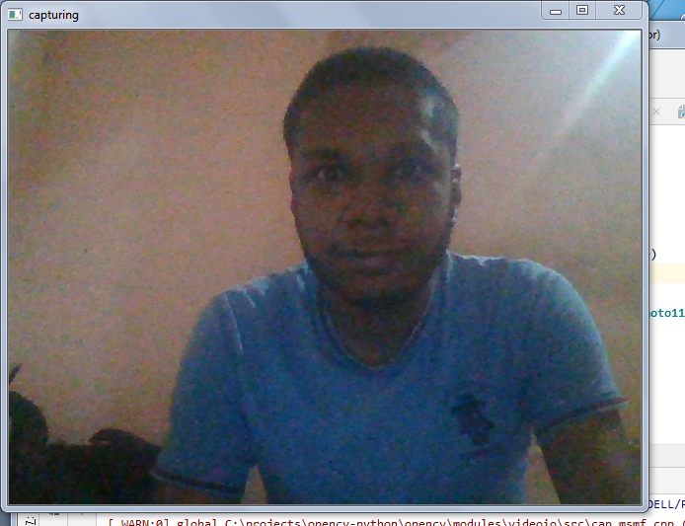
Camera module:
Fig. 16 Camera interface
Fig. 15 Opencv code to open camera and capture image

Slide 20
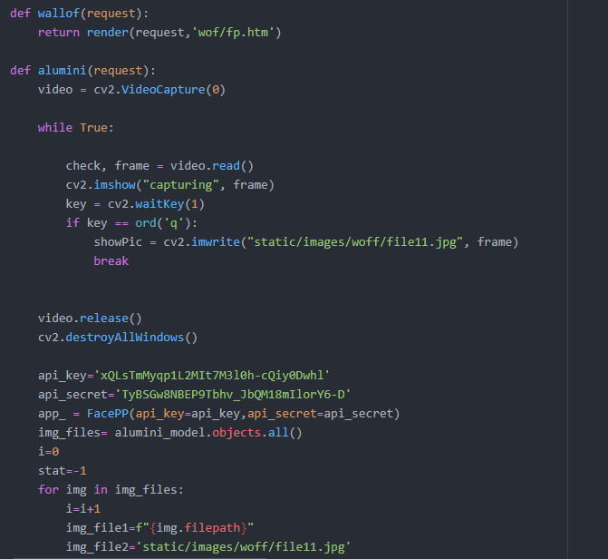
Integrated code of Camera module, Face comparison module and database
Fig. 17 Integration of all modules

Slide 21
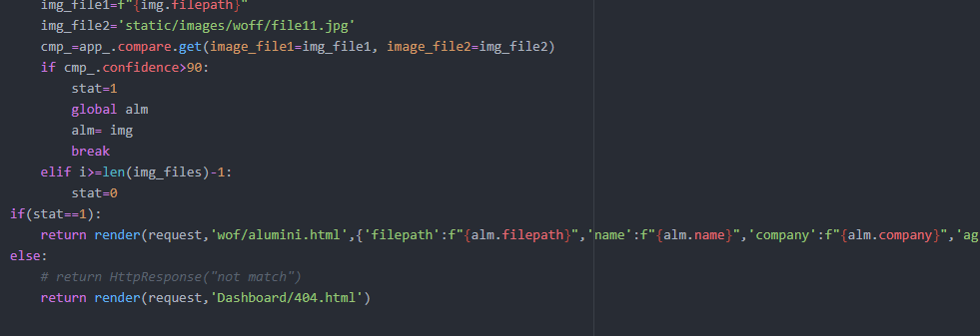
Integrated code of Camera module, Face comparison module and database
Fig. 18 Integration of all modules

Slide 22
Customer review analysis:
Customer review analysis is based on the sentimental analysis of customer reviews. Through customer review analysis companies get knowledge about what do customers think about their products and services and then companies can improve their services and products.
This sentiment analysis is based on simple artificial neural network hence by storing results of neural network we can automate the customer review analysis.
I have made this project using Numpy array only. I didn’t used any framework like Tensorflow, keras etc.

Slide 23
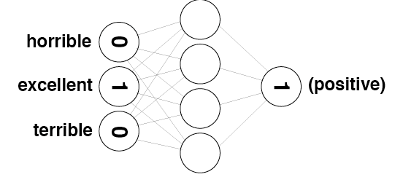
Neural network for Customer review analysis:
Fig. 19 Neural network for Sentiment analysis

Slide 24


Description of Neural network:
The Neural network contains 3 layers:
One input layer : contains 74074 nodes
One hidden layer : contains 10 nodes
One output layer : contain 1 node to decide review is positive or negative
Learning rate : 0.1
Total number of reviews on which we are working is 25000 reviews which in-turn contains 74074 unique words. That’s why size of input layer contains 74074 nodes.
Fig. 22 Number of reviews
Fig. 23 Number of unique words or vocab size

Slide 25


Customer reviews:
Fig. 20 Customer review
Fig. 21 Label of review

Slide 26
Neural network for Customer review analysis:
Fig. 24 Neural network for Sentiment analysis

Slide 27
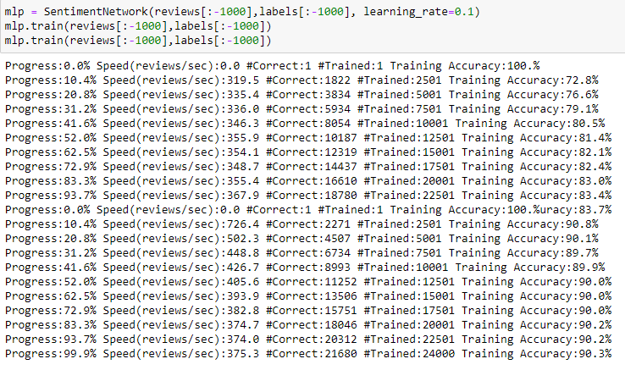
Training, Testing and reviews:
Fig. 25 Accuracy during training after first iteration is 83.7% and second iteration is 90.3%

Slide 28
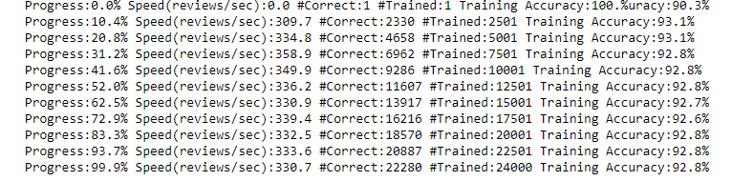
Training, Testing and reviews:
Fig. 26 Accuracy during training after third iteration is 92.8%

Slide 29

Training, Testing and reviews:
Fig. 27 Validation accuracy after first iteration of training
Fig. 28 Validation accuracy after second iteration of training
Fig. 29 Validation accuracy after third iteration of training

Slide 30
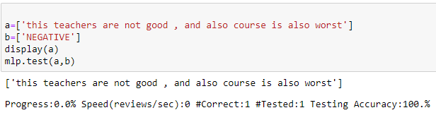
Training, Testing and reviews:
Fig. 30 Result

Slide 31
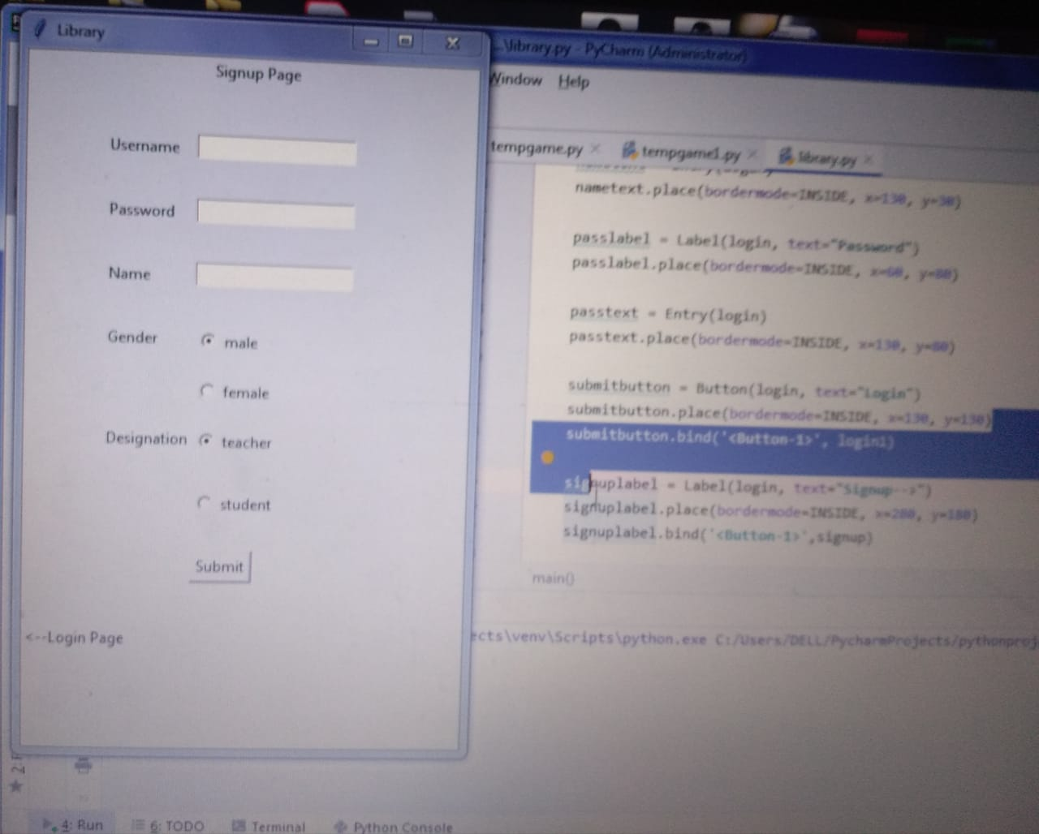
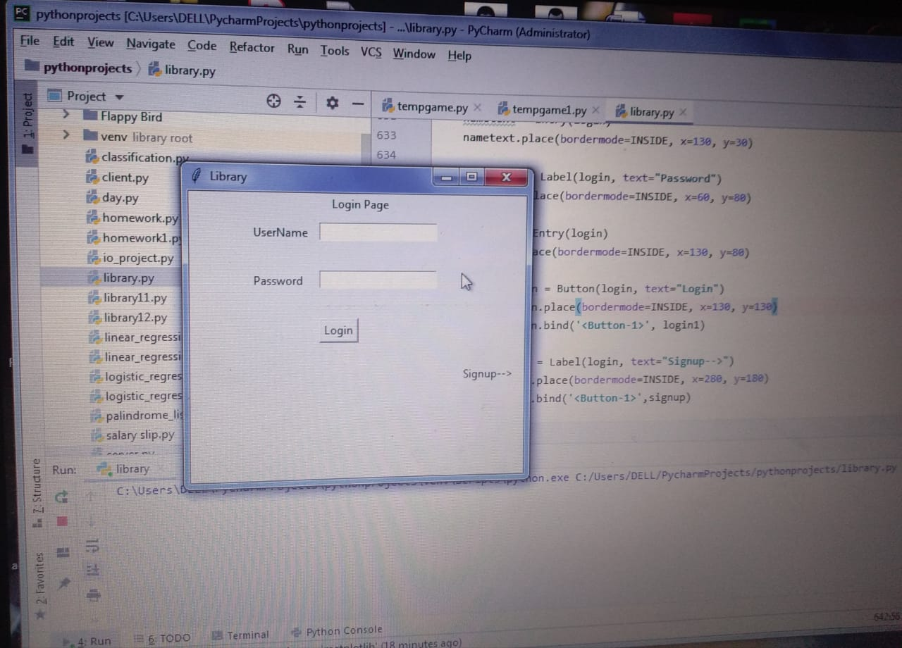
Screen-Shots of other projects
Library Management using Tkinter
Login Window
Sign-up Window

Slide 32
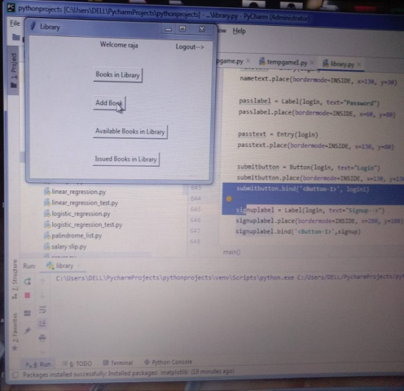
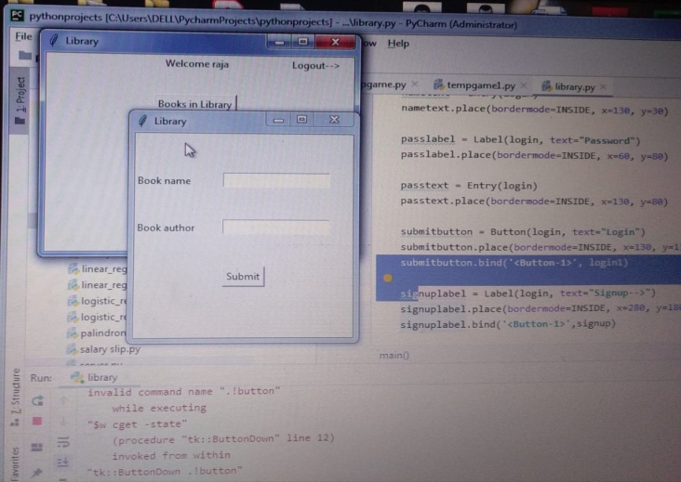
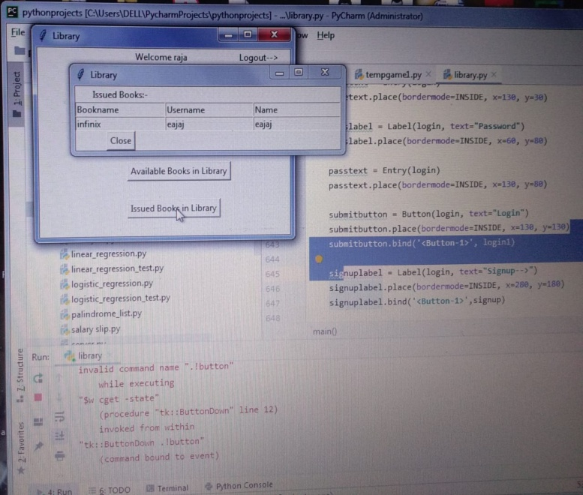
Menu Window
Add Book Window
Issued Book List

Slide 33
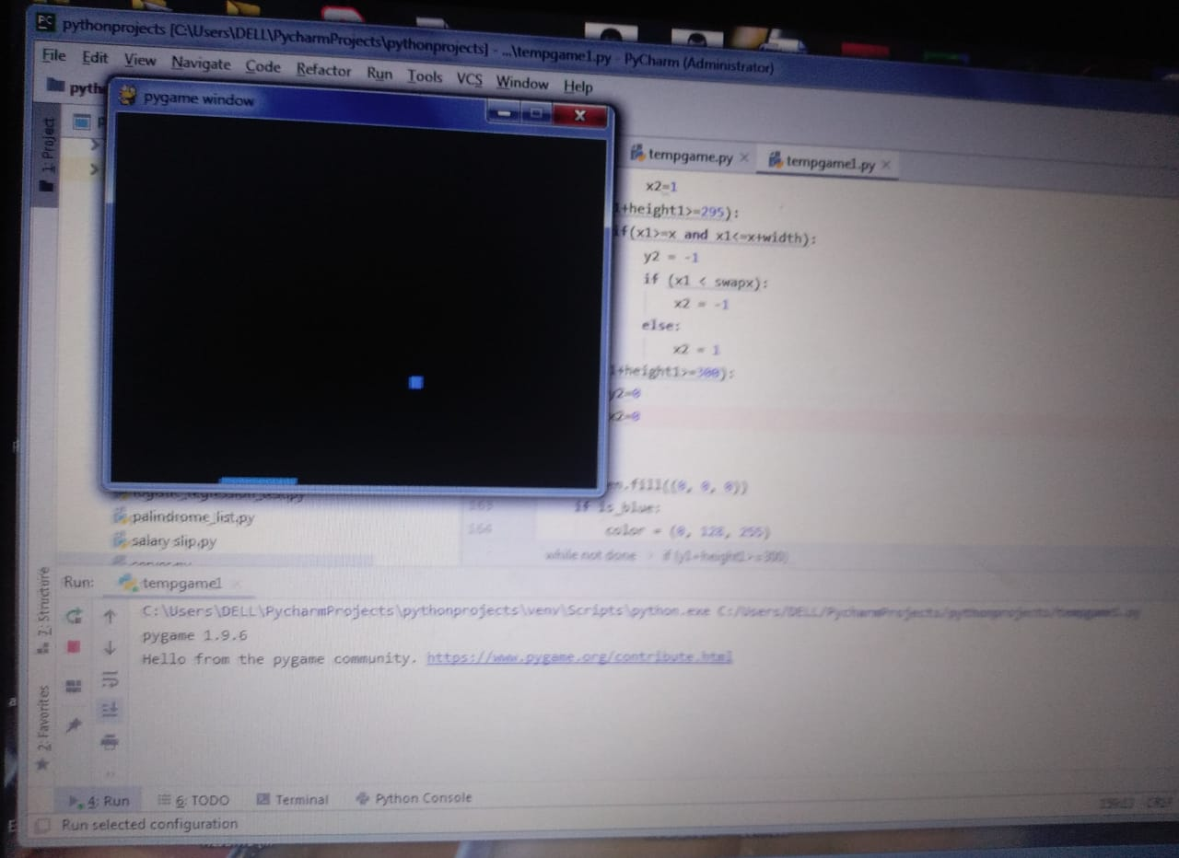
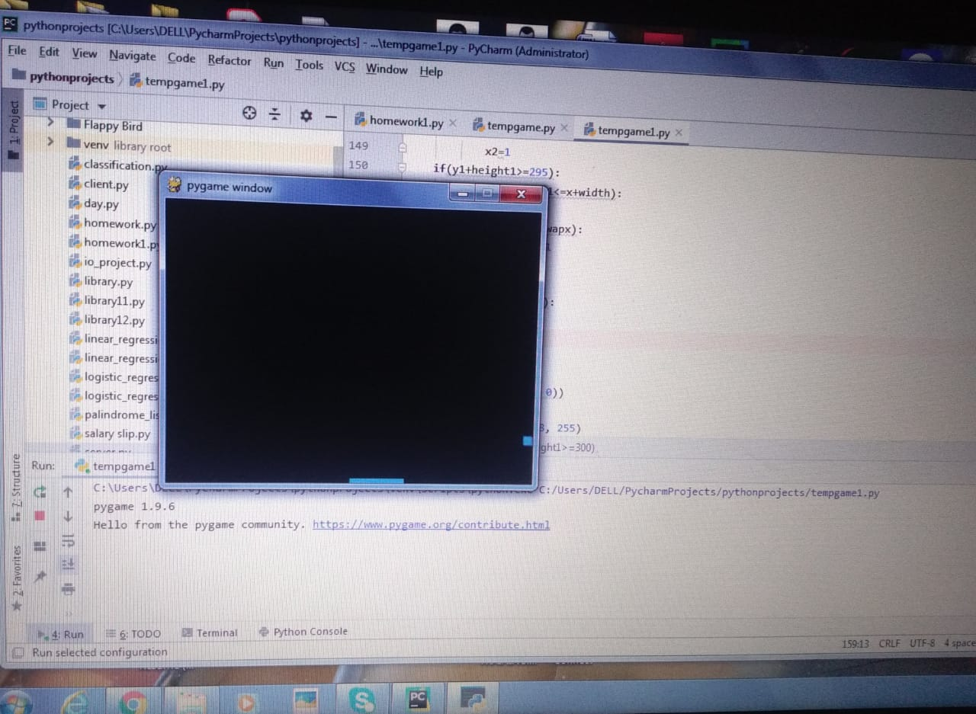
Python Game (Ball and Slider) using Pygame

Slide 34
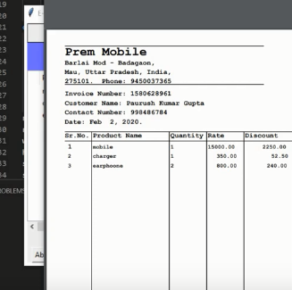
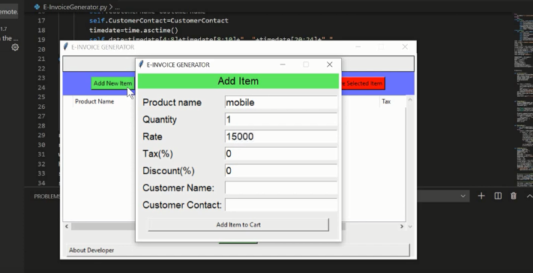
Invoice or Bill (PDF) generation using Python
Enter details Window
Bill or pdf generated

Slide 35
Description of our roles in the project:
Wall of Fame:
Integration of Camera module, Face comparison module, database to create whole system, Testing of Face comparison module is done by Shaikh Eajajuddin (EN16CS301241)
Frontend development, Admin dashboard and database management is done by Shubham sharma (EN16CS301256)
Work on Camera module is done by Suryansh Singh Tomar (EN16CS301271)
Options Technika:
Frontend development, Teacher and Counsellor dashboard development is done by Shubham sharma (EN16CS301256)
Real time data insertion, Frontend development is done by Suryansh Singh Tomar (EN16CS301271)
Customer review Analysis:
All the work is done by Shaikh Eajajuddin (EN16CS301241)

Slide 36
Thank you

