Slide 1
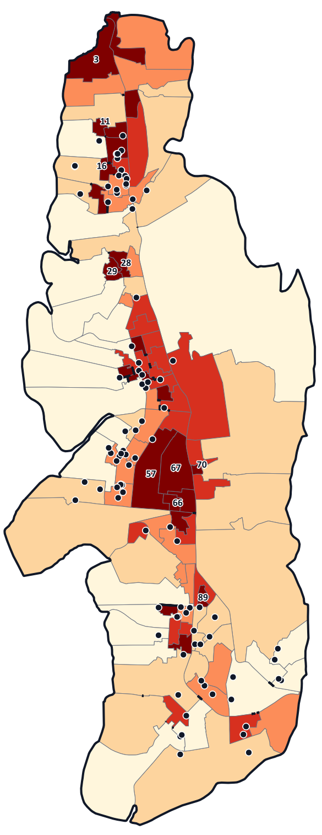
GIS · CA 3 PRESENTATION
Urban Climate Stress Mapping of Navi Mumbai
Heat, green cover and flood risk, ward by ward
Using Google Earth Engine and QGIS
Heat
Green cover
Flood
Hasnat Shaikh
Roll No. 2405003
Combined stress by ward
(QGIS map, April 2026)
MGM University · B.Tech IT, Semester 5 · Faculty: Vijaya Ahire · 30 September 2026
Notes:
[~15 sec]
SAY: "Good morning ma'am. I am Hasnat Shaikh. My project is Urban Climate Stress Mapping of Navi Mumbai, using Google Earth Engine and QGIS. It looks at heat, green cover and flood risk for each ward of the city."

Slide 2



1 · PROBLEM STATEMENT
Problem statement
Heat
Green cover
Flood
13.9 °C
26%
155.7 mm
gap between the hottest and the coolest ward average (33.7 to 47.6 °C) in April 2026. Source: Landsat 8/9.
of the study area is tree cover, while 33% is built-up. Source: ESA WorldCover 2021.
of rain fell in Nerul on 26 May 2025 (Belapur: 133.9 mm). Roads and the APMC market flooded. Source: Free Press Journal.
Problem: heat, low green cover and flooding do not affect every ward equally. This project combines them into one score for each of the 111 wards, so we can see where the stresses overlap.
Sources: Landsat 8/9 (our processing), ESA WorldCover 2021, Free Press Journal (26 May 2025, rainfall 8:30 am to 4:30 pm).
Urban Climate Stress Mapping of Navi Mumbai · Hasnat Shaikh
2 / 7
Notes:
[~45 sec]
SAY: "The problem is that heat, green cover and flooding are not the same in every ward. In April 2026, satellite data show ward average temperatures from 33.7 to 47.6 degrees — a gap of almost 14 degrees inside one city. Only 26 percent of the area is tree cover, and 33 percent is built-up. And on 26 May 2025, Nerul got 155.7 millimetres of rain, and Belapur 133.9, and roads and the APMC market flooded."
SAY: "So this project combines heat, green cover and flood risk into one score for each of the 111 wards, to show where the stresses overlap."

Slide 3
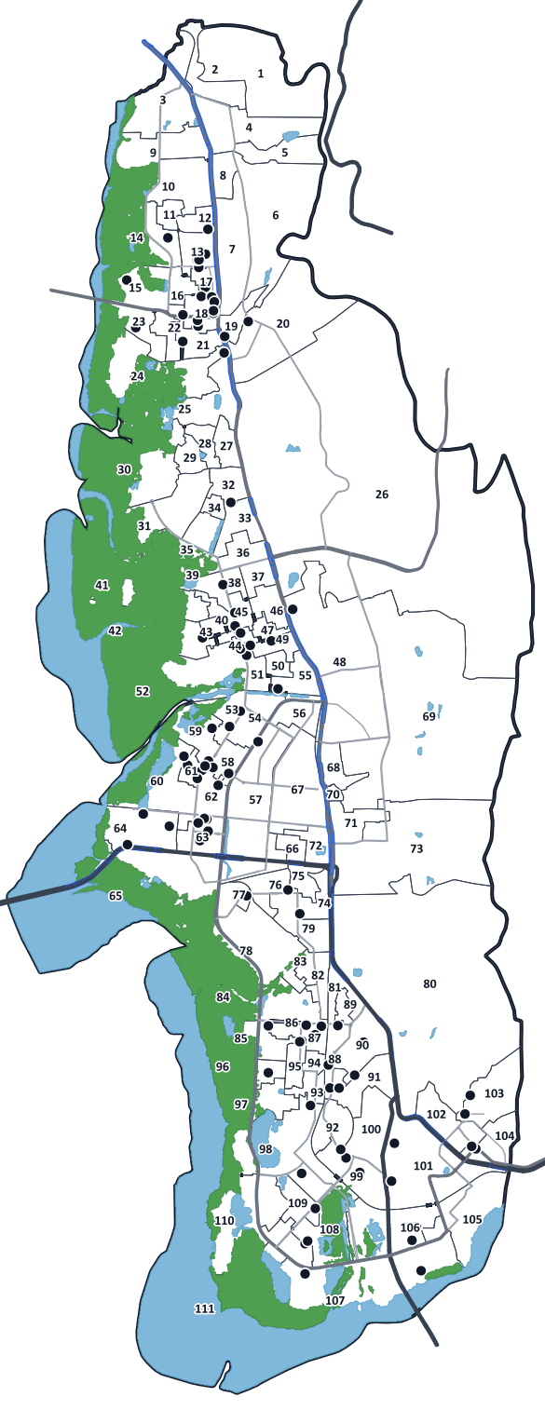
2 · AIM AND OBJECTIVES
Aim, objectives and study area
AIM
To measure heat, green cover and flood susceptibility for the 111 wards of Navi Mumbai and combine them into one Urban Climate Stress Index (UCSI).
Study area
Navi Mumbai, Maharashtra
111 wards (8 ward offices)
122.9 km² (sum of ward polygons)
Boundaries: OpenCity / BharatLAS
1
Prepare the ward boundaries and a GeoPackage database
2
Get heat, green cover and built-up data from satellites
3
Score flood susceptibility and combine all three (UCSI)
4
Run 10 queries and make the final maps
Ward count: 111 electoral wards (Wikipedia, NMMC). Area: sum of the ward polygons in our GeoPackage; other sources give different areas.
Urban Climate Stress Mapping of Navi Mumbai · Hasnat Shaikh
3 / 7
Notes:
[~35 sec]
SAY: "The aim is to measure heat, green cover and flood susceptibility for the 111 wards of Navi Mumbai and combine them into one index, the Urban Climate Stress Index, or UCSI."
SAY: "The objectives are: prepare the ward boundaries and a GeoPackage database; get heat, green cover and built-up data from satellites; score flood susceptibility and combine all three; and run ten queries and make the final maps. The study area is Navi Mumbai — 111 wards, about 123 square kilometres."
NOTE if asked about the 8 ward offices: the ward polygons carry ward numbers only, and I could not get a reliable ward-to-office list, so results are reported by ward. It can be added later as one text field.

Slide 4
3 · DATA AND METHOD
Data and methodology
Indicator | Data (all free) | Detail
Heat (LST) | Landsat 8/9 thermal band | 30 m
Green cover (NDVI) | Sentinel-2 | 10 m
Built-up land | ESA WorldCover 2021 | 10 m
Flood factors | SRTM elevation, water (WorldCover) | 30 m
Ward boundaries | OpenCity / BharatLAS (111 wards) | vector
Method
1
Collect free satellite data for April 2026
2
Calculate the mean of each indicator per ward
3
Score each indicator from 1 to 5 (QGIS)
4
Combine the scores: one UCSI per ward
UCSI = (Heat + Green-cover deficit + Flood) ÷ 3
Each part is scored from 1 (low stress) to 5 (high stress).
Flood score = elevation 43% + distance to water 27% + slope 16% + built-up 14% (AHP, consistency ratio 0.017).
5
Query, map and check the result (QGIS)
Rainfall is not used as a factor: 5-km rainfall data gives only about 4 pixels over the whole city. Five Google Earth Engine scripts for the same steps are in the project folder (gee/); they are written but not yet run.
Urban Climate Stress Mapping of Navi Mumbai · Hasnat Shaikh
4 / 7
Notes:
[~60 sec]
SAY: "All the data is free. Heat comes from Landsat 8 and 9 thermal bands, green cover from Sentinel-2, built-up land from ESA WorldCover, and flood factors from SRTM elevation and water bodies."
SAY: "I collected the data for April 2026, calculated the mean of each indicator for every ward, and then QGIS scores each indicator from one to five. The Urban Climate Stress Index is the average of heat, green-cover deficit and flood score. The flood score itself is a weighted sum: elevation 43 percent, distance to water 27, slope 16, built-up 14. The consistency ratio is 0.017, well under 0.1."
IF ASKED ABOUT GOOGLE EARTH ENGINE: the project folder has five Earth Engine scripts for the same steps. They are written from the official dataset pages but I have not run them yet; the delivered rasters came from the same public datasets processed with Python. Running them and comparing the numbers is the next step.
IF ASKED WHY NO RAINFALL: rainfall data has 5-km pixels, so only about four cover the city; it cannot separate wards.

Slide 5
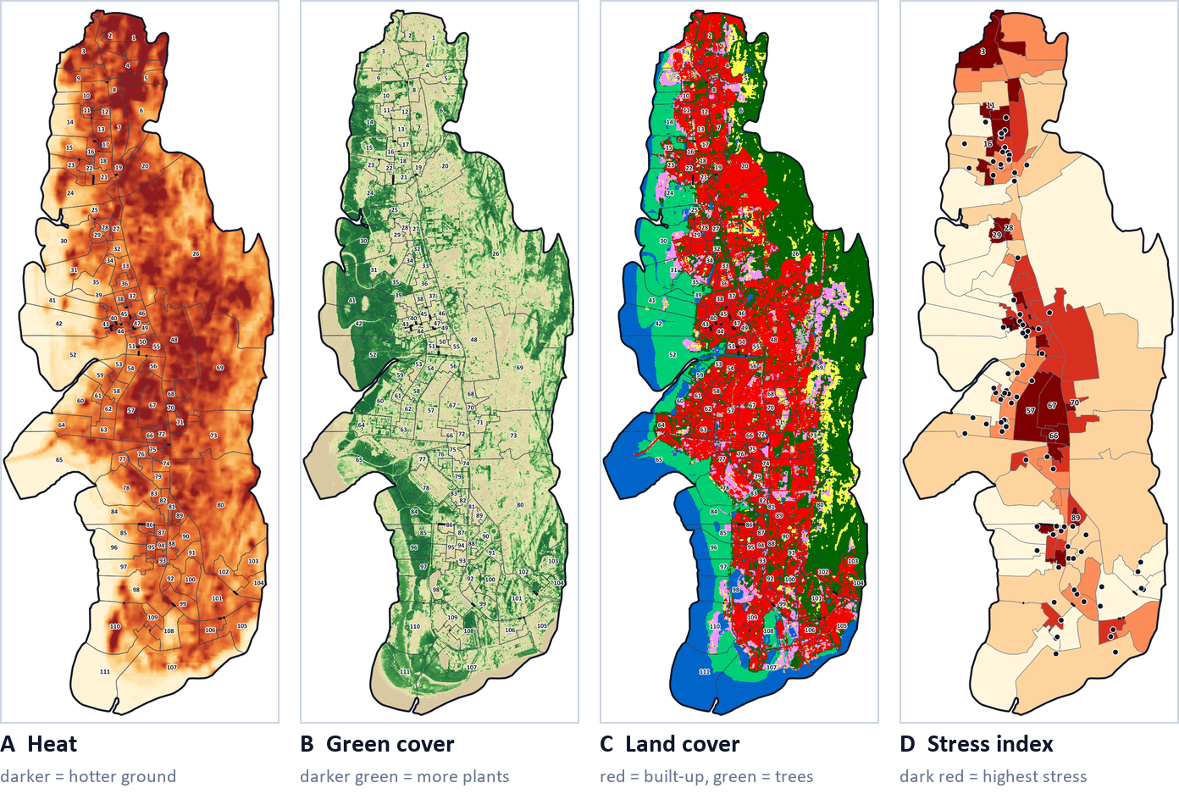
4 · RESULTS
Results: four maps from the QGIS project
13.9 °C
gap between the hottest and coolest ward (47.6 and 33.7 °C)
+0.76 / −0.75
correlation of temperature with built-up land / with vegetation (111 wards)
23 wards
in the highest stress class, but only 8.1 km² (6.6% of the city)
Data: Landsat 8/9 (13, 22, 30 Apr 2026, median), Sentinel-2 (8, 11 Apr), ESA WorldCover 2021, SRTM. Maps exported from QGIS. Ward level, one season (April 2026).
Urban Climate Stress Mapping of Navi Mumbai · Hasnat Shaikh
5 / 7
Notes:
[~55 sec]
SAY: "These maps come from my QGIS project. Map A is surface heat in April 2026, from three Landsat dates. Map B is vegetation, from Sentinel-2. Map C is land cover. Map D is the stress index for each ward; darker red means higher stress."
SAY: "Three numbers stand out. Ward temperatures differ by almost 14 degrees. The more built-up land in a ward, the hotter it is — correlation plus 0.76 — and the more vegetation, the cooler — minus 0.75. And the 23 wards with the highest stress cover only 8 square kilometres, about 7 percent of the city."
HONEST LIMITS: one season, ward level. Dry hill slopes also look hot in April. A second season is the next step.

Slide 6

5 · DATABASE AND QUERIES
Database design and queries
GeoPackage database
5 attribute queries (search by data)
Built-up 80% or more
30 wards
Wards (111)
Vegetation (NDVI) below 0.2
24 wards
polygon
Temperature 45 °C or more
23 wards
Water bodies (100)
polygon
Flood score 4.5 or more
22 wards
Major roads (729)
Built-up 80%+ and NDVI below 0.2
18 wards
line
5 spatial queries (search by location)
Hospitals (93)
point
Wards touching water or mangrove (1 ha+)
48 wards
Flood reports (3)
point
Wards within 200 m of a major road
78 wards
Hospitals in the highest-stress wards
8 of 93
LST by date (333 rows)
table
Nearest hospital to those wards (mean)
693 m
Also: city boundary, hot and low-green zones, 9 rasters, 2 relations (key Ward_ID). Field types: Integer, Text, Decimal, Date.
Ward with the waterlogged APMC site
ward 57
Answers come from the QGIS project (April 2026 data). Thresholds were chosen after looking at the data. Hospitals and roads: OpenStreetMap (may be incomplete).
Urban Climate Stress Mapping of Navi Mumbai · Hasnat Shaikh
6 / 7
Notes:
[~50 sec]
SAY: "Everything is stored in one GeoPackage: the 111 wards, water bodies, major roads, hospitals, three flood reports, a table of ward temperature by date, and the rasters. Two relations link the tables through the ward number."
SAY: "I ran five attribute queries and five spatial queries in QGIS. For example, 30 wards are 80 percent or more built-up, 24 have vegetation below 0.2, and 23 average 45 degrees or more. Spatially, 78 wards are within 200 metres of a major road, and only 8 of the 93 mapped hospitals are inside the 23 highest-stress wards. The APMC market that was waterlogged in May 2025 is in ward 57, which also ranks second in the index."
EXTRA: a raster overlay shows 18.9 square kilometres — about 15 percent of the city — is both 45 degrees or hotter and low in vegetation. Wards 57 and 66 are in the top quarter for heat, green-cover deficit and flood at the same time.
JARGON: attribute query = search the table; spatial query = search by location.

Slide 7


6 · OUTPUT, NEXT STEPS AND CONCLUSION
What is built, what is next, conclusion
Delivered
Next steps
Conclusion
QGIS project (.qgz)
Run the 5 Google Earth Engine scripts and compare values
Stress is concentrated in a few dense wards: 23 wards cover only 8.1 km² but are the hottest, most built-up and least green. Wards 70, 57, 67, 11 and 29 rank highest.
UCSI is a planning aid that compares wards. It is not a prediction of floods or heat waves.
GeoPackage database (.gpkg)
Add a monsoon-season image
9 rasters, 10 thematic maps
Add NMMC's ward-office list
Final UCSI map with legend, north arrow, scale bar
Compare with more flood reports
11 query result pages (5 + 5 + overlay)
Thank you. Suggestions are welcome.
Practical report (Word and PDF)
Urban Climate Stress Mapping of Navi Mumbai · Hasnat Shaikh
7 / 7
Notes:
[~40 sec]
SAY: "The project is built: a QGIS project, a GeoPackage, nine rasters, ten thematic maps, the final stress map, eleven query result pages and a practical report. Next I want to run the Google Earth Engine scripts and compare the numbers, add a monsoon-season image, and add the official ward-office list."
SAY: "In conclusion, stress is concentrated in a few dense wards. Twenty-three wards cover only about eight square kilometres but are the hottest, the most built-up and the least green. The index is a planning aid that compares wards; it is not a prediction. Thank you — suggestions are welcome."
Then stop and let mam speak first.

Slide 8
BACKUP · FOR QUESTIONS
Where our numbers come from
Number | Source
111 wards; 122.9 km² (sum of ward polygons) | Ward polygons from OpenCity / BharatLAS in our GeoPackage; 111 wards also per Wikipedia (NMMC)
Ward temperature 33.7 to 47.6 °C; 23% of the area ≥ 45 °C | Landsat 8/9 Collection 2 Level 2 (13, 22, 30 Apr 2026), median, Planetary Computer
Vegetation index (NDVI) | Sentinel-2 L2A (8 and 11 Apr 2026), Earth Search on AWS
Built-up 33.1%, trees 26.4%, mangrove 13.8%, water 13.3% | ESA WorldCover 2021 (10 m), inside the ward polygons
r = +0.76 (built-up) and −0.75 (NDVI) with temperature | Our calculation, 111 wards
26 May 2025: Nerul 155.7 mm, Belapur 133.9 mm (8:30 am to 4:30 pm) | Free Press Journal, 26 May 2025 (news report)
Flood weights 43 / 27 / 16 / 14; consistency ratio 0.017 | AHP calculated by us (elevation, water distance, slope, built-up)
Urban Climate Stress Mapping of Navi Mumbai · Hasnat Shaikh
Backup 1
Notes:
BACKUP: read the source column if asked where a number came from.

Slide 9
BACKUP · FOR QUESTIONS
Scores, weights and checks
How each indicator becomes a score
Flood factor | Weight | Score rule
Elevation | 43% | up to 5 m = 5 … over 50 m = 1
Distance to water | 27% | up to 250 m = 5 … over 2 km = 1
Slope | 16% | up to 2% = 5 … over 20% = 1
Built-up | 14% | 60%+ = 5 … under 10% = 1
Heat: the ward temperature is stretched to 1 (coolest ward) to 5 (hottest ward).
Green-cover deficit: the same for NDVI, turned upside down (least vegetation = 5).
Flood: elevation, slope, distance to water and built-up are scored 1 to 5, then combined with AHP weights.
UCSI = (Heat + Green-cover deficit + Flood) ÷ 3.
Does the ranking change if the weights change?
Heat-heavy weights (50/25/25): rank correlation 0.983, 7 of the top 10 wards stay.
Flood-heavy weights (25/25/50): rank correlation 0.95, 8 of the top 10 wards stay.
Urban Climate Stress Mapping of Navi Mumbai · Hasnat Shaikh
Backup 2
Notes:
BACKUP: how scores work and the sensitivity check. Rank correlation near 1 means the ward ranking hardly changes when the weights change.

Slide 10
BACKUP · FOR QUESTIONS
Limits and Plan B
Limit | How we handle it
Google Earth Engine scripts are written but not run yet | The delivered rasters use the same public datasets, processed with Python. Next step: run the scripts and compare (about 41 °C mean LST, NDVI 0.30).
One season only (April 2026) | Dry hill slopes also look hot. Next step: add a monsoon-season image and compare.
Thermal bands are 100 m (resampled to 30 m) | Ward averages are fine; very small wards (ward 70: 0.07 km²) are less reliable.
Surface temperature is not air temperature | We compare wards with each other; we do not claim air temperature.
8 ward offices are not in the data | Ward polygons carry only ward numbers. Add NMMC's ward-to-office list, then report by office.
Flood factors use SRTM (includes buildings and trees) and no tide or drainage data | It is a susceptibility index, not a flood forecast.
Hospitals and roads come from OpenStreetMap | Volunteer data, may be incomplete. Distances are straight lines.
Urban Climate Stress Mapping of Navi Mumbai · Hasnat Shaikh
Backup 3
Notes:
BACKUP: every limit has a plan. Be upfront about them.

