Slide 1
BANGABANDHU SHEIKH MUJIBUR RAHMAN SCIENCE AND TECHNOLOGY UNIVERSITY, GOPALGANJ-8100
Course No: CSE-321
A PROJECT ON Digital lab
management system
Course Title: Database Management Systems lab
Submitted By Supervised By
Name: s.m. shaikh sadi Md. Jamal Uddin
Student ID: 20121201030 Lecturer
Session: 2012-13 Department of Computer Science
Department of Computer Science and Engineering
and Engineering
Date of submission: 03-05-2015

Slide 2
Introduction:
Digital lab management system is a project in the era of Database System Management.
Some basic operations of SQL are applied here…

Slide 3
The operations:
Show
Insert
Delete
Update
Search
Like
7. and

Slide 4
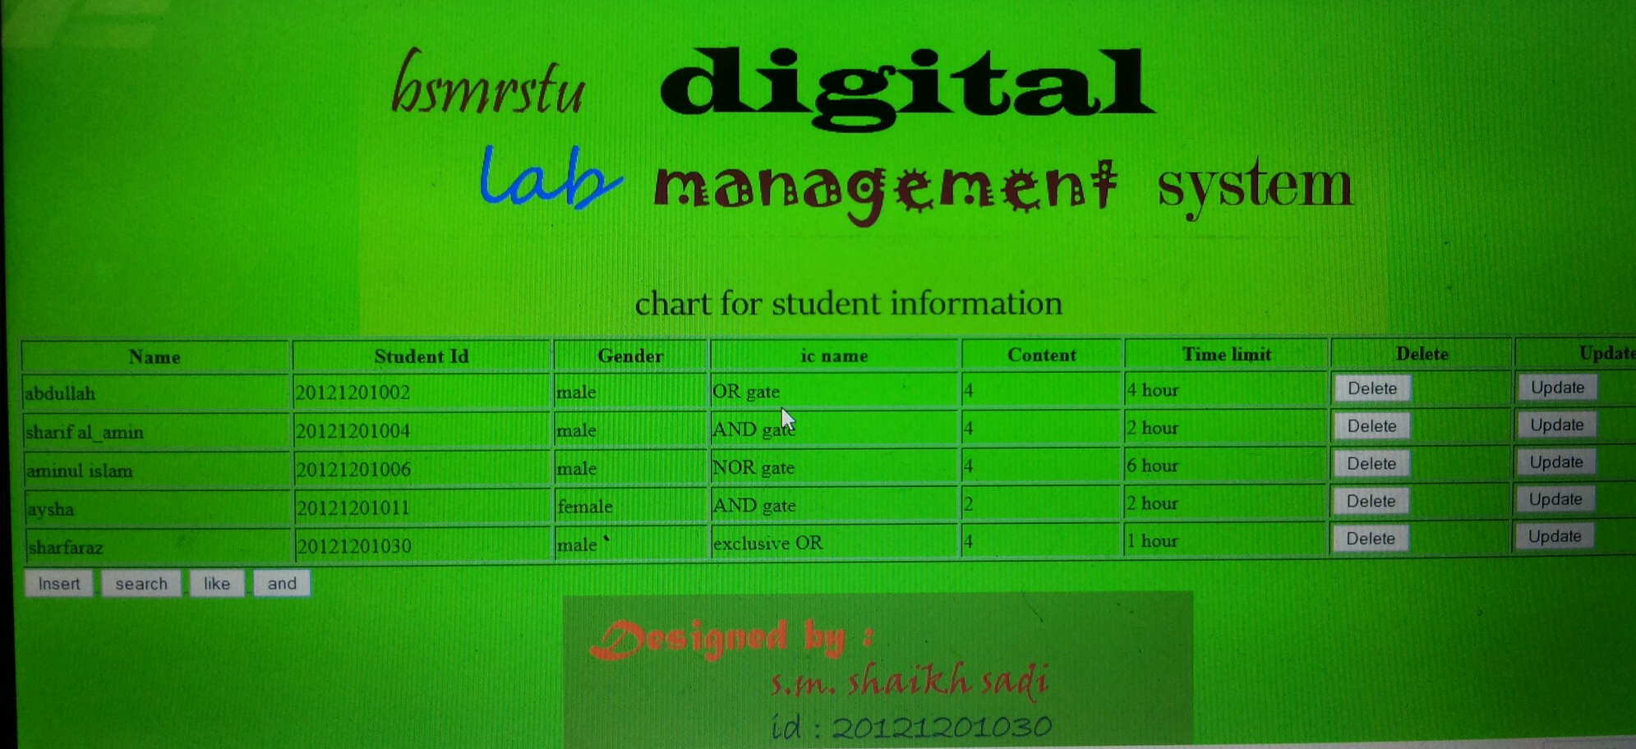
Show: It can show the inserted data (here, the information about movies) which is stored in the database.

Slide 5
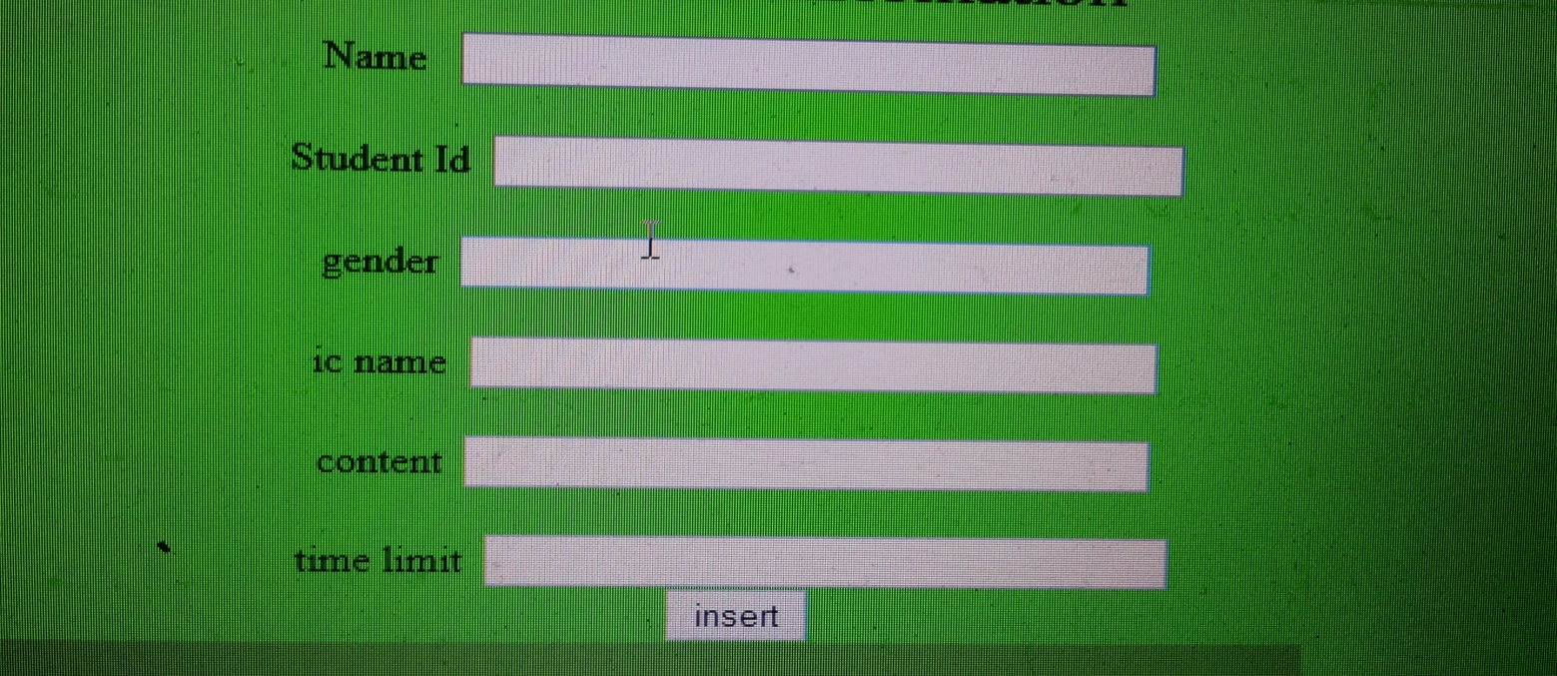
Insertion: From the insert menu, one can insert a data in the database according to the movie name, country of the origin, language, year of release and the duration of the movie.

Slide 6
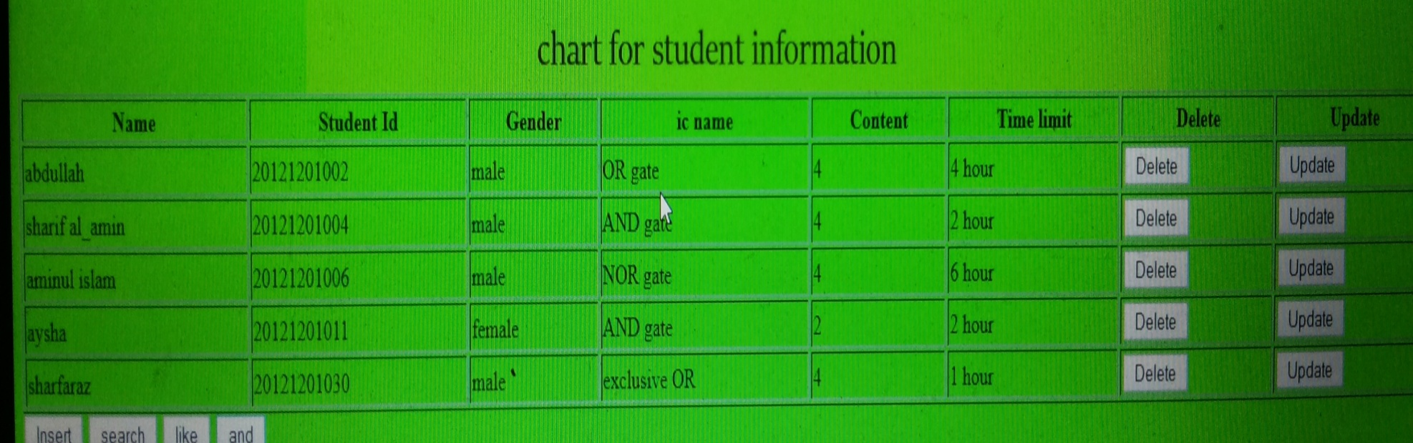
Deletion: From this menu, the user can delete any entry according to the movie name

Slide 7

Update: From this section, one can update the existing movie record bu any of its attribute, i.e. name, country, language etc.

Slide 8
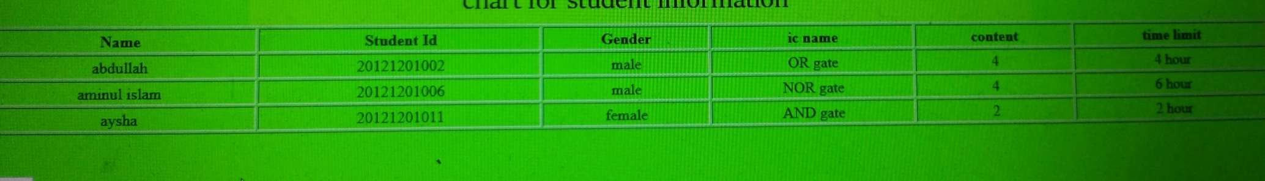
like: An user can sort the movie database by its name, or release year or by its length.

Slide 9
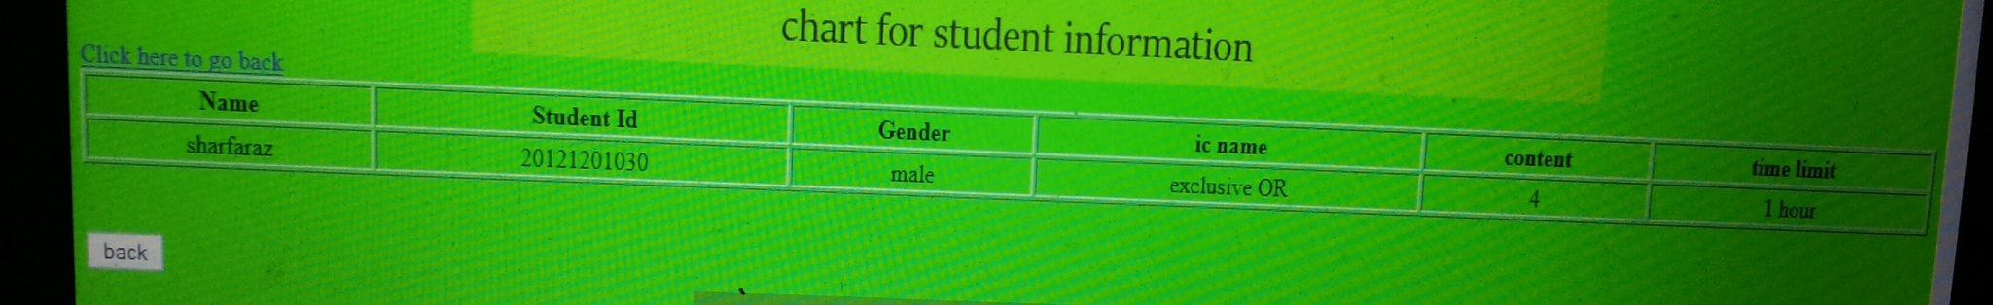
Searching:
One can search his desired movie by using this menu. This provides the information about the movie if it exists in the database.

Slide 10
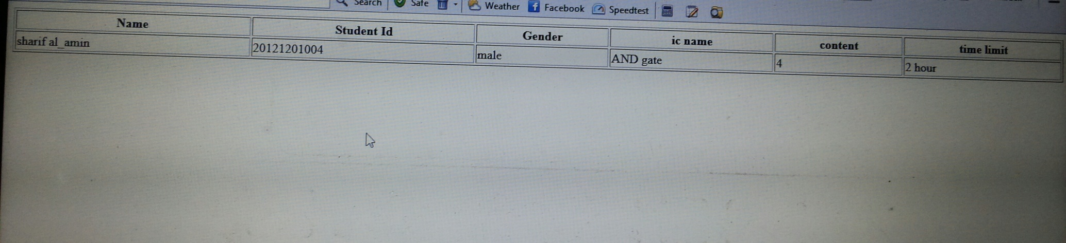
And: One can search his desired movie by using this menu. This provides

Slide 11
OR: One can search his desired movie by using this menu. This provides the information about the movie if it exists in the database.

Slide 12
thanks to all

