Slide 1
TalentMatch
Matches the right candidates with the right jobs.

Slide 2
TalentMatch - Applicant Tracking System (ATS)
Supervisor: Sir Rizwan Ali Abro
Group members:
Vishaka Pahuja
Mohammad Yaqoob

Slide 3
Project Scope
The Applicant Tracking System (ATS) simplifies hiring by allowing HR to post jobs and candidates to apply. It uses a fine-tuned BERT model to analyze resumes and match candidates based on skills, experience, and education.
If a candidate qualifies, they take an automated assessment. Those who pass move to the interview stage, while others receive a rejection message. HR can manage job posts, assessments, and interviews through the system.

Slide 4
System Overview
Core Components:
Frontend: React.js for user interaction
Backend: Node.js with Express and Flask for processing
AI Engine: Fine-tuned BERT model for resume analysis
Database: MongoDB for data storage
Workflow:
User registers and uploads a resume
AI analyzes skills, experience, and education
System matches the resume with job descriptions
Qualified candidates receive automated assessments
HR shortlists candidates based on scores and schedules interviews

Slide 5
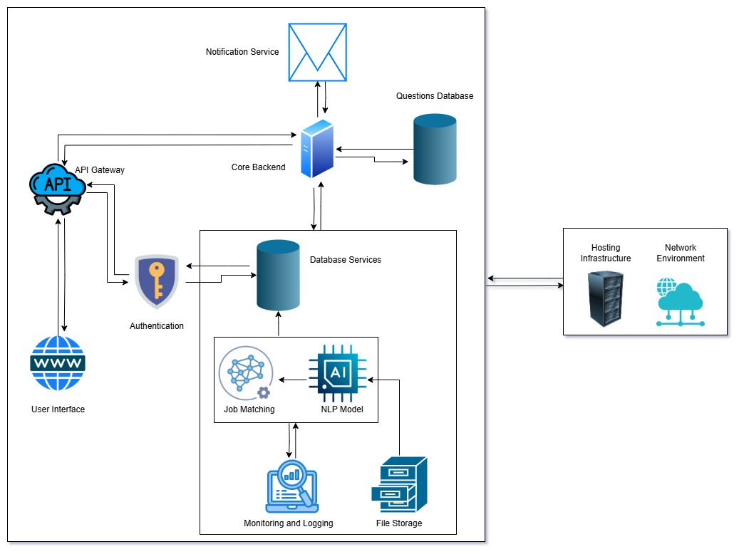
Architecture Design

Slide 6
Functional Requirements
User Management – Registration, Login, Profile Management
Job Management – Post Jobs, List Jobs, Search & Filtering
Application Handling – Upload Resume, AI-Based Ratings
Assessment & Interviews – Auto Test, Shortlisting, Scheduling
Alerts & Notifications – Job Updates, Alerts

Slide 7
Non-Functional Requirements
Performance Requirements
Process resumes and job descriptions in under 5 seconds.
Support up to 100 concurrent users.
Scalability Requirements
Handle increasing job postings and candidates efficiently.
Implement role-based access control (RBAC).
Security Requirements
Usability Requirements
Provide an intuitive UI and support PDF, DOCX, TXT resumes.

Slide 8
Dataset Discussion
Dataset Source:
The resume and job description datasets are sourced from Kaggle, containing diverse resumes and job postings.
Dataset Size:
The resume dataset includes thousands of resumes across various industries, while the job description dataset provides detailed job requirements.
Data Structure:
Each resume entry consists of candidate details, skills, experience, and education, while job descriptions outline required qualifications, responsibilities, and skills.
Labeling:
A new column is added to link each resume to its corresponding job description, enabling supervised learning for job matching.
Diversity:
The datasets cover multiple industries and roles, ensuring broad applicability for job matching and candidate assessment.

Slide 9
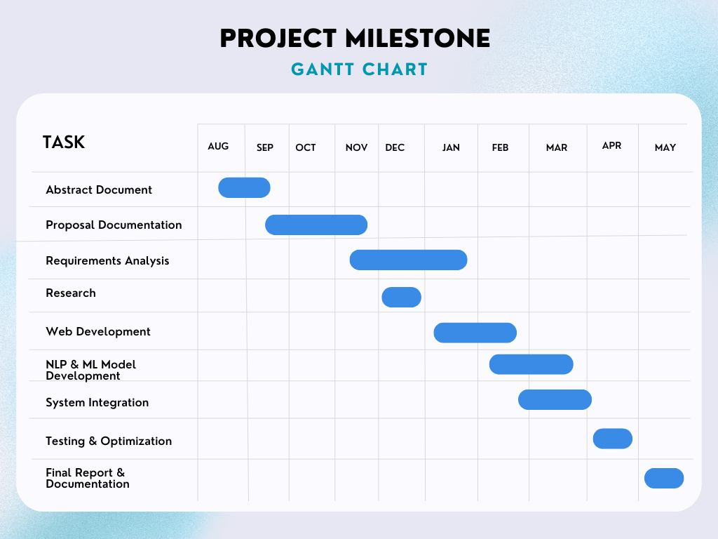

Slide 10
Thanks!

