Slide 1
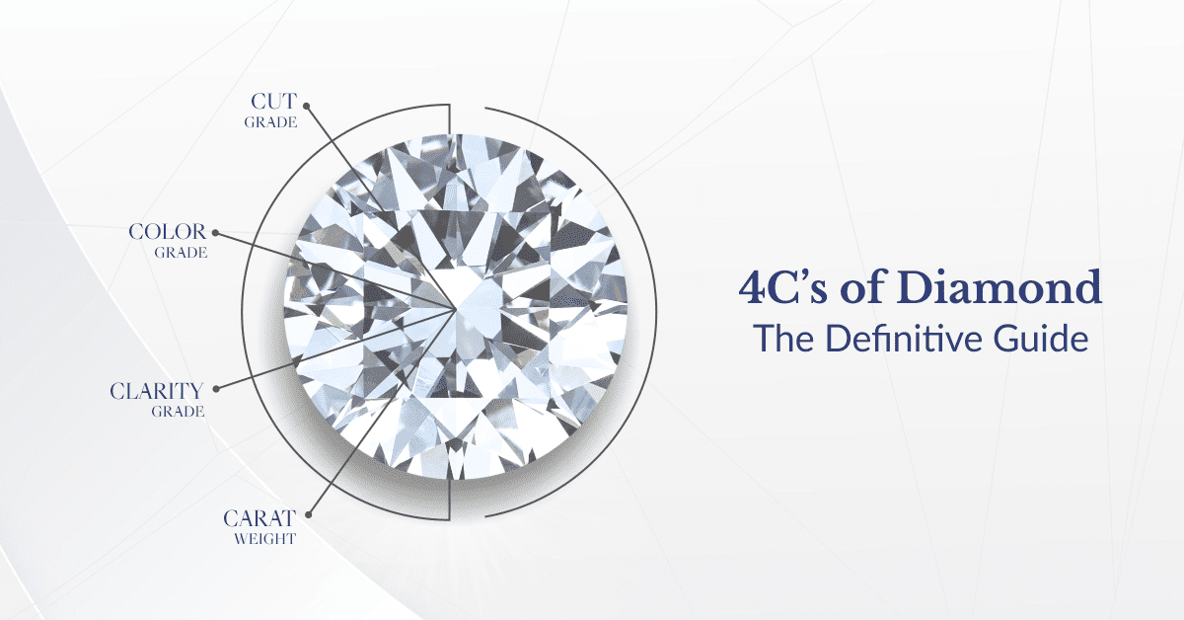
Diamond Price Prediction
By ~ Areeb Shaikh

Slide 2
Data Overview
Data Source :- https://www.kaggle.com/datasets/shivam2503/diamonds
Kaggle (Diamond Price Dataset with 50,000 records).
Features:-
Numerical: Carat, Dimensions (x, y, z).
Categorical: Cut (Fair, Good, Very Good, Premium, Ideal), Color (J to D), Clarity (I1 to IF).
Target Variable:- Price in USD.

Slide 3
Project Overview
Problem Statement
In the diamond industry, accurate pricing is a critical challenge due to the variability of diamond features such as carat, cut, color, clarity, and dimensions. The pricing process often involves manual evaluation, which can be subjective and inconsistent. This creates the need for a robust and data-driven solution to estimate diamond prices reliably and transparently.
Objective
The objective of this project is to predict the price of diamonds based on key features such as carat, cut, color, clarity, and dimensions. By leveraging machine learning techniques, the project aims to build an accurate predictive model that can estimate diamond prices, providing insights for the jewelry industry and potential buyers

Slide 4
Methodology
Data Preparation :-
1) Perform exploratory data analysis (EDA) to identify patterns and trends.
Univariate , Bivariate, Multivariate
2) Handle missing & Duplicate data (if any) and ensure consistent formatting.
3) Retain outliers as they reflect valid variability in diamond characteristics.
4) Feature Engineering
Created New Attribute (Size) By Combining Existing Attribute (x, y, z)
5) Label Encoding To Categorical Features

Slide 5
Insights & Visuals
Used visualizations
1) Bar Plot (Categorical Distribution)
2) Histogram (Numerical Distribution)
3) Scatter Plot (Carat vs Price)
4) Scatter Plot (Size vs Price)
5) Box Plot
6) Scatter + Regression plot
7) Heatmap (Correlation Matrix)
8) Feature Importance Plot

Slide 6
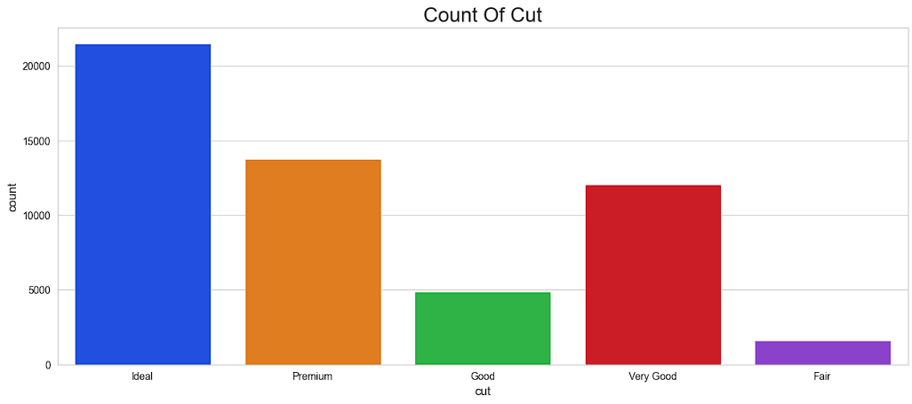

Slide 7
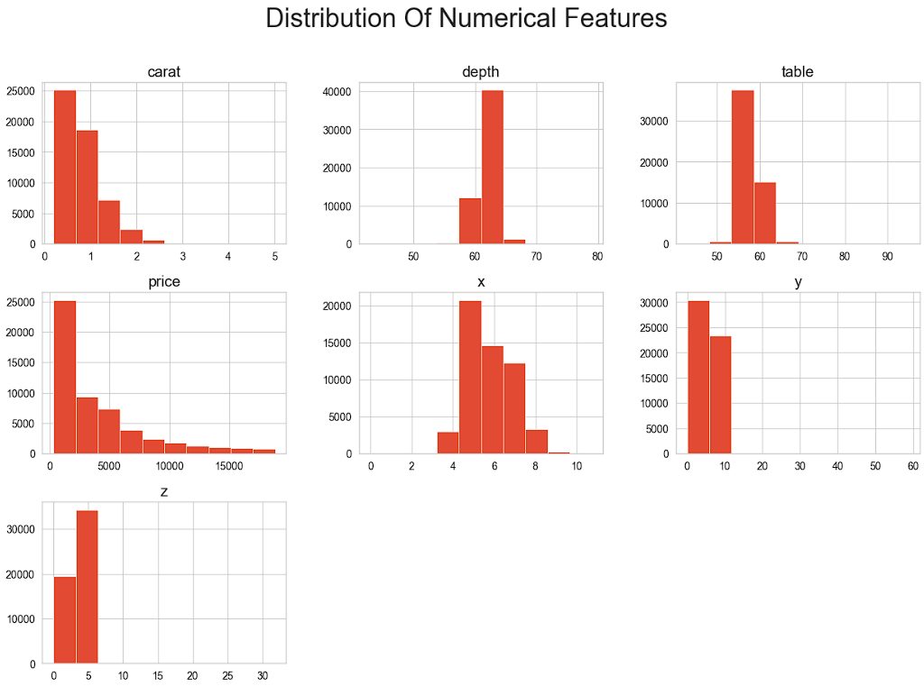

Slide 8
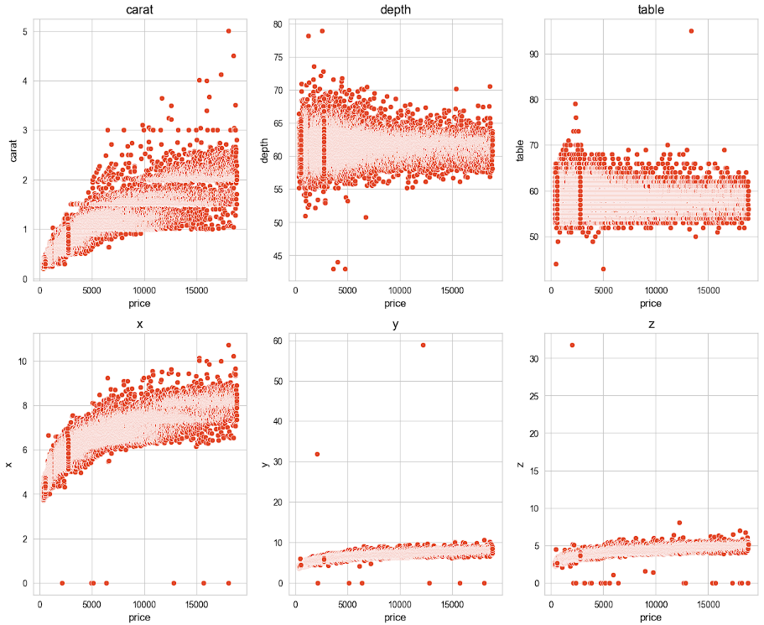
Relationship of all the feature with Target variable

Slide 9
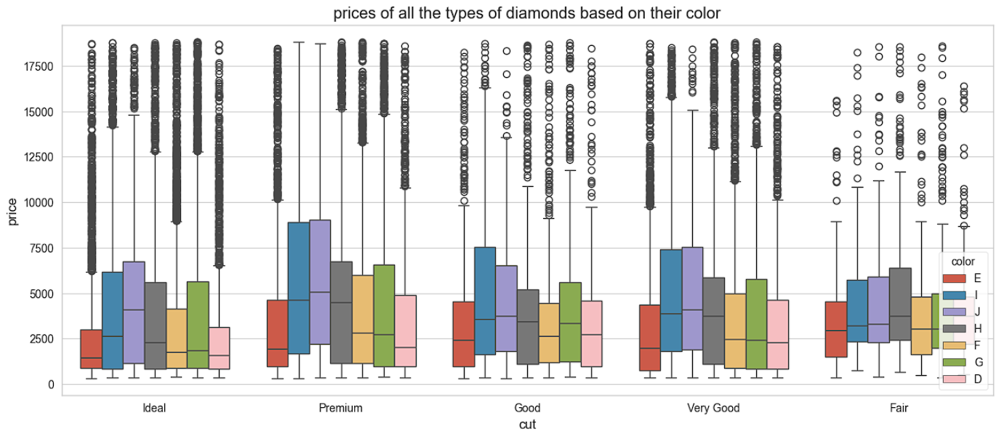

Slide 10
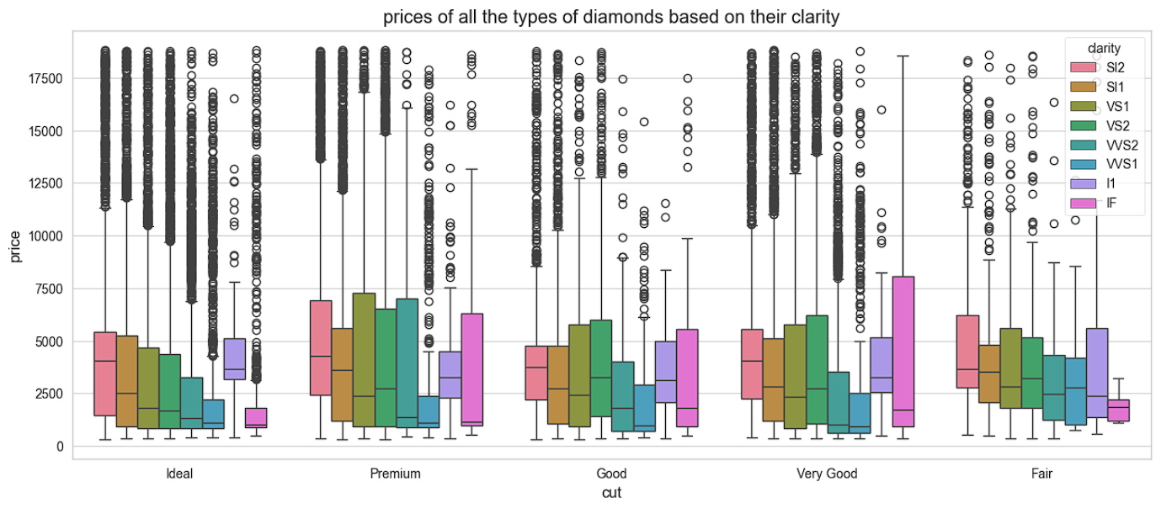

Slide 11
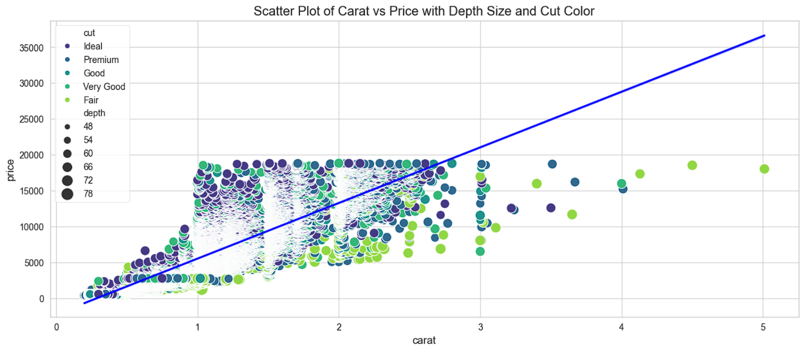

Slide 12
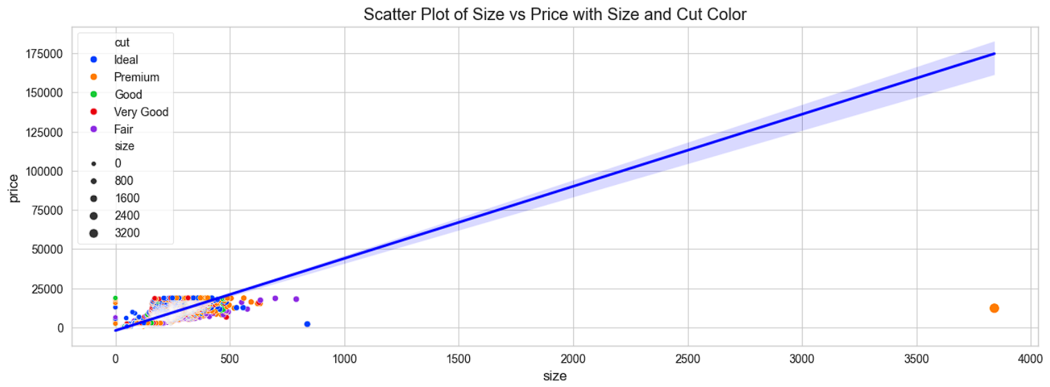

Slide 13
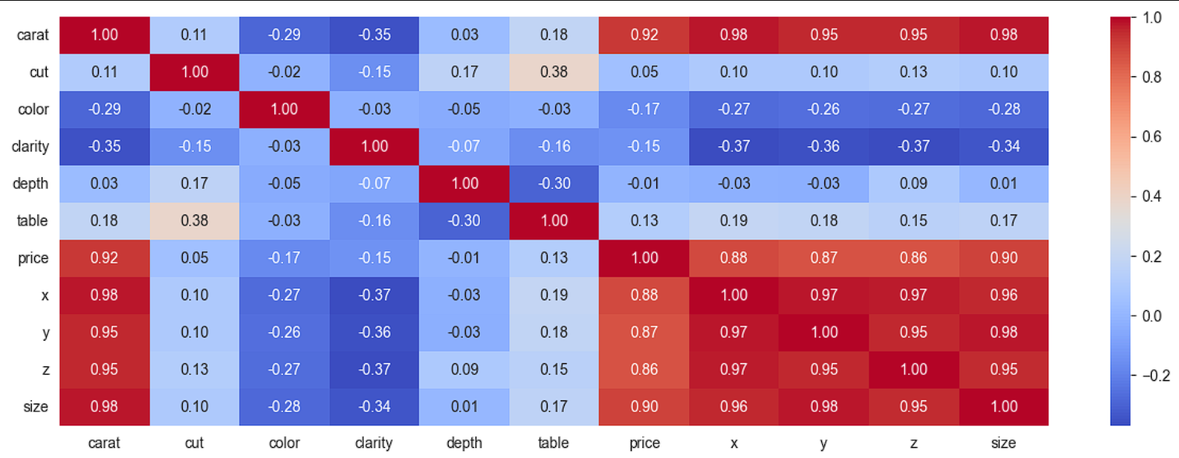
Heatmap Of Correlation Matrix

Slide 14
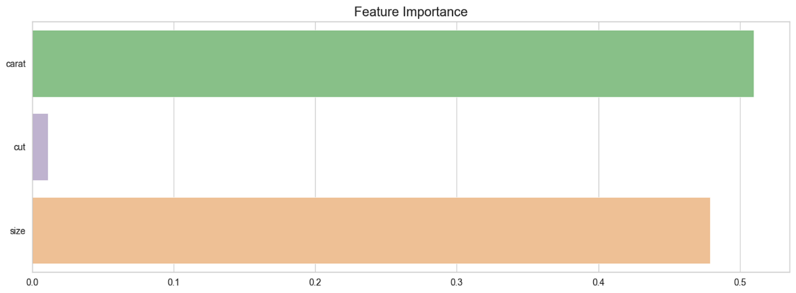

Slide 15
Model Development
Tree Based Models :-
Decision Tree
Random Forest
Ada Boost
XGB
Scaling-Based Models
Linear Regression
KNN
SVM

Slide 16
Challenges
Outliers:- Managing outliers to ensure they do not overly bias the model while retaining their valid variability.
Categorical Features:- Encoding qualitative attributes like cut, color, and clarity effectively for both tree-based and scaling-based models.
Model Tuning:- Balancing computation time during hyperparameter tuning for a large dataset.

Slide 17
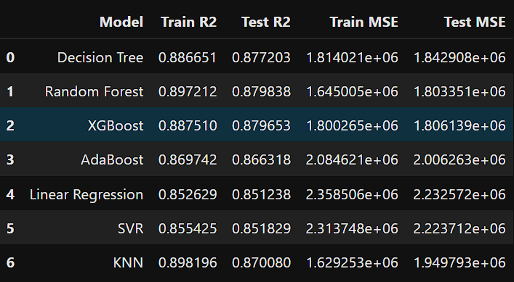
Model Performance Comparison

Slide 18
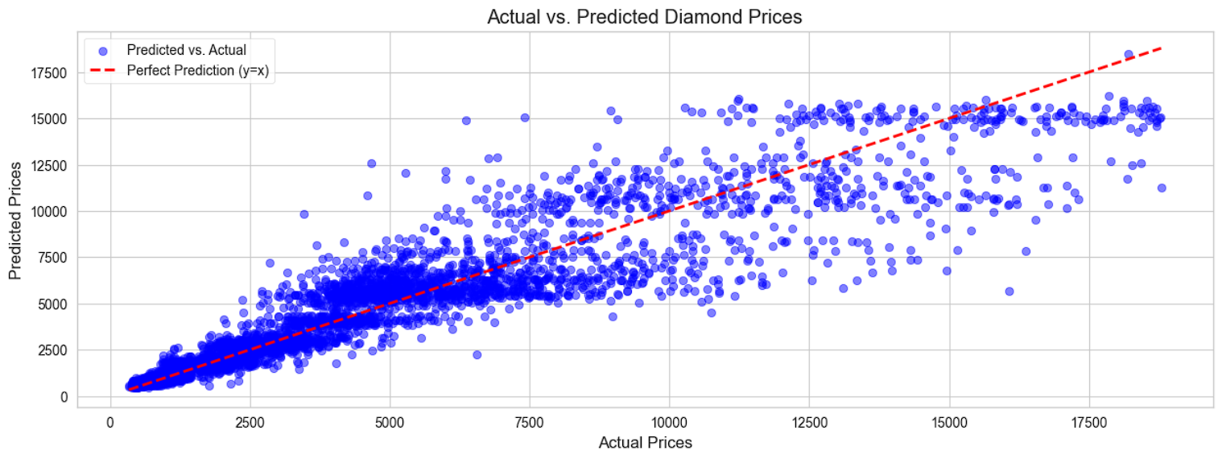
Actual VS Predicted Diamond Price

Slide 19
Conclusion & Practical Application
Conclusion
Impact of Models:- Accurate diamond price predictions help jewelers, buyers, and insurers determine fair prices.
Best Model: XG boost, due to its high R2 and low MSE on both training and test sets.
Good Alternatives: Random Forest , Decision Tree and KNN also show strong performance.
Baseline Models: Linear Regression and SVR provide good baselines but are outperformed by ensemble methods.
Practical Application
E-Commerce Platforms :- Automating pricing recommendations for diamonds listed on online marketplaces.
Inventory Management :- Helping jewelers value their inventory based on consistent pricing.
Fraud Detection :- Identifying discrepancies in diamond pricing for authentication and fraud prevention.
Customer Decision Support :- Assisting customers in understanding and justifying diamond prices during purchases.

Slide 20
Deployment Details
Description: The diamond price prediction model has been deployed as a web application using the Streamlit framework, enabling users to interact with the model seamlessly.
Platform: Streamlit cloud platform.
Deployment Process :
Model trained and saved using Pickle.
Interactive web app built with Streamlit for a user-friendly interface.
Hosted on Streamlit's free cloud service.
Accessibility:
Fully functional and accessible from any device via the link.
Link : https://diamond-price-predictions.streamlit.app/

