Slide 1
FACIAL EXPRESSION RECOGNITION BASED ON
CNN(Convolutional Neural Network)
BY:-
Shaikh Baba (210002068)
Pushkal Madhwacharya (210002059)
Aditya Meena (210002007)
INTRODUCTION:
Facial expression recognition is a pivotal area within pattern recognition research. Deep learning, particularly Convolutional Neural Networks (CNNs), has demonstrated remarkable prowess, surpassing other algorithms in fields like image recognition and natural language processing.
ADVANTAGES:
Hierarchical Feature Learning: CNNs learn features at different levels of abstraction, enabling robust image recognition.
Parameter Sharing: CNNs efficiently learn representations from large datasets.
Sparse Connectivity: CNN computes on relevant features while reducing computational load.

Slide 2
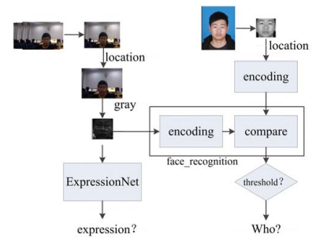
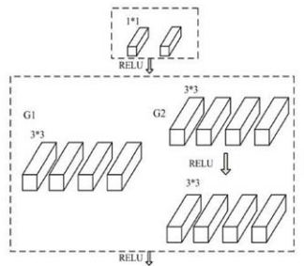
Methodology:
The proposed CNN model is trained on facial expression datasets containing labeled facial images. The model learns to recognize facial
expressions by extracting discriminative features
from facial images and mapping them to
corresponding expression labels.

Slide 3
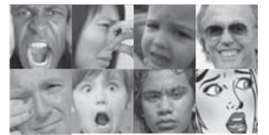
MODEL TRAINING:
For training our model the tensorflow was used and keras module is used to implement tensorflow after that pandas was used for creating the data set with over 35,887 files and it was picked up from KAGGLE. All images are uniform (40X40) grayscale images. The dataset is divided into 7 categories namely: [anger, disgust, fear, happiness, sadness, surprise, and neutral]. Because the dataset has some noise (all black pictures, cartoon pictures, non-expression images and non-expression pictures), it is difficult to identify and hence the accuracy was around 70.1%.The images are pre-processed prior to training Using data amplification techniques. After data amplification, the numbers of the entire training set is expanded to 10 times of the original size, and then all images are subtracted from the mean value. The learning rate is around 0.005 sec.

Slide 4
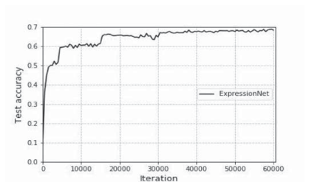
RESULT & OBSERVATION:
The KAGGLE dataset comprises 35,887 grayscale images.
Partitioned into training (28,709), test (3,589), and verification (3,589) sets.
Its 48x48 dimensions
Accommodate 7 emotion categories.
The accuracy stands at 70.1%.

Slide 5
CONCLUSION:
The cascading module implemented in ExpressionNet enhances feature extraction by utilizing three different channels and reducing parameters with 1x1 convolution kernels.
Compared to classic models like AlexNet, ExpressionNet achieves significantly improved accuracy while substantially reducing parameters.
Further refinement of this module promises enhanced network performance and model size reduction, necessitating experimentation with larger datasets.
REFERENCE:
Facial Expression Recognition Based on Convolutional Neural Network. Publisher: IEEECite: Zhou Yue; Feng Yanyan; Zeng Shangyou; Pan Bing.
https://www.kaggle.com/datasets/jonathanoheix/face-expression-recognition-dataset

