Slide 1
PRESENTING software PROJECT LAB progress
SOFTWARE PROJECT LAB - 01
This is Md. Shaikhul Islam
From BSSE-14
ID- 1438
Supervised by :
Assistant Prof. Abdus Satter
IIT, Dhaka University.

Slide 2
Room raccoon : Hotel Management System
SMART SERVICE , CLIENT SATISFACTION

Slide 3
INTRODUCTION
“Room Raccoon” a digital hotel management system.
Here there are two type of login interface – 1. Manager 2. Clients.
The manager can see the current clients, the dues with their lists, working employee, the records of previous and current clients, also the current rating of this hotel and if there are any complains or suggestions from the clients .
The Clients can create a profile using their name, phone number and password which will be kept encrypted inside. After logging in, the clients can book any room as their choice depending on availability, can see all the available packages with the corresponding prices and the food system while enrolling. The clients can check their current status of the packages, systems and also the payment status. Even while staying, he/she can place any complains or suggestions.
Mainly, this will be a software based management system with various functionality and the data will be preserved by a secured system produced by some complex encryption algorithm.

Slide 4
objectives
Make easily understandable and adaptable .
Confirm public data security .
System must be optimized .
Data overload or leakage should be checked .
System must not be crashed .
File management should be ensured .
Command lineup and system testing should be ensured .

Slide 5
Functions
Client:
Book room
Enroll food-package
Change room
Change food-package
View current status
Change password
Check out
Message to Authority
Review and Suggestions
Manager :
See Client list
See Employee list
See Recorded Clients
Due check
Communicate with Clients
Get reviews and suggestions

Slide 6

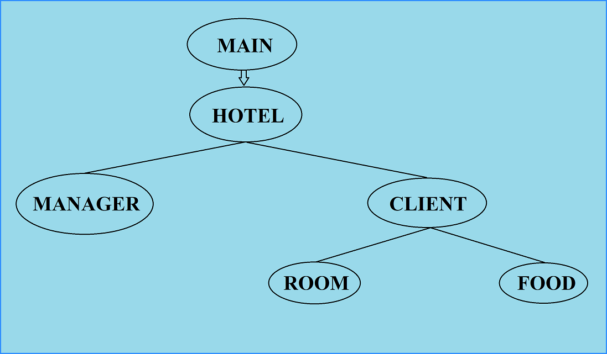
Class roadmap
From Main menu the whole control is delivered to hotel class. There are two type of classes to control the flow. The manager class to view from the administration. The Client class to get the services, and for this room and food class is also included in this client class. This is the flow of the command.

Slide 7
Implemented topics
Object creation and manipulation.
Vector and list
Structure based work
Sorting algorithm
Data preservation
Menu bar management
Header file inclusion
File read, write and append.
Socket Programming
Encryption-decryption
Multiple machine connectable

Slide 8
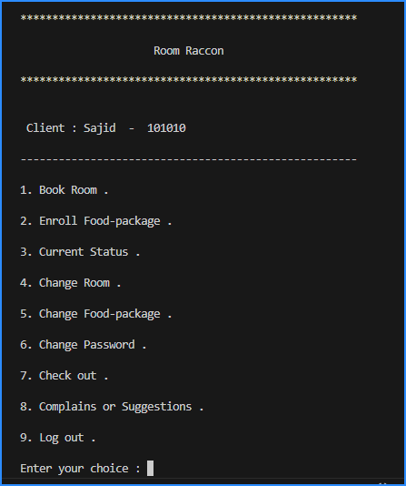
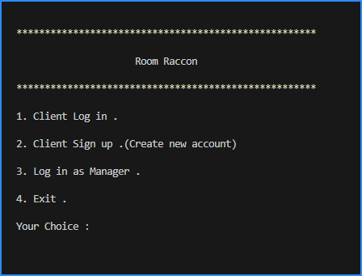
Some glimpses of control flow

Slide 9
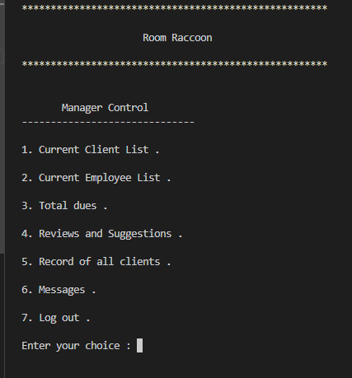
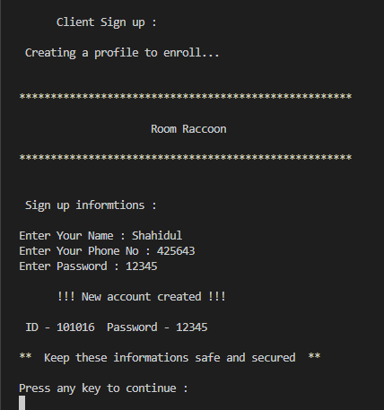
Some glimpses of control flow

Slide 10
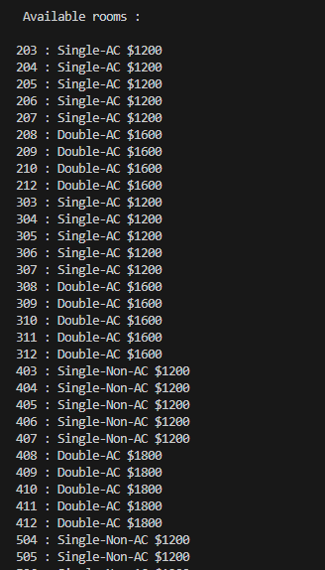
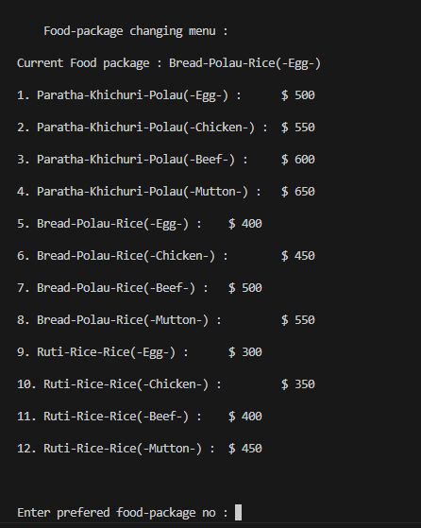
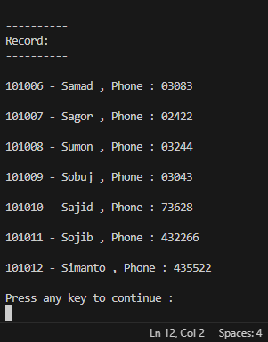
Some glimpses of control flow

Slide 11
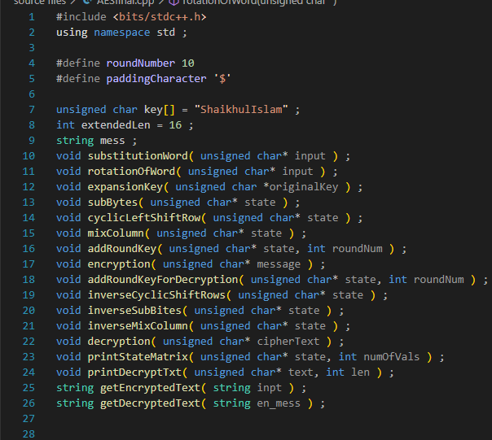
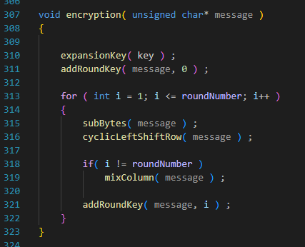
Some glimpses of control flow

Slide 12
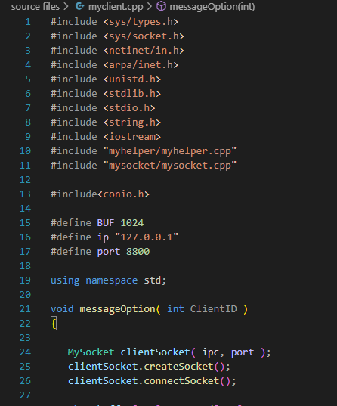
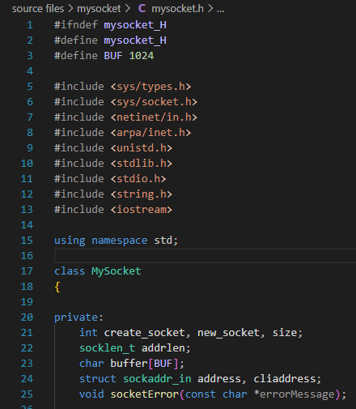
Some glimpses of control flow

Slide 13
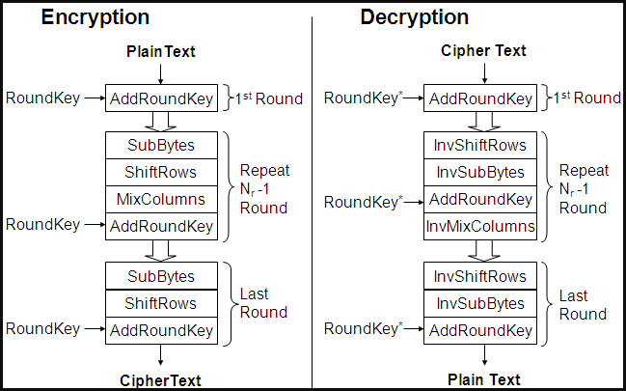
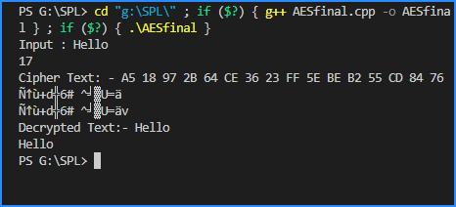
AES Encryption flow

Slide 14
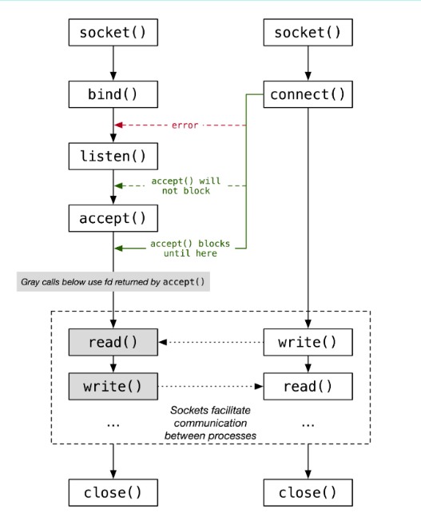
Server-Client connection through Socket Programming:
Multiple Clients can also be connected.

Slide 15
Special features
Secured data management
User-friendly system
All services in a single system
Machine calculated, less possibility of error
Smart service
Remote control and observation
Client – Authority communication

Slide 16
Observations From Midterm
An Encryption algorithm needs to be implemented.
Server-Client needs to be implemented to send messages.

Slide 17
Challenges:
Class-Object manipulation in C++.
AES algorithm was enough complex to implement correctly.
Integrating different encryption algorithms and socket programing.
Working with header files in C++
Establishing socket connection in C++.
Working with multiple type of source files.
Working with long lines of code and keeping track of everything.
Managing multiple files at a time.

Slide 18
motivation
Along with the modernization of the world, in every sector of life is needed to be upgraded . That’s why digitization is needed everywhere . With a view to claiming that, all type of office work is taken under modern machines . Nevertheless, the social organizations are also doing the same . In the management sector of hotel, leaving the pen-paper manual method adapting with digital system is certainly difficult . But to do so, a convenient and user-friendly is needed . That’s the motive of my work . Along with this , the security and privacy of the data is very important . That’s why the matter of encryption-decryption has been initiated . To fulfill and manage the prerequisites of people, this project is developed.

Slide 19
Conclusion:
This project help me out to learn patience and perseverance. Along with that how to seek solutions for the problems. The new way of learning by self-instinct. After all, this project has the capability to extend more get it in the commercial area.

Slide 20
Summary
Line of Code : 2400+
GitHub Link : https://github.com/Shaikh1828/SPL-01

Slide 21
Thank you

