Slide 1

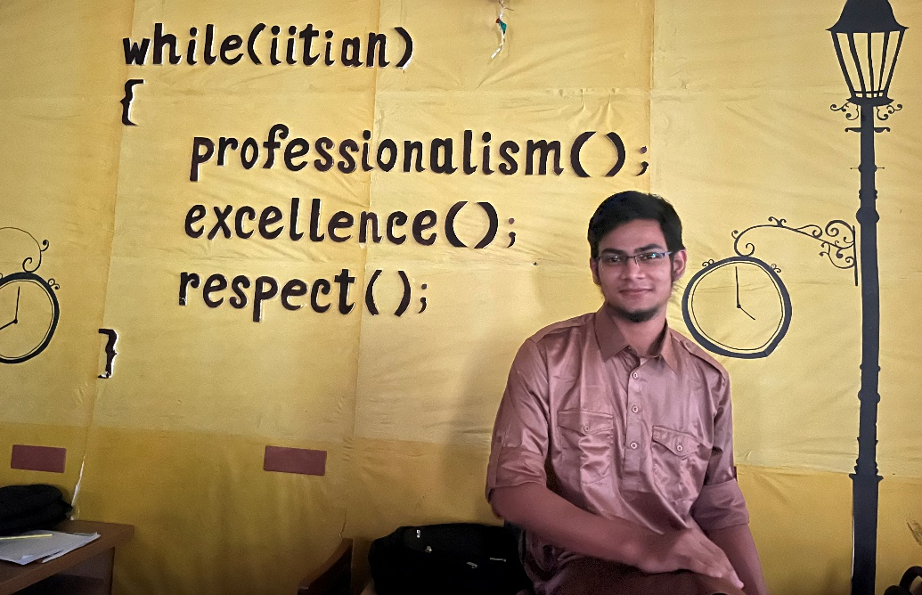
PRESENTING software PROJECT LAB progress
This is Md. Shaikhul Islam
From BSSE-14
Id – 1438
Supervised by :
Assistant Prof. Abdus Satter
IIT, Dhaka University.

Slide 2
Room raccon : Hotel Management System
SMART SERVICE , CLIENT SATISFACTION

Slide 3
INTRODUCTION
“Room Raccoon” a digital hotel management system. Here there are two type of login interface - one is for Manager, and the other one is for the Clients. After accessing the secured login system, the respective users will have their options of access.
The manager can see the current clients, the dues with their lists, working employee, the records of previous and current clients, also the current rating of this hotel and if there are any complains or suggestions from the clients .
The Clients can create a profile using their name, phone number and password which will be kept encrypted inside. After logging in, the clients can book any room as their choice depending on availability, can see all the available packages with the corresponding prices and the food system while enrolling. The clients can check their current status of the packages, systems and also the payment status. They can also change their current packages and their password through this menu. While checking out, the client can see the payment and status and can give a review and rating. Even while staying, he/she can place any complains or suggestions.
Mainly, this will be a software based management system with various functionality and the data will be preserved by a secured system produced by some complex encryption algorithm.

Slide 4
Functions
Client:
Book room
Enroll food-package
Change room
Change food-package
View current status
Change password
Check out
Complaints and suggestions
Manager :
See Client list
See Employee list
See Recorded Clients
Due check
Get messages and reviews

Slide 5
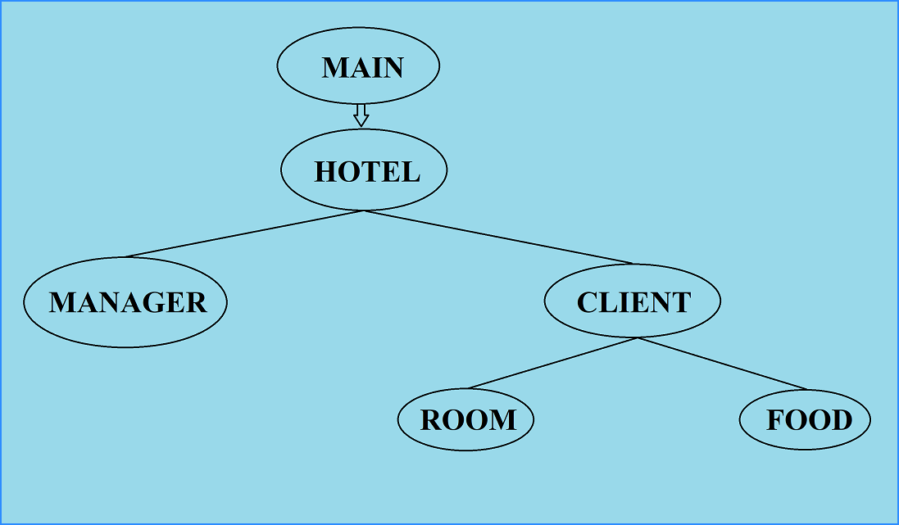
Class roadmap
From Main menu the whole control is delivered to hotel class. There are two type of classes to control the flow. The manager class to view from the administration. The Client class to get the services, and for this room and food class is also included in this client class. This is the flow of the command.

Slide 6
Implemented topics
File read, write and append.
Object creation and manipulation.
Vector and list
Structure based work
Sorting algorithm
Encryption-decryption
Data preservation
Menu bar management
Mathematical function usage
Header file inclusion

Slide 7
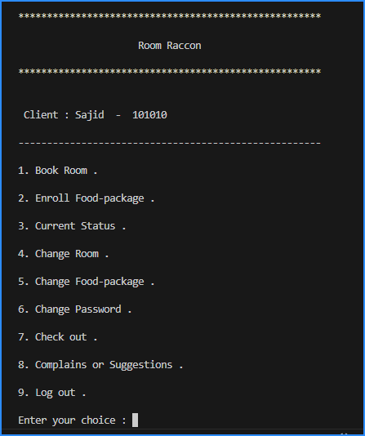
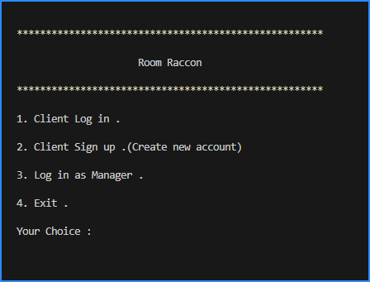
Some glimpses of control flow

Slide 8
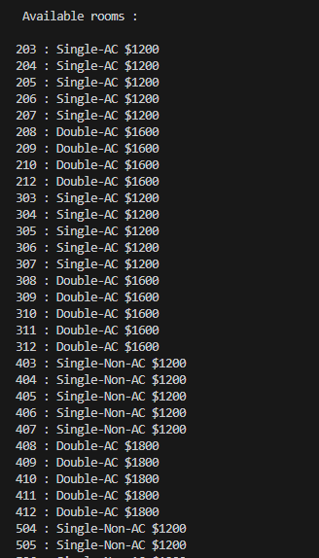
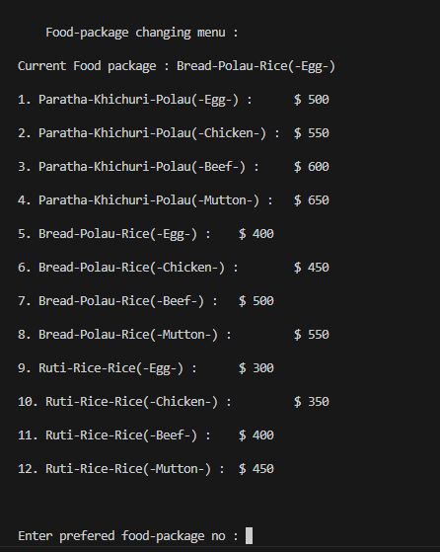
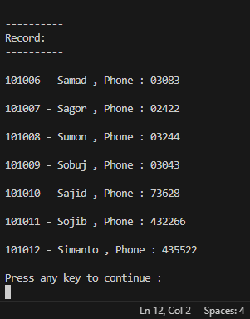
Some glimpses of control flow

Slide 9
motivation
Along with the modernization of the world, in every sector of life is needed to be upgraded . That’s why digitization is needed everywhere . With a view to claiming that, all type of office work is taken under modern machines . Nevertheless, the social organizations are also doing the same . In the management sector of hotel, leaving the pen-paper manual method adapting with digital system is certainly difficult . But to do so, a convenient and user-friendly is needed . That’s the motive of my work . Along with this , the security and privacy of the data is very important . That’s why the matter of encryption-decryption has been initiated . To fulfill and manage the prerequisites of people, this project is being developed.

Slide 10
Special features
Secured data management
User-friendly system
All services in a single system
Machine calculated, less possibility of error
Smart service
Remote control and observation
Many branch can be handled

Slide 11
objectives
Make easily understandable and adaptable .
Confirm public data security .
System must be optimized .
Data overload or leakage should be checked .
System must not be crashed .
Command lineup and system testing should be ensured .
File management should be checked several times .

Slide 12
Observations

