Slide 1
CampusReConnect
Name: A. M Samdani Mozumder
Roll: BSSE 1412
Name: Mohammed Yasin
Roll: BSSE 1406
Supervisor Name: Dr. Md. Nurul Ahad Tawhid

Slide 2
Table of Contents
01. Project Description
02. Motivation
03. Requirements
04. Timeline
05. Technology

Slide 3
Project Description
1

Slide 4
Project Description
CampusReConnect is a web-based platform designed to enhance academic engagement and networking within Dhaka University communities. It provides a centralized space for researchers to share their knowledge, connect with peers, and stay informed about the latest trends in their field.

Slide 5
Motivation
2

Slide 6
Motivation
Many research enthusiasts at the University of Dhaka face challenges due to limited interaction across departments, which hampers interdisciplinary research and innovation. This project is motivated by the need to create a unified platform that fosters research connections across the university. By developing this platform, we aim to promote academic collaboration, knowledge sharing, and research efficiency, potentially transforming how students and faculty engage in research endeavors

Slide 7
Requirements
3

Slide 8
Requirements
Normal Requirements:
Registration, Login, and Verification: Accounts are created using institutional emails, with verification ensuring only authorized university members have access.
Profile Creation with Research Metrics: Profiles include name, department, field of expertise, research interests, and key metrics like citation scores and h-index.
Personalized News Feed and Filtering: A tailored feed displays posts relevant to each user's field of study, with filtering options based on domain or academic subject.
Post Creation, Sharing, and Search: Posts can be created and tagged by academic topics, with search functionality to find relevant content or profiles by keywords, tags, or departments.
Networking and Messaging: Users can follow peers to stay updated on their activities, and engage in private messaging for discussing research or academic projects.
Groups, Communities, and Notifications: Specialized groups or communities can be joined based on research interests, with notifications for posts, comments, updates, and messages.

Slide 9
Requirements
Exciting Requirements:
Automated Summaries/Abstract: The platform could automatically generate concise summaries of long research papers or posts, helping users quickly digest important information.
Gamification: Introduce a points system where users can earn points for participating in discussions, answering questions, or helping others in research.

Slide 10
Timeline
4

Slide 11
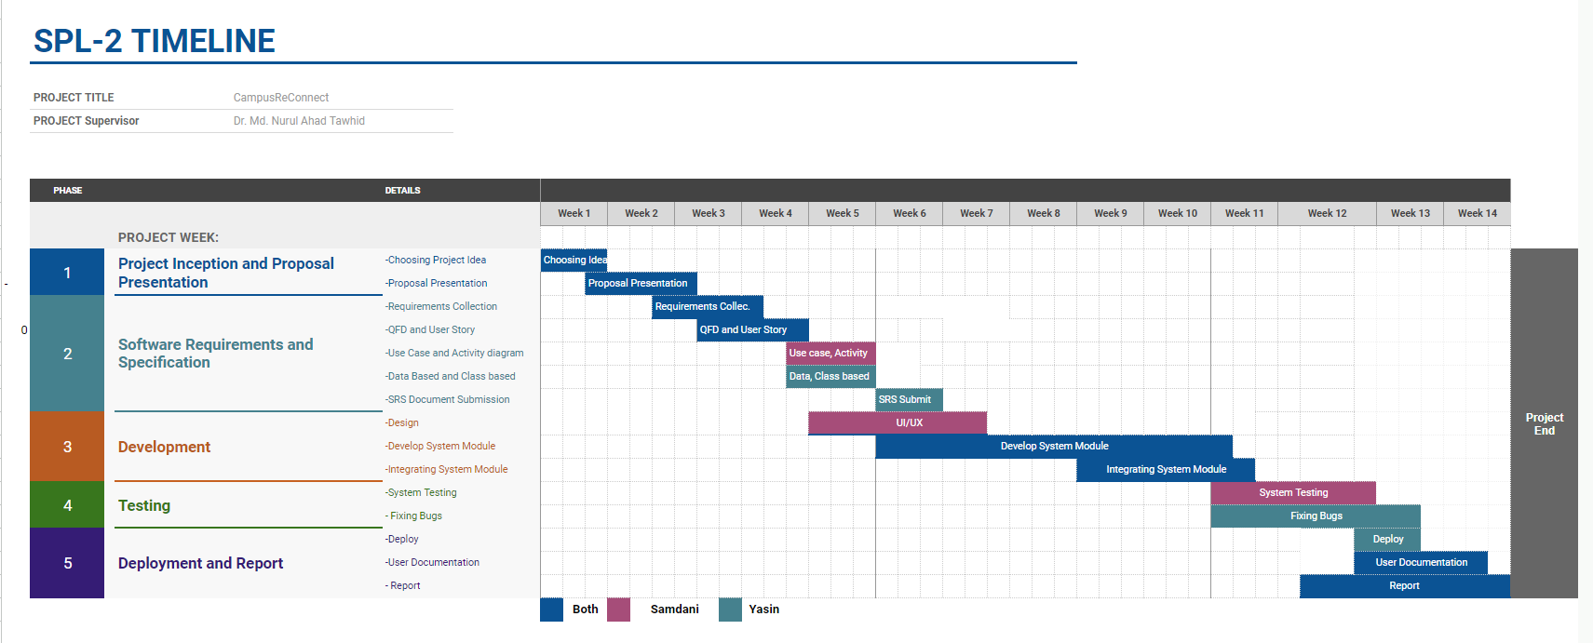

Slide 12
Technology
5

Slide 13




Technology
Frontend: Backend:
Database: Version
Control:

Slide 14
Thank You

