Slide 1
Operation-aware Neural Networks for User Response Prediction
Presented by: Shaikh Azan Asim and Nabeel Uddin, FAST-NU
Authors: Yi Yang, Baile Xu, Furao Shen, Jian Zhao

Slide 2
Motivation & Challenge
Importance of accurate CTR/CVR in online advertising and recommender systems
High-dimensional, sparse categorical features make interaction modeling difficult
Need for deep models that automatically learn feature interactions at scale

Slide 3
Limitations of Existing Models
FM/FFM: Shallow pairwise interactions, limited expressiveness
Deep Models (PNN, DeepFM): Capture higher-order patterns but share a single embedding per feature
Key issue: Shared embeddings force a compromise across operations

Slide 4
Key Idea of ONN
Operation-aware Embeddings: Learn distinct embeddings for each feature-operation pair
Allows features to adapt representation based on the operation (copy, inner-product, etc.)
Analogy to multi-sense word embeddings in NLP

Slide 5
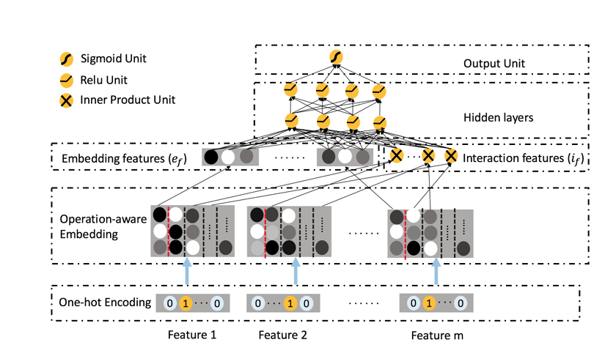
ONN Architecture Overview (Figure 1)
Three main components:
1. Operation-aware Embedding
2. Incipient Feature Extraction
3. MLP Prediction Head

Slide 6
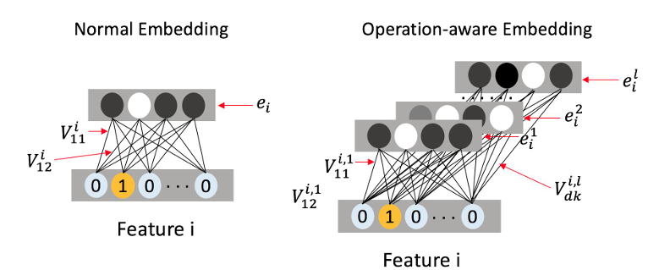
Operation-aware Embedding (Figure 2)
For each feature i and operation o, learn sub-embedding V_{i,o}
Mapping Γ(o,i) selects correct vector during interaction

Slide 7
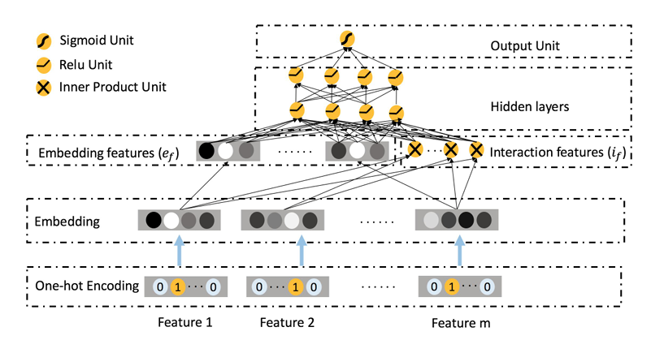
Theoretical Connections (Figures 3–5)
FM as single-op inner-product on shared embeddings
FFM as field-aware inner-products (operation-aware FM)
PNN as deep FM with shared embeddings

Slide 8
Offline Experiment Results (Tables 1–2)
Datasets: Criteo (45M), Tencent Ads (24M)
Metrics: Logloss, AUC, RMSE
ONN vs. FM, FFM, DNN, PNN, DeepFM
ONN achieves top AUC (e.g., 0.8123 vs. 0.8113) on Criteo

Slide 9
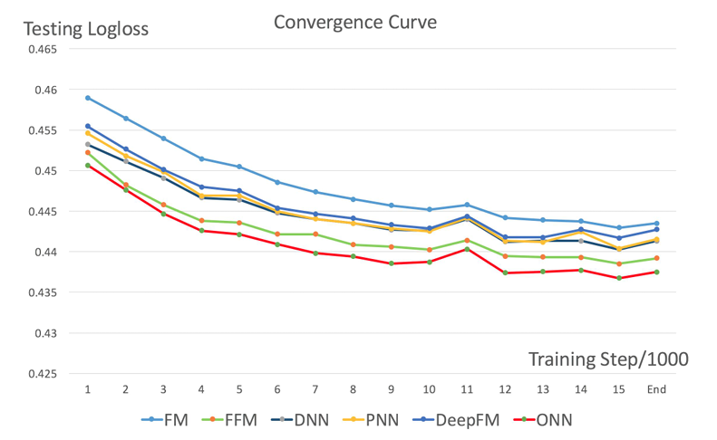
Online A/B Test Results (Figure 7)
Deployment in production streaming ads environment
ONN converges fastest, yields highest live CTR improvements

Slide 10
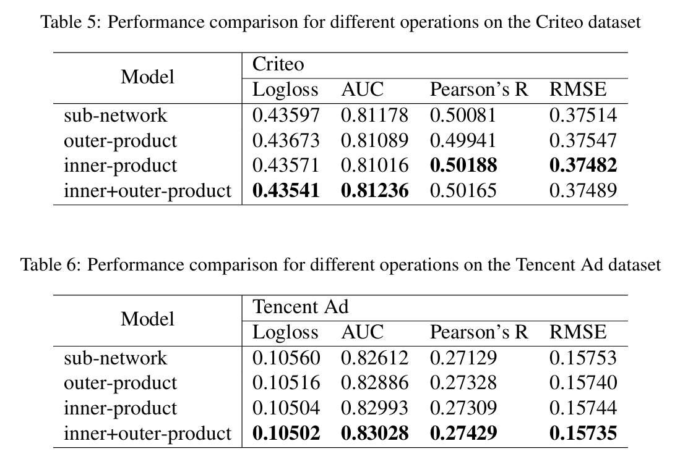
Operation Analysis (Tables 5–6)
Evaluate individual operations: copy vs. inner-product vs. combined
Inner-product yields largest single-op gain; combined ops best overall

Slide 11
What We Learned
Disentangled embeddings per operation unlock richer feature interactions
Modular design facilitates extension to new operations
Multi-sense embedding concept from NLP applies effectively to recommender systems
Batch normalization proved more stable than dropout in large-scale CTR models
Operation-aware embeddings improve expressiveness; Architectural modularity supports rapid prototyping; Transfer of NLP embedding ideas to CTR prediction

Slide 12
Conclusion & Future Work
ONN achieves state-of-the-art offline and online performance
Future directions: Operation-aware sub-networks, adaptive embedding dimensions, dynamic weighting of operations
Thank you! Questions?

