Slide 1
EMPLOYEE MANAGEMENT SYSTEM
SUBMITTED BY :-
1) Sujan Karim Shaikh
(Reg. No. :- 2020bcs505 Roll No. :- A74)
2) Pratiksha Datta Nilewar
(Reg. No. :- 2020bcs508 Roll No. :- B77)

Slide 2
Content
Abstract
Software Used
Why Java Swing
ER Diagram
Features
Advantages

Slide 3
ABSTRACT
Employee Management System is a distributed application, developed to maintain the details of employees working in any organization.
It maintains the record of Employees working in an organization and stores the personal and professional details of employees.
It provides an unique id for each and every employee which avoids the overlapping of the employee details.
We can insert, update, delete employee details as per our need which can ease the complexity of maintaining the database

Slide 4
SOFTWARES USED
Programming Language Used For Front-end - Core Java
Concept Used - Swing
IDE Used – NetBeans
Database Used For Back-end - MySQL

Slide 5
Why Java Swing
Swing components are platform independent
Highly customisable
Swing provides more components than AWT such as tables, button, list etc.

Slide 6
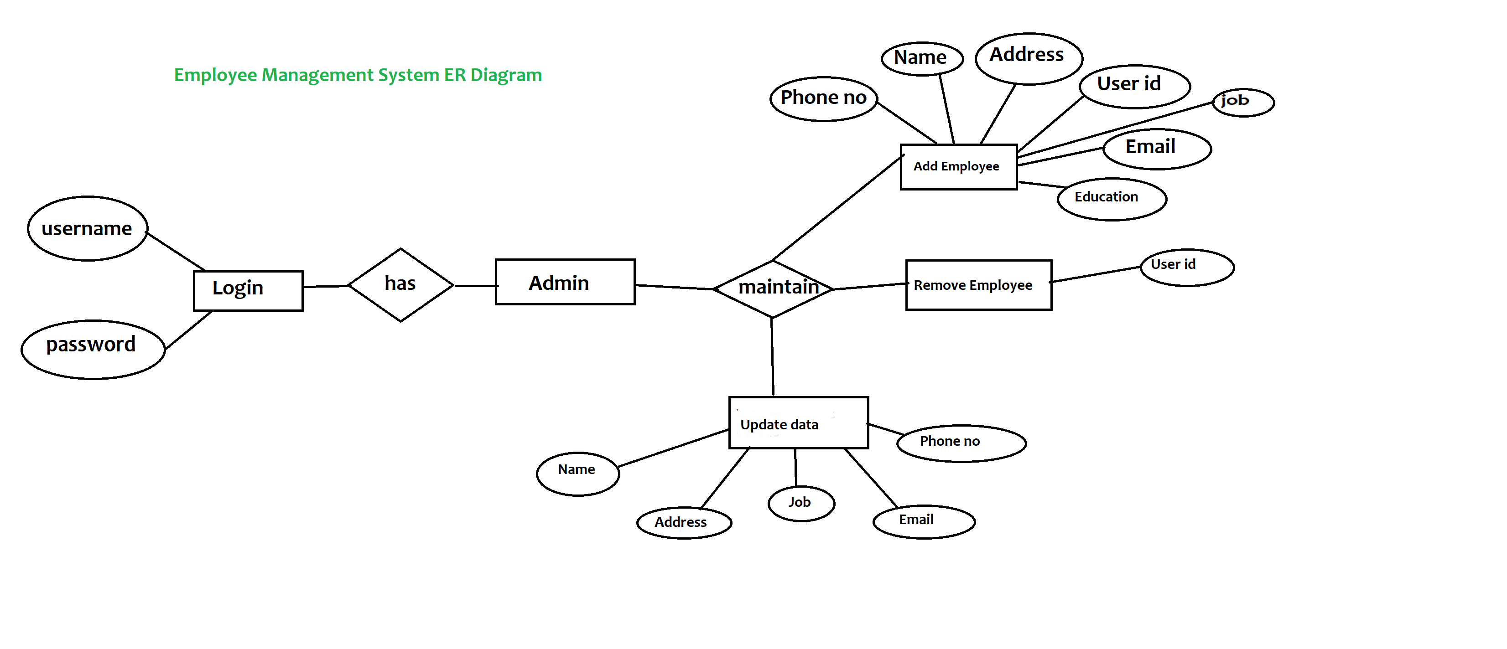
ER Diagram

Slide 7
Features
1) Add Employee Details
2) Remove Employee Details
3) Search Employee Details
4) Update Employee Details
5) View Employee Details

Slide 8
Advantages
Provide computerized system for maintaining records. More efficient & reliable.
Less time consuming and easy to use.
Huge data storage with less computer memory.
Avoid Human errors & efforts for Maintaining daily data.
Avoid Data manipulations.
Also avoids Data inconsistency & redundancy.

Slide 9
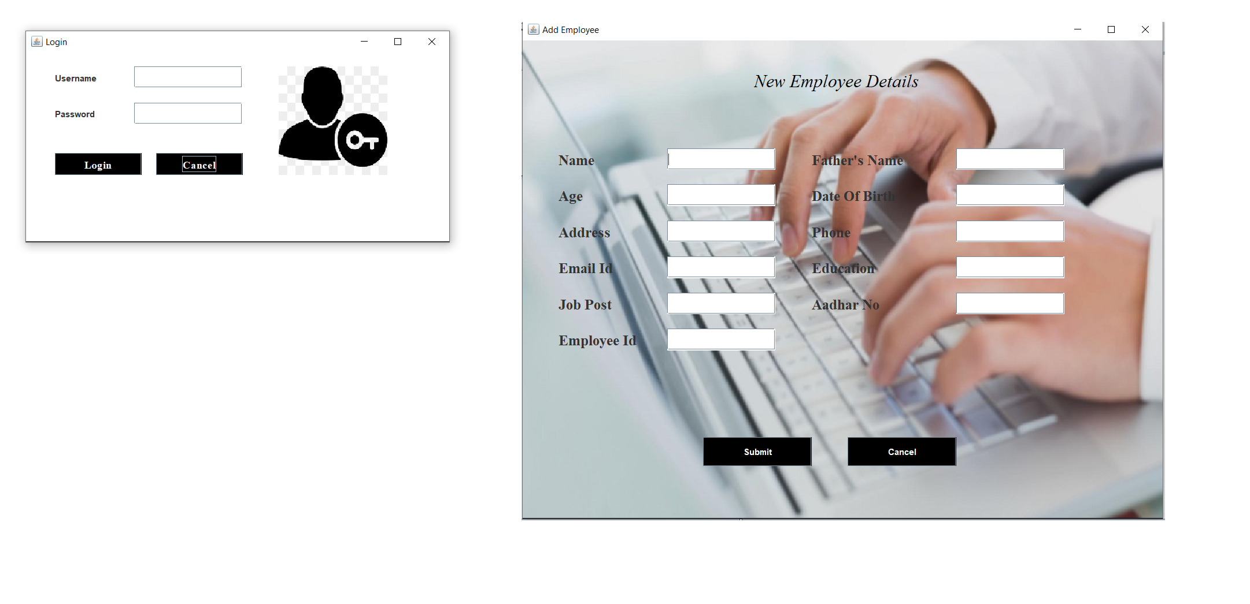

Slide 10
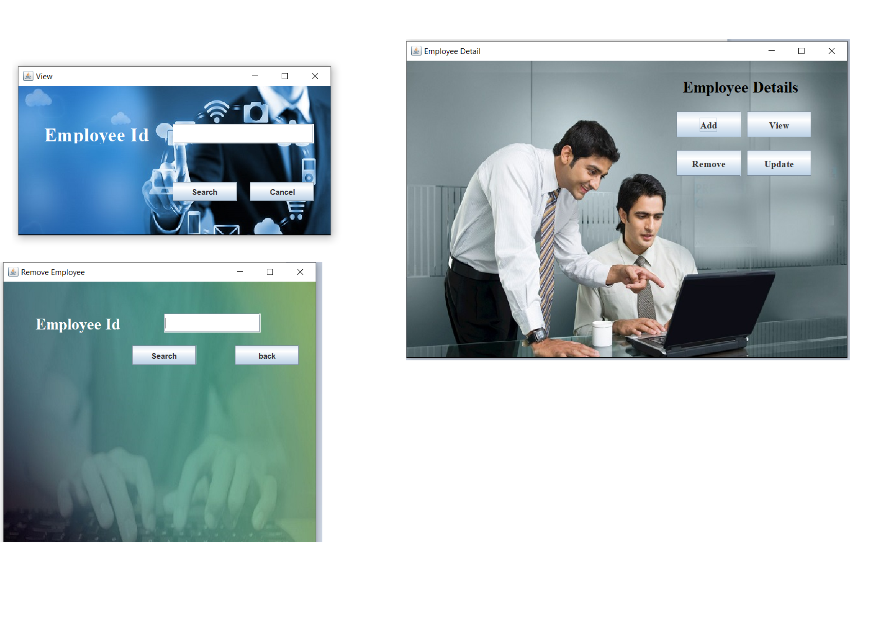

Slide 11
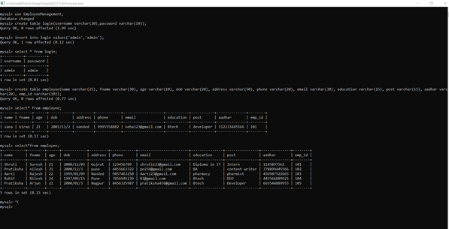

Slide 12
Thank you

