Slide 1
World Development Statistics
The impact of world war2 on life quality
Done By:
Safa Aljeshi
Shaikha Ali

Slide 2
Introduction
World War II (1939-1945) had major social, economic, and environmental impacts worldwide. This project analyzes data from 1925–1960 to examine changes in life expectancy, Gross National Income (GNI), and CO₂ emissions before, during, and after the war. It also explores how countries such as Germany and Japan recovered from the war’s effects and how industrial growth influenced economic development, quality of life, and environmental change over time.

Slide 3
Problem Statement
This project analyzes historical data on Gross National Income (GNI) per capita, life expectancy, and CO₂ emissions during and after World War II. Covering the period from 1925 to 1960, the study examines how the war influenced economic conditions, environmental indicators, and human quality of life, with particular focus on industrialized countries such as Germany and Japan.
The project also investigates patterns of decline and recovery associated with wartime destruction and post-war reconstruction. By analyzing these historical trends, the study aims to provide a clearer understanding of the long-term economic, social, and environmental impacts of large-scale global conflict.

Slide 4
Objectives:
To analyze historical trends in Gross National Income (GNI) per capita, life expectancy, and CO₂ emissions between 1925 and 1960.
To examine the impact of World War II on economic conditions, environmental indicators, and human quality of life.
To compare patterns of decline and recovery in industrialized countries such as Germany and Japan during and after the war period.
To identify how major historical events influenced industrial activity, public health, and economic growth over time.
To visualize historical trends using data analysis and graphical representations in Python.
To raise awareness of the long-term social, economic, and environmental consequences of global conflicts.

Slide 5
Gross National Income (GNI) per capita
(worldwide study)

Slide 6

We divide the countries into their classification groups:
Developed Countries: Nations with advanced economies, high industrialization, strong infrastructure, high income levels, and better quality of life indicators such as healthcare, education, and life expectancy.
Developing Countries: Nations that are still improving their economies and infrastructure. They generally have moderate income levels and are experiencing industrial and social growth but may still face challenges in healthcare, education, or poverty reduction.
Least Developed Countries (LDCs): Nations with the lowest levels of income, industrialization, and human development. These countries often face severe economic challenges, limited infrastructure, weaker healthcare and education systems, and higher poverty rates.

Slide 7
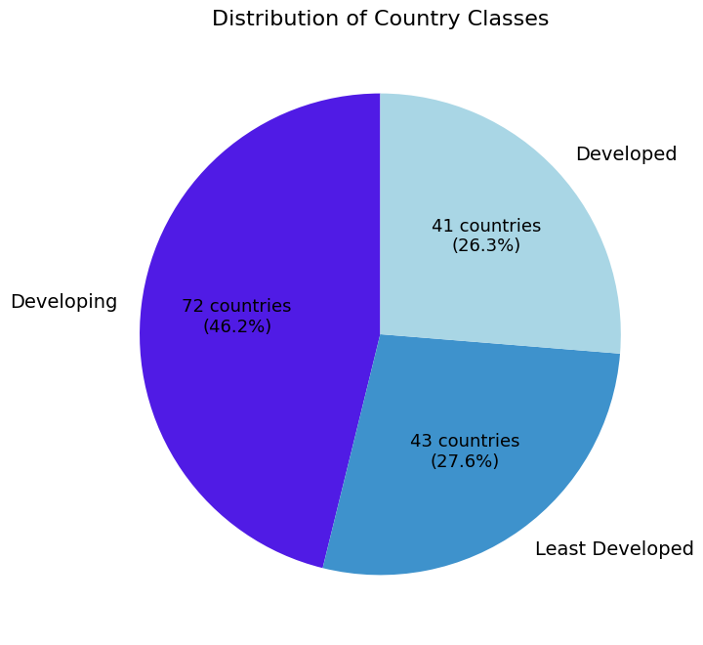
developing countries percentage is approximately the half of the countries represents 72 countries.
the developed and least developed are almost the same:
developed (41 countries)
least developed (43 countries)

Slide 8
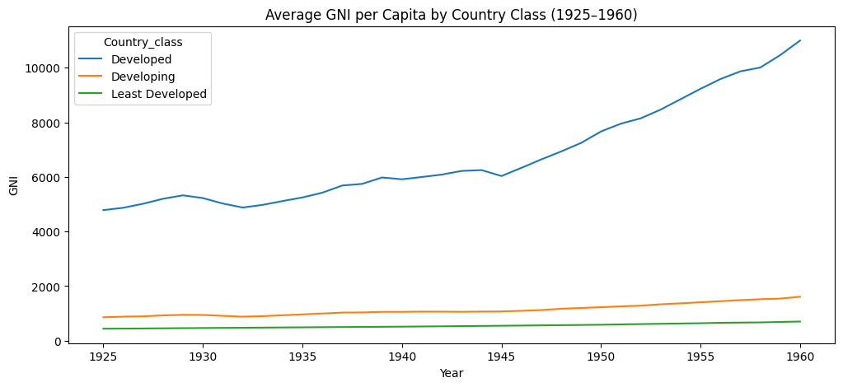
The graph shows that GNI increased in all development groups over time; however, a significant gap remains between them. Developed countries experienced the strongest growth, reaching approximately $11,000 by 1960. In contrast, developing and least developed countries remained far behind, with both groups staying below $2,000 throughout the period.

Slide 9
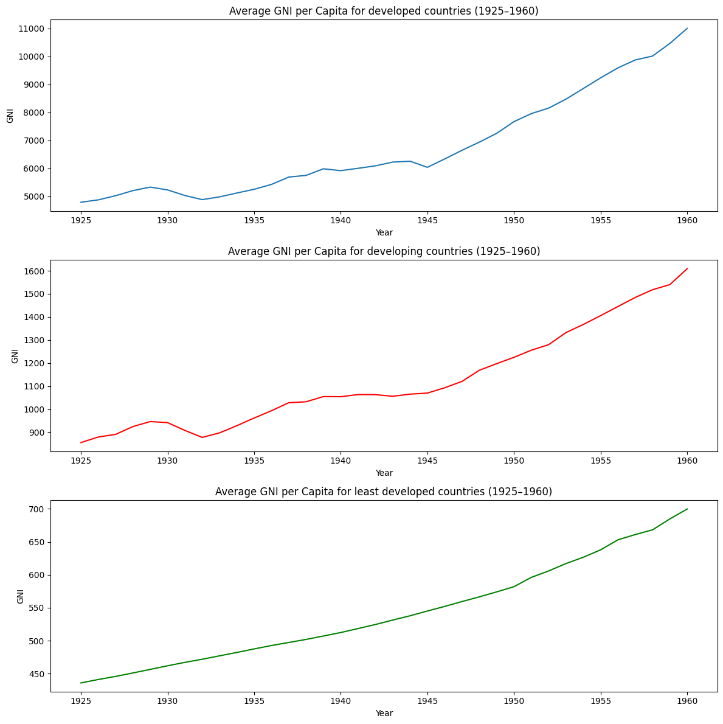
Developed countries experienced the strongest growth, rising from below $5,000 to about $11,000 by 1960.
Developing countries increased gradually from less than $900 to $1,600.
least developed countries grew more slowly from below $450 to about $700.
developed and developing countries experienced slower GNI growth between 1937–1945 due to World War II.
After 1945, growth accelerated rapidly, especially in developed countries.
Least developed countries were less affected, showing slower but more stable growth throughout the period.

Slide 10
Life Expectancy
(Worldwide Study)

Slide 11
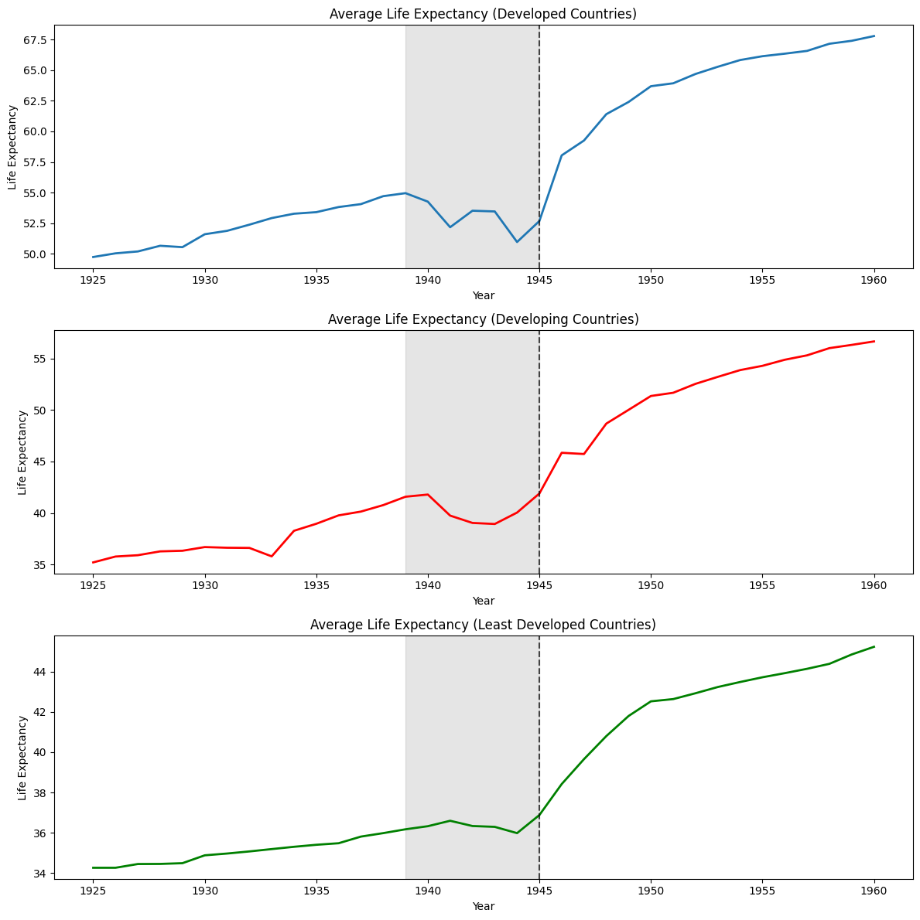
. The average life expectancy varied significantly between these groups. In 1925, life expectancy was approximately in the mid-30s for developing and least developed countries, while developed countries had a much higher average life expectancy, reaching the early 50s.

Slide 12
Life expectancy increased in all development groups from 1925–1960, with different patterns.
In developed countries, it rose steadily until 1940, fluctuated during World War II, and then increased rapidly after 1945, reaching over 67 years by 1960.
Developing countries showed gradual growth up to the early 40s, a slight decline during the war, and a steady post-war recovery to over 55 years.
Least developed countries had slower overall improvement, with minor gains before 1945, a small wartime drop, and a gradual rise after the war to above 44 years.

Slide 13
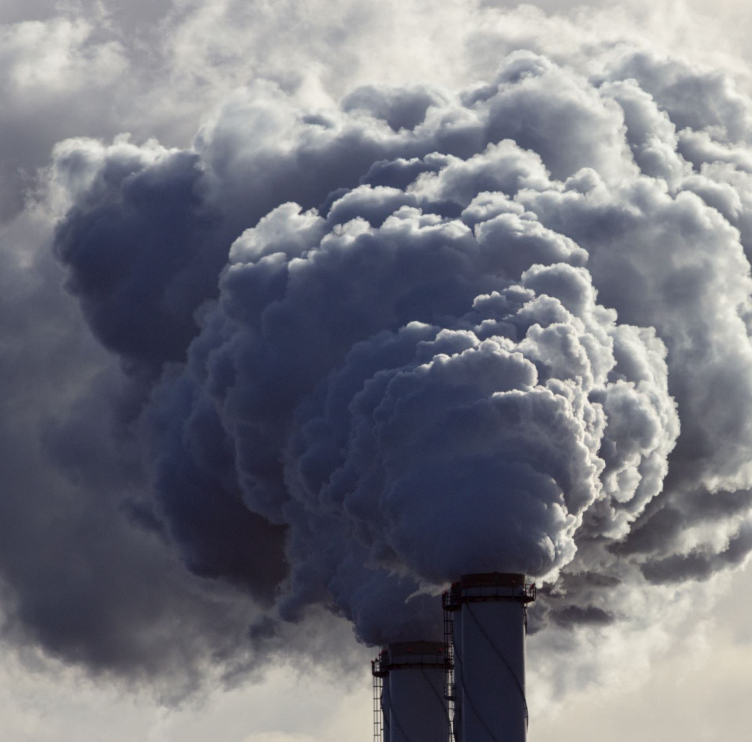
(Worldwide Study)
CO2 emissions

Slide 14
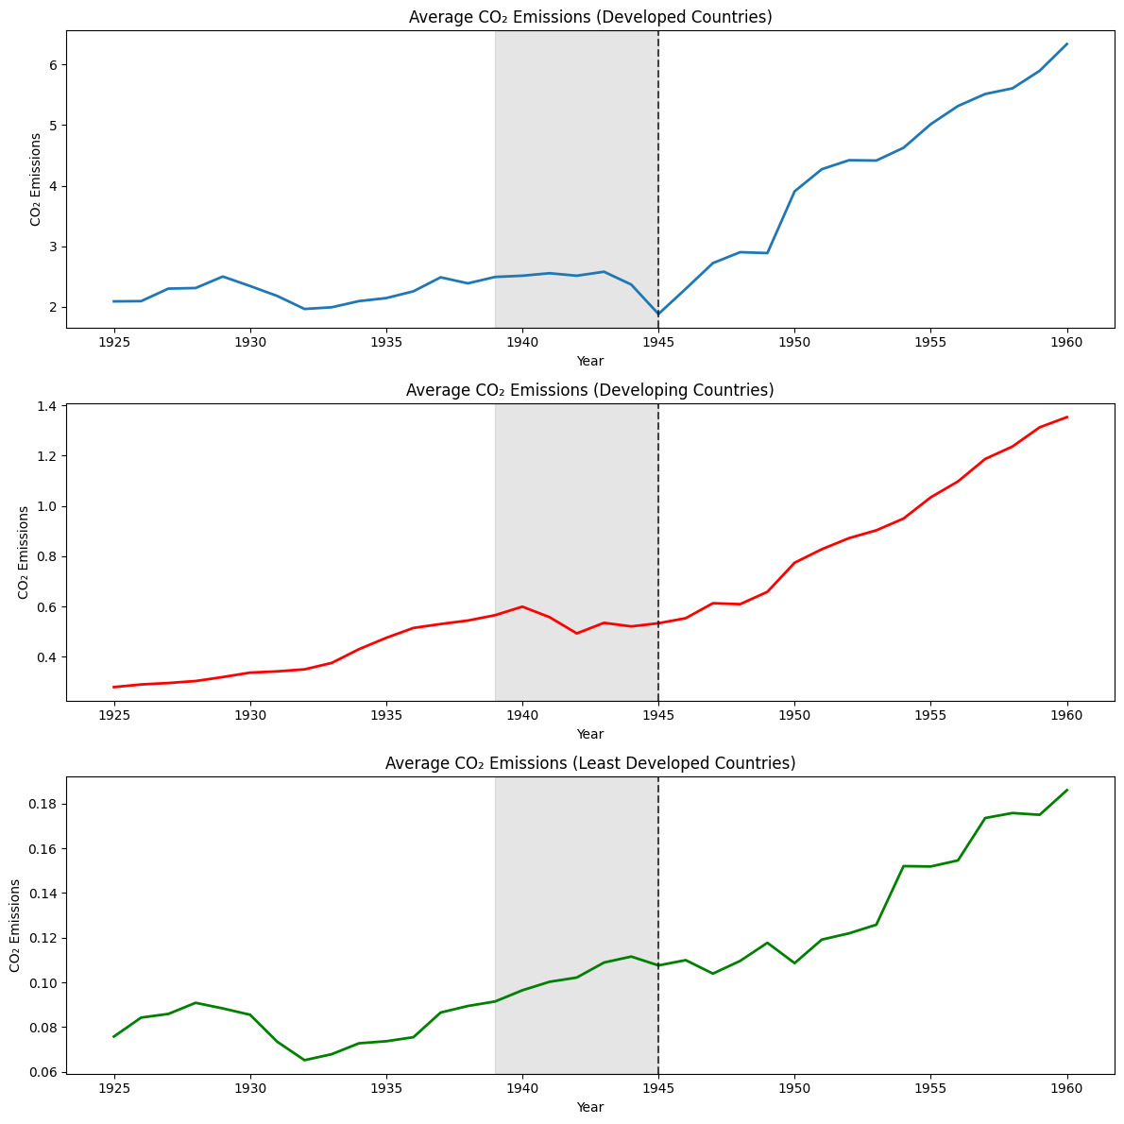
CO₂ emission levels varied significantly depending on the level of development. In 1925, developed countries had average emissions of approximately 2 units, compared to around 0.2 in developing countries, while least developed countries showed very low emission levels.
After World War II, CO₂ emissions increased sharply across all groups, reflecting rapid industrial expansion and economic recovery. However, developed countries experienced much higher emission growth than the other groups due to faster industrialization and larger-scale economic activity.
By 1960, average CO₂ emissions exceeded 6 units in developed countries and reached around 1.4 in developing countries, while least developed countries remained below 1 throughout the period.

Slide 15
(Worldwide Study Summary)
World War II had a significant impact on the economic growth of developed and developing countries, slowing the growth of Gross National Income (GNI) during the war period. In contrast, least developed countries showed no clear short-term disruption in GNI growth.
The war also had a stronger effect on life expectancy in developed and industrialized countries, where wartime destruction and social disruption caused temporary declines and instability. Meanwhile, least developed countries experienced more limited short-term effects but continued to maintain lower life expectancy levels throughout the studied period.
After World War II, CO₂ emissions increased sharply across all country groups, reflecting rapid industrial expansion and post-war economic recovery. However, developed countries experienced much higher emission growth than the other groups due to faster industrialization and larger-scale economic activity, while least developed countries remained below 1 unit throughout the period.

Slide 16
Case study country I
(Japan)

Slide 17
Japan (1925–1960)
1925–1930s
Japan experienced rapid industrialization and military expansion, increasing economic growth and industrial production.
1939–1945
World War II (1939–1945): The war caused major destruction to infrastructure, industry, and civilian life, especially after the atomic bombings of Hiroshima and Nagasaki in 1945.
late 1940s–1950s
Post-war recovery (late 1940s–1950s): Japan rebuilt through economic reforms, industrial growth, and improvements in healthcare and living conditions.
1960
By 1960: The country entered the early stage of its “economic miracle,” with rising income, longer life expectancy, and increasing industrial emissions.

Slide 18
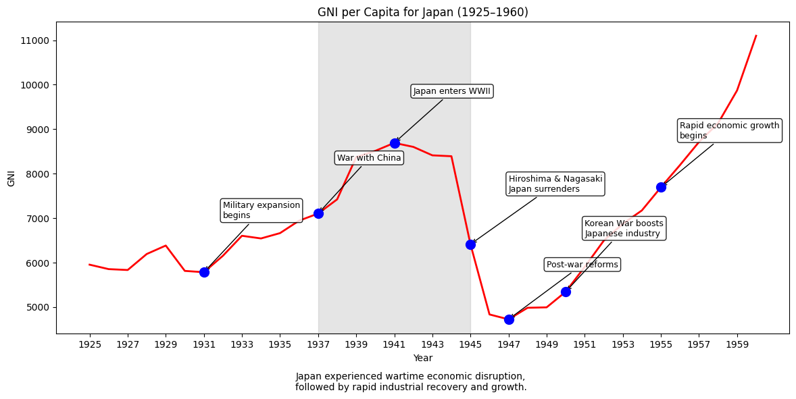
In 1925, Japan’s Gross National Income (GNI) per capita was about $6,000. It rose steadily through the early 1930s and more rapidly up to 1941 (over $8,000) due to industrial growth and military expansion.
After Japan entered World War II, GNI growth slowed and collapsed between 1945–1947, dropping below $5,000 because of wartime destruction, economic disruption, and the impact of the atomic bombings of Hiroshima and Nagasaki.
From around 1950, Japan entered a strong recovery phase, and GNI rose rapidly, exceeding $10,000 by 1960 due to industrial reconstruction and economic reforms.

Slide 19
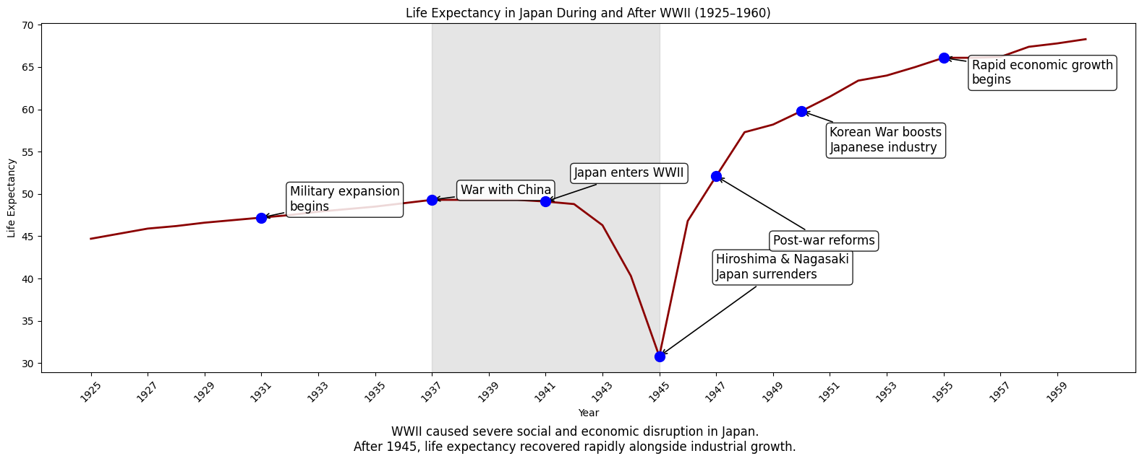
In Japan, life expectancy between 1925 and 1941 increased slowly due to continuous military conflicts in Asia and Japan’s involvement in World War II. By 1945, the average life expectancy dropped sharply from the mid-40s to the early 30s as a result of wartime destruction, poor living conditions, and the impact of the atomic bombings of Hiroshima and Nagasaki.
After 1945, life expectancy recovered rapidly alongside economic reconstruction, healthcare improvements, and industrial growth, eventually exceeding 65 years by 1960.

Slide 20
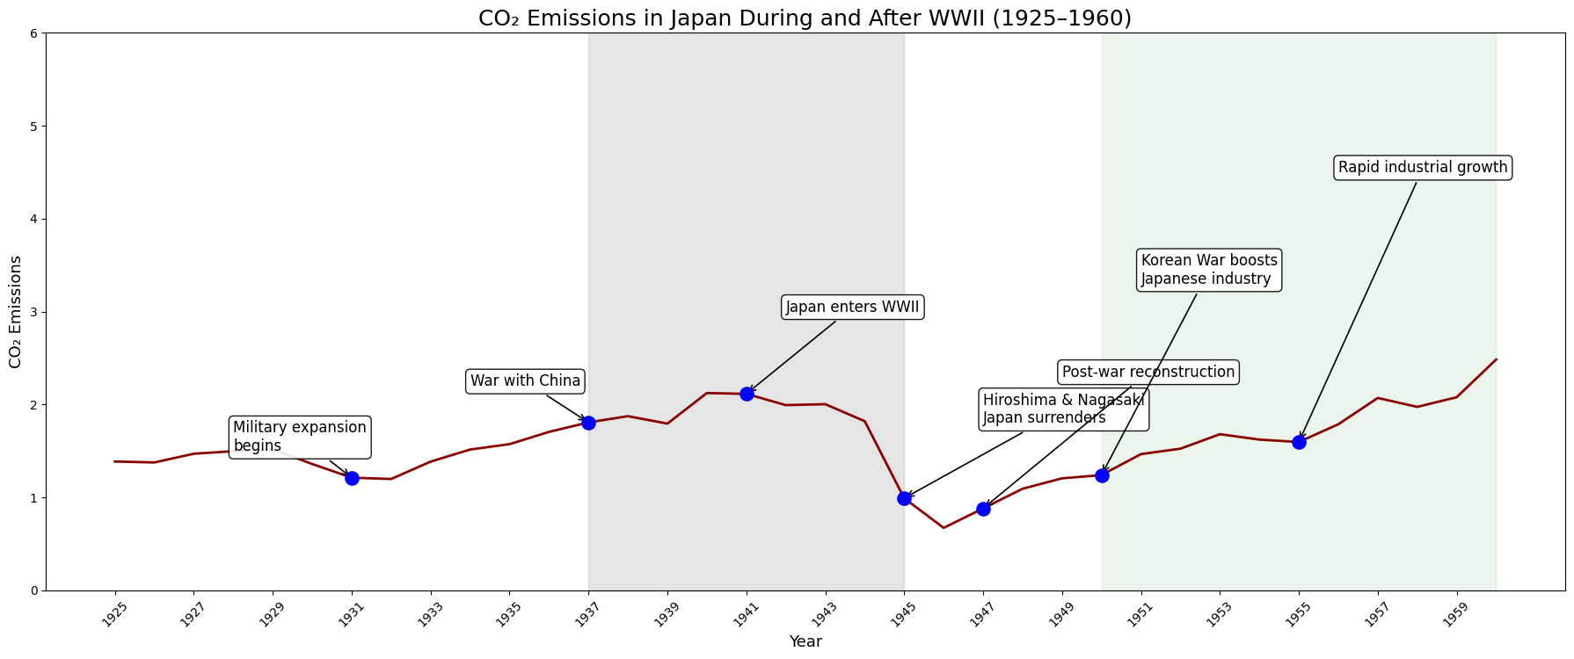
“Japan’s CO₂ emissions declined sharply during the final years of WWII due to destruction of industrial infrastructure and economic collapse. Following post-war reconstruction and industrial expansion in the 1950s, emissions increased rapidly, reflecting Japan’s transformation into a major industrial economy.”

Slide 21
Case study country II
(Germany)

Slide 22
Germany(1925-1960)
Late 1920s–1930s
Germany faced economic instability, including the Great Depression, followed by rapid militarization and industrial growth in the 1930s.
1939–1945
World War II (1939–1945): Germany played a central role in the war, resulting in widespread destruction, economic collapse, and sharp declines in living standards and life expectancy.
1945
Post-1945: The country was divided and began reconstruction with international support, including the Marshall Plan.
1950s
West Germany experienced the “Wirtschaftswunder” (economic miracle), marked by strong industrial growth, rising GNI, improved living standards, and increasing CO₂ emissions due to rapid industrialization.

Slide 23
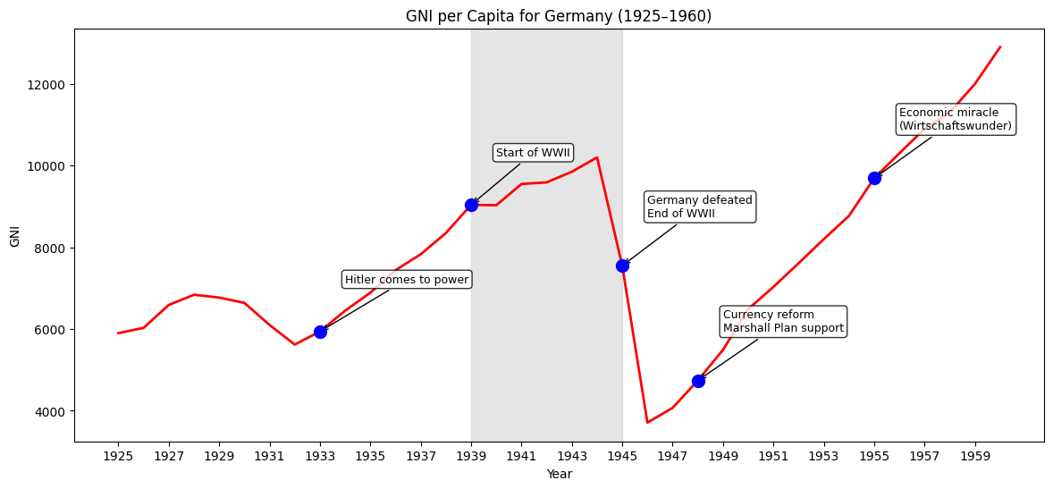
Germany’s Gross National Income (GNI) rose significantly between 1932–1939 due to rapid militarization and industrial expansion under the Nazi regime.
During World War II, growth slowed and then dropped sharply between 1944–1946 because of military defeat, infrastructure destruction, and economic collapse.
After 1945, Germany began rebuilding with international support, including the Marshall Plan, leading to the rapid economic recovery of West Germany in the 1950s, known as the “Wirtschaftswunder.”

Slide 24
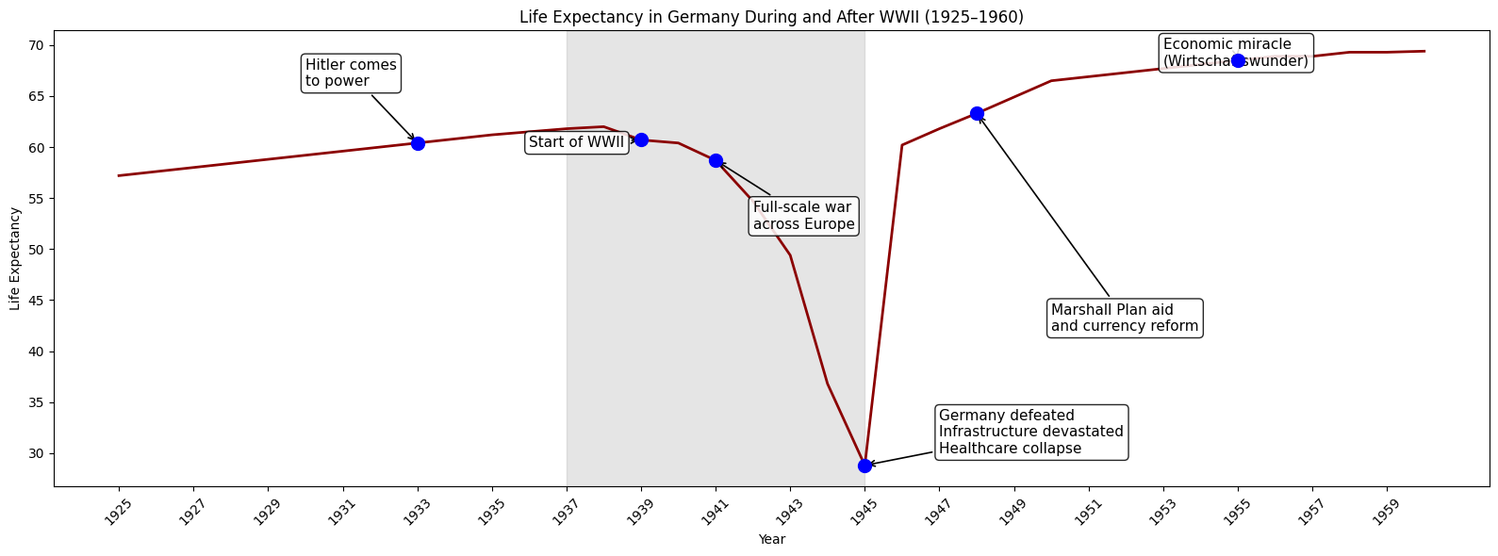
In Germany, life expectancy remained above 55 years between 1925 and 1941 before declining sharply during the final years of World War II. By 1945, the average life expectancy had fallen to below 30 years due to wartime destruction, food shortages, civilian casualties, and the collapse of healthcare and living conditions.
After the war, life expectancy recovered rapidly alongside economic reconstruction, healthcare improvements, and industrial growth, eventually reaching around 70 years by 1960.

Slide 25
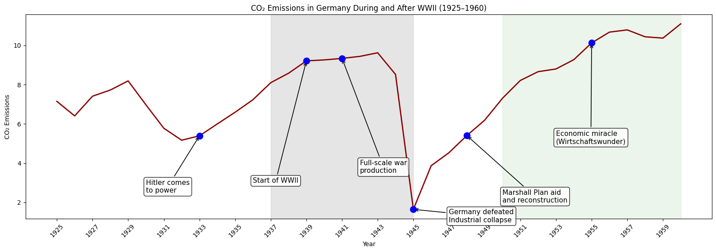
CO₂ emissions in Germany were relatively high starting from 1925, although they fluctuated during the late 1920s due to the effects of the Great Depression and energy shortages. Beginning in the early 1930s, emissions increased rapidly as a result of militarization and industrial expansion under the Nazi regime, reaching more than 9 units by 1943.
After 1943, CO₂ emissions began to decline sharply and collapsed by 1945 due to wartime destruction, industrial collapse, fuel shortages, and Germany’s defeat in World War II. Following 1946, emissions increased again as Germany entered a period of rapid industrial reconstruction and economic recovery, eventually exceeding 12 units by 1960.

Slide 26
Gross National Income (GNI)
Japan | Germany
strong economic growth before World War II due to rapid industrialization and military expansion. economy became increasingly affected by prolonged military conflict in Asia dropped significantly after the atomic bombings and post-war economic disruption. After 1950, showed rapid economic recovery and industrial growth. | strong economic growth before World War II due to rapid industrialization and military expansion. maintained relatively higher and more stable GNI levels during the early war years sharp economic collapse around 1945 as a result of wartime destruction and defeat. After 1950, recovered strongly, reflecting successful post-war reconstruction and industrial expansion.

Slide 27
Life expectancy
Japan | Germany
Around 45 years of age during most of the studied period before WWII, didn’t grow fast because of Asian war. Life expectancy declined sharply during the final years of the war due to destruction, poor living conditions, food shortages, and healthcare collapse. Experienced severe social disruption after the atomic bombings of Hiroshima and Nagasaki in 1945 After 1945, showed rapid improvements in life expectancy as healthcare systems, living conditions, and economies recovered. | Germany had higher life expectancy levels than Japan during most of the studied period before WWII. Life expectancy declined sharply during the final years of the war due to destruction, poor living conditions, food shortages, and healthcare collapse experienced major declines due to widespread destruction across Europe and the collapse of infrastructure by the end of the war. After 1945, showed rapid improvements in life expectancy as healthcare systems, living conditions, and economies recovered.

Slide 28
CO2 emissions
Japan | Germany
Reached maximum of 2 units before the war and after the recovery by 1960. CO₂ emissions increased before and during the war as industrial and military production expanded. experienced a major decline in emissions after 1945 due to economic collapse and wartime destruction. Showed rapid increases in CO₂ emissions as reconstruction and industrial recovery accelerated. | Maintained higher CO₂ emissions than Japan during most of the period due to its larger industrial base and heavy wartime industry. CO₂ emissions increased before and during the war as industrial and military production expanded. Emissions collapsed sharply around 1945 because of industrial destruction, fuel shortages, and wartime defeat. Showed rapid increases in CO₂ emissions as reconstruction and industrial recovery accelerated.

Slide 29
Summary
This project analyzed the impact of World War II on economic growth, quality of life, and environmental change from 1925–1960 using Gross National Income (GNI) per capita, life expectancy, and CO₂ emissions. The study compared global development groups and examined Japan and Germany as case studies.
The results showed that developed countries generally had higher GNI, life expectancy, and CO₂ emissions than developing and least developed countries. World War II caused major economic and social disruption, especially in industrialized nations, leading to declines in GNI and life expectancy around 1945.
Japan and Germany experienced severe wartime collapse followed by rapid recovery during the 1950s through industrial reconstruction, economic growth, improved living conditions, and rising CO₂ emissions linked to industrialization.

Slide 30
Conclusion
The findings show that World War II had major long-term economic, social, and environmental effects, especially on industrialized countries such as Germany and Japan. The war disrupted economic growth, reduced life expectancy, and damaged industrial systems, while post-war reconstruction led to rapid recovery and development.
The study also highlights the link between industrialization and environmental impact, as CO₂ emissions increased sharply during post-war economic expansion, particularly in developed countries.
Overall, the project demonstrates how major global conflicts can strongly affect economic performance, human well-being, and environmental change over time.

