Slide 1

Presentation of Digital Signal Processing
DUAL TONE MULTIPLE FREQUENCY (DTMF) Decoder

Slide 2
Group Members: Roll No:-
M.Ali Shaikh 2017-TE-027
M.Arsalan Mirza 2017-TE-028
Abdul Quyyum Qureshi 2017-TE-036
Muhammad Ahemad 2017-TE-033
SUBMITTED TO: SIR IRFAN USMANI

Slide 3
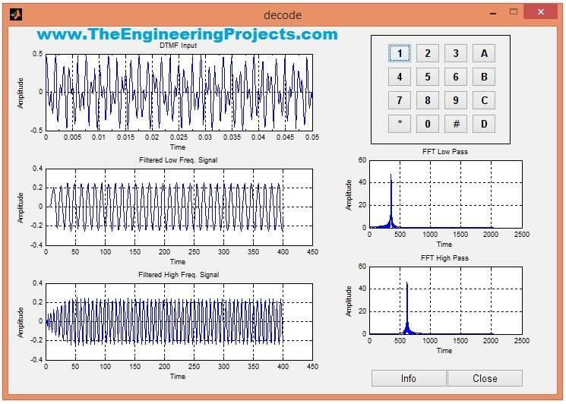
DUAL TONE MULTIPLE FREQUENCY (DTMF)

Slide 4
In this project, We have designed a keypad in MATLAB using the GUI functionality of MATLAB. After designing the keypad, I have assigned a tune to each of these buttons. Obviously the tune attached to each button is different and when we press any of these buttons, then the MATLAB recognizes the respective button. This project is designed in MATLAB and I have tested it on MATLAB 2009 and MATLAB 2014 and it works fine on both of them.

Slide 5
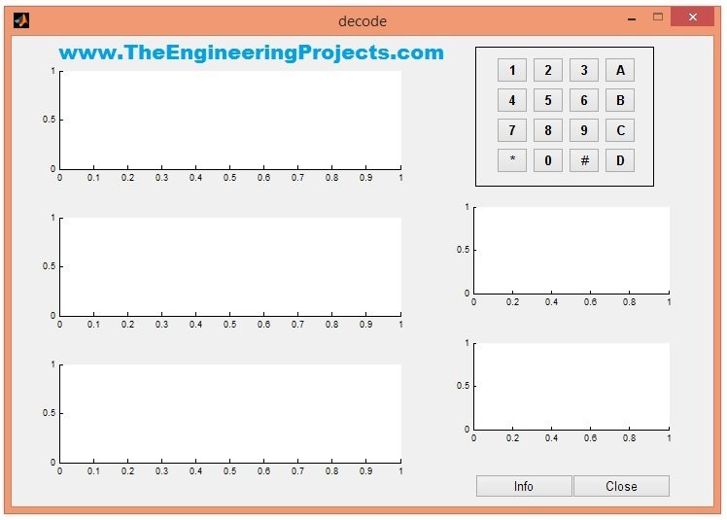
When you run the file named as decoder.m, it will start the GUI which will look something as shown in below figure:

Slide 6
That’s the GUI used for DTMF Decoder using MATLAB.
You can see a keypad is shown in the above GUI, now I have assigned a specific tune to each of these buttons and the code for assigning this tune is as follows:
t=[0:0.000125:.05]; fs=8000; f1=770;f2=1477; y1=.25*sin(2*pi*f1*t); y2=.25*sin(2*pi*f2*t); y=y1+y2;sound(y,fs)So, you can see in the above code that I have generated a sine wave and then created a sound using that sine wave.
So, we have such sounds assigned to each of these buttons.
Now once button is pressed, the respective sound will be activated and rite after that sound, I have added a subroutine for decoding that sound.

Slide 7
This subroutine is placed in a separate file named as subdecode.m.
This subdecode.m is responsible for DTMF decoding and its code is as follows:
CODING
axes(handles.fig1); plot(t,y); set(handles.fig1,'XMinorTick','on'); title('DTMF Input');xlabel('Time'); ylabel('Amplitude');grid; rmain=2048*2;rmag=1024*2; cn=9;cr=0.5; cl=.25;ch=.28; [b,a]=cheby1(cn,cr,cl); yfilt1=filter(b,a,y); h2=fft(yfilt1,rmain); hmag2=abs(h2(1:rmag)); [b1,a1]=cheby1(cn,cr,ch,'high'); yfilt2=filter(b1,a1,y); h3=fft(yfilt2,rmain); hmag3=abs(h3(1:rmag)); axes(handles.fig2); plot(yfilt1);grid; title('Filtered Low Freq. Signal'); xlabel('Time');ylabel('Amplitude'); axes(handles.fig3); plot(yfilt2);grid; title('Filtered High Freq. Signal'); xlabel('Time');ylabel('Amplitude');

Slide 8
hlow=fft(yfilt1,rmain); hmaglow=abs(hlow); axes(handles.fig4); plot(hmaglow(1:rmag)); title('FFT Low Pass');grid; xlabel('Time');ylabel('Amplitude'); hhigh=fft(yfilt2,rmain); hmaghigh=abs(hhigh); axes(handles.fig5); plot(hmaghigh(1:rmag)); title('FFT High Pass');grid; xlabel('Time');ylabel('Amplitude'); m=max(abs(hmag2));n=max(abs(hmag3)); o=find(m==hmag2);p=find(n==hmag3); j=((o-1)*fs)/rmain; k=((p-1)*fs)/rmain; if j<=732.59 & k<=1270.91; disp('---> Key Pressed is 1'); elseif j<=732.59 & k<=1404.73; disp('---> Key Pressed is 2'); elseif j<=732.59 & k<=1553.04; disp('---> Key Pressed is 3'); elseif j<=732.59 & k>1553.05; disp('---> Key Pressed is A'); elseif j<=809.96 & k<=1270.91; disp('---> Key Pressed is 4'); elseif j<=809.96 & k<=1404.73; disp('---> Key Pressed is 5'); elseif j<=809.96 & k<=1553.04; disp('---> Key Pressed is 6'); elseif j<=809.96 & k>1553.05; disp('---> Key Pressed is B'); elseif j<=895.39 & k<=1270.91; disp('---> Key Pressed is 7'); elseif j<=895.39 & k<=1404.73; disp('---> Key Pressed is 8'); elseif j<=895.39 & k<=1553.04; disp('---> Key Pressed is 9'); elseif j<=895.39 & k>1553.05; disp('---> Key Pressed is C'); elseif j>895.40 & k<=1270.91;
end

Slide 9
Now you can see in this code we are applying FFT on each of these sound signals and then comparing them to get our required button press.
Now, when I press any of these buttons then the GUI will look something as shown in below figure:

Slide 10
You can see in the above figure that first graph is showing the DTMF input, which is actual signal which I have converted to sound on button press.
The second graph is showing the Filtered Low Frequency Signal while the third one is showing the Filtered High Frequency Signal.
The two graphs on the right side are showing the Amplitude of FFT Low Pass and FFT High Pass.
Now if you have a look at the Command window of MATLAB then it will give you the button pressed as shown in below figure:

Slide 11
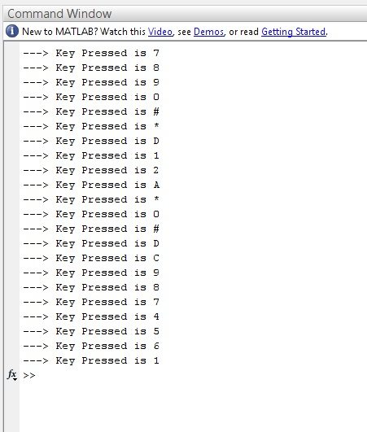
These are the buttons which I have pressed while testing it and it has given me each time which button is pressed.

Slide 12

THANK YOU

