Slide 1
Zoo Management System

Slide 2
Introduction
A Zoo Management System is a software tool created to help run a zoo more easily. It allows zoo staff to organize and manage important information, such as details about animals, their living spaces (habitats), employees, feeding schedules, and visitor records.
By storing all this information in one place using a SQL database (a tool for organizing data), the system makes it easier to find and update information, reduces the amount of manual work, and helps keep everything running smoothly.

Slide 3
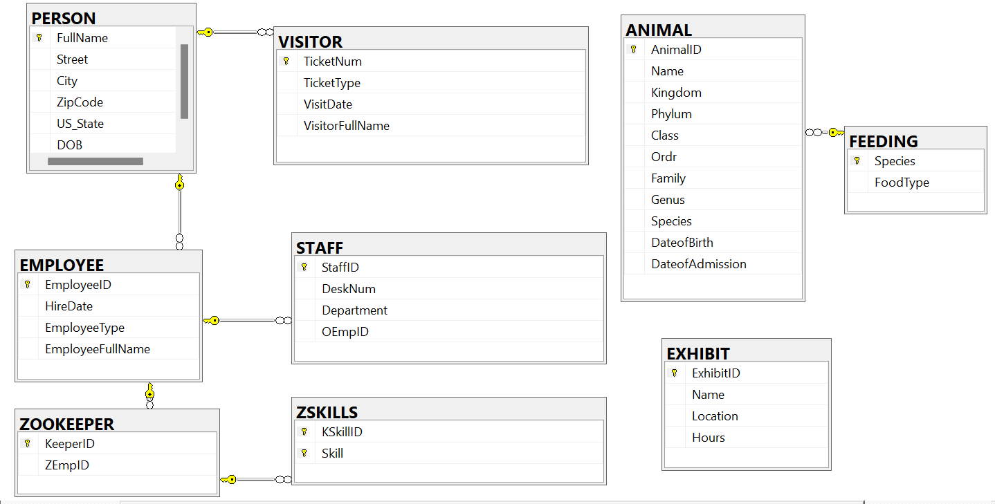
ER Diagram

Slide 4
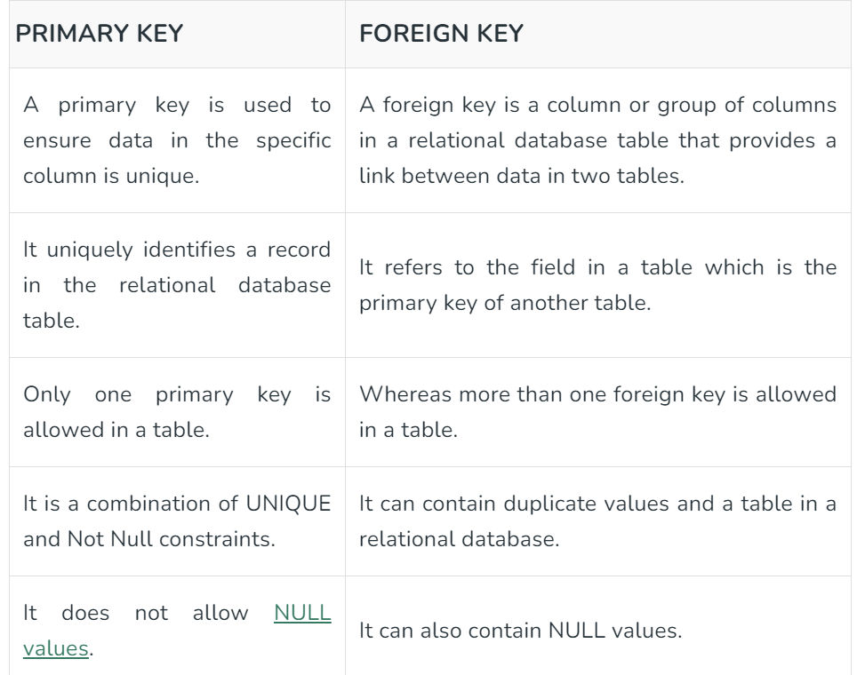
Primary key and Foreign Key

Slide 5
Relationship between Tables
create table ANIMAL(
Animal ID varchar(9) primary key,
Name varchar(20),
Kingdom varchar(20),
Phylum varchar(20),
Class varchar(20),
Order varchar(20),
Family varchar(20),
Genus varchar(100),
Species varchar(100),
Date of Birth date,
Date of Admission date,
constraint ANIMAL_FK foreign key(Species) references FEEDING(Species));
create table FEEDING(
Species varchar(100)
primary key,
FoodType varchar(50));

Slide 6
Relationship between Tables
CREATE TABLE PERSON(
FullName VARCHAR(40) NOT NULL,
Street VARCHAR(50),
City VARCHAR(20),
ZipCode INT(5),
US_State VARCHAR(20),
DOB DATE,
CONSTRAINT PERSON_PK PRIMARY KEY (FullName));
CREATE TABLE VISITOR(
Ticket Num INT(8) NOT NULL,
Ticket Type VARCHAR(5),
Visit Date DATE ,
Visitor Full Name VARCHAR(40),
CONSTRAINT VISITOR_PK PRIMARY KEY(TicketNum),
CONSTRAINT VISITOR_FK FOREIGN KEY(Visitor Full Name) REFERENCES PERSON(FullName));

Slide 7
Key SQL Queries
Retrieving animal details (SELECT).
Adding a new animal (INSERT).
Updating feeding schedules (UPDATE).
SQL are used to combine rows from two or more tables

Slide 8
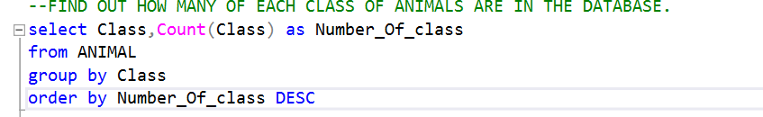
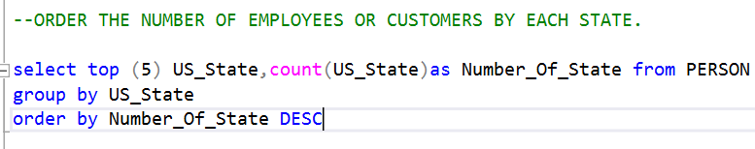
QUERIES

Slide 9
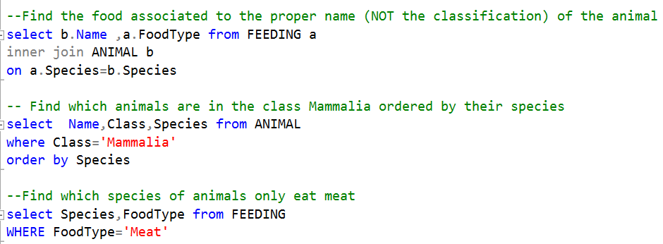

Slide 10
SystemFeature
Animal Management: Track details like species, health, and age.
Habitat Management: Assign animals to specific enclosures.
Staff Management: Record employee roles and responsibilities.
Feeding & Medical Records: Maintain feeding schedules and health check-ups

Slide 11
Conclusion
The Zoo Management System developed using SQL demonstrates the effectiveness of a relational database in managing the complex operations of a zoo. By structuring the data into well-organized tables, the system simplifies the management of animals, habitats, staff, feeding schedules, and medical records.

