Slide 1
Noise Pollution Monitoring using IOT
TEAM MEMBERS:
Mohan Krishna
Yeswanth
Vignesh Kumar
Pavan Kumar
Shaik kaif
PHASE 3 :
Data analytics to identity noise pollution
patterns,High-noise areas,
and potential sources.

Slide 2
Overview
We focus on innovation by incorporating data analytics into our project
The project involves deploying IoT sensors to measure noise pollution in public areas and providing real-time noise level data accessible to the public through a platform or mobile app.
The primary objective is to raise awareness about noise pollution and enable informed decision-making.
This project includes defining objectives, designing the IoT sensor system, developing the noise pollution information platform, and integrating them using IoT technology and Python.
This phase is crucial because it allows us to dig deeper into the noise pollution data we've collected using IoT devices.

Slide 3
Data collection
In this phase, we collect noise data using various sensors, such as microphones and sound level meters, connected to our IoT devices. These devices continuously monitor noise levels in different areas, providing us with a rich dataset
Data analytics
Data analytics involves the use of advanced algorithms and techniques to process and analyze the collected noise data. This phase allows us to extract valuable insights and patterns from the raw data.

Slide 4
Noise Pollution Pattern
By applying data analytics, we can identify patterns in noise pollution. For example, we might discover that noise levels are consistently higher during certain times of the day or week, which can help us understand the sources of noise pollution.
High-Noise Areas
NOISE AREAS
Industrial facilities
Highways
Railways
Airplane traffic
Outdoor construction
Data analytics helps us pinpoint high-noise areas within our study area. These could be specific neighborhoods, streets, or even individual buildings where noise pollution is a significant concern.

Slide 5
Potential Noise Sources
We discussed the identification of potential noise sources through data analysis ,
Through data analysis, we can uncover potential noise sources. This may include identifying specific machinery, transportation routes, or industrial facilities that contribute to noise pollution.
Potential Noise Sources
Specific machinery
Transportation routes
Industrial facilities

Slide 6
IoT Technology
IoT technologies and devices used in our project like ,
we leverage IoT technology, including sensors, communication networks, and data processing capabilities. IoT devices are the backbone of our data collection and analysis efforts, enabling real-time monitoring and insights.
IOT TECHNOLOGY
Sensors
Communication networks
Data processing capabilities
enabling real-time monitoring

Slide 7
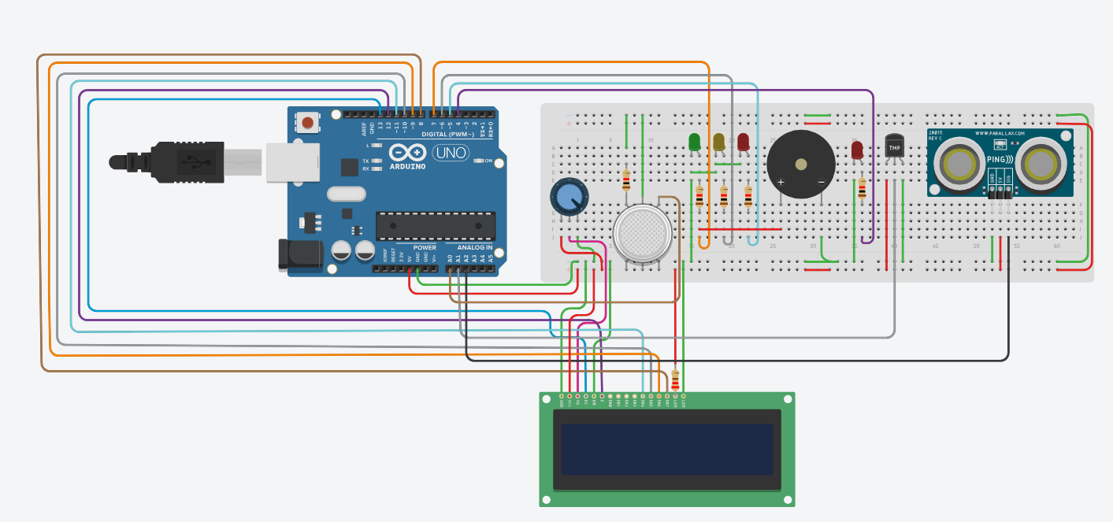
Model:

Slide 8
Coding:
import requests
import matplotlib.pyplot as plt
# Replace 'YOUR_API_KEY' with your actual OpenWeatherMap API key
API_KEY = 'YOUR_API_KEY'
def get_air_quality_data(city, api_key):
base_url = "http://api.openweathermap.org/data/2.5/air_pollution"
params = {
"q": city,
"appid": api_key
}
response = requests.get(base_url, params=params)
if response.status_code == 200:
data = response.json()
return data
else:
print("Error fetching data")
return None

Slide 9
Coding:
def plot_air_quality(data):
labels = ['CO', 'NO', 'NO2', 'O3', 'SO2', 'PM2.5', 'PM10']
values = [data['list'][0]['components'][comp] for comp in labels]
plt.bar(labels, values)
plt.title('Air Quality Index Components')
plt.xlabel('Pollutants')
plt.ylabel('Concentration (µg/m³)')
plt.show()
if __name__ == "__main__":
city = "New York" # Change this to your desired city
air_quality_data = get_air_quality_data(city, API_KEY)
if air_quality_data:
plot_air_quality(air_quality_data)

Slide 10
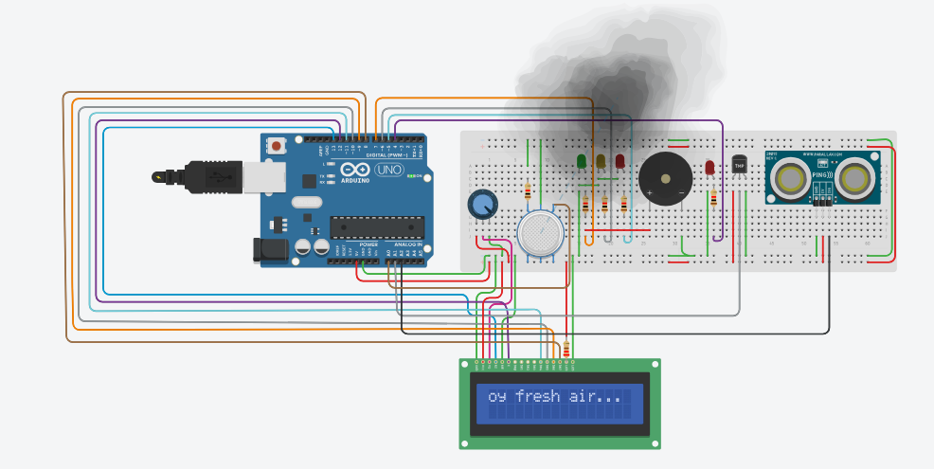
OUTPUT:

Slide 11
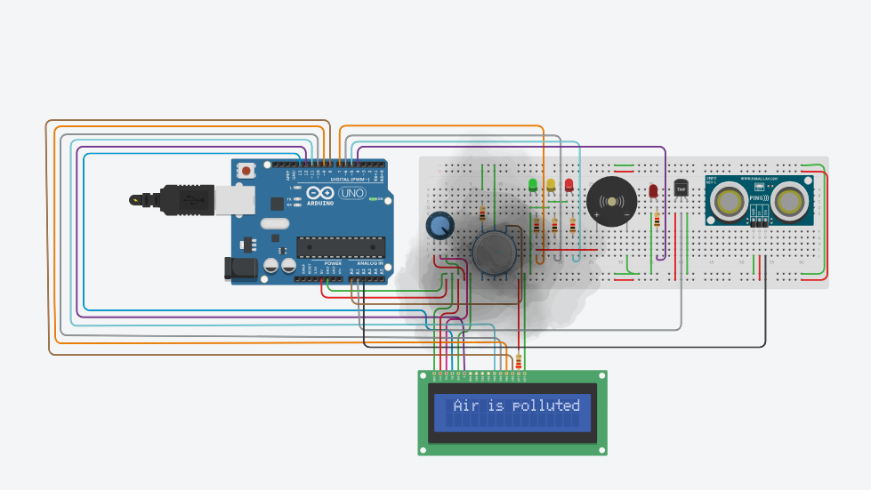
Output:

Slide 12
Challenges and Solutions
Challenges faced during the innovation phase :
While innovating with data analytics, we may encounter challenges such as data quality issues, sensor calibration, or data privacy concerns. We must address these challenges by implementing solutions like data filtering, sensor maintenance, and privacy protocols to ensure the accuracy and integrity of our analysis
Challenges and Solutions
Data quality issues
Sensor calibration
Data Concerns
Data filtering
Sensor maintenance
Privacy protocols

Slide 13
Future Works
Our vision for how this innovation can be further developed
Looking ahead, our project's innovation in noise pollution analysis opens up exciting possibilities. We can explore the development of predictive models, urban planning improvements, or noise mitigation strategies based on the insights gained during this phase.
Explore advancements in sensor technology to improve the accuracy and sensitivity of noise measurements.
Investigate the integration of additional environmental sensors to provide a more comprehensive understanding of ambient conditions.
The potential applications are vast and can contribute to a quieter and healthier environment

Slide 14
Conclusion
In conclusion, the hypothetical case studies outlined showcase the diverse applications and positive outcomes of implementing noise pollution monitoring through IoT.
These scenarios illustrate the effectiveness of real-time data in addressing specific noise-related challenges in various environments, from urban cities to educational institutions and residential communities.
https://www.tinkercad.com/things/5EwQYqxNBui-copy-of-air-sound-pollution-monitoring/editel?tenant=circuits

