Slide 1
Data Science - Maths
Mean : The average of number in a data set is called as mean.
Ex: [1,2,3,4,5]
then,
mean=1+2+3+4+5/5=3
Mode : The most common value or the highest repeating value in the data set is called as Mode.
Ex : [1,2,4,3,5,2,6,3,2]
then,
Mode=2
Median : The mid point or middle value of the data set Is called as median.
Ex : [1,2,3,4,5]
then,
Median=3

Slide 2
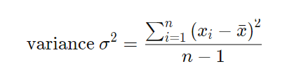
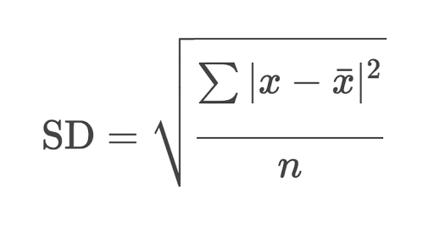
Variance (σ²): Statistical measurement of the spread between numbers in a data set.
Standard Deviation : It is the amount of variation in the data set.
SD = sq.root of its variance

Slide 3
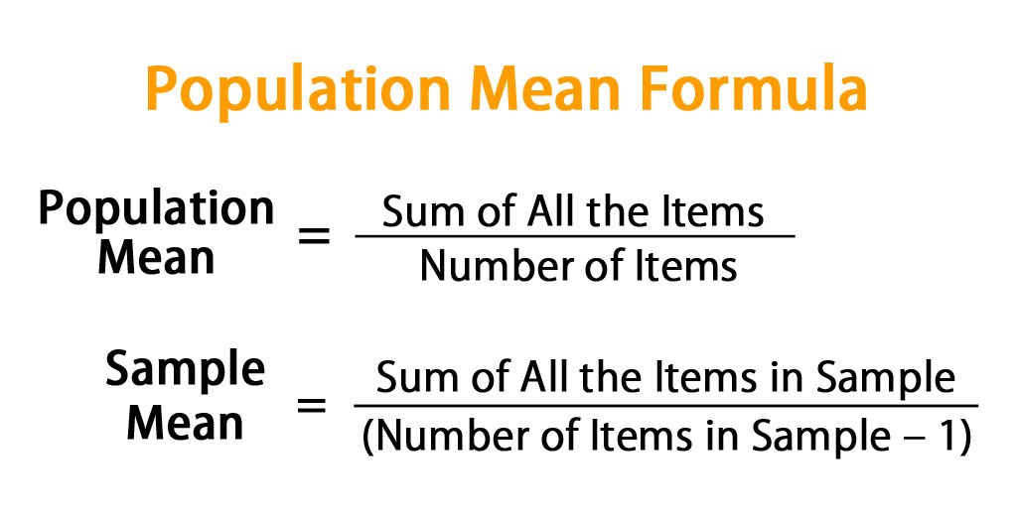
Population Mean : It is the mean of all the values in the population
Sample Mean : is the arithmetic mean of small sample data drawn from population.

Slide 4
1.Data set : [7,11,16,14,11,13,19,13,13]
Mean : 13
Median :
order [7,11,11,13,13,13,14,16,19]
-> 13
Mode : 13
2.Data Set :[16,15,16,17,19,12,14,9]
Mean : 14.75
Median :
order=[9,12,14,15,16,16,17,19]
Even number of n
So, round middle values
15+16/2=15.5
Mode : 16
3.Data Set : [27,66,24,81,50,40,74,81,97]
Mean : 60
Median :66
Mode : 81

