Slide 1
ComplianceIQ
AI-Driven Multi-Agent Regulatory Compliance System
IRDAI . MAS · 3 specialized agents · knowledge graph · audit-grade observability
Capstone Demo — ~10 minutes
Notes:
[0:00 - 0:45] Hi - this is the ComplianceIQ capstone demo. ComplianceIQ is an AI-driven multi-agent regulatory compliance system. It reads internal company policies, compares them against regulations from IRDAI and the Monetary Authority of Singapore, identifies compliance gaps, scores them by severity, and produces an audit-ready DOCX report - end to end in under thirty minutes for less than ten cents in OpenAI usage. In the next ten minutes I'll walk through the problem, the architecture, the three agents, a live end-to-end run, the dashboard, the report, and the new FastAPI surface. [Advance to slide 2]

Slide 2
The problem
Compliance teams in financial services spend WEEKS each quarter manually cross-referencing internal policies against IRDAI / MAS regulations. Audits surface gaps LATE; evidence is rebuilt from scratch.
Multi-jurisdiction complexity
Policy ↔ regulation mapping
many regulators, all updating constantly
tens of thousands of clause connections done by hand
Late gap identification
Documentation burden
gaps surface during the audit, not before
evidence binders rebuilt from scratch every cycle
Notes:
[0:45 - 1:45] Compliance teams in financial services spend weeks every quarter manually cross-referencing policies against regulations. Four pain points keep coming up. Multi-jurisdiction complexity: IRDAI and MAS update constantly, and an insurer operating in both jurisdictions has to track both. The mapping itself: tens of thousands of clause-to-policy connections, all currently done by hand. Late gap identification: gaps usually surface during the audit, not before, which is the worst possible time. Documentation burden: evidence binders are rebuilt from scratch every audit cycle. ComplianceIQ replaces that workflow with an observable, reproducible AI pipeline. [Advance to slide 3]

Slide 3
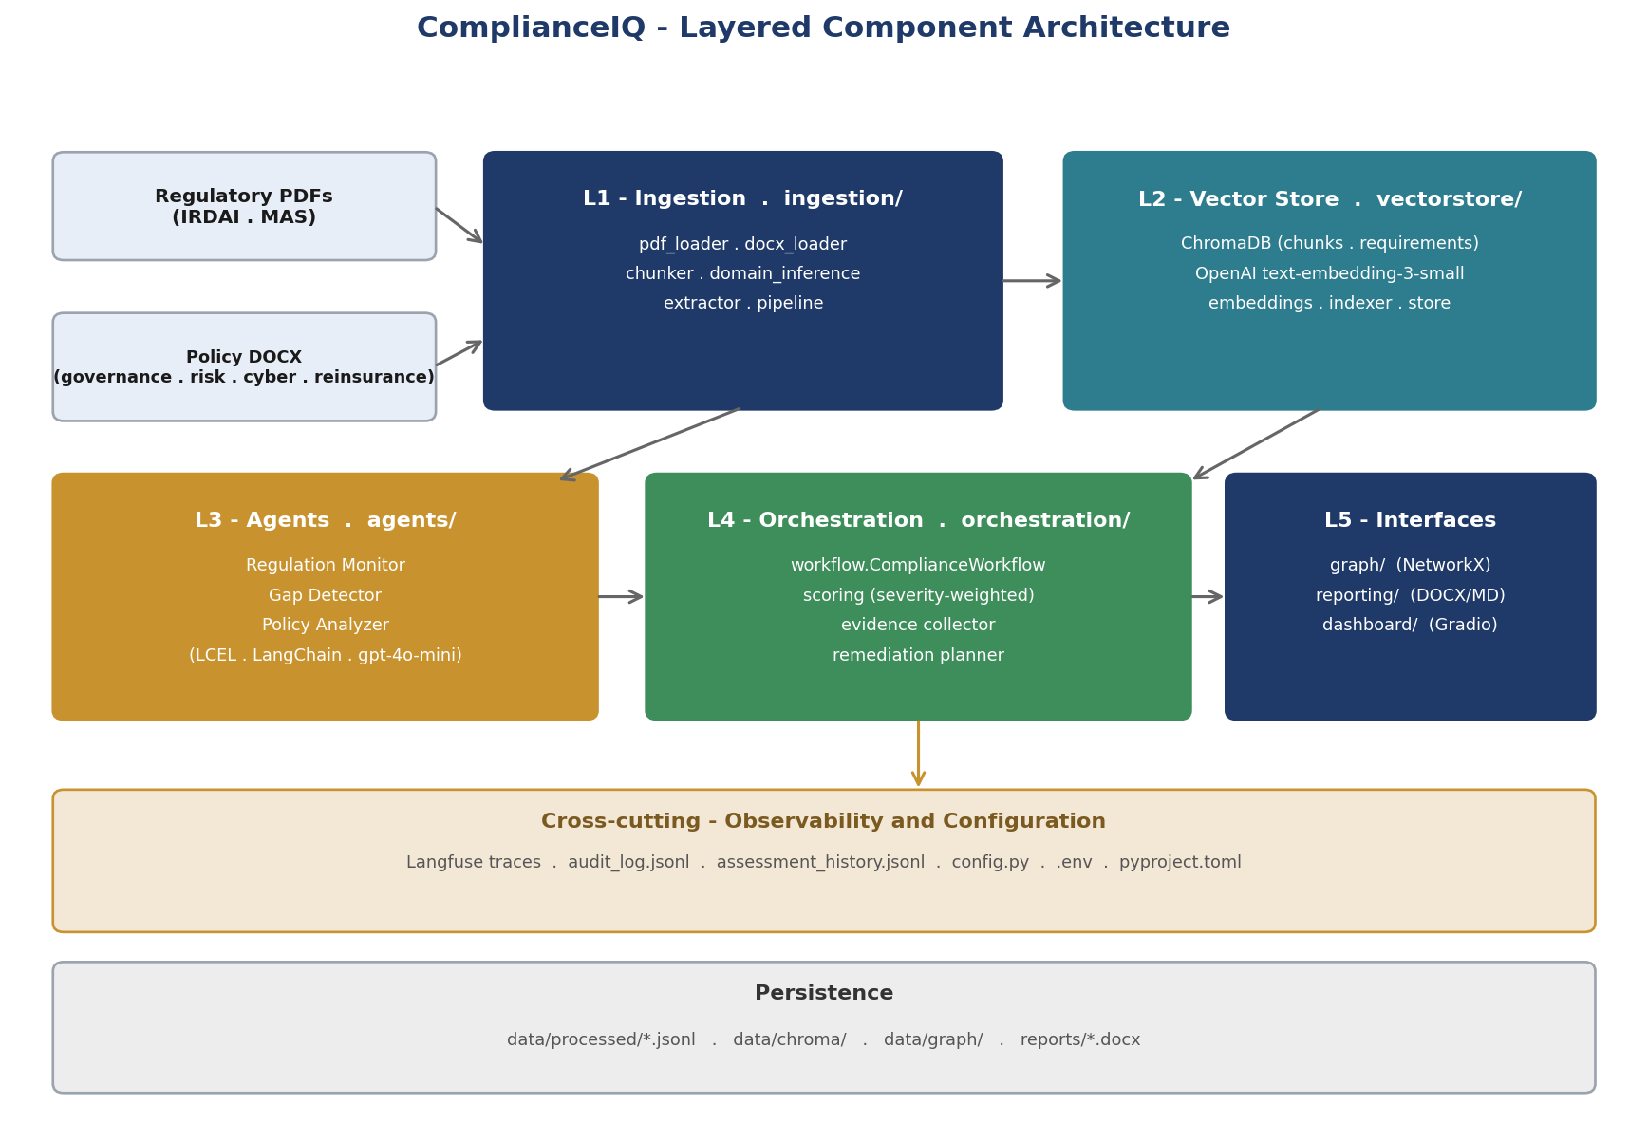
Architecture — five layers
Cross-cutting observability + immutable audit log on every run.
Notes:
[1:45 - 2:45] The system is organised into five logical layers. Layer one is ingestion - PDFs and DOCX in, structured chunks out, classified by domain. Layer two is the vector store - two ChromaDB collections, chunks and requirements, with OpenAI embeddings. Layer three is the three specialised agents. Layer four is orchestration - running the agents, scoring, evidence collection, remediation. Layer five is the interfaces: knowledge graph, DOCX reports, the Gradio dashboard, and the new FastAPI server. Cutting across all of them is observability - Langfuse traces every LLM call, and every run produces an immutable JSONL audit log. [Advance to slide 4]

Slide 4
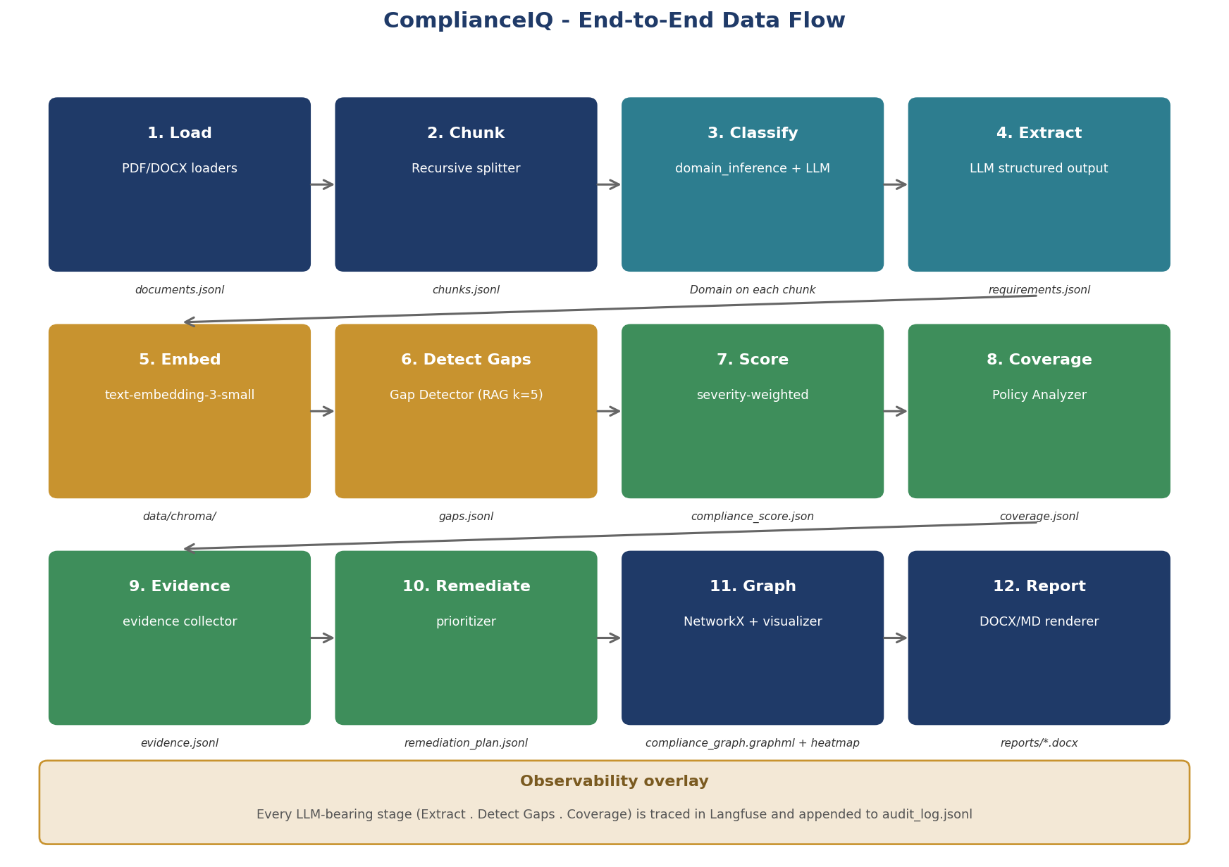
12-stage pipeline — JSONL contracts at every stage
Notes:
[2:45 - 3:30] Each stage consumes the previous stage's JSONL artefact and produces its own. That gives me three things. First - every stage is independently runnable, debuggable, and re-runnable. Second - any tool that opens JSON can introspect outputs. No bespoke loaders. Third - re-runs are idempotent because Chroma uses deterministic IDs derived from source file plus chunk index. [Advance to slide 5]

Slide 5
Three specialized agents — single-responsibility, LCEL, Pydantic-typed
Regulation Monitor
Reads each IRDAI/MAS document; extracts mandatory actions + evidence needs into a typed RegulationSummary.
Gap Detector
RAG over ChromaDB (top-5 policy chunks per requirement); LLM judges coverage; writes Gap with severity, remediation_priority, confidence, and ClauseRef.
Policy Analyzer
Aggregates gaps per Domain into a CoverageAssessment with quality + weighted scores.
Notes:
[3:30 - 4:30] Single-responsibility scales. The Regulation Monitor reads each regulatory document and extracts a structured summary. The Gap Detector - the core RAG component - retrieves the top five policy chunks for each requirement from ChromaDB and asks the LLM to judge coverage, severity, remediation priority, and a confidence score. The Policy Analyzer rolls everything up per domain. Every agent uses the same LCEL pattern: prompt pipe llm dot with-structured-output and a Pydantic schema. Schema violations fail at the agent boundary, never downstream. [Advance to slide 6 and switch to Terminal 1]

Slide 6
Live demo
1.
python main.py orchestrate --concurrency 8 --limit 5
(small to keep it fast)
2.
Inspect compliance_score.json
deterministic severity-weighted formula
3.
python main.py dashboard
Overview → Gaps → Coverage → Reports → Upload
4.
Open compliance_assessment_report.docx
audit-ready DOCX
5.
python main.py api → /docs
REST endpoints; live /score and /gaps query
6.
python main.py history --compare
trend tracking across runs
Notes:
[4:30 - 8:00] LIVE SEGMENT - follow ComplianceIQ_Demo_Runbook.md TERMINAL 1: python main.py orchestrate --concurrency 8 --limit 5 Narrate while it runs (~60-90s): 'You can see the Regulation Monitor starts first... then the Gap Detector runs in parallel, with each completed gap appended to gaps.jsonl in real time...' When done: type data\processed\compliance_score.json | more 'The number is computed in pure Python - no LLM in the headline metric - using severity weights three, two, one for high, medium, low and coverage values of one, point five, and zero. Same gaps in always produce the same score.' Then: python main.py dashboard Open http://localhost:7860 and click through Overview > Gaps > Coverage > Remediation > Search > Reports > UPLOAD (point at HITL queue).

Slide 7
Key technical decisions
LCEL + Pydantic structured output
Deterministic Python scoring (no LLM in headline metric)
Schema violations fail at the agent boundary, never downstream.
Severity weights {3,2,1} × coverage {1.0, 0.5, 0.0}. Auditors can recompute by hand.
JSONL artefacts per stage
Fail-open Langfuse observability
jq, pandas, Excel all 'just work'; CI fixtures are checked-in JSONL snippets.
Pipeline reliability decoupled from observability uptime.
Tier-up routing + LRU caches
HITL gate before remediation publication
gpt-4o-mini default; tier up to gpt-4o on low-confidence high-stakes calls.
Pauses when score < threshold OR any gap is low-confidence.
Notes:
[8:00 - 9:30] [Switch to slide 7 only briefly, then back to live demo] Open reports/compliance_assessment_report.docx in Word. Scroll: executive summary > per-domain table > top gaps > remediation. 'Audit-ready DOCX. Exactly what a regulator-facing audit binder needs.' TERMINAL 2 (NEW terminal, leave dashboard running): .venv\Scripts\Activate.ps1 python main.py api Open http://localhost:8000/docs. 'Same workflow, exposed over HTTP. POST /assess kicks off background runs. GET /score returns the latest ComplianceScore. GET /gaps takes filters - that's the HITL queue exposed as an API.' Then back to terminal: python main.py history --compare 'Every assessment writes a snapshot. Compare flag shows the delta against the previous run.'

Slide 8
Headline numbers
22
3
~700
source documents (14 IRDAI/MAS PDFs + 8 policies)
specialized agents over a 12-stage pipeline
LLM calls per full assessment
< $0.10
< 30 min
100%
OpenAI spend per full run
raw PDFs → audit-ready DOCX
LLM call coverage in Langfuse traces
Notes:
[9:30 - 9:50] [Pause 5 seconds on each metric block] To wrap up - twenty-two source documents, three agents, a twelve-stage pipeline, around seven hundred LLM calls per full assessment for less than ten cents of OpenAI spend, under thirty minutes from raw PDFs to audit-ready DOCX, and one hundred percent LLM observability when Langfuse is configured. [Advance to slide 9]

Slide 9
Recap
Production-shaped, layered, typed Python system — not a notebook.
Three LCEL agents + RAG + NetworkX KG + deterministic scoring.
Audit-grade: every LLM call traced, every run snapshotted to JSONL.
Resilient: retries, model tiering, async parallelism, fail-open observability, HITL gate.
Reach surfaces: CLI, Gradio dashboard with Upload tab, FastAPI with OpenAPI docs.
Thank you — questions welcome.
Notes:
[9:50 - 10:00] ComplianceIQ is not a notebook. It is a layered, typed, observable Python system that demonstrates production AI engineering on a real regulatory-tech problem. Three LCEL agents over RAG and a NetworkX knowledge graph. Deterministic scoring. Audit-grade tracing. Resilience baked in. Three reach surfaces - CLI, Gradio dashboard, FastAPI. Thank you. [STOP RECORDING]

