Slide 1

BLUESTOCK FINTECH
Mutual Fund Data Analytics
Capstone Project — Final Presentation
Prepared by Shaik Mohammad Vali
Data Analyst | Python • SQL • Power BI • Excel
Project Duration: June 20, 2026 – July 10, 2026

Slide 2
AGENDA
What We'll Cover
1
Project Overview & Objectives
7
Advanced Analytics
2
Project Structure & Tech Stack
8
Power BI Dashboard Walkthrough (4 Pages)
3
Dataset & ETL Pipeline
9
Key Insights
4
Database Design
10
How to Run the Project
5
Exploratory Data Analysis
11
Future Improvements
6
Financial Performance Analytics
Bluestock Fintech • Mutual Fund Data Analytics Capstone
2

Slide 3
SECTION 01
Project Overview & Objectives
A comprehensive Mutual Fund Data Analytics solution built as part of the Bluestock Data Analytics Capstone — covering data collection, cleaning, storage, analysis, and visualization to generate meaningful business insights for investors.
Key Objectives
Build an automated ETL pipeline for mutual fund datasets
Store cleaned data in a SQLite database
Analyze fund performance using financial risk & return metrics
Visualize trends using interactive Power BI dashboards
Recommend funds based on risk and performance profile
Generate actionable insights for investors
Bluestock Fintech • Mutual Fund Data Analytics Capstone
3

Slide 4
SECTION 02
Project Structure & Technologies Used
Technology Stack
Repository Structure
MUTUAL_FUND_PROJECT/
├─ data/ (raw, processed, db)
├─ notebooks/ (ingestion → cleaning → EDA →
performance → advanced analytics)
├─ scripts/ (etl_pipeline.py, compute_metrics.py,
live_nav_fetch.py, recommender.py)
├─ sql/ (schema.sql, queries.sql)
├─ dashboard/ (Mutual_Fund_Dashboard.pbix)
├─ reports/ (Final_Report.pdf, Presentation.pptx)
└─ README.md, requirements.txt, .gitignore
Programming
Database
Python, Pandas, NumPy
SQLite, SQL
Analysis
Visualization
Jupyter, Matplotlib, Seaborn
Power BI
Data Access
Version Control
Requests API (live NAV)
Git & GitHub
Bluestock Fintech • Mutual Fund Data Analytics Capstone
4

Slide 5
SECTION 03
Dataset & ETL Pipeline
Dataset Components
ETL Pipeline Steps
Fund Master
1
Extract raw CSV files
NAV History
2
Remove duplicates
AUM Details
3
Handle missing values
Scheme Performance
4
Standardize column names
Investor Transactions
5
Convert date columns
6
Load into SQLite database
Bluestock Fintech • Mutual Fund Data Analytics Capstone
5

Slide 6
SECTION 04
Database Design
SQLite backend • data/db/bluestock_mf.db
Table | Purpose
fund_master | Master reference data for each mutual fund scheme
nav_history | Historical daily NAV records per scheme
fact_aum | Assets Under Management by fund / AMC over time
scheme_performance | Computed return and risk metrics per scheme
investor_transactions | SIP, lumpsum and redemption transaction records
Bluestock Fintech • Mutual Fund Data Analytics Capstone
6

Slide 7
SECTION 05
Exploratory Data Analysis
Analysis Areas
Visualizations Used
Missing Value Analysis
Duplicate Analysis
Distribution Analysis
Correlation Analysis
Fund Category Analysis
AUM Analysis
NAV Trends
Performance Comparison
Histograms
Boxplots
Bar Charts
Line Charts
Scatter Plots
Heatmaps
Bluestock Fintech • Mutual Fund Data Analytics Capstone
7

Slide 8
SECTION 06
Financial Performance Analytics
CAGR
Volatility
Sharpe Ratio
Sortino Ratio
Compounded annual growth rate
Standard deviation of returns
Risk-adjusted return vs. risk-free rate
Risk-adjusted return, downside deviation
Beta
Alpha
Max Drawdown
VaR / CVaR
Sensitivity to benchmark movement
Excess return over the benchmark
Largest peak-to-trough decline
Potential & expected tail-risk loss
Bluestock Fintech • Mutual Fund Data Analytics Capstone
8

Slide 9
SECTION 07
Advanced Analytics
1
Cohort Analysis
2
Risk Analysis
Grouping investors and funds to study behavior and performance over time.
Evaluating volatility, drawdown, and downside risk across categories.
3
Fund Recommendation System
4
VaR & CVaR Analysis
Suggesting funds aligned to an investor's risk appetite.
Quantifying tail-risk exposure across the mutual fund universe.
Bluestock Fintech • Mutual Fund Data Analytics Capstone
9

Slide 10
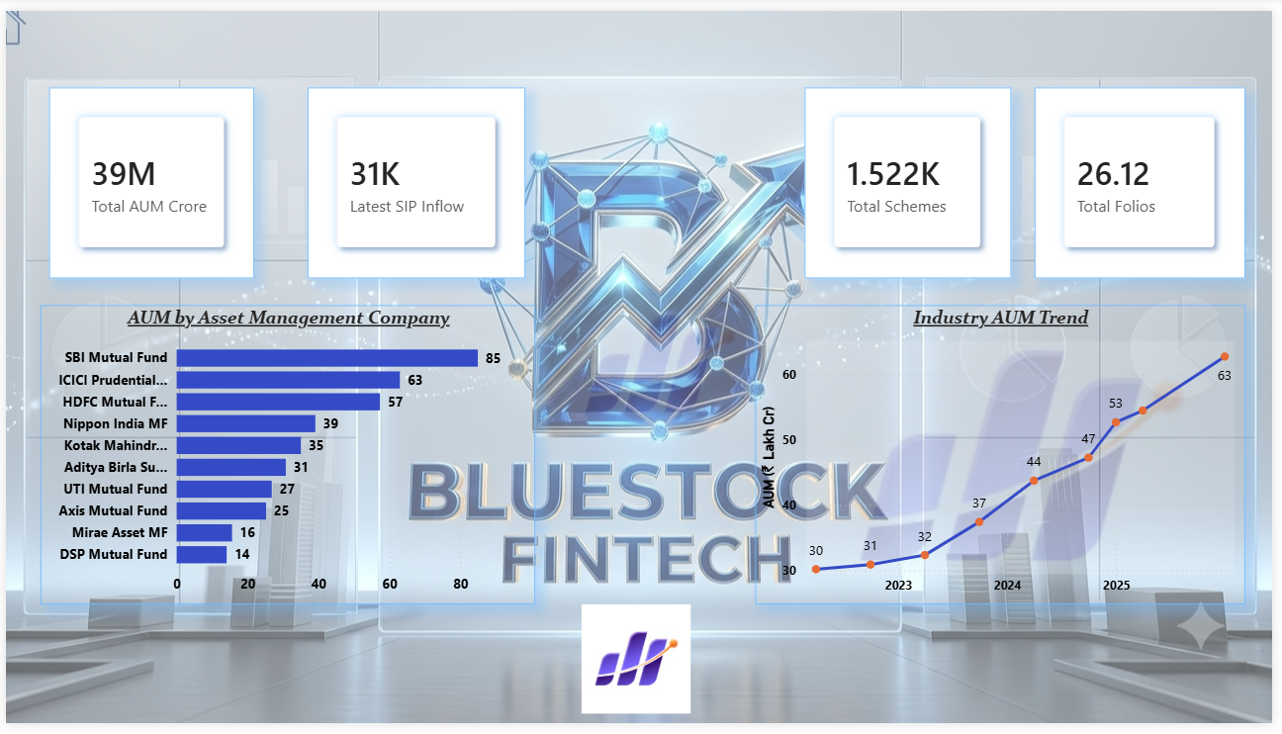
DASHBOARD 01
Industry Overview
Overall summary of the mutual fund dataset — total funds, AUM, average returns, and category distribution.
Key Highlights
Total AUM: 39M crore
Total Schemes: 1,522
Total Folios: 26.12K
Latest SIP Inflow: 31K
Top AMCs: SBI, ICICI Prudential, HDFC
Industry AUM trending up 2023–2025
Bluestock Fintech • Mutual Fund Data Analytics Capstone
10

Slide 11
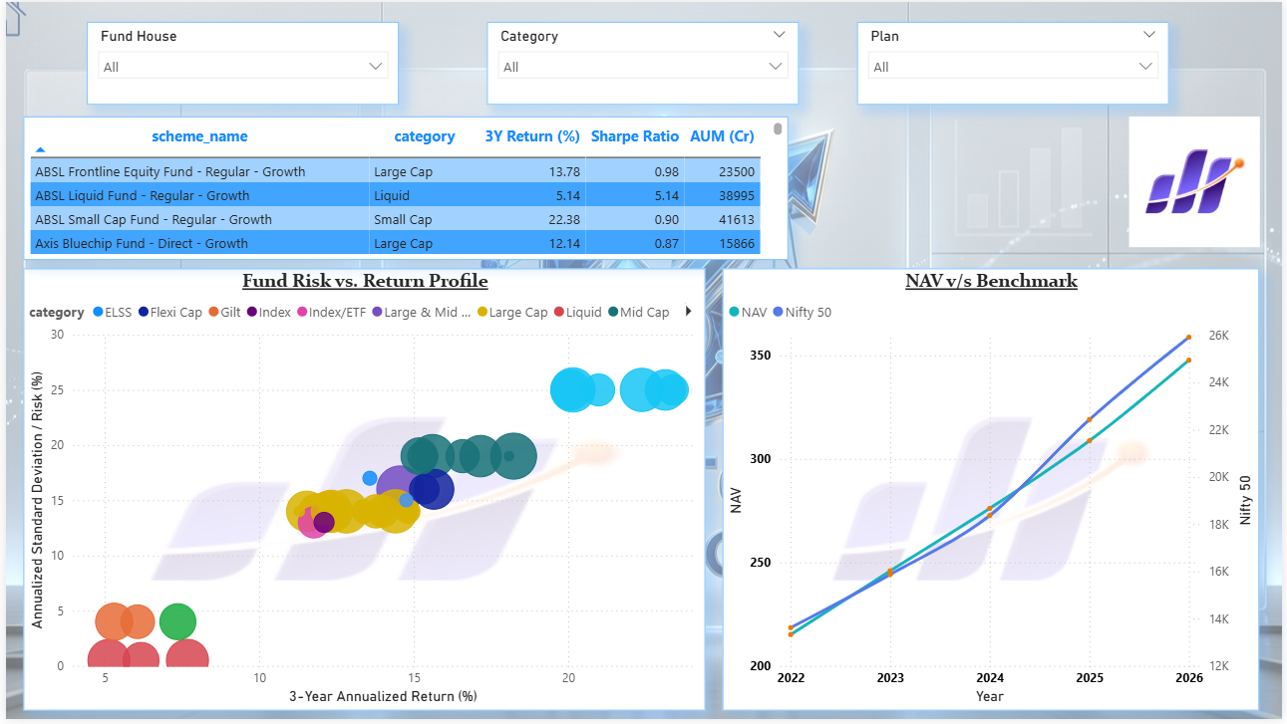
DASHBOARD 02
Fund Performance
Fund performance analyzed via CAGR, annual returns, Sharpe Ratio, and NAV trends, with Fund House / Category / Plan filters.
Key Highlights
Scheme-level 3Y Return %, Sharpe Ratio & AUM table
Risk vs. Return bubble chart by category
NAV vs. Nifty 50 benchmark, 2022–2026
Interactive slicers for deep-dive comparison
Bluestock Fintech • Mutual Fund Data Analytics Capstone
11

Slide 12
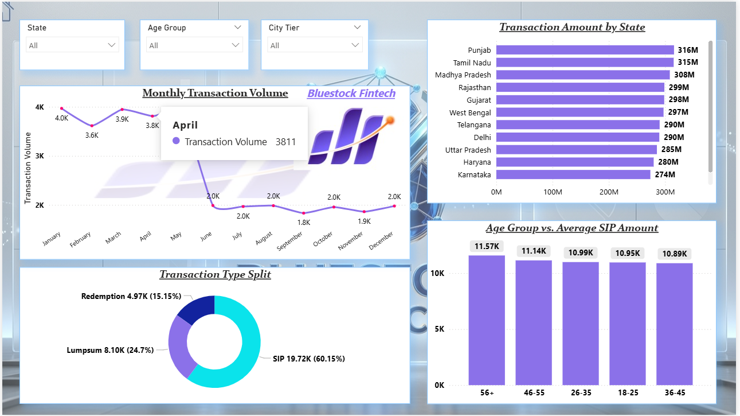
DASHBOARD 03
Investor Analytics
Investor behavior across transaction volumes, transaction types, and demographics by state and age group.
Key Highlights
SIP 60.15% • Lumpsum 24.7% • Redemption 15.15%
Monthly volume peaks near 4K in Q1
Top states: Punjab, Tamil Nadu, MP
56+ age group leads average SIP amount
Bluestock Fintech • Mutual Fund Data Analytics Capstone
12

Slide 13
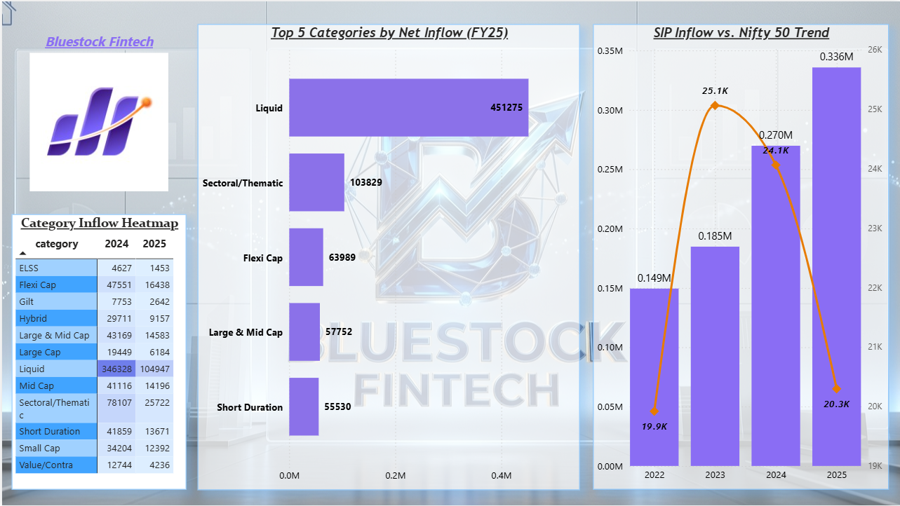
DASHBOARD 04
SIP & Market Trends
SIP inflows by category benchmarked against the Nifty 50, with a category-wise year-over-year inflow heatmap.
Key Highlights
Liquid funds lead FY25 net inflow: 451,275
SIP inflows resilient through market swings
2024–2025 category heatmap comparison
Sectoral/Thematic & Flexi Cap follow closely
Bluestock Fintech • Mutual Fund Data Analytics Capstone
13

Slide 14
SECTION 13
Key Insights
01
Equity funds generated higher long-term returns than debt funds.
02
Lower expense ratio funds delivered better risk-adjusted performance.
03
Higher AUM does not always indicate superior returns.
04
Sharpe Ratio effectively identifies consistent performers.
05
Maximum Drawdown highlights downside risk across funds.
06
SIP inflows stay resilient even through market corrections.
Bluestock Fintech • Mutual Fund Data Analytics Capstone
14

Slide 15
SECTION 14
How to Run the Project
Quick Start
Project Outputs
git clone https://github.com/yourusername/
mutual_fund_project.git
Cleaned CSV files
SQLite database
SQL queries
EDA notebooks
Performance & advanced analytics
Power BI dashboard
Final report & presentation
pip install -r requirements.txt
python scripts/etl_pipeline.py
python scripts/compute_metrics.py
python scripts/live_nav_fetch.py
Bluestock Fintech • Mutual Fund Data Analytics Capstone
15

Slide 16
SECTION 15
Future Improvements
1
Live NAV updates using MFAPI
2
Streamlit web application
3
Portfolio optimization (Markowitz Model)
4
Monte Carlo simulation for risk scenarios
5
Automated email reporting
Bluestock Fintech • Mutual Fund Data Analytics Capstone
16

Slide 17
Thank You
Mutual Fund Data Analytics Capstone Project
Shaik Mohammad Vali
Data Analyst | Python • SQL • Power BI • Excel
github.com/Shaikvali-skills
Submitted to Bluestock Fintech • July 10, 2026

