Slide 1
Unified Public Wi-Fi Security Monitoring System for Smart Cities
Submitted in the partial fulfillment for the award of the degree of
BACHELOR OF ENGINEERING
IN
INFORMATION SECURITY
Submitted by:
Shail Gupta :22BIS50003
Jahir : 22BIS70078
Md.Hadique:22BIS50006
Under the Supervision of:
Komal Mehta(E15888)
Department of AIT-CSE
DISCOVER . LEARN . EMPOWER

Slide 2
Outline
Introduction to Project
Block Diagram / System Architecture
Experimental Setup Design
Required Equipment / Software
Methodology Used
Research Methodology
Feasibility & Innovation
References

Slide 3
Introduction to Project
Smart Cities offer free public Wi-Fi to enhance connectivity, but these networks are prone to cyber-attacks such as man-in-the-middle attacks, spoofing, and malware injections.
Traditional security solutions lack scalability and adaptability for open public networks.
The project aims to build a Unified Security Monitoring System leveraging Open-Source Intrusion Detection Systems (IDS) like Snort, along with Wireshark and Python-based automation, to ensure secure public Wi-Fi environments.

Slide 4
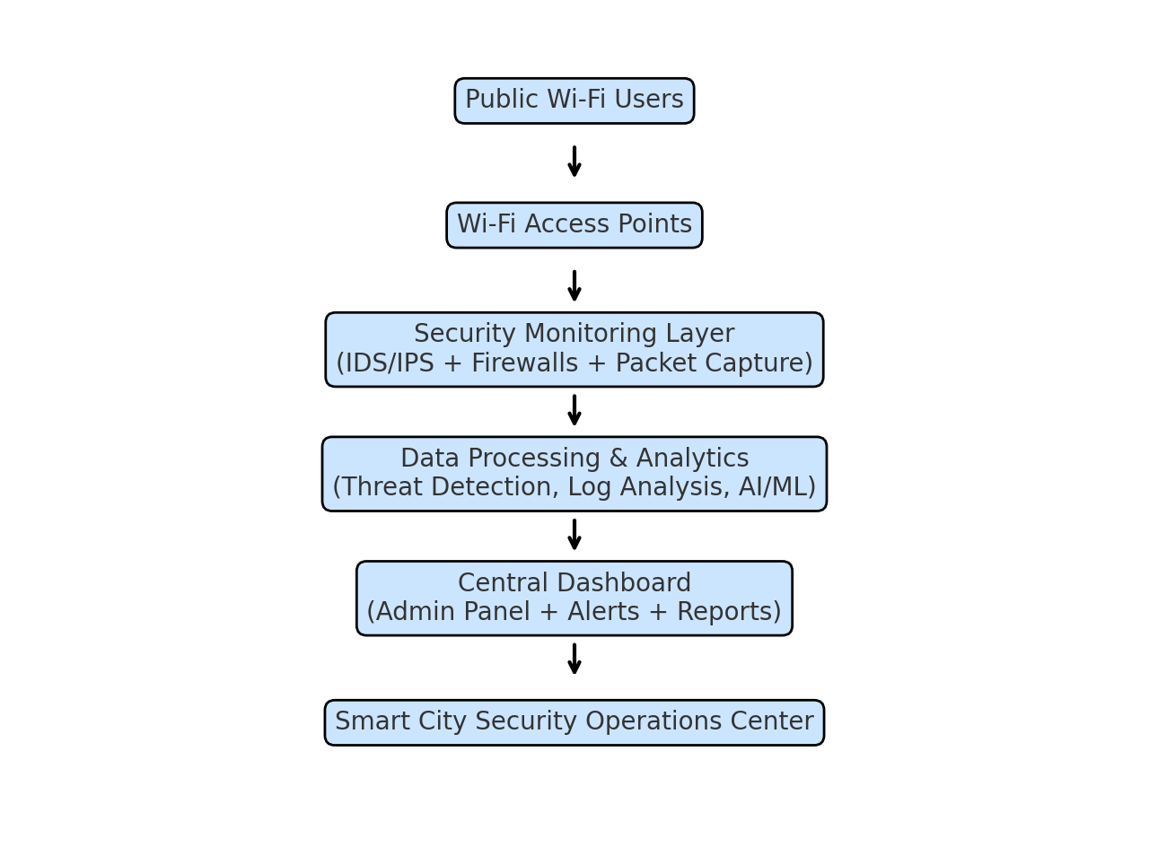
Block Diagram / System Architecture

Slide 5
Experimental Setup Design
• Public Wi-Fi hotspots (test environment)
• Security monitoring devices/software
• Centralized logging server
• Admin dashboard for real-time monitoring
Flow: Wi-Fi → IDS/IPS → Monitoring System → Dashboard

Slide 6
Required Equipment / Software
Hardware:
• Wi-Fi Access Points
• Monitoring Server / Router
• Network Sensors
Software:
• Wireshark / tcpdump
• SIEM Tool (Splunk, ELK)
• Firewall (pfSense / Windows Defender)

Slide 7
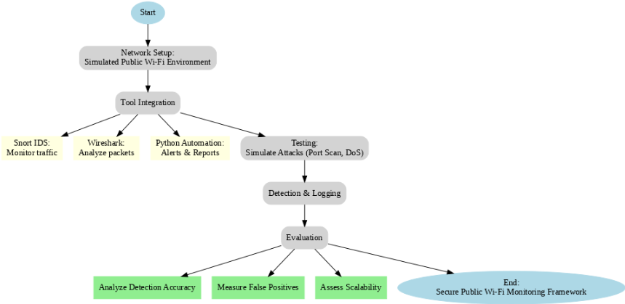
Methodology Used

Slide 8
Research Methodology
Research Methodology:
1. Identify threats in public Wi-Fi
2. Collect traffic logs
3. Apply security analysis
4. Generate reports & alerts
Data Collection:
1. Real-time packet capture
2. Logging suspicious activities

Slide 9
Feasibility & Innovation
Feasibility Analysis:
• Scalable across multiple hotspots
• Low-cost using open-source tools
• Compatible with smart city frameworks
Innovative Elements:
• Unified monitoring across city-wide hotspots
• AI-driven anomaly detection
• Real-time dashboard for administrators

Slide 10
References
Snort IDS Documentation – [snort.org]
Wireshark User Guide – [wireshark.org]
“Intrusion Detection in Smart Cities” – IEEE Access, 2023
OWASP IoT Project – [owasp.org]

