Slide 1
Cravings
Food Delivery System

Slide 2
Made By
Shail Kiran Patel
23002170410022
AIML
A1 – 24

Slide 3
01
02
03
04
Introduction
Features
Demerits
Diagrams

Slide 4
Introduction
Welcome to Cravings, a console-based food delivery system designed to cater to the diverse tastes and preferences of modern food lovers. Our system serves two key users: the Restaurant Manager and Customers, each with a unique set of features tailored to their roles.
Restaurant Managers have the tools to manage their menus, update availability, and ensure that their cuisine offerings are always up-to-date. Customers, on the other hand, can explore a wide variety of cuisine options and select from categories like snacks, lunch, and dinner, all while enjoying the thematic experiences offered by different restaurants.
Cravings is designed to provide an intuitive and efficient food ordering experience, making it easier for users to satisfy their culinary desires. Whether it’s a quick snack or a full-course dinner, Cravings brings the best of local and international cuisines right to your fingertips.

Slide 5
Some Astonishing Features
1
Password Encryption
2
Soft delete
Cravings ensures user security by implementing SHA-256 hashing algorithm.
Cravings allows soft deleting, of both manager and customer accounts.

Slide 6
Some Astonishing Features
3
Log Tables
4
Forgot Password Options
Cravings maintains detailed log tables to track user logins, deleted accounts, and past orders, ensuring complete auditability and data integrity.
Cravings utilizes method that can help you get your account even in the event of forgetting password.

Slide 7
User Defined Data Structures
Array List
Doubly Circular Linked List
HashMap
HashSet
Queue
Stack
Add, Remove, Get,
Size, Contains, Display
Add, Remove, Display, Size, getHead
Put, Get, Remove, containsKey, keySet,
Put, Get, Remove, containsKey, Size, keySet
Enqueue, Dequeue, Peek, isEmpty, Size
Push, Pop, Peek, isEmpty, size, viewStack

Slide 8
Demerits
1
Console Based Program
2
Lack of Admin
No Delivery Personnel side of Program
Console-based programs lack graphical interfaces, which can make them less user-friendly and harder to navigate for users accustomed to graphical user interfaces (GUIs).
Without an admin to oversee the overall app, there is a risk of uncoordinated management, potential security lapses, and inefficiencies in handling user issues and system maintenance.
3
Lack of delivery personnel in the program limits the ability to manage and track deliveries efficiently, potentially leading to delays and reduced customer satisfaction.

Slide 9

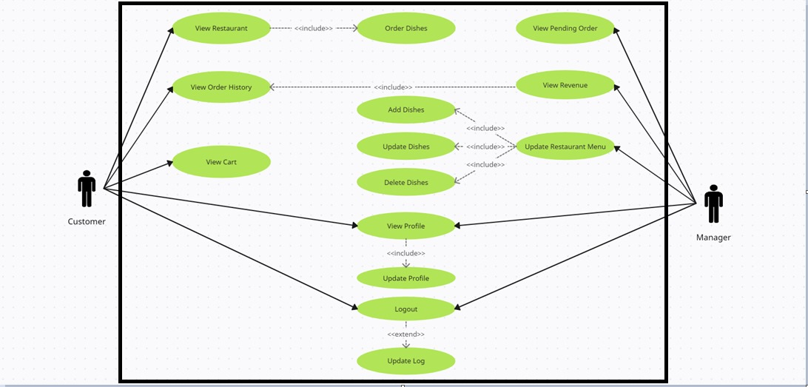
Use Case Diagram

Slide 10

Thanks!

