Slide 1

INVESTING FOR BEGINNERS

Slide 2
ASSETS
Cash – Liquidity & power to buy anything
Equity – Ownership into a business
Fixed Income – Lending money to someone
Real Estate - Ownership of physical space
Commodities - Ownership of goods which has an end use

Slide 3
MARKET PARTICIPANTS
Institutions
Retailers
Brokers
Exchange
Depositories

Slide 4
FUNDAMENTAL ANALYSIS
Balance Sheet
P&L Statement
Cash flow Statement
Financial Ratios
Understanding Business

Slide 5
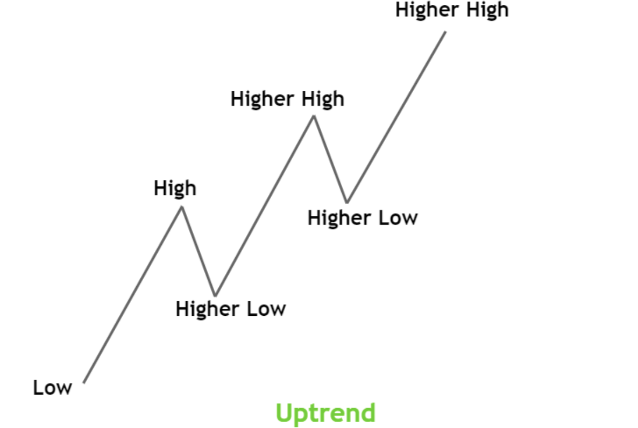
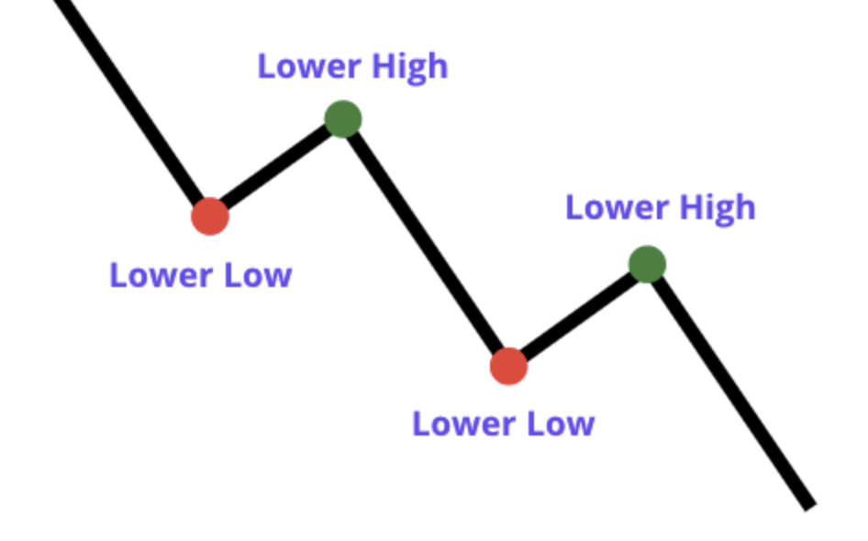
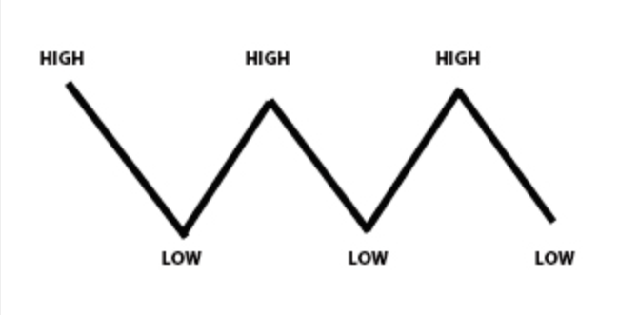
TECHNICAL ANALYSIS

Slide 6
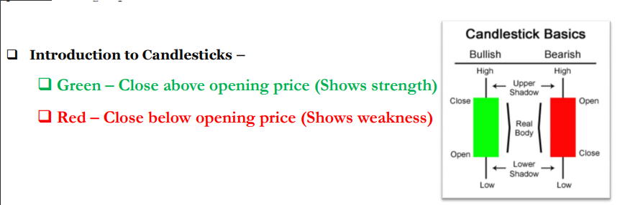
Analysis-Candlesticks

Slide 7
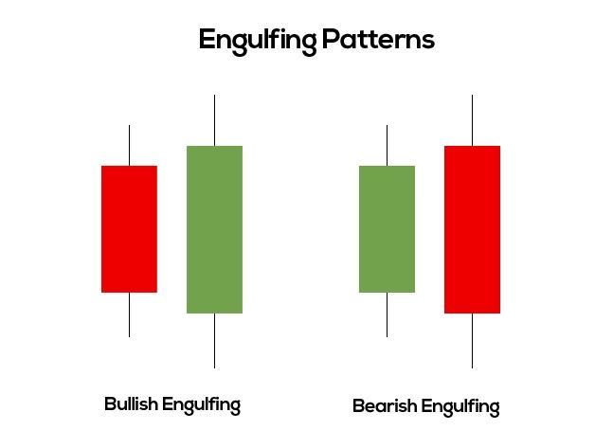
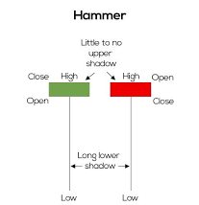
Types of candlesticks

Slide 8
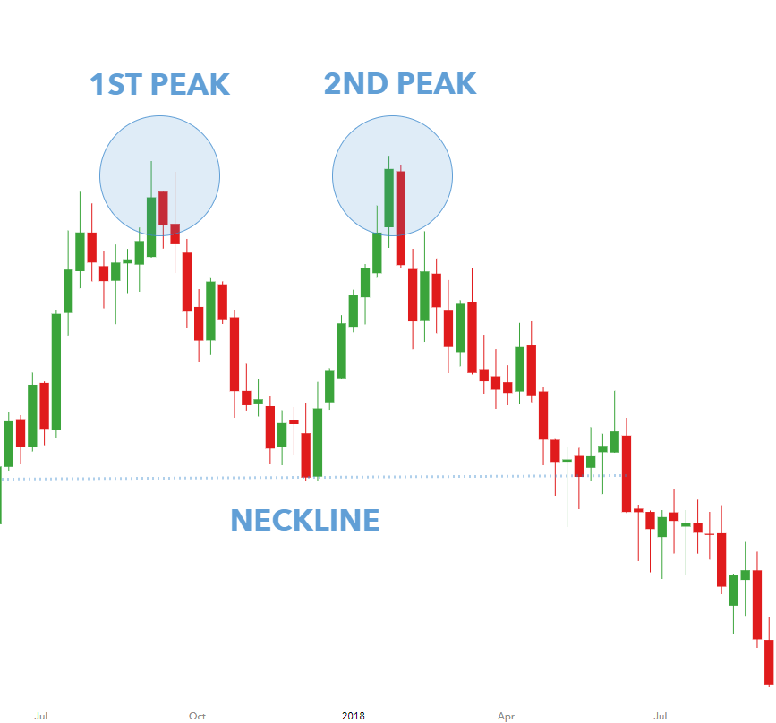
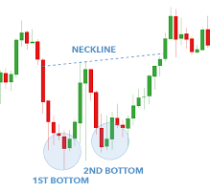
Candlesticks Pattern
Double Top
Double Bottom

Slide 9
Thankyou

