Slide 1
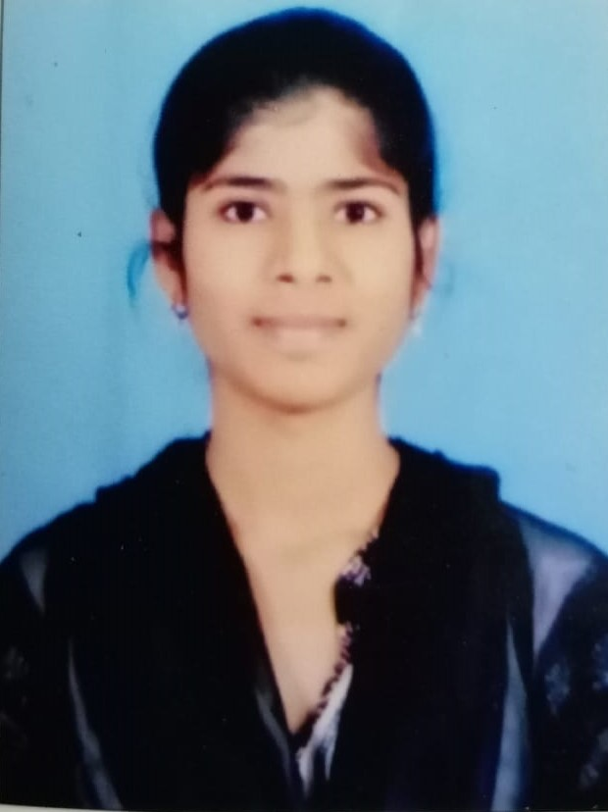
SHAILAJA RAPOLU Application Development Associate
Shailaja rapolu
shailaja.rapolu@accenture.com
ACCENTURE
Hyderabad, India
Technical Skills
Java Standard edition
Spring boot
Kafka
SQL
Ruby On Rails
Spring Core
HTML
CSS , Bootstrap
SCDF
Professional Background
SUMMARY
Ms. Shailaja Rapolu is Application Development Associate in Accenture’s Hyderabad, India.
I have experience 1 years+.
I have good knowledge on SQl database
I am getting training in Ruby On Rails Technology under Martin Devapitchai from the last 2 months.
EDUCATION
University college of engineering Kakatiya university .
Bachelor Technology (Electrical and Electronics ).
Selected Experience
I have Knowledge on developing webpages using Ruby On Rails , Bootstrap Technology.
I have got trained on Java Standard Edition in GFT Training by LKM Techgenics.
TECHNOLOGIES:
Ruby On Rails.
Bootstrap.
HTML.
CSS.

