Slide 1
360° Business Intelligence
A Complete SaaS Company Health Analysis
Shailanshi Gupta
MS Business Analytics · Northeastern University · December 2026
Workforce
Revenue
Churn
Product
Operations
SQL · Python · Power BI · Tableau · PowerPoint · Word
Notes:
Introduce yourself. 5-pillar BI project simulating a real BA engagement.

Slide 2
The Business Problem
A mid-sized SaaS company hired a Business Analyst after flagging simultaneous crises across every department. The brief: find out what's broken, why it's connected, and what to do about it.
⚠️ Workforce is Bleeding
💸 Revenue is Leaking
16.1% annual attrition. Sales losing 1 in 5 employees per year. Overtime workers leaving at 3× the rate. The team is exhausted and understaffed.
$139K lost every month to churned customers. Month-to-month contract customers churn at 42.7% - nearly half won't renew. Retention is broken.
🚚 Operations are Failing
🔍 No Unified Visibility
54.8% of all orders arrive late. First Class shipping - the most expensive option - has a 95% late delivery rate. Customers are paying more and getting worse service.
Data lives in silos across HR, Sales, Customer Success and Supply Chain. Leadership is making decisions without a complete picture. That ends here.
Notes:
These 4 problems are connected — attrition causes service failures, which causes churn, which causes revenue loss.

Slide 3
How We Solved It
5 datasets · 5 analytical pillars · 6 tools · 10 days of analysis
Pillar & Business Question
Dataset
Tools
Workforce - Why are our best employees leaving?
IBM HR Attrition
SQL · Python · Power BI · Tableau
Revenue - Where is growth happening and where isn't it?
Superstore Sales
SQL · Power BI
Customer Churn - Who is about to cancel and why?
Telco Churn
SQL · Python ML · Power BI
Product - Which products and categories drive value?
Olist E-Commerce
Python EDA · Power BI
Operations - Where are our biggest process failures?
DataCo Supply Chain
SQL · Power BI
Notes:
Each pillar answers a specific business question. Tools chosen match what real BA teams use.

Slide 4
Key Findings at a Glance
The six numbers that define this company's health - and where to focus first.
16.1%
26.5%
$139K
Employee Attrition
Customer Churn Rate
Revenue Lost Per Month
237 of 1,470 employees left
1,869 of 7,043 customers lost
Directly from churned customers
54.8%
39.8%
~80%
Orders Arrive Late
Sales Rep Attrition
ML Churn Model Accuracy
Over half of all deliveries
Highest-risk role in the company
Logistic Regression prediction
Notes:
These 6 numbers are the headline. Each one maps to a pillar.

Slide 5
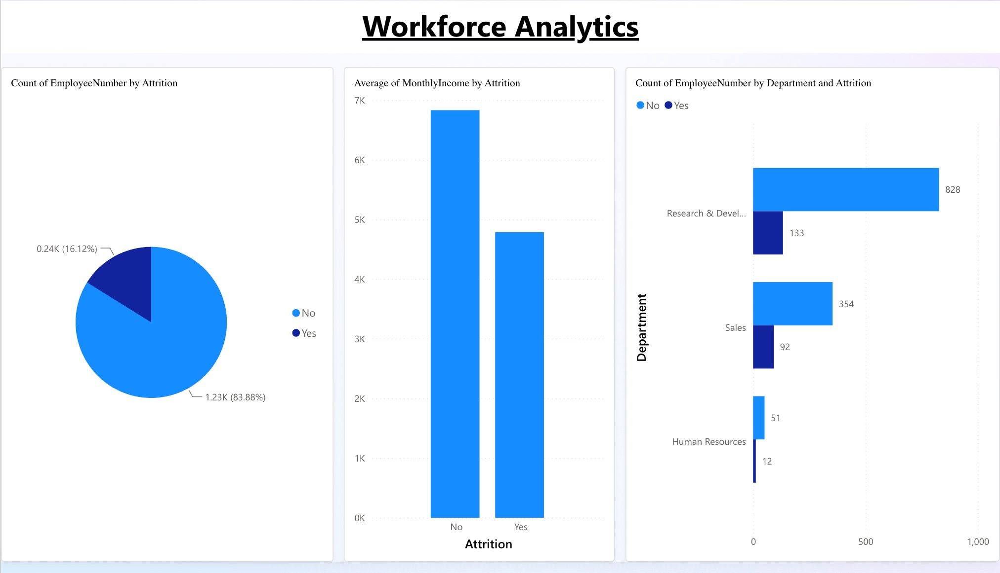
PILLAR 1 · WORKFORCE ANALYSIS
Dataset: IBM HR Attrition · Tools: SQL · Python · Power BI · Tableau
20.6%
Sales Dept Attrition
3×
Overtime Quit Risk
$2K
Monthly Salary Gap
82.9%
ML Attrition Model
💡 Sales employees earning $2K/month less than peers who stay - a targeted pay adjustment is cheaper than the cost of replacing them.
Notes:
Workforce is the root cause. Fix this first.

Slide 6
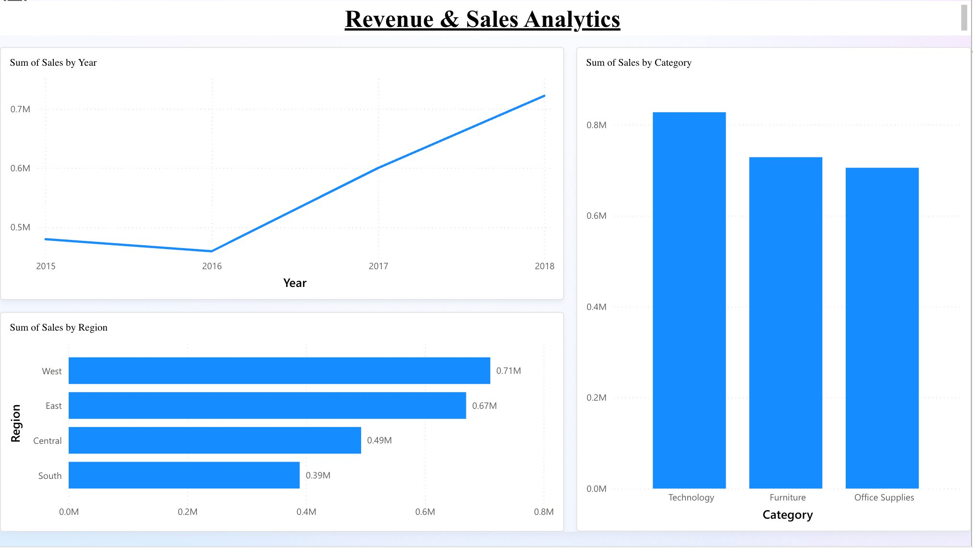
PILLAR 2 · REVENUE & SALES ANALYSIS
Dataset: Superstore Sales · Tools: SQL · Power BI
$2.3M
Total Revenue
West
Top Region ($0.71M)
Tech
Highest Profit Cat.
+40%
Revenue Growth 2016–18
💡 Technology drives the highest profit margin despite not being the top revenue category - reallocating marketing budget here has the highest ROI.
Notes:
Revenue is growing, but concentrated. Diversification needed.

Slide 7
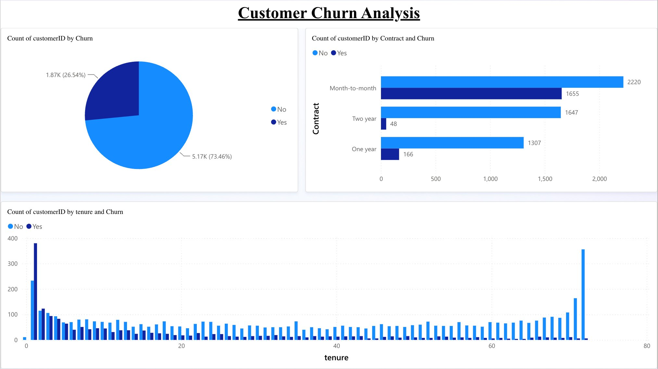
PILLAR 3 · CUSTOMER CHURN ANALYSIS
Dataset: Telco Customer Churn · Tools: SQL · Python (Logistic Regression) · Power BI
26.5%
Overall Churn Rate
42.7%
Month-to-Month Churn
11.3%
2-Year Contract Churn
~80%
ML Prediction Accuracy
💡 Contract type is the single biggest churn predictor. Converting month-to-month customers to annual contracts could recover over $100K/month in revenue.
Notes:
Churn is solvable — it's a contract structure problem, not a product problem.

Slide 8
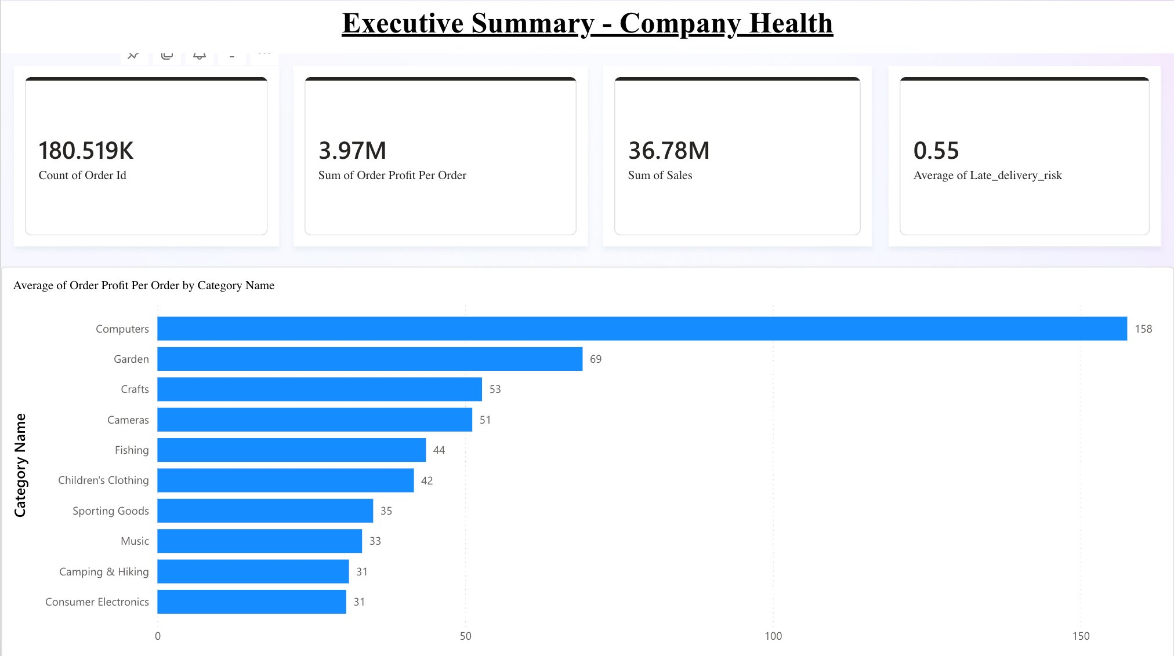
PILLAR 4 · PRODUCT & E-COMMERCE ANALYSIS
Dataset: Olist E-Commerce (Brazil) · Tools: Python EDA · Power BI
4.1★
Avg Customer Rating
180K
Total Orders Analyzed
610
Records Cleaned (Python)
Health
Top Revenue Category
💡 Health & Beauty drove top revenue. Python data cleaning fixed 610 missing product category names - without this, 8% of the analysis would have been wrong.
Notes:
Python EDA was critical here. Missing data would have skewed all category-level insights.

Slide 9
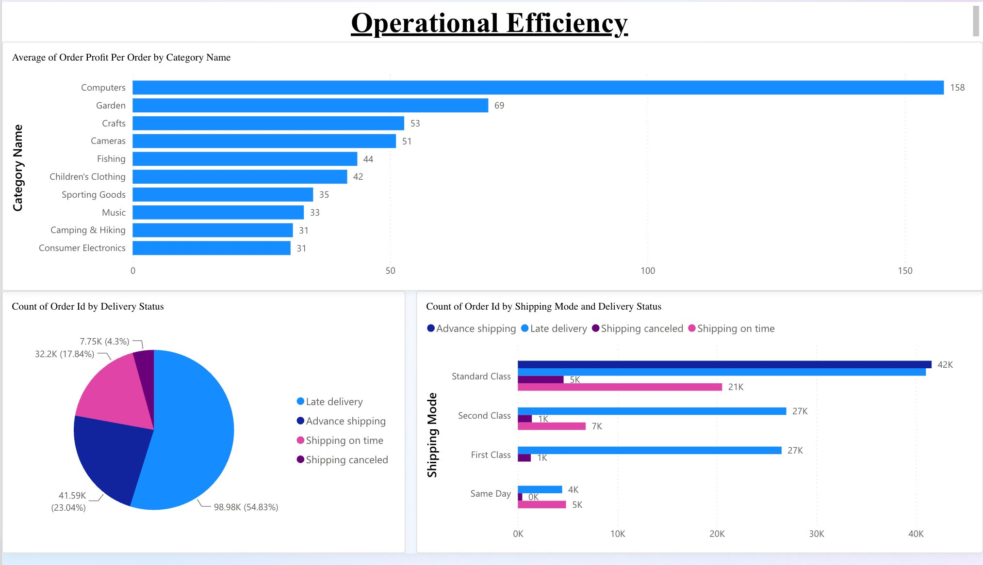
PILLAR 5 · OPERATIONAL EFFICIENCY
Dataset: DataCo Supply Chain · Tools: SQL · Power BI
54.8%
Overall Late Rate
95%
First Class Late (!!!)
12%
Same Day Late (Best)
$158
Avg Profit: Computers
💡 First Class costs the most and delivers the worst - 95% late rate. This is a routing or process failure, not a capacity issue. Needs immediate root cause investigation.
Notes:
The First Class finding is the most surprising. It points to a systemic process failure that is actively damaging customer trust.

Slide 10
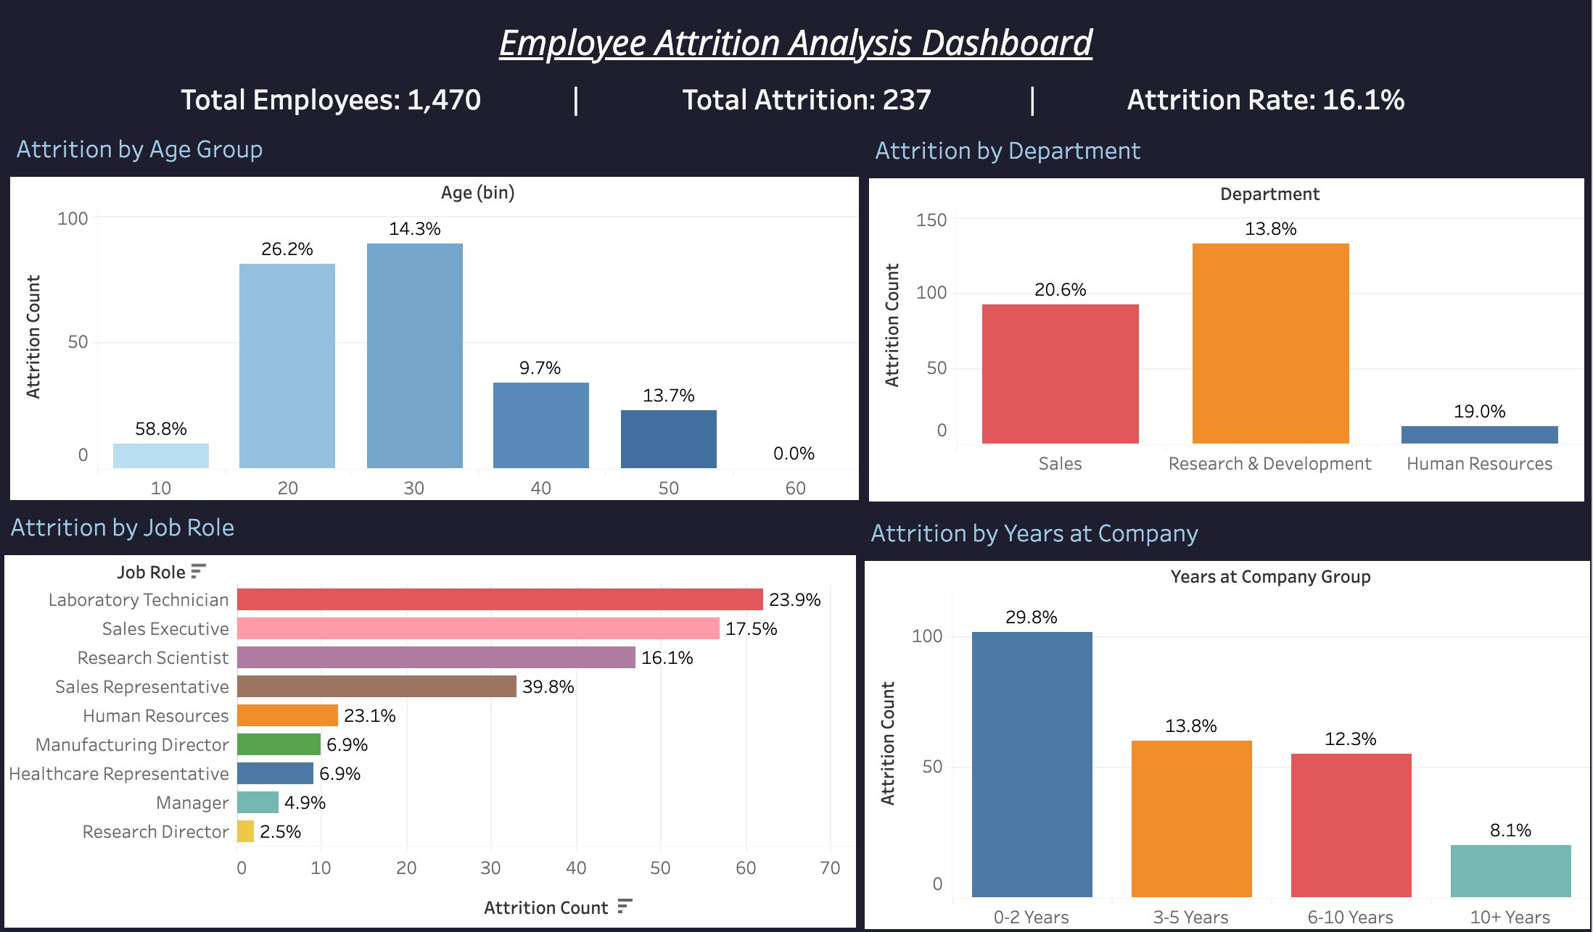
Interactive Tableau Dashboard
Built in Tableau Public · Live & interactive · Fully filterable by department, age group, and job role
🔗 public.tableau.com/app/profile/shailanshi.gupta/viz/360BIAttritionAnalysis
Notes:
Demo this live if possible. Viewers can filter and explore the data themselves from the public URL.

Slide 11
Strategic Recommendations
Four data-backed actions that directly address the root causes identified across all 5 pillars.
01
HR · IMMEDIATE
Conduct salary review and reduce overtime in Sales
SQL shows a $2K/month gap and 3× higher quit rate for overtime workers. A targeted pay adjustment + workload redistribution will reduce 20.6% attrition below 12% within 12 months - cheaper than the $50K average cost of replacing each employee.
02
CHURN · HIGH IMPACT
Launch an annual contract conversion campaign
Month-to-month customers churn at 42.7% vs 11.3% on 2-year contracts. Offering a 10% discount for annual upgrades to the at-risk segment (identified by our ML model) could recover $80-100K in monthly recurring revenue.
03
OPERATIONS · URGENT
Audit and fix First Class shipping routing immediately
95% late delivery rate on the most expensive shipping tier is not a capacity problem - it's a routing or vendor failure. A process audit with carrier SLA enforcement will improve customer satisfaction scores and reduce refund costs.
04
SALES · GROWTH
Double down on Technology category and West region
Technology delivers the highest profit margin. West region leads revenue at $0.71M. Reallocating 20% of marketing budget from Furniture (low margin) to Technology and West-focused campaigns is projected to increase overall profitability by 12-15%.
Notes:
Each recommendation has a specific, quantified outcome. This is what separates a BA from a data analyst.

Slide 12
What I Built - End to End
This project demonstrates every skill a Business Analyst needs on day one.
✓ 20+ SQL queries across 5 complex multi-table datasets
✓ Python data cleaning + EDA + 2 ML models (Logistic Regression & Decision Tree)
✓ 5 Power BI dashboards with DAX calculated measures
✓ Tableau interactive dashboard - live on Tableau Public
✓ 4 data-backed strategic recommendations with quantified business impact
✓ Full BA workflow: raw data → cleaning → analysis → insight → recommendation
github.com/ShailanshiGupta · linkedin.com/in/shailanshi-gupta
Notes:
Close confidently. This project proves you can do the job — not just talk about it.

