Slide 1
RED
BLACK
TREE
Continues…

Slide 2

Deletion
7
2
z
12
1
5
10
14
4
16
If we need to delete the node having value = 10
Means this node has both children NULL
Solution is: z.p.left = NULL

Slide 3
Deletion
7
2
12
1
5
14
4
16
A node having value = 10 is now deleted.
executed
Solution is: z.p.left = NULL

Slide 4

Deletion
7
2
z
12
1
5
10
14
4
11
16
If we need to delete the node having value =10
Means this node has left child is NULL but right child is not NULL
Solution is: z.p.left = z.right

Slide 5
Deletion
7
2
12
1
5
11
14
4
16
A node having value = 10 is now deleted.
executed
Solution is: z.p.left = z.right

Slide 6
Deletion
7
2
z
12
1
5
10
14
4
9
16
If we need to delete the node having value = 10
Means this node has left child is not NULL and right child is NULL
Solution is: z.p.left = z.left

Slide 7
Deletion
7
2
12
1
5
9
14
4
16
A node having value = 10 is now deleted.
executed
Solution is: z.p.left = z.left

Slide 8
Deletion
z
7
2
12
1
5
10
14
4
9
11
13
16
y
Old Concept of deletion…
If we need to delete the node having value = 7
Means this node has left child and right child are not NULL
Then find the minimum value after 7

Slide 9

Deletion
z
9
2
12
1
5
10
14
4
9
11
13
16
y
Old Concept of deletion…
z.Item = y.item
Then replaces the value 7 by its successor 9
Means the minimum value after 7 or
minimum value in 7’s right
Then delete node y, which virtually deletes a node having value 7

Slide 10

Deletion
z
7
2
12
y
1
5
10
14
4
9
11
13
16
Tree
x
Concept of deletion…
If we need to delete the node having value = 7
Means this node has left child and right child are not NULL

Slide 11
Deletion
z
7
2
12
y
1
5
10
14
4
9
11
13
16
Tree
x
Concept of deletion…
Now cut the node y from its original position with the help of
below line of code
y.p.left = y.right

Slide 12
Deletion
z
7
y
2
12
1
5
9
10
14
4
11
13
16
Tree
x
Concept of deletion…
Executed
y.p.left = y.right
Now try this
y.right = z.right

Slide 13
Deletion
z
y
9
7
2
12
1
5
10
14
4
11
13
16
Tree
x
Concept of deletion…
Executed
y.right=z.right
Now try this
y.right.p = y

Slide 14
Deletion
z
y
9
7
2
12
1
5
10
14
4
11
13
16
Tree
x
Concept of deletion…
Executed
y.right=z.right
y.right.p=y
Now try this
Now replace z and place y at z’s place

Slide 15
Deletion
z
y
7
9
2
12
1
5
10
14
4
11
13
16
Tree
x
Concept of deletion…
Executed
Place y at z’s place

Slide 16
Deletion
z
y
7
9
2
12
1
5
10
14
4
11
13
16
Tree
x
Concept of deletion…
Executed
Place y at z’s place
Now try this
y.left = z.left

Slide 17
Deletion
z
y
7
9
2
12
1
5
10
14
4
11
13
16
Tree
x
Concept of deletion…
Executed
y.left = z.left
Now try this
y.color=z.color

Slide 18
Deletion
z
y
7
9
2
12
1
5
10
14
4
11
13
16
Tree
x
Concept of deletion…
Executed
y.color=z.color

Slide 19
Deletion
y
9
2
12
1
5
10
14
4
11
13
16
Tree
x
Concept of deletion…
Executed
y.color=z.color
But originally y’s color was red then there is no call fro delete fix-up but if the
original color of y was black then we must call delete fix-up
for balancing 5th property

Slide 20
RB-TRANSPLANT(T, u, v)
1. if u.p == T.nil then
2. T.root = v
3. elseif u == u.p.left then
4. u.p.left = v
5. else u.p.right== v
6. v.p = u.p
TREE-MINIMUM(x)
1. while x.left ≠ T.nil
2. x = x.left
3. return x

Slide 21
RB-Delete
RB-DELETE(T, z)
1. y = z
2. y-original-color = y.color
3. if z.left ==T.nil then
4. x = z.right
5. RB-TRANSPLANT(T, z, z.right)
6. elseif z.right == T.nil then
7. x = z.left
8. RB-TRANSPLANT(T, z, z.left)
9. else y = TREE-MINIMUM(z.right)
10. y-original-color = y.color
11. x = y.right
12. if y.p == z then
13. x.p = y
14. else RB-TRANSPLANT(T, y, y.right)
15. y.right = z.right
16. y.right.p = y
17. RB-TRANSPLANT(T, z, y)
18. y.left = z.left
19. y.left.p = y
20. y.color = z.color
21. If y-original-color == BLACK then
22. RB-DELETE-FIXUP(T, x)

Slide 22
RB-Delete-Fixup
Cases
Cases 1: If x’s sibling w is red
Cases 2: If x’s sibling w’s left child and right child are black
Cases 3: If x’s sibling w’s right child is black
Cases 4: If x’s sibling w’s right child is not black

Slide 23
RB-Delete-Fixup
Cases
Cases 1: If x’s sibling w is red
Make w.color = black
x.p.color = red
LEFT-ROTATE (T, x.p)
w = x.p.right
Cases 2: If x’s sibling w’s left child and right child are black
Make w.color = red
x = x.p.
Cases 3: If x’s sibling w’s right child is black
Make w.left.color = black
w.color = red
RIGHT-ROTATE (T, w)
w = x.p.right

Slide 24
RB-Delete-Fixup
Cases 4: If x’s sibling w’s right child is not black means
this reacts as else condition of Case 3
Make w.color = x.p.color
x.p.color = black
w.right.color = black
LEFT-ROTATE (T, x.p)
x = t.root
x.color = black

Slide 25
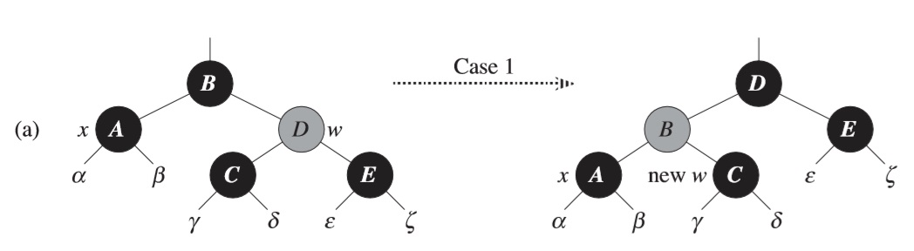
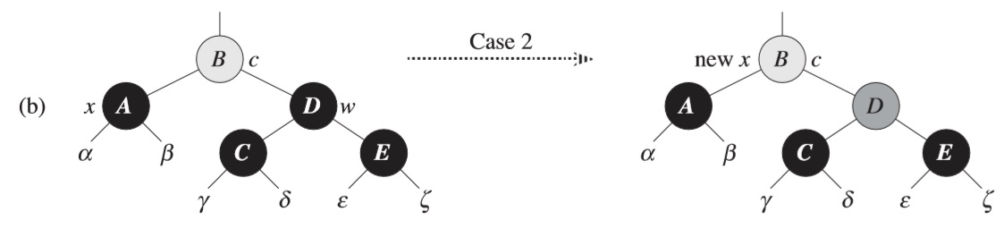
RB-Delete-Fixup

Slide 26
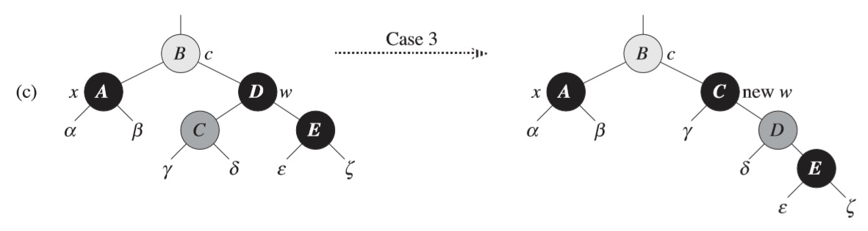
RB-Delete-Fixup

Slide 27
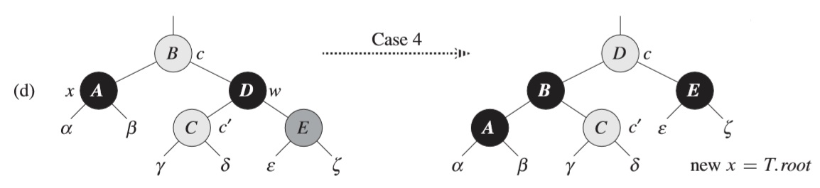
RB-Delete-Fixup

Slide 28
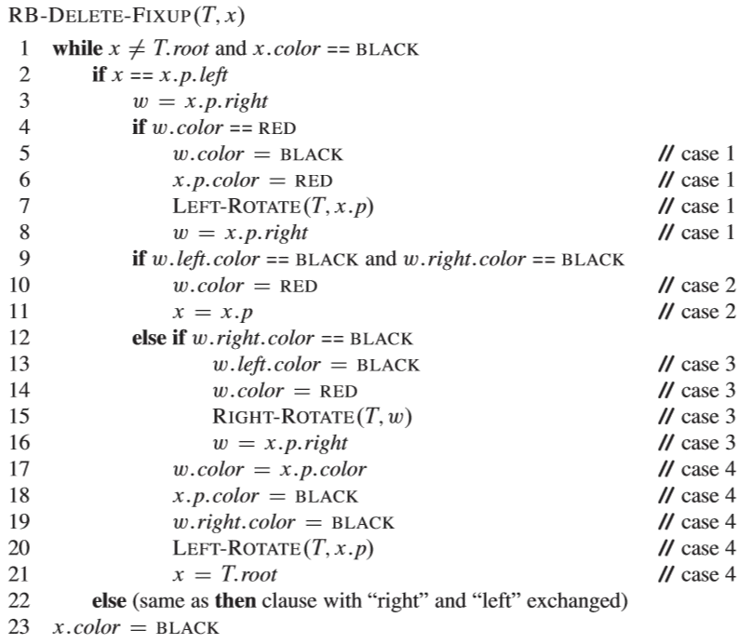
RB-Delete-Fixup

Slide 29
Thanks

