Slide 1
FINGO
Kingfar, Shailendra, Szabolcs, Yitung

Slide 2
What is it
Mobile application for immigrants
Helps the integration process
Using gaming elements for easy study
Really easy to use for kids also
Database contains the most important infos

Slide 3
Why FINGO?
Always up to date
New features coming
Easy to make friendships between users

Slide 4
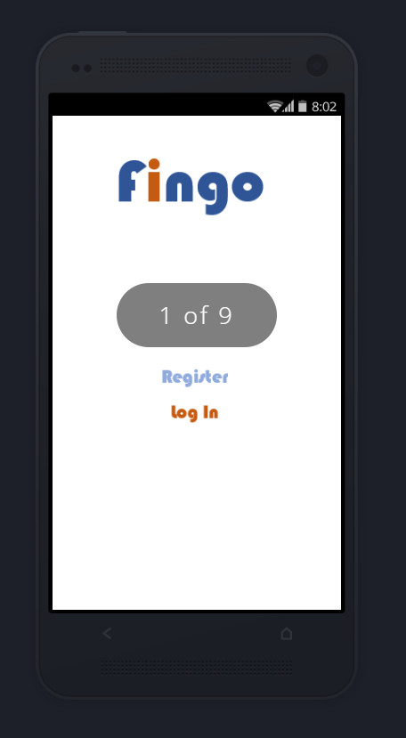
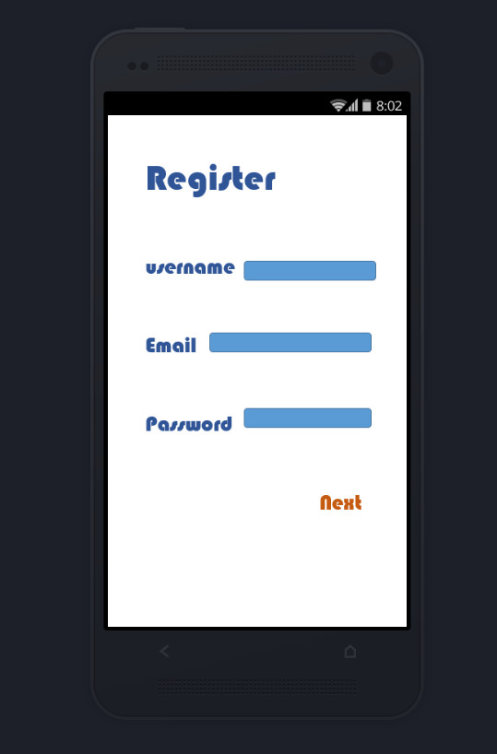
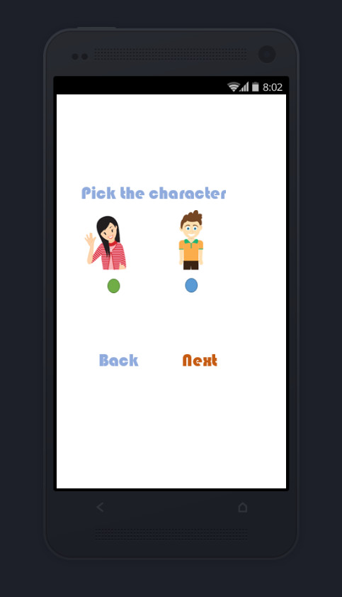
How does it look like

Slide 5
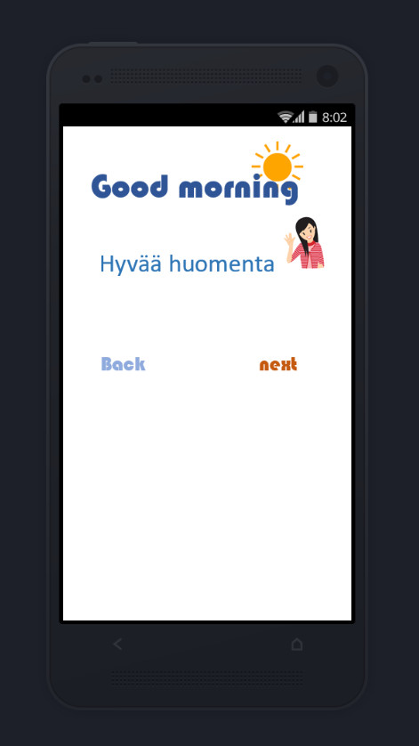
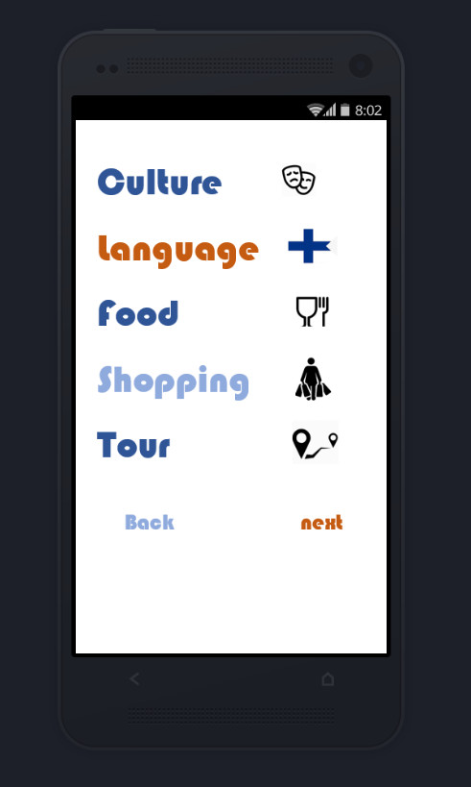
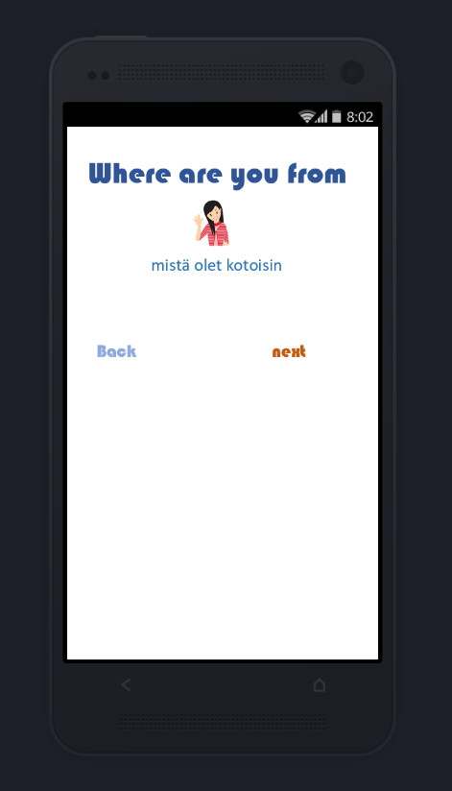
How does it look like

Slide 6
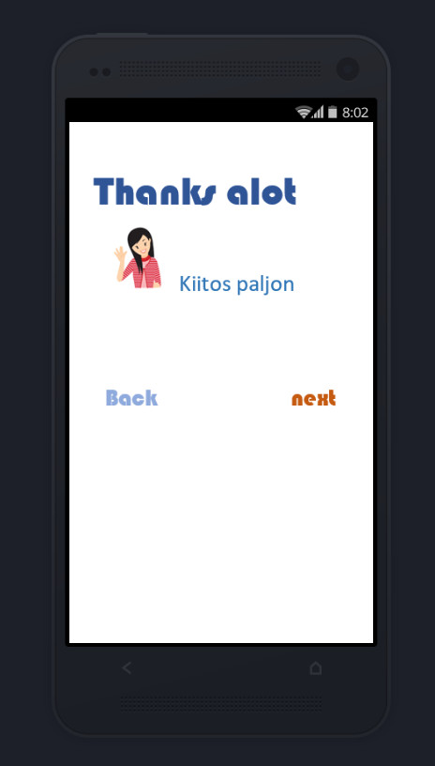
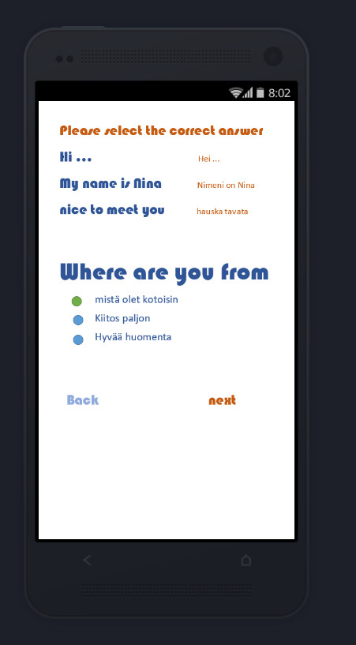
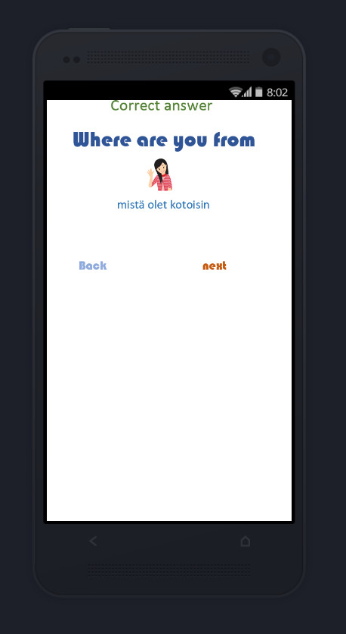
How does it look like

Slide 7
How did we test
3 different nationality person
Freshly moved into Finland (less than a year)
Fluent english speaking skills
Well equipped media room
Professional team

Slide 8
Topics
Culture
Difference between norhtern and southern region
Sauna culture
Nature friendly attitude
Language
Topic orientated vocabulary
Most important/used sentences, phrases
Differences between written and spoken language

Slide 9
Topics
Food
Typical finnish kitchen
Effects of the swedish/russian kitchen
Importance of huge forests, large lakes
Shopping
Popular shops
K-Market, Alepa, Prisma, etc…
Shoppingcenters
Kamppi, Forum, Kaari, etc..

Slide 10
Topics
Tourism/sightseeing
Nature trip opportunities, ship trips, aurora boralis, animals, flora, sealife
Helsinki in a nutshell
Tampere in a nutshell
Rovaniemi in a nutshell
Santa Claus village

Slide 11
Testing
Location Haaga Helia media room
Participants from: Japan, Nepal, Hungary
Gender: 1 female, 2 male
Age: 20-24
Stay in Finland less than a year

Slide 12
Testing
Conclusion
Pro:
Easy to use
Clear, well visable interface
The screen is not crowded/easy to navigate
Really good idea to study through gaming
Contra:
There are no functioning buttons
Registration maybe not neccessary
Not enough content

Slide 13
Video
Youtube link:

