Slide 1

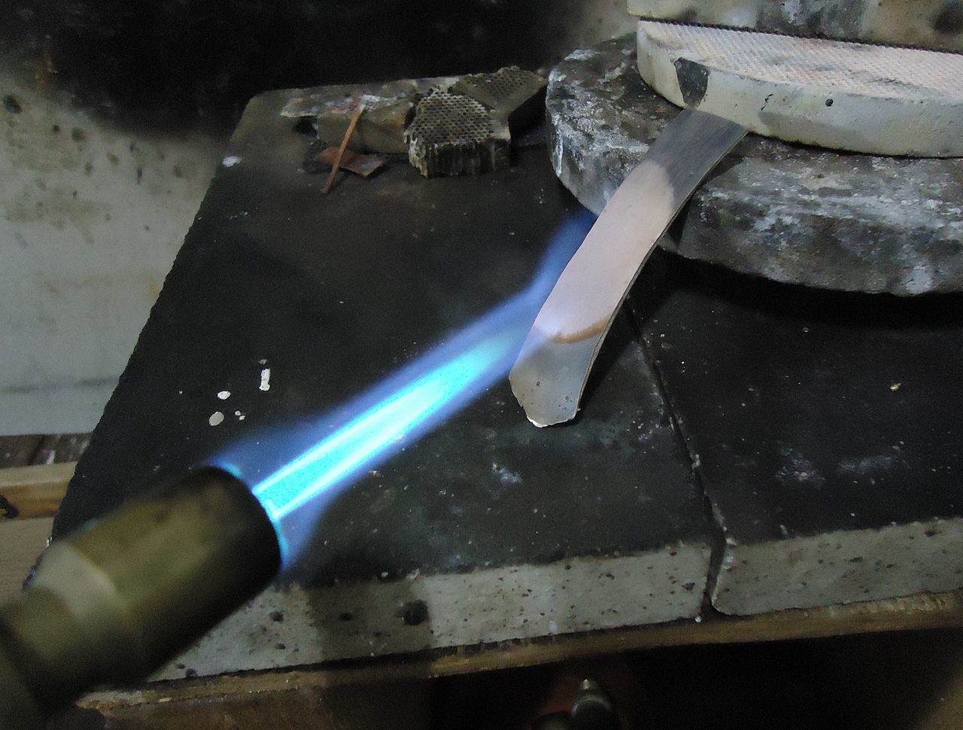
GENETIC -SIMULATED ANNEALING bank lending optimization REPORT NANISETTY SAI SHAILESH 18IM30013

Slide 2
Objectives
To optimize the result using genetic algorithm.
To optimize the result using an amalgamation of genetic algorithm and simulated annealing algorithm.
To compare the two algorithms.

Slide 3

Genetic Algorithm
1
Let us first start with the first objective.

Slide 4
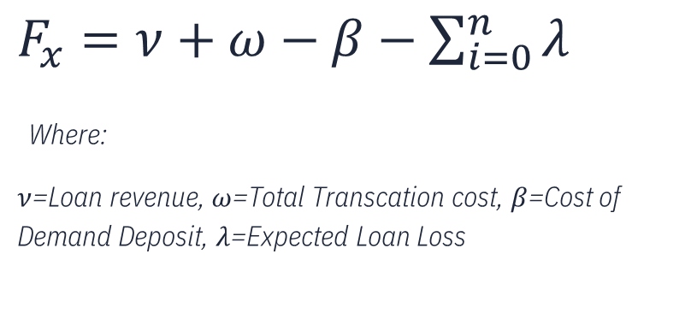
Fitness Function
$F_{x}=ν+ω−β−\sum_{i=0}^{n}{λ}$
Where:
$ν$=Loan revenue, $ω$=Total Transcation cost, $β$=Cost of Demand Deposit, $λ$=Expected Loan Loss

Slide 5
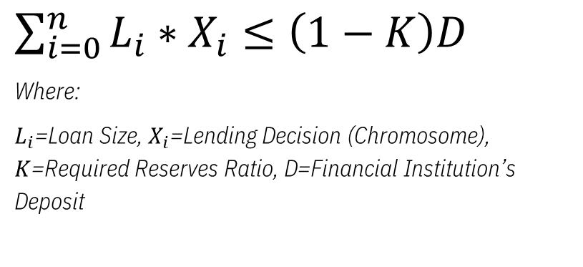
Constraint
$\sum_{i=0}^{n}{L_{i}∗X_{i}≤\left(1−K\right)D}$
Where:
$L_{i}$=Loan Size, $X_{i}$=Lending Decision (Chromosome), $K$=Required Reserves Ratio, D=Financial Institution’s Deposit

Slide 6

Chromosome representation
1
1
0
1
0
0
0
1
0
1
1 indicates that the customer is selected for lending
0 indicates that the customer is not selected for lending

Slide 7
Parts of Genetic algorithm
CROSSOVER
Two parents are selected and a part of their chromosomes are switched among them.
MUTATION
Each gene of the chromosome has a small probability of modifying itself.

Slide 8
HyperParameters
Hyper parameter | Value
Population Size | 10
Number of iterations | 18
Crossover Type | Single Point Crossover
Crossover Probability | 0.8
Mutation Probability | 0.006

Slide 9
Results
Result | Value
Optimal Solution | [1, 0, 0, 1, 0, 1, 1, 0, 1, 0]
Optimal Fitness Value | 2.723

Slide 10
2
GENETIC-SIMULATED annealing optimization
Let’s start with our second objective

Slide 11
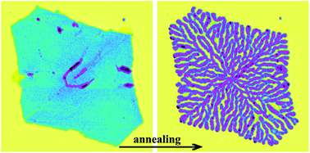
About the algorithm
This optimization technique is a modified form of Simulated Annealing to solve variables in the form of binary encodings.
It takes solutions from the genetic algorithm as inputs to the Simulated Annealing and then improves the solution further to reach the optimal point.

Slide 12
Parts of the algorithm
GENETIC SIMULATED ANNEALING optimization
Genetic Algorithm
SIMULATED ANNEALING
Crossover
Mutation
Initial temperature
COOLING Factor
ACCEPTANCE-LIMIT

Slide 13

Key Parameters Explanation
Initial Temperature
It marks as the starting point for the temperature and will be decreased using cooling factor in subsequent iterations.
Cooling factor
It is an expression which decreases the current temperature after fulfilling the iterations on the current temperature.
Acceptance limit
It is a limit on the number of solutions that can be accepted on a specific temperature.

Slide 14
Hyper parameters
Hyper parameter | Value
Population Size of GA | 10
Number of iterations of ga | 18
Initial Temperature of SA | 950
Cooling Factor of SA | 0.88
Number of iterations (For same temperature) of sa | 8
Acceptance limit of sa | 2

Slide 15

Results
Result | Value
Optimal Solution | [1, 0, 1, 1, 0, 1, 0, 0, 1, 1]
Optimal Fitness Value | 3.1854

Slide 16
3
comparison
Finally, Let’s end the presentation with our third objective

Slide 17
Comparison
result | Genetic algorithm | Chromosome swarm optimization
Optimal solution | [1, 0, 0, 1, 0, 1, 1, 0, 1, 0] | [1, 0, 1, 1, 0, 1, 0, 0, 1, 1]
Optimal fitness value | 2.723 | 3.1854
As we can see in the above table the amalgamated algorithm of Genetic + Simulated Annealing came up with a better solution than simple genetic algorithm.
Hence, We made a better choice by going with amalgamated algorithm.

Slide 18

Thank you

