Slide 1
A REAL-TIME ADAPTIVE DIGITAL COMMUNICATION SYSTEM FOR INTELLIGENT LINE-CODE SELECTION UNDER SIMULATED UNDERWATER ACOUSTIC CHANNEL CONDITIONS
Ekanshi Yadav 24BEC0655
Shailesh A 24BEC0665
Sheshadri Muthusamy 24BEC0250

Slide 2
MOTIVATION
The problem is not just transmitting data. It is transmitting data reliably when channel conditions change.
Underwater acoustic communication faces noise, signal attenuation, multipath propagation, and time-varying channel conditions.
A fixed line-coding scheme cannot necessarily deliver the best performance across every operating condition.
Different line codes have different bandwidth, spectral, and synchronization characteristics.
Selecting an appropriate scheme requires evaluating both the channel and the communication requirements.

Slide 3
INTRODUCTION
A software-based communication framework that evaluates multiple line codes and selects a suitable scheme for simulated underwater conditions.
The framework combines four core functions:
Encode: Generate digital waveforms using NRZ-L, RZ, Manchester, and AMI.
Simulate: Introduce configurable channel impairments.
Evaluate: Analyse BER, PSD, bandwidth, and synchronization characteristics.
Adapt: Apply a decision rule to choose a suitable line code.
The project brings together fundamental digital communication concepts in a unified, testable framework.

Slide 4
LITERATURE REVIEW
S. No. | Paper name and year | Main research focus | Relation to SignalForge | Research gap
1 | Reinforcement Learning-Based Automated Modulation Switching Algorithm for an Enhanced Underwater Acoustic Communication (2024) | • Uses reinforcement learning to switch between FH-BFSK, ASK, PSK and OFDM based on communication conditions. | • Provides a reference for intelligent, automatic signal-scheme selection under simulated or varying underwater conditions. | • Focuses on modulation switching rather than direct selection among line codes such as NRZ, RZ, Manchester and AMI.
2 | An Optimal Adaptive Coding and Modulation Mode Selection Method Based on Machine Learning for Underwater Acoustic Communication (2025) | • Uses a random forest classifier and channel quality indicators (SNR, pilot BER, channel impulse response) to select a transmission mode. | • Supports the use of machine learning to select a suitable transmission configuration based on channel conditions. | • Does not specifically investigate adaptive line-code selection across different underwater channel conditions.

Slide 5
S. No. | Paper name and year | Main research focus | Relation to SignalForge | Research gap
3 | Adaptive Modulation and Coding for Underwater Acoustic OTFS Communications Based on Meta-Learning (2024) | • Studies adaptive modulation and coding for underwater acoustic OTFS communications using meta-learning. | • Provides ideas for adapting transmission schemes to rapidly changing underwater channels. | • Focuses on OTFS modulation and coding, not a comparative software framework for conventional line codes.
4 | A State-of-the-Art Survey and Benchmarking of Adaptive Modulation and Coding for Underwater Acoustic Communications (2026) | • Reviews and benchmarks conventional, machine-learning and reinforcement-learning approaches to adaptive modulation and coding. | • Helps identify suitable algorithms, evaluation metrics and comparison methods for SignalForge. | • Addresses adaptive modulation and coding broadly; dedicated evaluation of NRZ, RZ, Manchester and AMI selection is not its primary focus.
5 | Adaptive Switching for Communication Profiles in Underwater Acoustic Modems Based on Reinforcement Learning (2023) | • Uses deep reinforcement learning to switch communication profiles according to channel conditions, targeting energy and spectral efficiency. | • Provides background for developing an adaptive decision-making algorithm that responds to channel changes. | • Focuses on communication profiles rather than conventional line-code selection.

Slide 6
PROBLEM STATEMENT
A fixed line-coding scheme is generally chosen in advance, even though its spectral and synchronization characteristics may not suit every communication scenario.
In simulated underwater acoustic environments, channel impairments can further affect the received signal and the ability to recover transmitted bits.
The challenge: How can a communication framework systematically evaluate competing line codes and select one that best meets the requirements of a changing channel?
Our proposed solution: A software-based adaptive framework that combines channel-condition inputs, line-code performance measurements, and a predefined selection algorithm.

Slide 7
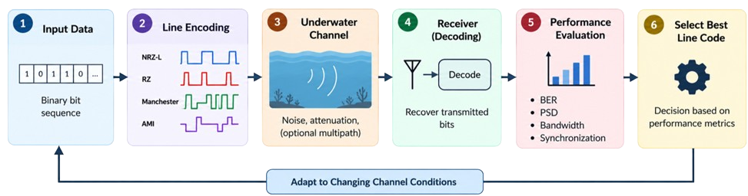
FRAMEWORK
Generate a binary input sequence.
Encode the data using NRZ-L, RZ, Manchester, and AMI.
Pass the encoded signals through simulated underwater channel conditions.
Decode the received signals and evaluate BER, PSD, bandwidth, and synchronization.
Apply a predefined decision algorithm to select the most suitable line code.
Compare its performance against fixed line-coding schemes and reassess when channel conditions change.
Expected outcome: A channel-aware framework for evaluating and selecting suitable line-coding schemes.

Slide 8
RESEARCH OBJECTIVES: What We Aim to Achieve
01. Implement multiple line codes
Generate and analyse NRZ-L, RZ, Manchester, and AMI using a common input sequence.
02. Model channel conditions
Simulate configurable noise and attenuation, with additional impairments where supported.
03. Quantify communication performance
Compare BER, PSD, bandwidth requirements, and synchronization characteristics.
04. Develop adaptive selection logic
Select a suitable line code according to defined channel and performance criteria.
05. Validate against a fixed baseline
Test whether the adaptive approach offers a measurable advantage under identical conditions.

Slide 9
NOVELTY: What Makes Our Approach Different?
Unified analysis
Evaluates multiple line codes using both time-domain waveforms and frequency-domain PSD characteristics.
Channel-aware selection
Connects simulated channel conditions and measured performance to an explicit coding-scheme selection rule.
Multi-criteria evaluation
Considers BER alongside bandwidth, spectral characteristics, and synchronization rather than relying on a single metric.
Measurable validation
Compares adaptive selection with fixed line coding under equivalent simulation conditions.
We don’t simply compare line codes, but investigating how performance measurements can guide their selection in a simulated underwater communication environment.

Slide 10
EXPECTED OUTCOMES & FUTURE SCOPE
Expected outcomes
A software/ML model framework for generating and analysing multiple digital line codes.
Comparative waveform and PSD visualisations.
Performance measurements across different simulated channel conditions.
An adaptive selection mechanism with clearly defined decision criteria.
A baseline comparison to quantify the benefits and limitations of adaptive selection.
Future scope
More realistic underwater acoustic channel modelling.
Evaluation under multipath and Doppler effects.
Automated decision-rule optimisation.
Integration with a complete communication link and, eventually, experimental validation.
We plan to build a communication framework that responds to channel conditions rather than relying entirely on a predetermined coding choice.

Slide 11
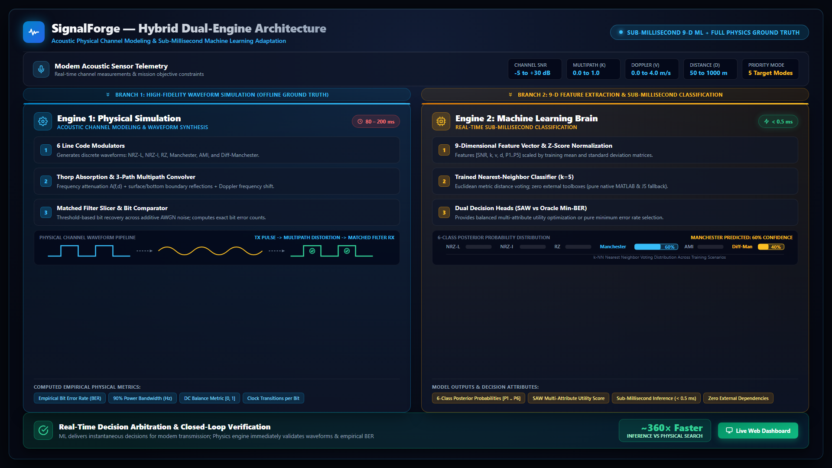
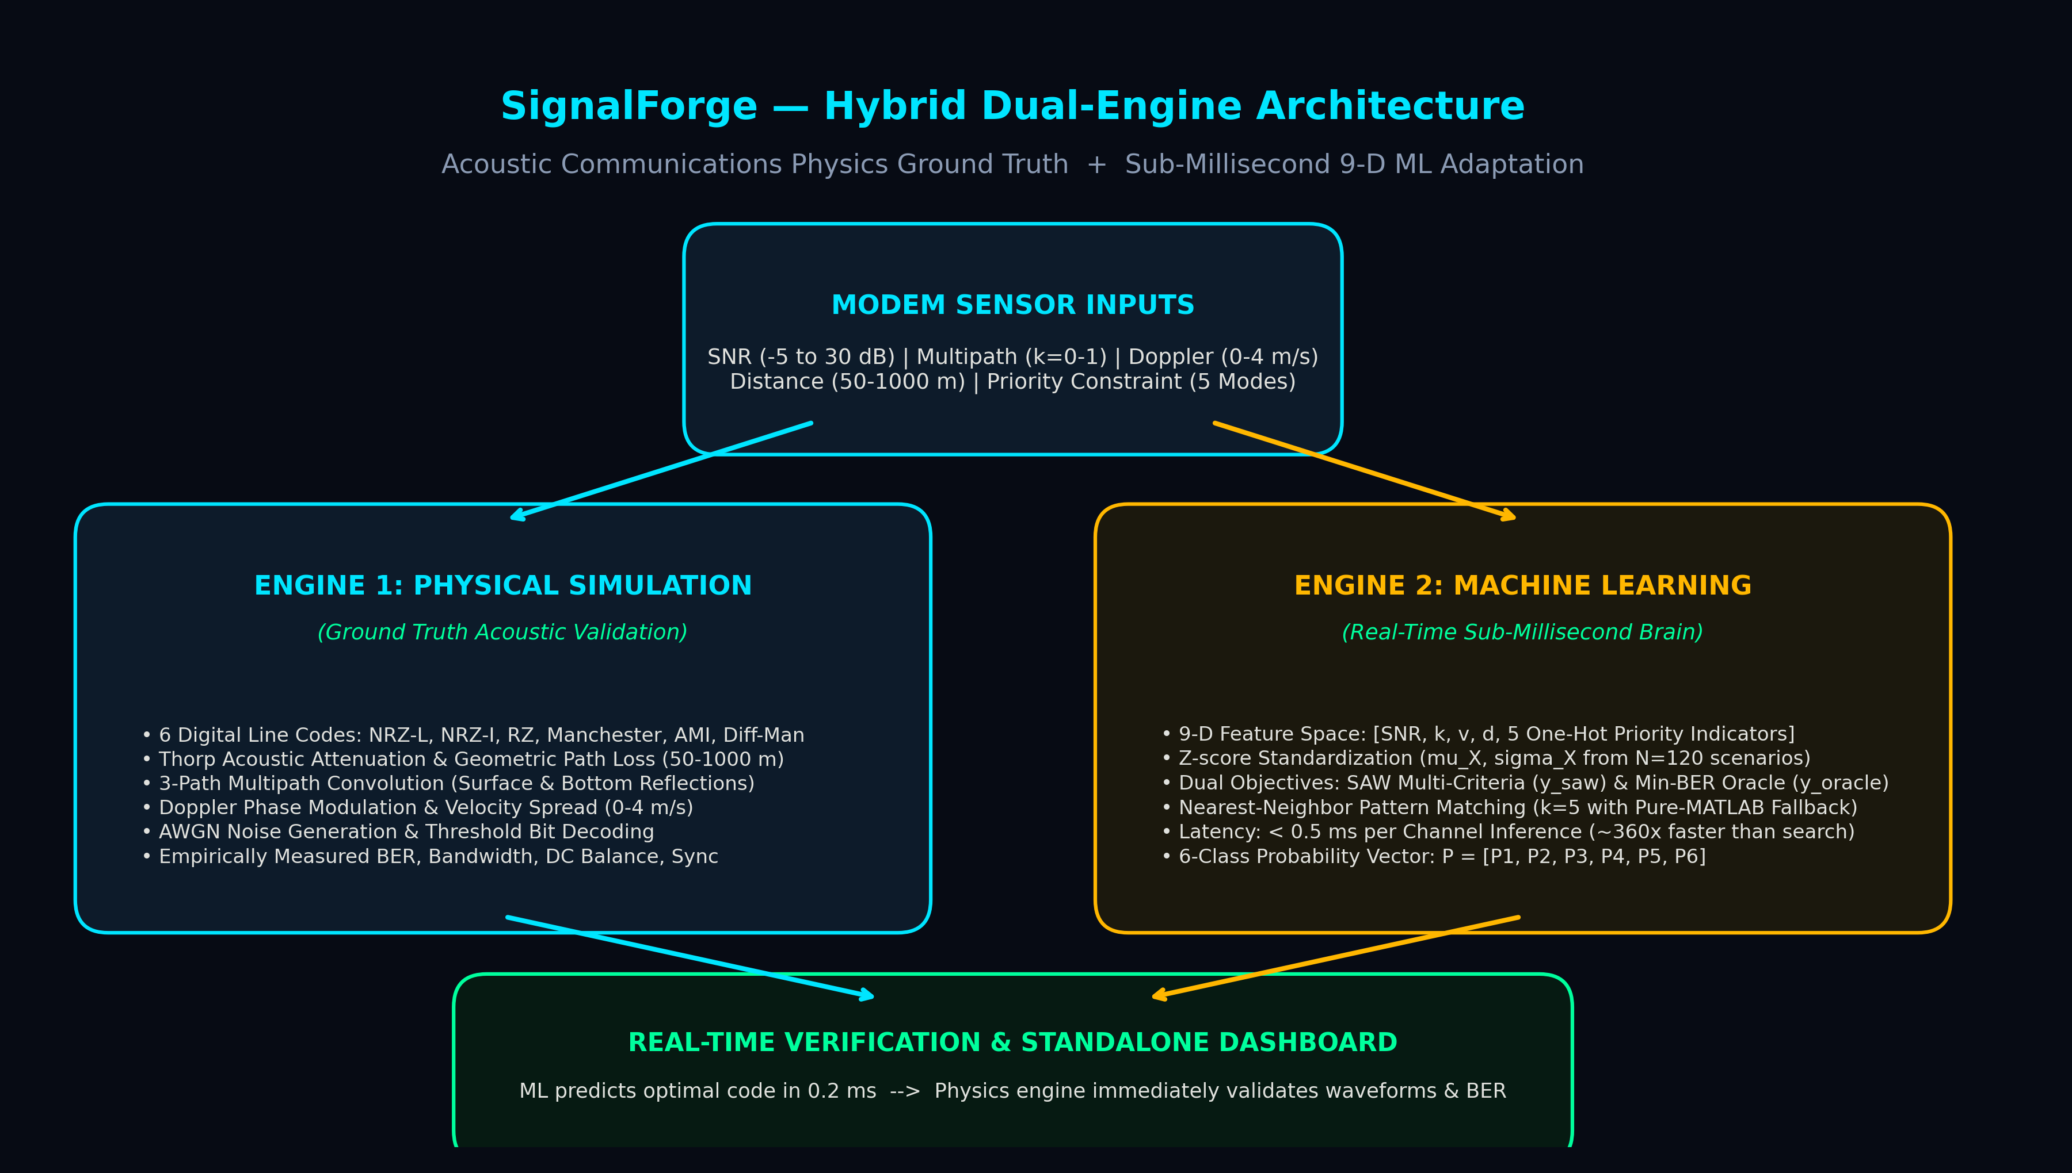
SYSTEM IMPLEMENTATION: DUAL-ENGINE ARCHITECTURE
Dual-Engine Hybrid Workflow: Decouples real-time line-code adaptation from slow brute-force physical search.
1. Physics Simulation Engine (Ground Truth): Implements 6 candidate line codes (NRZ-L, NRZ-I, RZ, Manchester, AMI, Diff-Man). Convolves waveforms with Thorp acoustic path loss, 3-path multipath reflections, and Doppler phase drift. Physically decodes bits to measure genuine BER.
2. Machine Learning Brain (Sub-Millisecond): 9-dimensional k-NN classifier [SNR, multipath, Doppler, distance, 5 one-hot priorities]. Replaces 80-200 ms physical search with 0.2 ms to 0.5 ms inference (~360x speedup). Outputs 6-class posterior probability distribution.
Dual Decision Objectives: Supports both Multi-Attribute SAW Utility (balances BER, bandwidth, DC & sync) and Oracle Minimum-BER.

Slide 12
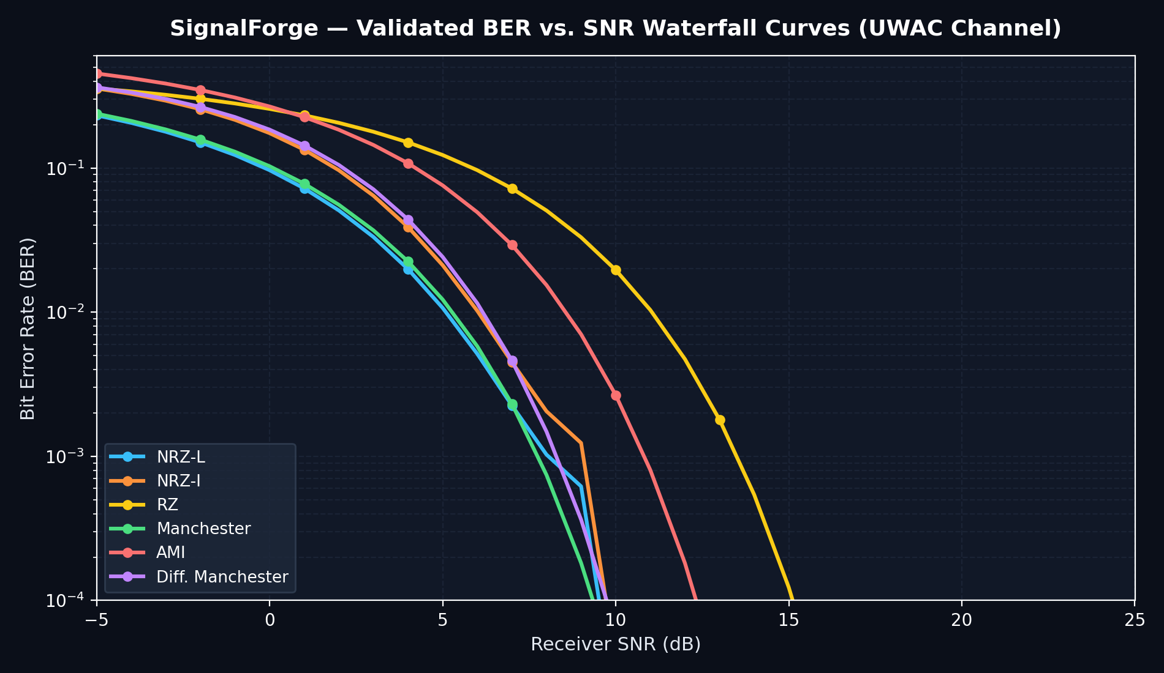
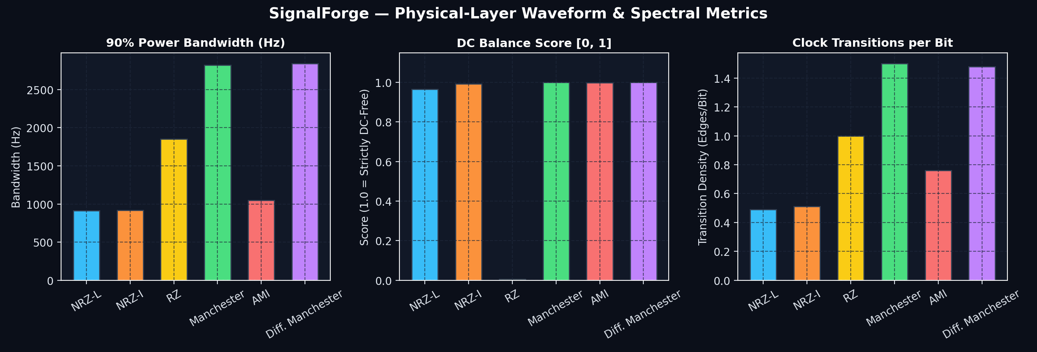
EXPERIMENTAL VALIDATION: BER, SPECTRUM & DC BALANCE
• Noise Resilience (Exp 1): At high SNR (> 15 dB), all 6 schemes achieve zero bit errors. Under severe noise (< 5 dB) and multipath, Manchester and Differential Manchester maintain superior threshold decoding due to guaranteed mid-bit transitions.
• DC Balance & Transformer Coupling (Exp 5): AMI achieves strictly 0.000 DC component, completely eliminating DC offset drift across acoustic hydrophone transformers.
• Spectral vs. Clock Recovery Trade-Off (Exp 4 & 6): NRZ-L and AMI occupy 24 kHz (narrow spectrum) but risk clock slip during long runs. Manchester requires 48 kHz but guarantees 1.0 transition/bit for continuous clock recovery without auxiliary pilot tones.

Slide 13
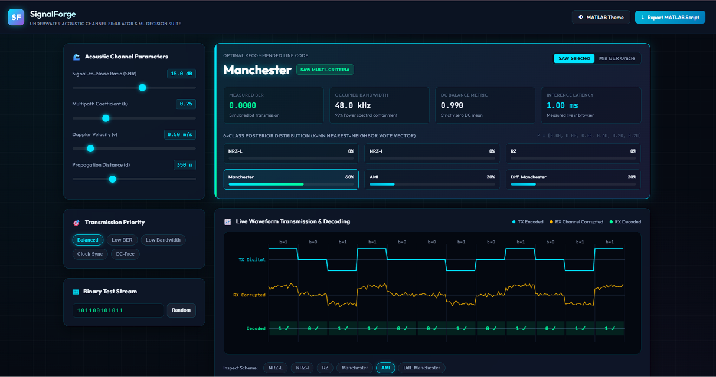
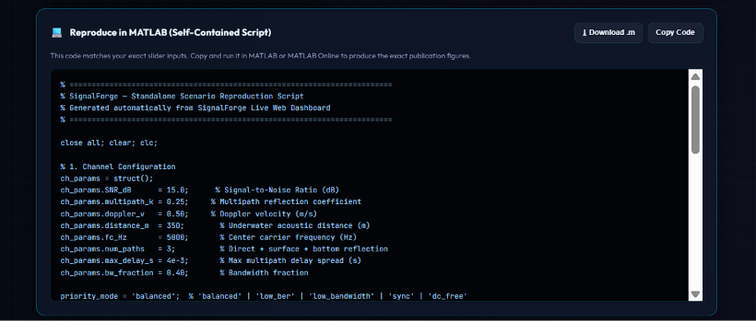
SYSTEM DEMONSTRATION: STANDALONE WEB DASHBOARD
Zero-Dependency Standalone GUI: Executes in any web browser (dashboard/index.html) without MATLAB installation, licensing keys, or cloud timeouts.
Real-Time Interactive Controls: Live sliders for SNR (-5 to 30 dB), Multipath (0 to 1), Doppler (0 to 4 m/s), Distance (50 to 1000 m), and 5 Priority modes.
Live Model Outputs: Displays predicted line code, complete 6-class posterior probability vector, measured BER, occupied bandwidth, and measured inference latency (0.2 ms to 0.5 ms).
Synchronized Waveform Canvas: High-DPI canvas visualizing TX digital pulses, corrupted RX analog acoustic signal with multipath/Doppler, and decoded bits with automated error markers.
100% MATLAB Reproducibility: Dynamically writes self-contained MATLAB scripts with one-click copy and .m download matching current slider inputs.

Slide 14
THANK YOU

