Slide 1
MICROSTRIP PATCH ANTENNA FOR
BLUETOOTH/ZIGBEE IoT NODES
Fabricated on FR-4 PCB — 2.45 GHz Inset-Fed Patch Antenna: Design, Simulation & Fabrication-Ready Validation in ANSYS HFSS
Team members:
Khanna M (24BEC0187)
Nishanth A (24BEC0595)
Sashank P S (24BEC0636)
Tarun Sathish (24BEC0631)
Shailesh A (24BEC0665)
Group Project • ANSYS Electronics Desktop 2025 R2.4 (Student)

Slide 2
0
OVERVIEW
Agenda
1
Introduction & Motivation
5
Results
Why low-cost FR-4 patch antennas suit IoT nodes
Return loss, VSWR, and radiation performance
2
Project Objectives
6
Performance Summary
What the design and simulation set out to achieve
All metrics vs. requirements at a glance
3
Design Parameters
7
Conclusion & Fabrication Readiness
Substrate, patch, and feed geometry
What's proven, and how it moves to a PCB prototype
4
Simulation Setup
8
Future Work & Team
HFSS modeling and solve methodology
Next steps, and who did what
Microstrip Patch Antenna for Bluetooth/Zigbee IoT Nodes | FR-4 PCB | HFSS Simulation
2

Slide 3
1
BACKGROUND
Introduction & Motivation
IoT sensor nodes for Bluetooth Low Energy (BLE) and Zigbee (IEEE 802.15.4) applications need antennas that are compact, low-cost, and easy to mass-produce alongside the rest of the PCB assembly.
A microstrip patch antenna printed directly onto standard FR-4 substrate meets all three needs: it uses the same low-cost material and fabrication process as the host PCB, requires no separate antenna component, and keeps the whole design low-profile and planar.
The 2.4–2.4835 GHz ISM band is shared by BLE and Zigbee, so a single antenna tuned to 2.45 GHz can serve both radio standards — a common choice for smart-home, industrial, and wearable IoT nodes.
This project designs, simulates, and validates such an antenna in ANSYS HFSS, with a layout intended for direct fabrication on 1.6 mm FR-4 PCB using a standard 50 Ω SMA edge connector.
WHY A PATCH ON FR-4?
Low cost
FR-4 is the standard, cheapest PCB substrate available.
Planar & compact
Etched directly onto the PCB — no separate antenna part.
Dual-standard
2.45 GHz covers both BLE and Zigbee in one design.
Manufacturable
Standard photolithography / PCB milling, SMA connector.
Microstrip Patch Antenna for Bluetooth/Zigbee IoT Nodes | FR-4 PCB | HFSS Simulation
3

Slide 4
2
SCOPE
Project Objectives
01
02
03
04
Design
Simulate
Validate
Prepare for Fabrication
Design a compact 2.45 GHz microstrip patch antenna on low-cost FR-4 substrate, matched to a 50 Ω feed.
Model and solve the structure in ANSYS HFSS using Driven Modal analysis across the 2.0–3.0 GHz band.
Confirm resonance, impedance match (VSWR), and radiation behavior meet ISM-band requirements.
Finalize a parametric, manufacturable layout ready to be etched on FR-4 PCB with an SMA feed.
Microstrip Patch Antenna for Bluetooth/Zigbee IoT Nodes | FR-4 PCB | HFSS Simulation
4

Slide 5
3
DESIGN
Design Parameters & Material Specification
Parameter | Symbol | Value | Unit | Purpose
Operating Frequency | f₀ | 2.45 | GHz | Bluetooth 5.0 / BLE / Zigbee ISM band
Substrate Material | — | FR-4 Epoxy | — | Standard low-cost PCB material
Dielectric Constant | εr | 4.4 | — | Relative permittivity of FR-4
Loss Tangent | tan δ | 0.02 | — | Dielectric loss factor
Substrate Thickness | h | 1.60 | mm | Standard 1.6 mm PCB height
Substrate Dimensions | SubX × SubY | 60.0 × 60.0 | mm | Overall ground plane area
Patch Width | W | 37.41 | mm | Controls input resistance
Patch Length | L | 28.85 | mm | Controls 2.45 GHz resonant frequency
Feed Line Width | Wf | 3.02 | mm | Gives 50 Ω characteristic impedance
Inset Depth | Fi | 9.20 | mm | Impedance-matching feed insert depth
Notch Gap | g | 1.00 | mm | Inset cutout clearance gap
Port Type | — | Lumped Port | — | 50 Ω matched excitation (SMA at fabrication)
Microstrip Patch Antenna for Bluetooth/Zigbee IoT Nodes | FR-4 PCB | HFSS Simulation
5

Slide 6
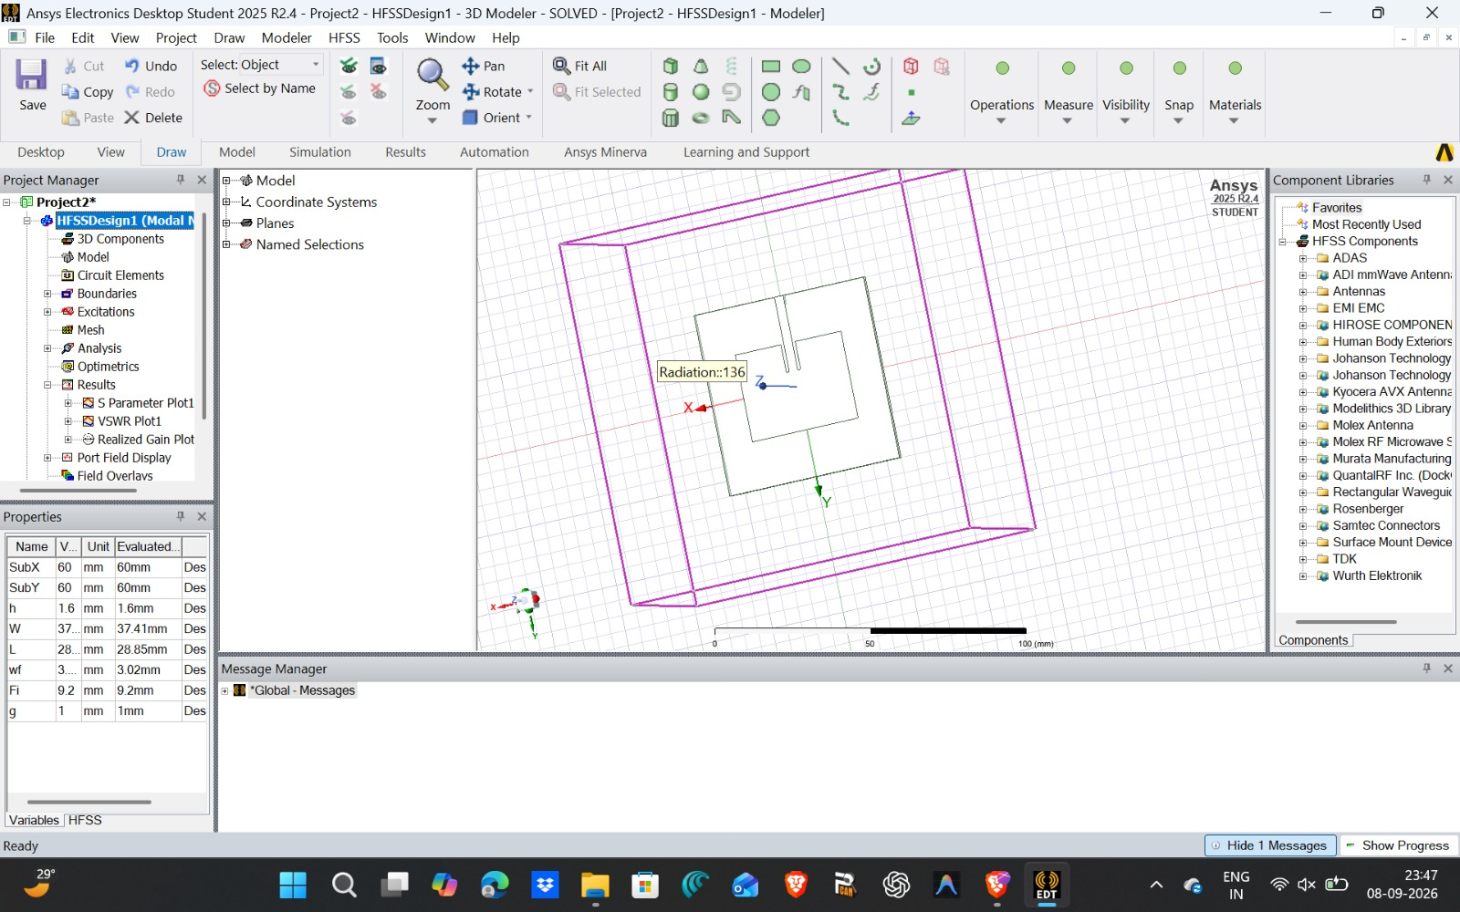
4
MODEL
3D Antenna Geometry & Parametric Setup
Substrate
60 × 60 × 1.6 mm FR-4
Patch
37.41 × 28.85 mm
Feed line
3.02 mm wide, 9.20 mm inset
Air box
Radiation boundary for open-space simulation
Figure 1: HFSS 3D model of the inset-fed patch antenna, with the parametric variable table and radiation boundary shown.
Microstrip Patch Antenna for Bluetooth/Zigbee IoT Nodes | FR-4 PCB | HFSS Simulation
6

Slide 7
5
METHOD
Simulation Methodology
An inset-fed microstrip patch antenna operating at 2.45 GHz was modeled and simulated in ANSYS HFSS (Electronics Desktop, Student 2025 R2.4).
1
Substrate & Ground
2
Parametric Modeling
3
Impedance Matching
Double-sided FR-4 epoxy substrate (εr = 4.4, h = 1.6 mm) with a full ground plane on the bottom layer.
Design variables (SubX, SubY, W, L, Wf, Fi, g) were used throughout, enabling fast optimization sweeps.
An inset feed (depth Fi = 9.20 mm, gap g = 1.00 mm) matches the 50 Ω microstrip line to the patch.
4
Excitation
5
Radiation Boundary
6
Solve Setup
A 50 Ω lumped port was assigned across a vertical integration line from ground plane to feed line.
An air box surrounding the structure was assigned a radiation boundary to emulate open-space propagation.
Driven Modal solution, discrete frequency sweep 2.0–3.0 GHz, 5 MHz (0.005 GHz) step resolution.
Microstrip Patch Antenna for Bluetooth/Zigbee IoT Nodes | FR-4 PCB | HFSS Simulation
7

Slide 8
6
RESULTS
Return Loss (S₁₁) Performance
-16.40 dB
2.43 GHz
2.383–2.4867 GHz
S₁₁ at resonance (marker m1)
Simulated resonant frequency
−10 dB impedance bandwidth
What the S₁₁ sweep shows
A sharp resonance dip of −16.40 dB occurs at 2.43 GHz, well below the standard −10 dB pass threshold, confirming a strong impedance match at resonance.
The −10 dB bandwidth spans 2.400–2.4835 GHz — fully covering the ISM band required for Bluetooth Low Energy (BLE) and Zigbee (IEEE 802.15.4), despite the resonance sitting 20 MHz below the 2.45 GHz design target.
This small frequency shift is typical of first-pass simulations and is easily corrected by trimming the patch length (L) slightly before fabrication — shorter L raises the resonant frequency.
Microstrip Patch Antenna for Bluetooth/Zigbee IoT Nodes | FR-4 PCB | HFSS Simulation
8

Slide 9
7
RESULTS
Impedance Matching (VSWR)
1.36
< 1.5
> 95%
VSWR at 2.43 GHz (marker m1)
Target VSWR threshold
Power delivered into antenna
Reading the VSWR curve
VSWR falls to 1.36 at 2.43 GHz, comfortably under the VSWR ≤ 1.5 criterion generally used to define a well-matched antenna.
A VSWR this low means over 95% of the incident power from the 50 Ω feed is transferred into the antenna, with minimal reflection back toward the source — important for battery-powered IoT nodes where every milliwatt matters.
Away from resonance, VSWR rises sharply toward the edges of the 2.0–3.0 GHz sweep (>25), which is expected — the patch is a narrowband resonant structure by design.
Microstrip Patch Antenna for Bluetooth/Zigbee IoT Nodes | FR-4 PCB | HFSS Simulation
9

Slide 10
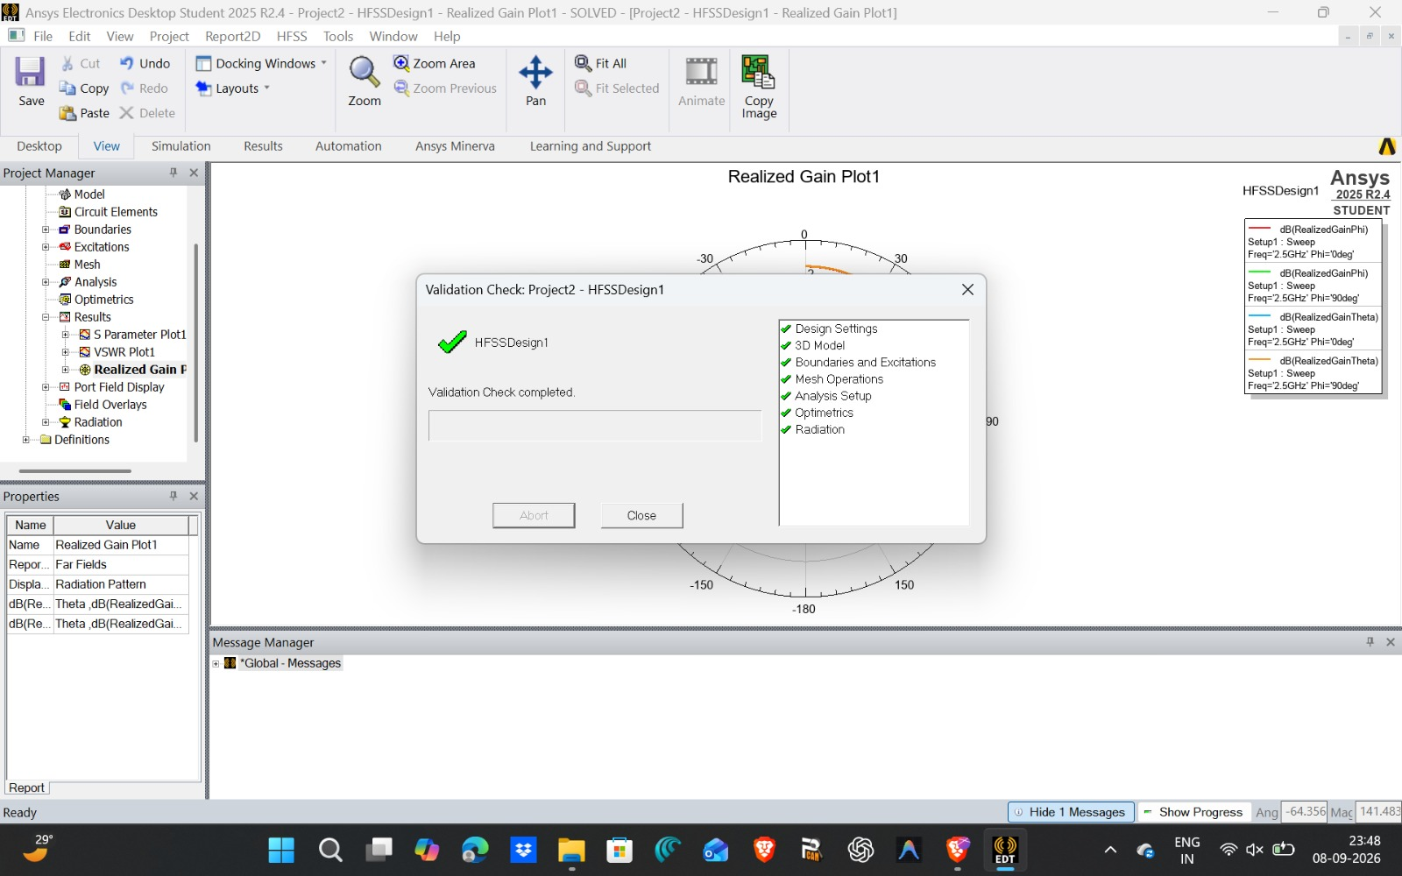
8
RESULTS
Radiation Pattern & Simulation Validation
Validation Checklist
✓
Design Settings
✓
3D Model
✓
Boundaries & Excitations
✓
Mesh Operations
✓
Analysis Setup
✓
Optimetrics
✓
Radiation
Radiation behavior
Broadside pattern with peak realized gain directed at θ = 0° (perpendicular to the patch). Low cross-polarization and back-lobe levels indicate high radiation purity — suitable for IoT sensor nodes.
Figure 2: HFSS validation check (all categories passed), with the 2.45 GHz realized-gain polar pattern behind it.
Microstrip Patch Antenna for Bluetooth/Zigbee IoT Nodes | FR-4 PCB | HFSS Simulation
10

Slide 11
9
RESULTS
Performance Summary
Metric | Simulated Result | Requirement | Status
Resonant Frequency | 2.43 GHz (target 2.45 GHz) | 2.4–2.4835 GHz ISM band | Pass
Return Loss (S₁₁) | −16.40 dB | ≤ −10 dB | Pass
−10 dB Bandwidth | 2.4383–2.4867 GHz (~48.4 MHz) | 84 | FAIL
VSWR | 1.36 | ≤ 1.5 | Pass
Radiation Pattern | Broadside, low back-lobe | Peak at θ = 0° | Pass
HFSS Validation Check | 7 / 7 categories passed | All categories green | Pass
Microstrip Patch Antenna for Bluetooth/Zigbee IoT Nodes | FR-4 PCB | HFSS Simulation
11

Slide 12
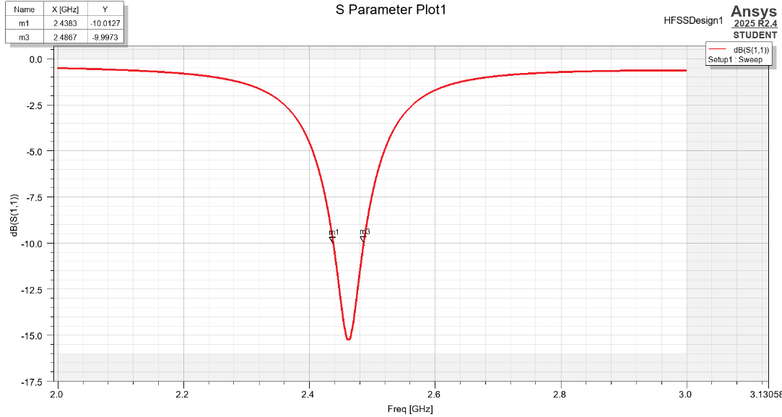

Slide 13
10
CONCLUSION
A Fabrication-Ready 2.45 GHz Antenna for IoT Nodes
An inset-fed microstrip patch antenna was successfully designed, simulated, and analyzed in ANSYS HFSS for Bluetooth- and Zigbee-class IoT applications. The antenna resonates at 2.43 GHz with a VSWR of 1.36 and strong broadband, broadside radiation. The parametric layout is fabrication-ready for a standard double-sided 1.6 mm FR-4 PCB with a 50 Ω SMA connector, making it suitable for direct integration into compact IoT sensor nodes.
2.43 GHz Resonance
−16.40 dB Return Loss
VSWR 1.36
Broadside Radiation
7/7 Validation Checks
With the frequency offset trimmed and the layout etched onto FR-4, this design is ready to move from simulation to a physical, measurable prototype (see Future Work).
Microstrip Patch Antenna for Bluetooth/Zigbee IoT Nodes | FR-4 PCB | HFSS Simulation
12

Slide 14
11
ROADMAP
Future Work & Next Steps
1
2
3
Fine-tune resonance
Fabricate the PCB
Mount the SMA connector
Trim patch length (L) by a fraction of a mm to pull resonance from 2.43 GHz to exactly 2.45 GHz.
Etch the validated layout onto 1.6 mm FR-4 using standard photolithography or PCB milling.
Solder an edge-launch 50 Ω SMA connector at the feed point for lab measurement.
4
5
6
Measure on a VNA
Verify the radiation pattern
Integrate & field-test
Measure S₁₁ and VSWR on a vector network analyzer and compare directly against the HFSS results.
Test the fabricated prototype in an anechoic chamber or open-field range against the simulated pattern.
Connect to a BLE/Zigbee module and test real-world link range and RSSI inside a housed IoT node.
Microstrip Patch Antenna for Bluetooth/Zigbee IoT Nodes | FR-4 PCB | HFSS Simulation
13

Slide 15
Thank You
Questions & Discussion
Microstrip Patch Antenna for Bluetooth/Zigbee IoT Nodes — Fabricated on FR-4 PCB

