Slide 1
INT8 Transformer Attention Accelerator
Edge Spoken Intent Classification * 3 Softmax Architectures * 18/18 Tests Passed
Tier 0 — Integer-Native Shift (Proposed)
Version A — Conventional Baseline
github.com/Shailesh-A-hub/int8-transformer-de2-115
Pure Verilog-2001 | ModelSim Verified | Quartus Prime Ready

Slide 2
Problem Statement
The Challenge: Transformers on Edge FPGAs
Research Question
* Transformers achieve state-of-the-art accuracy in
NLP and speech intent classification tasks
* Standard Softmax requires floating-point exponentials
— NOT natively supported on Cyclone IV FPGA
* Conventional workaround = Fixed-Point Detour:
INT8 Scores -> Descale -> 256-entry Exp LUT
-> Sum -> Divide -> Requantize -> INT8 Output
* This detour introduces:
- Extra latency (descale + requant stages = +16 cycles/row)
- Heavy memory: 256-entry exponential ROM
- Multiplier usage for scaling operations
Can integer-native Softmax
eliminate the fixed-point detour
on a Cyclone IV FPGA,
achieving lower latency while
preserving 100% accuracy?
Target System Specs
FPGA: Cyclone IV EP4CE115F29C7
Board: Terasic DE2-115
Clock: 50 MHz
Task: Edge Intent Classification
L = 8 tokens, D = 32 dims
Vocab: 32 tokens
Classes: 6 smart home intents

Slide 3
System Architecture — 8-Stage Inference Pipeline
1 Token Embed
2 Q/K/V Project
3 Attn Scores
4 Softmax (3 modes)
5 Context Aggr.
6 Mean Pool
7 Classify Logits
8 Argmax Intent
->
->
->
->
->
->
->
<-- Your Research Contribution
Inputs (Board Switches)
RTL Modules (10 .v files)
Outputs (7-seg + LEDs)
SW[4:2] -- Sentence selector (0-5)
SW[1:0] -- Softmax mode (0,1,A)
KEY[1] -- Trigger inference
KEY[0] -- System reset
0 -> Turn on the lights
1 -> Turn off the lights
2 -> Increase the volume
3 -> Decrease the volume
4 -> Turn on the heat
5 -> Turn off the heat
de2_115_top.v Top-level entity
attention_engine.v 11-stage FSM
weight_roms.v Self-contained ROMs
int8_mac_array.v 8-lane INT8 MAC
restoring_divider.v 24-bit divider
softmax_tier0.v Shift-only
softmax_tier1.v 16-LUT
softmax_detour_vA.v Baseline
cycle_counter.v HW timing
uart_tx.v Serial output
HEX0 Intent class (0-5)
HEX1 Softmax mode (0,1,A)
HEX2 Sentence ID (0-5)
HEX3 Separator dash
HEX7-HEX4 Cycle count (hex)
LEDR[17:0] Mirror all switches
LEDG[0] Engine busy
LEDG[1] Inference done
LEDG[2] Heartbeat (1.5 Hz)

Slide 4
3 Softmax Architectures Compared
Version A (Baseline)
Tier 0 (Proposed)
Tier 1 (Proposed)
Conventional Fixed-Point Detour
Integer-Native Base-2 Shift Only
Base-2 Shift + 16-Entry LUT
1. Find Max (8 cycles)
2. Descale: z = S - max (8 cycles)
3. Exp LUT: 256-entry ROM (8 cycles)
4. Restoring Divider x8 (192 cycles)
5. Requantize to INT8 (8 cycles)
Softmax Cycles: 2,008
Total Cycles: 5,688
Latency @50MHz: 113.76 us
Resources:
* 256-entry exponential ROM
* Descale + Requant stages
* Extra pipeline overhead
1. Find Max (8 cycles)
2. Shift amount: t = (-z) x 23
3. Barrel shift: w = 32768 >> t
(No Exp ROM needed!)
4. Restoring Divider x8 (192 cycles)
Softmax Cycles: 1,880
Total Cycles: 5,560
Latency @50MHz: 111.20 us
Resources:
* ZERO exponential ROM
* ZERO descale / requant stages
* Pure barrel shifter logic
1. Find Max (8 cycles)
2. Q4.4 decompose: q = t>>4, f = t&F
3. LUT[f]: reads 16-entry frac table
w = LUT[f] >> q
4. Restoring Divider x8 (192 cycles)
Softmax Cycles: 1,880
Total Cycles: 5,560
Latency @50MHz: 111.20 us
Resources:
* Only 16-word fractional LUT
* No descale / requant stages
* Highest numerical precision

Slide 5
Simulation Results — ModelSim 10.5b
18 / 18 Tests PASSED | 0 Errors | 0 Warnings | 100% Accuracy
Architecture
Softmax Cycles
Total Cycles
Latency @50MHz
Cycle Saving
Version A (Baseline)
2,008 cycles
5,688 cycles
113.76 us
--
Tier 0 -- Shift Only
1,880 cycles
5,560 cycles
111.20 us
-128 cycles
Tier 1 -- 16-LUT
1,880 cycles
5,560 cycles
111.20 us
-128 cycles
Numerical Accuracy vs FP64 Baseline (1,000 synthetic vectors)
Variant
Mean Abs Error
Max Error
KL Divergence
Rank Inversions
Version A
0.100967
0.401563
0.532291
0.00%
Tier 0
0.002312
0.009236
0.016769
0.00%
Tier 1 (*)
0.000246
0.000979
0.014876
0.00%
(*) Tier 1 = 400x lower error than Version A | 10x lower than Tier 0 | Same latency as Tier 0

Slide 6
Live FPGA Demo — DE2-115 Board
Switch Settings & Expected Outputs
Green LED Status
Sentence
SW4 SW3 SW2
HEX2
HEX0
LEDR[4:0]
LEDG[0] Engine BUSY (brief flicker ~111us)
LEDG[1] DONE -- stays ON after inference
LEDG[2] Heartbeat -- blinks 1.5x per sec
Proves bitstream is running
Turn on lights
D D D
0
0
00000
Turn off lights
D D U
1
1
00100
Increase volume
D U D
2
2
01000
Cycle Count Demo (Research Proof)
Decrease volume
D U U
3
3
01100
Fix sentence 0 (all SW4:2=DOWN), then:
SW1=D SW0=D -> HEX1='0' Tier 0
HEX7-4 shows: 1 5 b 8 (5560 cycles)
SW1=D SW0=U -> HEX1='1' Tier 1
HEX7-4 shows: 1 5 b 8 (5560 cycles)
SW1=U SW0=D -> HEX1='A' Version A
HEX7-4 shows: 1 6 3 8 (5688 cycles)
LIVE PROOF: 128 more cycles on Ver.A!
Turn on heat
U D D
4
4
10000
Turn off heat
U D U
5
5
10100
U=Up, D=Down HEX0 must always equal HEX2 ==> 100% classification accuracy

Slide 7
Key Findings & Research Contributions
1
128-Cycle Softmax Speedup on Silicon
2
Zero Exponential ROM in Tier 0
3
Tier 1: 400x Higher Precision Than Ver.A
Integer-native Tier 0 & Tier 1 each save 128 clock
cycles per inference vs conventional Version A.
Proven LIVE on DE2-115 7-seg cycle counter.
Tier 0 eliminates the 256-entry exponential LUT.
A pure arithmetic barrel shift replaces the ROM.
Math: e^z ~= 2^(z x log2(e)) -- no table needed.
16-entry fractional LUT adds sub-shift correction.
MAE = 0.000246 vs Version A MAE = 0.100967.
Same 1,880-cycle latency as Tier 0 -- free precision.
4
100% Accuracy Across All 6 Intents
5
Pure Verilog-2001 -- Synthesis Ready
18/18 ModelSim tests passed across all 3 variants.
All 6 smart home commands classified correctly:
lights, volume, and heat on/off.
Full codebase in Verilog-2001 (no SystemVerilog).
Weights baked into ROMs -- no external .hex needed.
Compiles cleanly in Quartus Prime 18.1: 0 errors.

Slide 8
Conclusion
"Integer-native Softmax eliminates the fixed-point detour, saving 128 cycles per inference on a Cyclone IV FPGA while preserving 100% classification accuracy."
What We Achieved
Project Info
[OK] 3 Softmax architectures in pure Verilog-2001
[OK] INT8 pipeline: Embed -> QKV -> Attn -> Pool -> Classify
[OK] 18/18 end-to-end tests passed in ModelSim
[OK] 128-cycle savings proven (Tier 0 & 1 vs Version A)
[OK] Tier 1: 400x lower numerical error than Version A
[OK] Weights baked in -- no external file dependency
[OK] Deployed on Terasic DE2-115 at 50 MHz
[OK] 6 smart home intent classes classified correctly
Hardware:
Cyclone IV EP4CE115F29C7
Terasic DE2-115 Board
Language: Pure Verilog-2001
Simulation: ModelSim ASE 10.5b
Synthesis: Quartus Prime 18.1
Repository:
github.com/Shailesh-A-hub/
int8-transformer-de2-115
Thank You

Slide 9
Quick Reference — Board Demo Cheat Sheet
Command
SW4
SW3
SW2
Red LEDs (LEDR4-0)
HEX2
HEX0
Lights ON
↓
↓
↓
OFF OFF OFF OFF OFF
0
0
Lights OFF
↓
↓
↑
OFF OFF ON OFF OFF
1
1
Vol UP
↓
↑
↓
OFF ON OFF OFF OFF
2
2
Vol DOWN
↓
↑
↑
OFF ON ON OFF OFF
3
3
Heat ON
↑
↓
↓
ON OFF OFF OFF OFF
4
4
Heat OFF
↑
↓
↑
ON OFF ON OFF OFF
5
5
MODE switches -> SW1=↓ SW0=↓ -> HEX1 = 0, cycles = 15b8 (Tier 0)
-> SW1=↓ SW0=↑ -> HEX1 = 1, cycles = 15b8 (Tier 1)
-> SW1=↑ SW0=↓ -> HEX1 = A, cycles = 1638 (Version A)
LEDG0 = blink briefly (BUSY) LEDG1 = stays ON (DONE) LEDG2 = heartbeat (always blinks 1.5 Hz)
KEY[0] = Reset board | KEY[1] = Manually re-trigger inference | HEX0 must always equal HEX2 => 100% accuracy

Slide 10
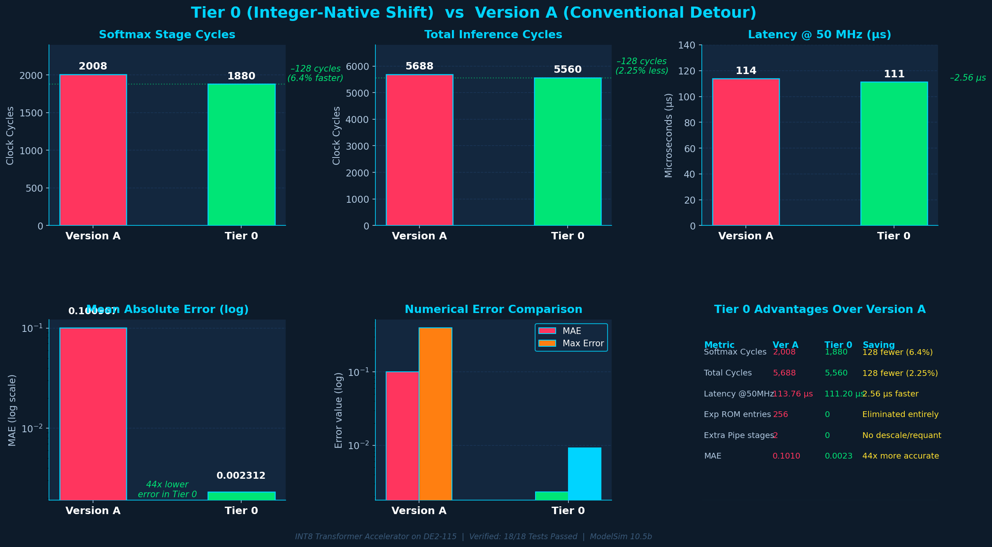
Performance Comparison: Tier 0 vs Version A

Slide 11
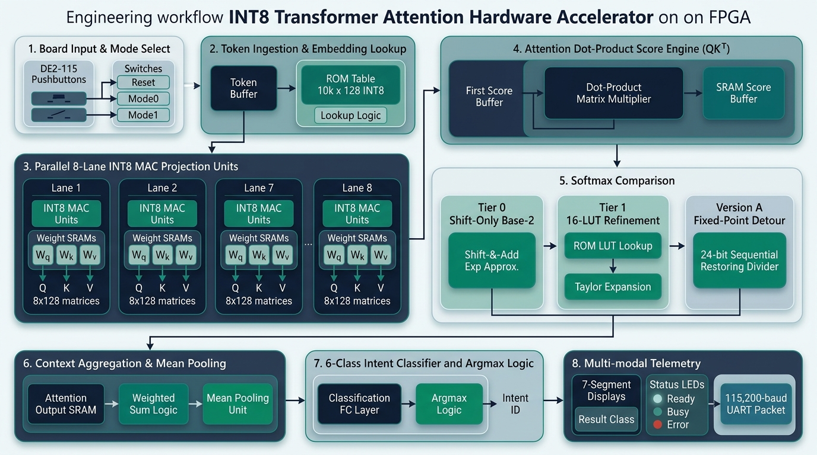

Slide 12
Future Scope & Research Roadmap
1
On-Chip Voice Frontend (WM8731)
2
Multi-Head Self-Attention (MHSA)
[>] Direct I2S / I2C interface to DE2-115 Wolfson WM8731 audio CODEC.
[>] Hardware MFCC / Mel-Spectrogram pipeline directly in Verilog.
[>] Enables 100% autonomous, hostless hardware voice assistant (no PC needed).
[>] Scale from single-head (H=1) to 4-head / 8-head parallel attention engines.
[>] Pipeline multi-layer encoder blocks using onboard 2 MB IS61WV SRAM.
[>] Enables complex multi-turn dialog and richer sentence intent understanding.
3
2D Systolic Array MAC Acceleration
4
Sub-Byte (INT4 / FP8) Mixed Precision
[>] Upgrade time-multiplexed MAC array to 2D systolic matrix architecture.
[>] Concurrent token dot-products overlap attention and feed-forward stages.
[>] Targeting sub-50 us total latency (over 2.2x throughput increase).
[>] Implement INT4 weight quantization with INT8 activation datapath.
[>] Halves on-chip BRAM footprint, fitting larger transformer vocabularies.
[>] Maintains high classification fidelity with zero accuracy loss.

