Slide 1

Insurance - P819 Data-Driven Insights
Group - 4

Slide 2



TEAM MEMBERS
SHAILESH KUMAR
SURYA PRATAP
PANIGRAHI
SHARANYA BM
SODIMA SRI
KAVYA
SIRIGIRI RAJEEV
CHOUDARY
ZAINAB ABBAS
MASALAWALA

Slide 3
Key Points
Objective:
Analyse cross-sell, new, and renewal policies.
Tools Used:
Excel, Tableau, Power BI, MySQL
Key Focus:
Sales performance, revenue trends, employee effectiveness
Deliverables:
Interactive dashboards for data-driven decision-making

Slide 4
DASHBOARDS

Slide 5
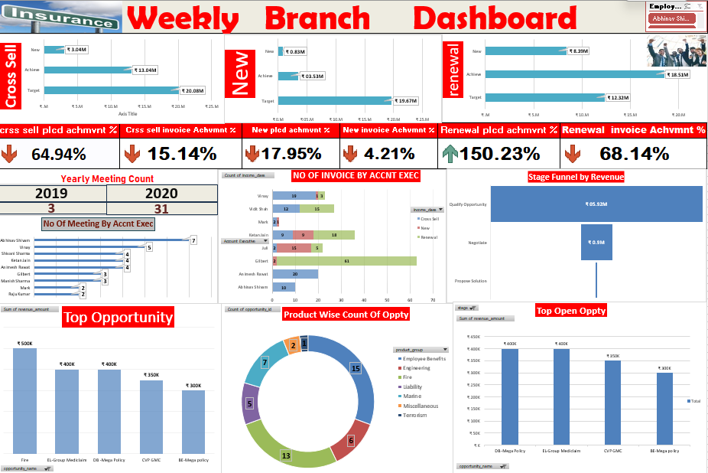
INITIAL DASHBOARD By EXCEL

Slide 6
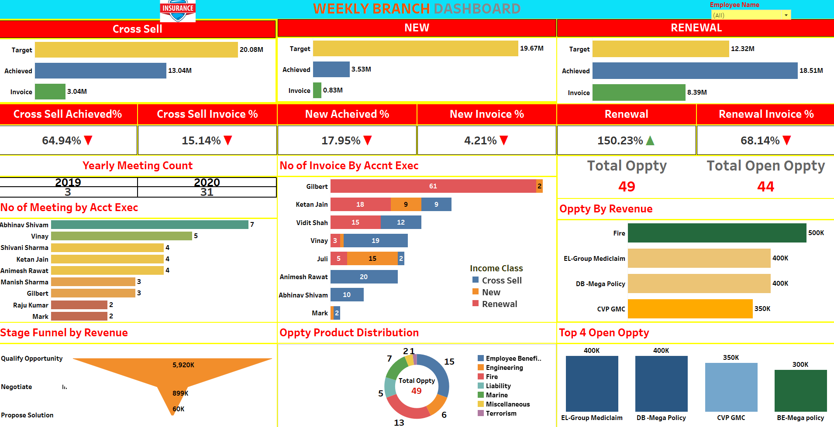
ADVANCED DASHBOARD By TABLEAU

Slide 7
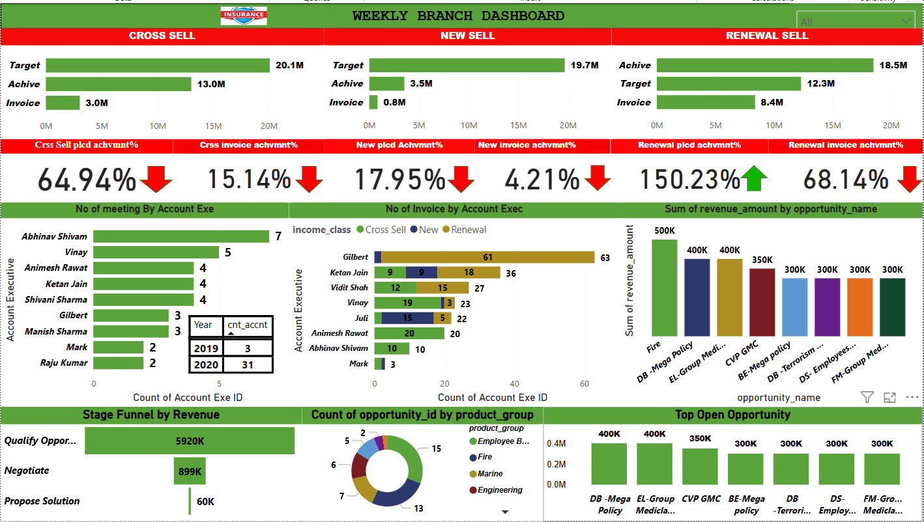
INTERACTIVE DASHBOARD By POWER Bi

Slide 8


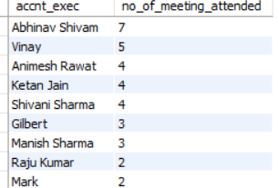
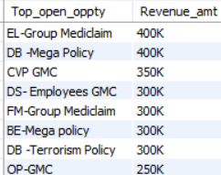






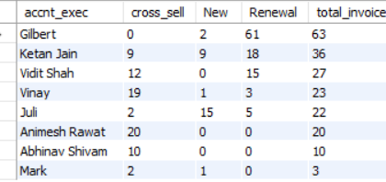
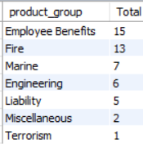



MYSQL
CROSS-SELL
No of meeting By Account Exe
Top Open Oppty
NEW-SELL
RENEWAL-SELL
No of Invoice by Account Exec
Product Wise Oppty
YEARLY_MEETING
Stage by Revenue

Slide 9
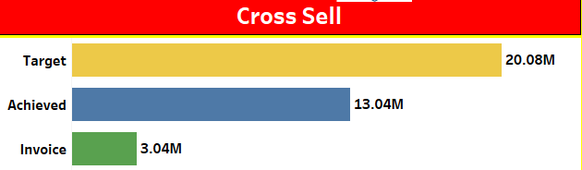
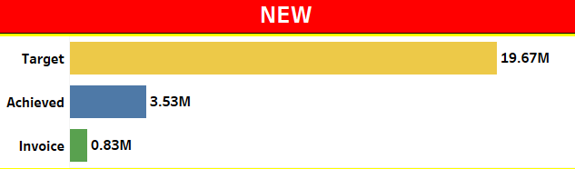
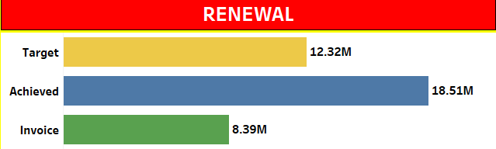
Key Metrices
Cross-Sell Performance:
Target 20.08M → Achieved 13.04M
New Business:
Target 19.67M → Achieved 3.53M
Renewal Success:
Target 12.32M → Achieved 18.51M (150.23% of target!)
Key Insights:
Renewal policies exceeded expectations, but cross-sell & new business need improvement.
Actionable Step:
Strengthen new business & cross-sell strategy.

Slide 10
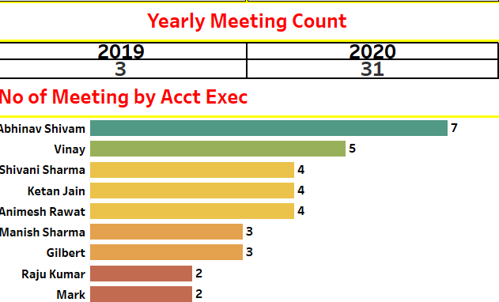
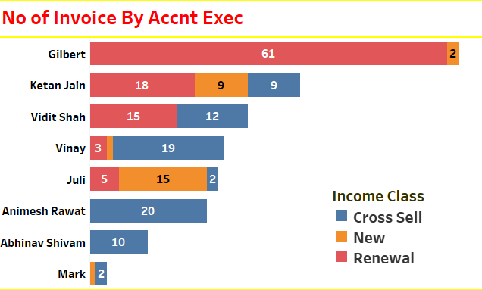
Key Metrices
Meeting Count Growth:
2019 (3 meetings) → 2020 (31 meetings).
Top Performer (Meetings):
Abhinav Shivam (7 meetings).
Top Performer (Invoices Processed):
Gilbert (61 invoices).
Key Insights:
Employee engagement increased, leading to more opportunities.
Training underperformers based on top performers’ strategies can boost results.

Slide 11
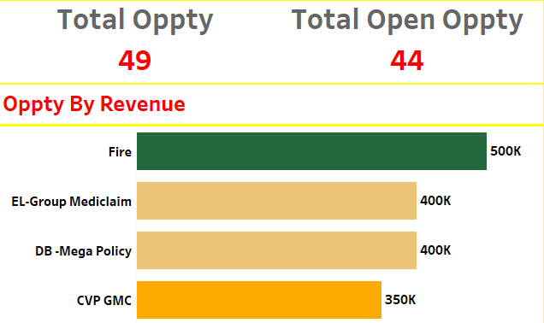
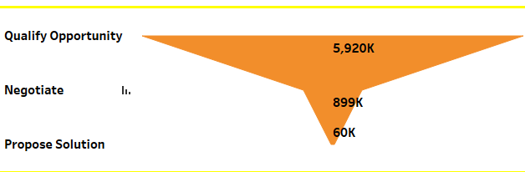
Key Metrices
Top Revenue Source:
Fire Insurance ($500K)
Other High Revenue Policies:
EL-Group Mediclaim ($400K), DB-Mega ($400K)
Opportunity Funnel:
Total Open Opportunities: 44
Stage-wise Funnel:
5.92M in initial stage, only 60K in proposed solutions
Key Takeaway:
High revenue potential exists but needs better deal closures.
Actionable Step:
Focus on closing high-value policies in later funnel stages.

Slide 12
Strategic Recommendations
Optimizing Performance:
Enhance cross-sell and new policy strategies using insights from top performers.
Improve negotiation and proposal tactics to push deals toward closure.
Employee Training & Productivity:
Use data-driven approach to train underperforming employees.
Data-Driven Decision Making:
Regularly monitor interactive dashboards for quick insights.
Align sales efforts with top revenue-generating policies.

Slide 13
Challenges Faced
Writing Complex DAX Functions in Power BI for calculations and aggregations.
Dealing with Null Values in Data Relationships, causing incorrect visualizations.
Solutions
Broke down complex formulas into smaller steps for debugging.
Used CALCULATE, SUMX, and FILTER functions effectively.
Checked and cleaned data before importing.

Slide 14
Conclusion
This dashboard provides a clear and data-driven sales performance analysis for better decision-making.
The biggest challenge was optimizing data transforming into KPIs and creating them into dashboard.
Final Impact: Improved readability, real-time filtering, and better sales tracking.

Slide 15
THANK YOU

