Slide 1


PROJECT ON
Telecom Customer
Churn Analysis
T
%
22.6%
of customers churn
From Dirty Data to Business Insight - A Full EDA Journey
Presented by:
SHAILESH PAWAR
!
Start Presentation →
LinkedIn
GitHub
5,500
Raw Records
12
Columns
10+
Issues Cleaned
22.6%
Churn Rate

Slide 2
PROJECT BRIEF
Problem Statement & Objective
!
Problem Statement
>
Objective
Telecom providers lose significant recurring revenue when customers churn - but raw customer data is rarely clean enough to model directly.
Nulls, outliers, inconsistent formatting, and duplicate records obscure the real signals driving customer attrition.
Clean a genuinely messy telecom customer dataset end-to-end and perform exploratory analysis to uncover churn drivers.
Quantify high-risk customer segments and translate findings into revenue-at-risk figures that support retention decisions.
TELECOM CUSTOMER CHURN ANALYSIS
2

Slide 3
DATA UNDERSTANDING
Dataset Overview
Numerical Columns
Categorical Columns
Telecom Customer
Churn Dataset
TenureMonths
Gender, ContractType
Months as an active customer
Customer demographic & plan type
5,500
MonthlyCharges
InternetService
Current monthly billing amount
DSL / Fiber Optic / No Internet
raw rows collected
TotalCharges
TechSupport, PaperlessBilling
Cumulative amount billed to date
Service subscription flags
12
SeniorCitizen
PaymentMethod, Churn
features + 1 target
Binary flag (0/1)
Billing method & target label
5,463
Target Column: Churn
Binary label (Yes / No) - indicates whether the customer discontinued service. Used to drive every downstream cleaning, EDA, and modeling decision.
rows after cleaning
TELECOM CUSTOMER CHURN ANALYSIS
3

Slide 4
DATA CLEANING
Duplicate Records Found & Removed
A duplicate is an exact copy of another row: same CustomerID and same value in every column. Sample pairs from the raw data:
37
Exact duplicate rows
74
Rows involved (37 pairs)
5,500 → 5,463
Rows before and after
0
Duplicate CustomerIDs after
Row | CustomerID | Gender | TenureMonths | ContractType | MonthlyCharges | PaymentMethod | TotalCharges | Churn
307 (kept) | 1626-MZEYG | NaN | 9 | Month-to-Month | NaN | Electronic Check | 707.98 | No
5383 (dropped) | 1626-MZEYG | NaN | 9 | Month-to-Month | NaN | Electronic Check | 707.98 | No
465 (kept) | 1638-MXRBY | Male | 13 | One Year | 45.16 | NaN | 591.86 | No
1512 (dropped) | 1638-MXRBY | Male | 13 | One Year | 45.16 | NaN | 591.86 | No
3935 (kept) | 9412-BVHGH | Female | 19 | One Year | NaN | Electronic Check | 1103.8 | No
5053 (dropped) | 9412-BVHGH | Female | 19 | One Year | NaN | Electronic Check | 1103.8 | No
3251 (kept) | 9903-FZAJV | Female | 42 | Month-to-Month | $18.00 | Mailed Check | 741.05 | No
3497 (dropped) | 9903-FZAJV | Female | 42 | Month-to-Month | $18.00 | Mailed Check | 741.05 | No
Showing 4 of the 37 duplicate pairs and 8 of 12 columns. Each pair keeps the first row and drops the second using drop_duplicates().
TELECOM CUSTOMER CHURN ANALYSIS
4

Slide 5
DATA CLEANING
Column-by-Column Cleaning Summary
Column
Issue Identified
Cleaning Action
Full Dataset
37 exact duplicate rows
Dropped via drop_duplicates()
Gender
Casing dupes + 109 nulls
Standardized casing, imputed with mode
TenureMonths
Outliers: -3, 150, 999
Capped to valid range 0-72 (domain logic)
ContractType
Whitespace + null-like strings + 65 nulls
Stripped, converted, imputed with mode
InternetService
Null-like strings + 66 nulls
Converted to NaN, imputed with mode
TechSupport / PaperlessBilling
137 / 81 nulls
Imputed with mode
PaymentMethod
Casing dupes + 228 nulls
Standardized casing, imputed with mode
MonthlyCharges
Currency text + outliers + 109 nulls
Stripped "$", IQR-capped, median imputed
TotalCharges
Blank strings for tenure=0
Converted to numeric, structural 0-impute
TELECOM CUSTOMER CHURN ANALYSIS
5

Slide 6
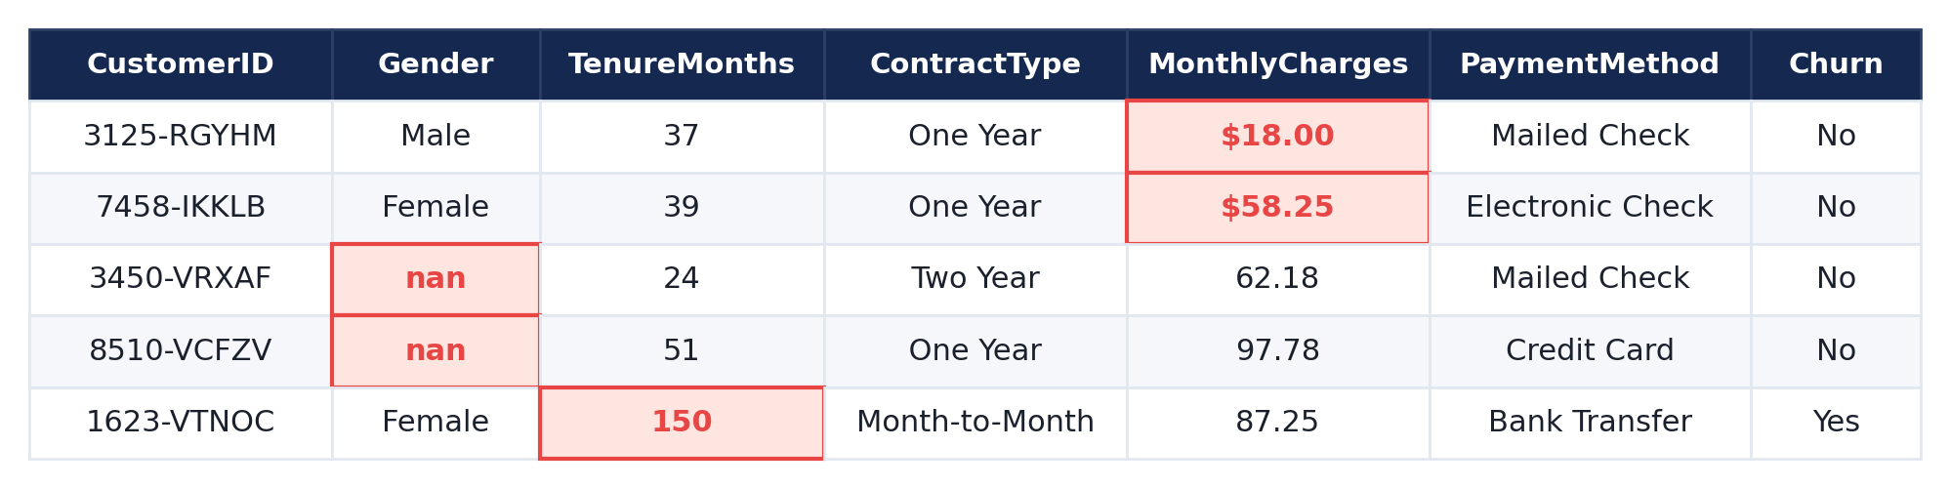
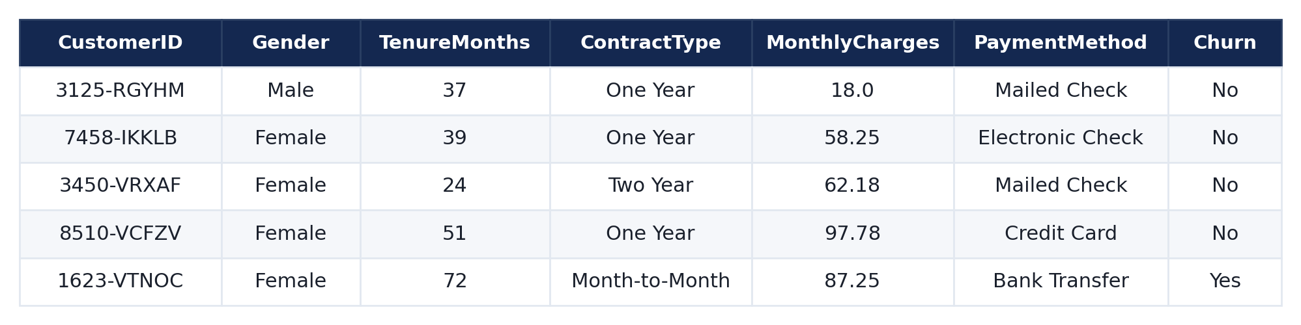
DATA CLEANING
Raw vs. Cleaned Data - Side by Side
Same 5 customer records, shown before and after the cleaning pipeline. Highlighted cells mark the exact issues fixed.
BEFORE
AFTER
TELECOM CUSTOMER CHURN ANALYSIS
6

Slide 7
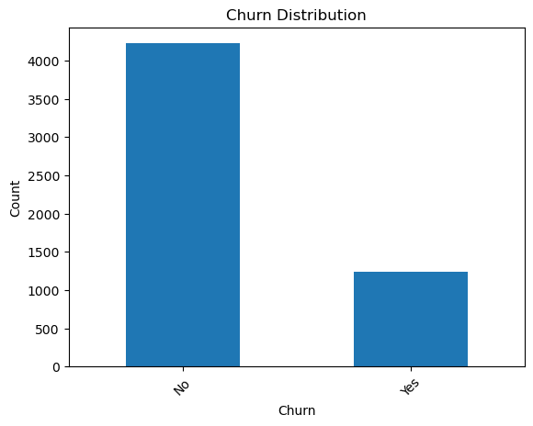
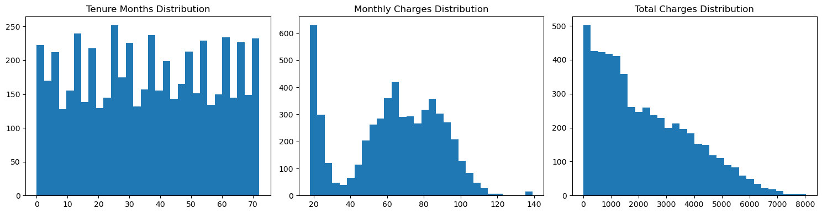
EXPLORATORY DATA ANALYSIS
Univariate Analysis: Target & Numeric Distributions
What this tells us
77.4%
22.6%
Retained Customers
Churned Customers
A healthy real-world class imbalance, common in churn problems. It shaped the modeling approach: evaluate with precision-recall rather than accuracy alone.
Observation:
Tenure spans 0-72 months, Monthly Charges center near $45-85, and Total Charges is right-skewed, as expected after capping.
TELECOM CUSTOMER CHURN ANALYSIS
7

Slide 8
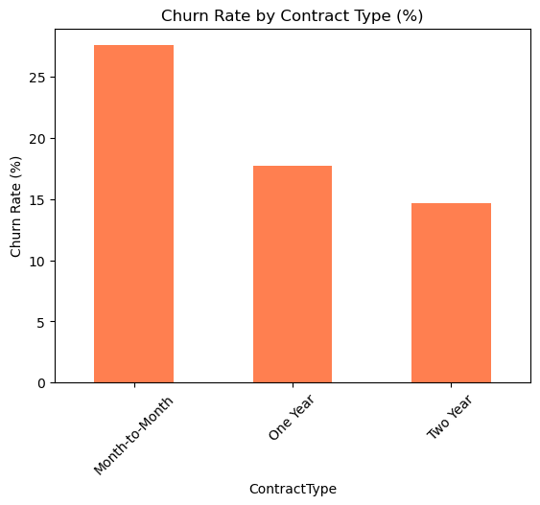
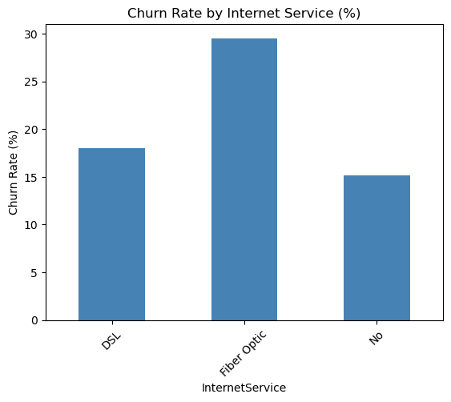
BIVARIATE ANALYSIS
Churn Drivers: Contract Type & Internet Service
Churn Rate by Contract Type
Churn Rate by Internet Service
Month-to-Month
~27%
Fiber Optic
~29%
One Year
~18%
DSL
~18%
Two Year
~15%
No Internet
~15%
Insight
Insight
Month-to-Month customers churn at nearly double the rate of Two Year customers, the strongest single churn driver. Short commitments mean low-friction exits.
Fiber Optic customers churn far more than DSL or No Internet, likely from price sensitivity on the costliest tier. A priority segment for retention review.
TELECOM CUSTOMER CHURN ANALYSIS
8

Slide 9
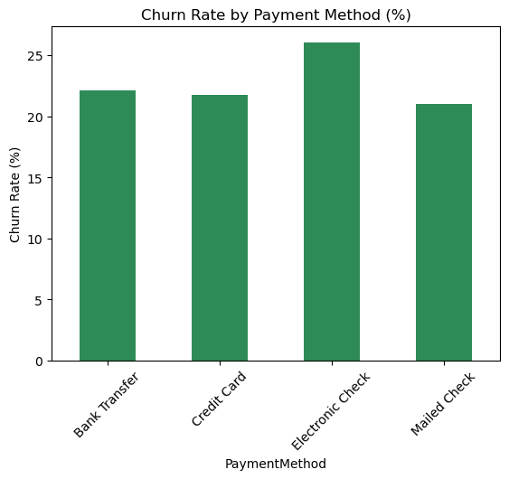
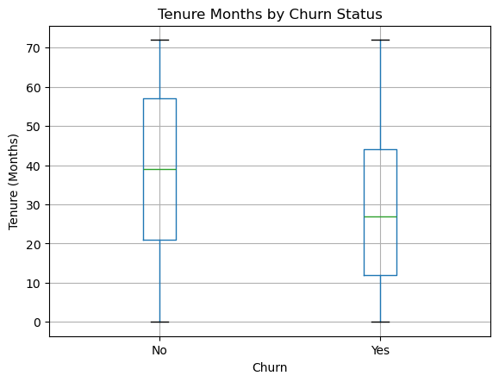
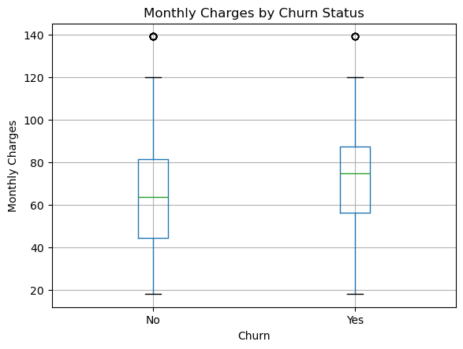
BIVARIATE ANALYSIS
Churn Drivers: Payment Method & Numeric Features
Churn Rate by Payment Method
Numeric Features vs. Churn
Electronic Check
~26%
Bank Transfer
~22%
Credit Card
~21.5%
Mailed Check
~21%
Tenure vs. Churn
Monthly Charges vs. Churn
Insight
Observations
Electronic Check users churn more than automatic payment methods. Manual payers are less locked in, a well-known telecom churn pattern.
Tenure: churned customers skew to shorter tenure, so risk peaks early. Monthly Charges: churners carry slightly higher median charges, hinting at price sensitivity.
TELECOM CUSTOMER CHURN ANALYSIS
9

Slide 10
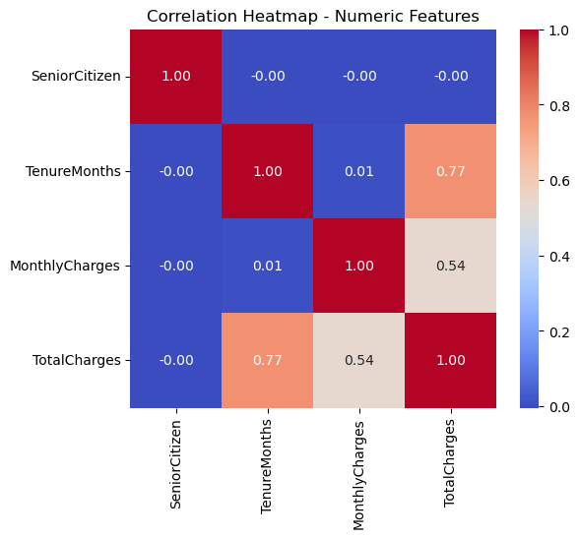
EXPLORATORY DATA ANALYSIS
Correlation Heatmap - Numeric Features
Reading the Heatmap
TenureMonths and TotalCharges: strong positive correlation - expected, since longer-tenured customers naturally accumulate higher total billing.
MonthlyCharges and TotalCharges: moderate positive correlation, driven by the same underlying billing relationship.
SeniorCitizen: shows weak correlation with the other numeric features - behaves largely independently.
TELECOM CUSTOMER CHURN ANALYSIS
10

Slide 11
KEY FINDING
The High-Risk Customer Segment
What happens when the three strongest churn drivers combine?
Month-to-Month
Contract
+
Fiber Optic
Internet
+
Electronic Check
Payment
=
39.1%
Why this matters
Only ~6% of customers (335 of 5,463) fall into this segment
Yet they account for a disproportionate share of total churn risk
A precise, actionable target for retention campaigns - not a guess
churn rate in the high-risk segment
vs. 21.6% for everyone else - nearly 2x baseline
TELECOM CUSTOMER CHURN ANALYSIS
11

Slide 12
BUSINESS IMPACT
Revenue at Risk
Turning churn probability into a dollar figure a business stakeholder can act on.
$86,284
$27,974
$10,836
Monthly revenue already lost
to churned customers
Monthly revenue exposure from
the high-risk segment alone
Already realized monthly loss
from the high-risk segment
$1.04M annualized
$335,692 annualized
39% of segment revenue
Total Portfolio vs. High-Risk Exposure
Total Monthly Revenue
8.1% of total revenue
sits in a segment that's
only 6% of customers
$344,300
High-Risk Segment Exposure
$27,974 (8.1%)
TELECOM CUSTOMER CHURN ANALYSIS
12

Slide 13
SUMMARY
Key Insights from EDA
1
Overall churn rate stands at 22.6%
2
Month-to-Month contracts churn ~2x more than Two Year
A healthy, realistic imbalance for classification modeling
Contract length is the single strongest churn predictor
3
Fiber Optic customers show the highest churn among internet types
4
Electronic Check users churn more than automatic payment methods
Likely price-sensitivity driven - a retention priority segment
Manual billing correlates with lower customer stickiness
5
The combined high-risk segment churns at 39.1%
6
8.1% of total revenue sits in the high-risk segment
Nearly double the baseline - despite being only ~6% of customers
A concentrated, actionable target for retention spend
TELECOM CUSTOMER CHURN ANALYSIS
13

Slide 14
Conclusion
What this analysis found
This EDA turned a messy telecom dataset into a clean, insight-rich foundation and revealed a precise high-risk churn segment (Month-to-Month + Fiber Optic + Electronic Check) with 39.1% churn and $27,974 in monthly revenue exposure.
Data Cleaning • Exploratory Data Analysis • Business Insight Generation

Slide 15
Thank You
Questions & Discussion Welcome
22.6%
Overall churn rate
39.1%
High-risk segment churn
$27,974
Monthly revenue at risk
SP
SHAILESH PAWAR
↺ Back to Start
Key Insights
Telecom Customer Churn Analysis | EDA Project
linkedin.com/in/shaileshpawar-cse
github.com/Shailesh-Pawar-18

