Slide 1
Fraud Detection in FinTech Domain

Slide 2
Agenda
Introduction
Frauds in FinTech space
Evolution and Types of Frauds
Examples of real-life Frauds in FinTech giants
Fraud Detection using AI and ML
Supervised Fraud Detection
Fraud Detection from the lens of supervised learning
Challenges in ML model development
Model evaluation
Hands-on exercise
Anomaly Detection
Fraud Detection from the lens of un-supervised learning
Hands-on exercise

Slide 3
Introduction

Slide 4





Frauds in FinTech space
Frauds – The cost of convenience
In Q2 2022, UPI clocked over 17.4 Billion txns in volume amounting to 30.4 Trillion INR
Online payment fraud losses to exceed $343bn over next 5 years

Slide 5
Evolution and Types of Frauds
Phishing
Identity Theft
Web Skimming
Social Engineering
Bot Attacks
Fraudsters are finding more and more innovative way to exploit the loopholes in the system
Fintech gains are trying to reinstate the faith in system by bring in stricter checks and balances like Multi-Factor Authentication, Stricter customer onboarding, ensuring KYC for all customers etc.

Slide 6


Examples of real-life Frauds in FinTech giants
Money Received Scam
Device Takeover Frauds

Slide 7
Fraud Detection using AI and ML
Traditionally rules were used to filter out Fraudulent behaviors in the financial systems
Some of the issues with the rules were:
Labor intensive process in creating the hand-crafted rules
Doesn’t automatically evolve over time
Uses legacy software to enforce a rule which doesn’t work well with real-time data streams that are present in the current digital space
Catches only the obvious fraudulent scenarios
Need for AI-based fraud detection

Slide 8
References
News Paper Articles:
Economic Times
Fintech Global

Slide 9
Supervised Fraud Detection

Slide 10

Fraud Detection from the lens of supervised learning
Model Fraud detection as a supervised learning problem – Type & Nature of fraud are known a priori
Potential issues:
Class imbalance
Limited to only a particular type of Fraud
Things to keep in mind
Accuracy – Not a Good measure
Consider a 1000 txns happen via a banking system and out of which 10 are fraudulent
ML Model
Predicts all txns as good
Accuracy – 99.0%?

Slide 11
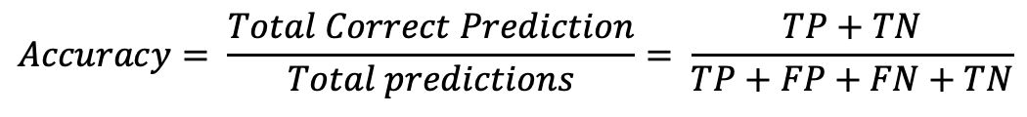
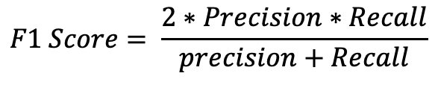
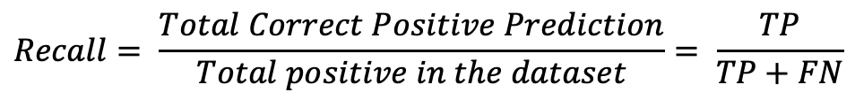
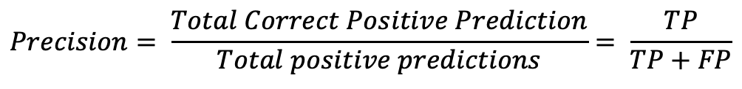
Model Performance Metrics
Actual Class
$$Accuracy= \frac{Total Correct Prediction}{Total predictions}= \frac{TP+TN}{TP+FP+FN+TN}$$
Fraud
Non - Fraud
TP
FP
Fraud
$$Precision= \frac{Total Correct Positive Prediction}{Total positive predictions}= \frac{TP}{TP+FP}$$
Predicted Class
FN
TN
Non - Fraud
$$Recall= \frac{Total Correct Positive Prediction}{Total positive in the dataset}= \frac{TP}{TP+FN}$$
$$F1 Score= \frac{2∗Precision∗Recall}{precision+Recall}$$
Actual Class
Fraud
Non - Fraud
0
0
Fraud
Predicted Class
10
990
Non - Fraud

Slide 12
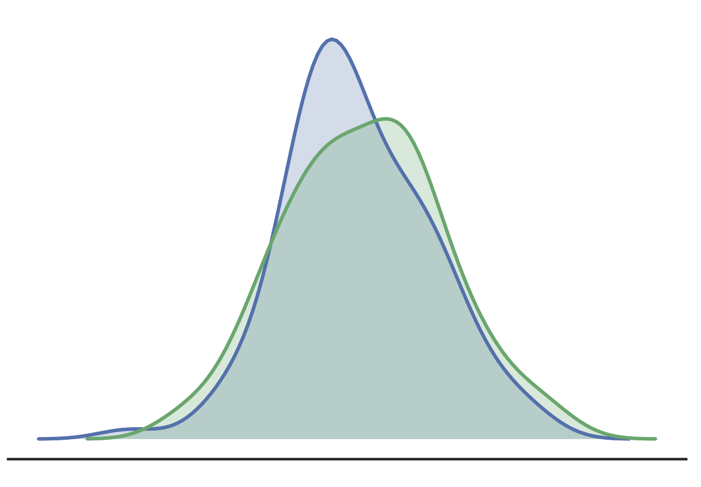
Model Relevance Metric
Population Stability Index – PSI
Used to quantify the relevance of the model
The population on which the model is run keeps on changing it’s nature
Need to retrain the model once we see a shift in population – Model becomes obsolete
Score Range | Decile | Scoring% (A) | Training% (B) | A-B | ln(A/B) | Decile PSI
0 – 0.12 | 1 | 10 | 12 | -2 | -0.18 | 0.36
0.12 – 0.2 | 2 | 10 | 8 | 2 | 0.22 | 0.44
0.2 – 0.35 | 3 | 10 | 11 | -1 | -0.095 | 0.095
0.35 – 0.4 | 4 | 10 | 9 | 1 | 0.105 | 0.105
0.4 – 0.53 | 5 | 10 | 10 | 0 | 0 | 0
0.53 – 0.6 | 6 | 10 | 12 | -2 | -0.18 | 0.36
0.6 – 0.8 | 7 | 10 | 10 | 0 | 0 | 0
0.8 – 0.89 | 8 | 10 | 8 | 2 | 0.22 | 0.44
0.89 – 0.95 | 9 | 10 | 9 | 1 | 0.105 | 0.105
0.95 - 1 | 10 | 10 | 11 | -1 | -0.095 | 0.095
Guideline:
PSI < 10%: No significant change in population
PSI < 20%: Moderate change in population
PSI > 20%: significant change in population
Total PSI = 2%

Slide 13
Anomaly Detection

Slide 14
Fraud Detection from the lens of unsupervised learning
Model Fraud detection as an unsupervised learning problem – Anomaly detection problems
Type and nature of frauds are not known a priori
Helps us in getting started when there is no labelled data available
Methods:
Gaussian Distribution based anomaly detection
Isolation Forest

Slide 15
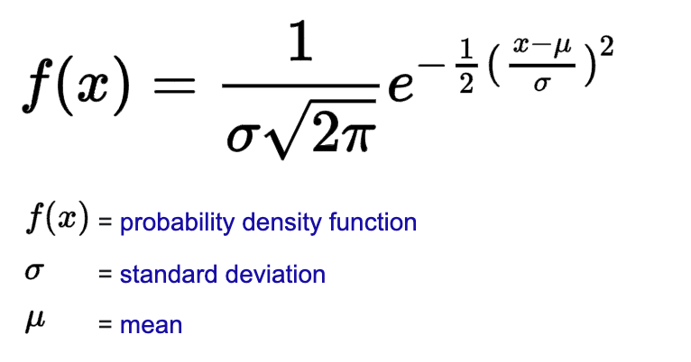
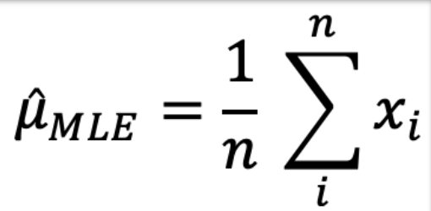
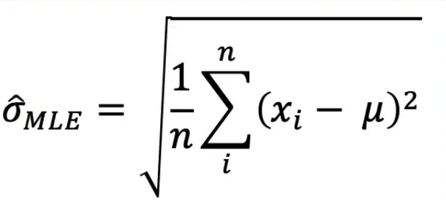
Example
Gaussian Distribution based anomaly detection
Mathematical Formulation
Txn Amount
# Login Attempts

Slide 16
Example
Isolation Forest
Methodology
Tree-based algorithm
Points that are easy to separate form the anomalies -> Fewer decisions to take
Points that are difficult to separate form genuine points -> More decision to seperate

