Slide 1


Introduction to Compilers: Basics
In Association With: ACM Student Chapter & Information Technology Department of Engineering, G L Bajaj
By-
Shailesh Kumar Jha
Kirti Gupta
(Final Year - IT Branch)

Slide 2
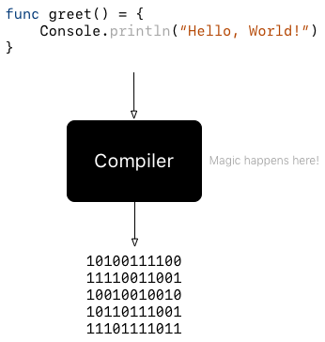
Compilers?
What is it?
Who is it?
Where is it?
What it contains?
What does it do?
What are its different phases?
Why is it needed?
Lets Find Out..

Slide 3
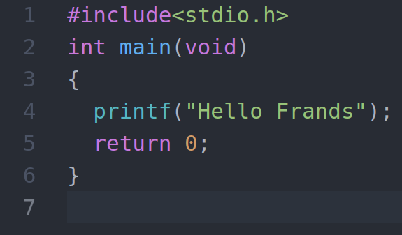
Have A Look At This:
What is the output of this code?
What makes it do that?
Who does that?
What does the each line means?
How the System knows about this?

Slide 4
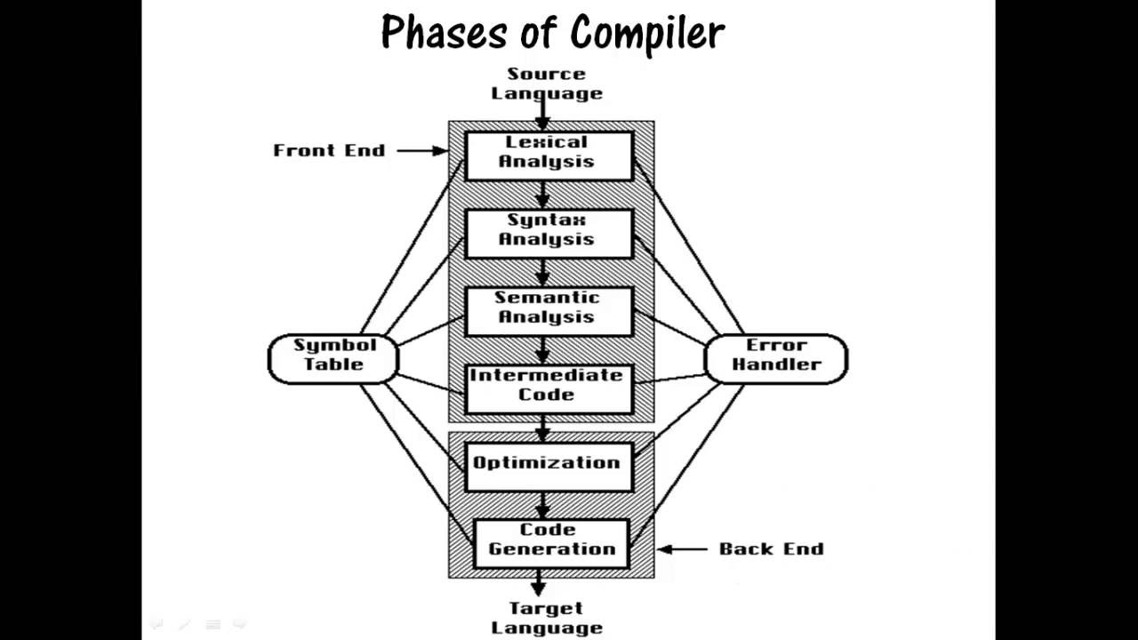

Slide 5
Lets Get Back to this
What does the Line #1 contains:
Type following command:
cd /usr/include
code stdio.h
What does the Line #2 contains?
What does the Line #4 contains?
What does the Line #5 contains?

Slide 6
Lexical Analysis:
Lexical analysis, or tokenization is the process of converting a sequence of characters into a sequence of tokens.
A lexical token is a sequence of characters that can be treated as a unit in the grammar of the programming languages. Examples:
Keywords; Examples-for, while, if etc.
Identifier; Examples-Variable name, function name etc.
Operators; Examples '+', '++', '-' etc.
Separators; Examples ',' ';' etc

Slide 7
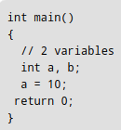

How Lexical Analyzer functions:
For the following program:
The Corresponding Lexical Tokens are:-
(Note there is no token generated for comments)

Slide 8
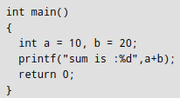
Count the Number of Tokens:

Slide 9
Syntax Analysis:
Parsing, syntax analysis or syntactic analysis is the process of analysing a string of symbols, either in natural language, computer languages or data structures, conforming to the rules of a formal grammar.
Syntax Analysis, consists of Parsers, which parses the code even if some errors exist in the program.
The language defined in the form of CFG in the compiler, tells the syntax structure of the programming language.

Slide 10
Derivation:
A derivation is basically a sequence of prodeuction rules, in order to get the input string.
There are two types of Derivations:
LMD (Left Most Derivation)
RMD (Right Most Derivation)
Two decisions are taken during parsing:
Deciding the non-terminal which is to be replaced
Deciding the production rule, by which, the non-terminal will be replaced

Slide 11
Semantic Analysis:
Semantics of a language provide meaning to constructs, like tokens and syntax structure.
It is a task of ensuring that the declarations and statements of a program are semantically correct, i.e., that their meaning is clear and consistent with the way in which control structures and data types are supposed to be used.

Slide 12
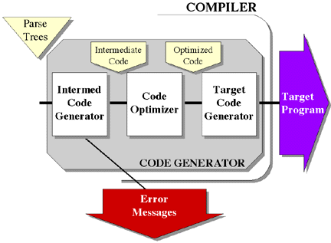
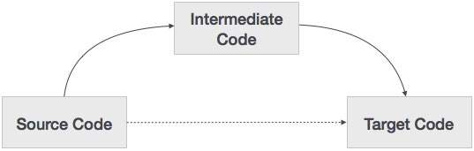
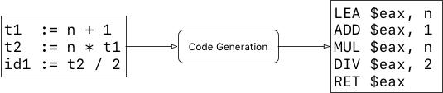
Intermediate Code Generation:

Slide 13
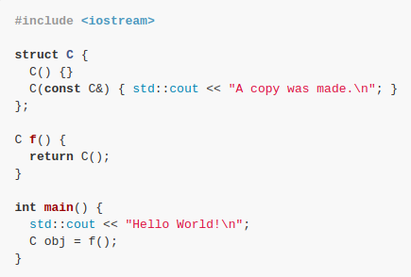
What is the output of the following code?

Slide 14
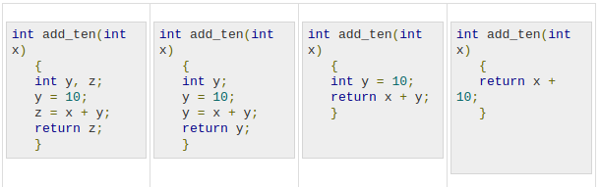

Code Optimization:
Have a look at this:
What about this?

Slide 15
Code Generation:
Code generation is the process by which a compiler's code generator converts some intermediate representation of source code into a form (e.g., machine code) that can be readily executed by a machine.
Code generation is generally considered the last phase of compilation, although there are multiple intermediate steps performed before the final executable is produced. These intermediate steps are used to perform optimization and other relevant processes.

Slide 16
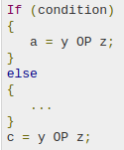
Can we do something with this?

Slide 17
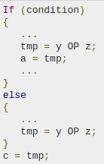

Slide 18
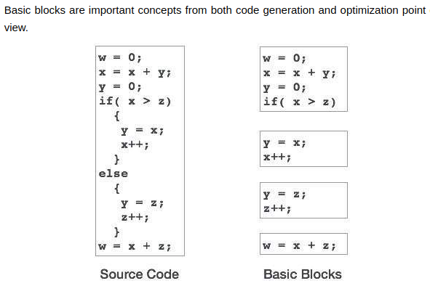
Basic Blocks:

Slide 19
Ques: Why we need to Optimize our code in the program?

Slide 20


