Slide 1
Computer Aided Diagnosis of
Parkinson's Disease
Jyoti Prakash Uprety
Shailesh Adhikari
Sushmita Poudel
Shulav Karki
( Newell Group, 2022)
Don’t worry, presentation is on dark mode.

Slide 2
10 million
Global cases in 2022 due to PD
$2,500
Medication cost a year
60,000
Cases in US every Year
NO TEST
No Test or Progression Marker
Only 4%
diagnosed before age 50

Slide 3
Problem Statement
Parkinson’s is a neurodegenerative disorder without a specific diagnosis. It is a movement disease and its risk can be easily classified with enough parameters. ^{[1]}
Even though the disease is not diagnosable, if caught early, one can remain active with proper medication.
Thus, based on a patient’s vocal skills we aim to develop a model that will accurately classify whether the person has Parkinson’s disease.

Slide 4
Feasibility Study
We believe our project is operationally feasible as it aims to detect the disease at an early stage. Hence its implementation in healthcare could be beneficial for predicting PD through data-driven analysis.
Since the project is going to be carried out entirely with free resources like Google Colab and GitHub, it is both technically and economically feasible.
Many research papers have backed this idea of early detection by ML.
Notes:
> Computational Incomplex

Slide 5
“ .. KNN can predict with accuracy of 97.43% in early stage of PD .. “
(Mittal and Sharma, 2022) ^{[2]}
“ .. NN with SMOTE outperformed machine learning models in classifying PD and ET based on IMU data set .. “
(Moon et al., 2020) ^{[3]}
“ .. ML approaches have potential to provide clinicians with additional tools to screen, detect or diagnose PD .. “
(Mei, Desrosiers and Frasnelli, 2021) ^{[4]}

Slide 6
Source of Data
The dataset is collected from UCI Machine Learning Repository, which was created by Sakar et al., 2019. ^{[5]}
About Data:
The data were collected from 252 Parkinson's disease patients ranging in age from 33 to 87.
Number of observations: 756.
Features includes:
• Vocal Features (Pulses, jitter, shimmer)
• Patient parameters

Slide 7
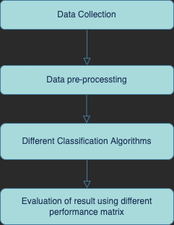
System Flowchart
Notes:
> Multiple algorithm , comparison , find best algorithm

Slide 8
Performance Metrics
Accuracy
Ratio of correct prediction by total predictions
Confusion Matrix
Matrix with TP, TN, FP and FN
ROC and AUC
Recall, Precision and F1 Score
Kappa
Compares the observed accuracy to an expected accuracy

Slide 9
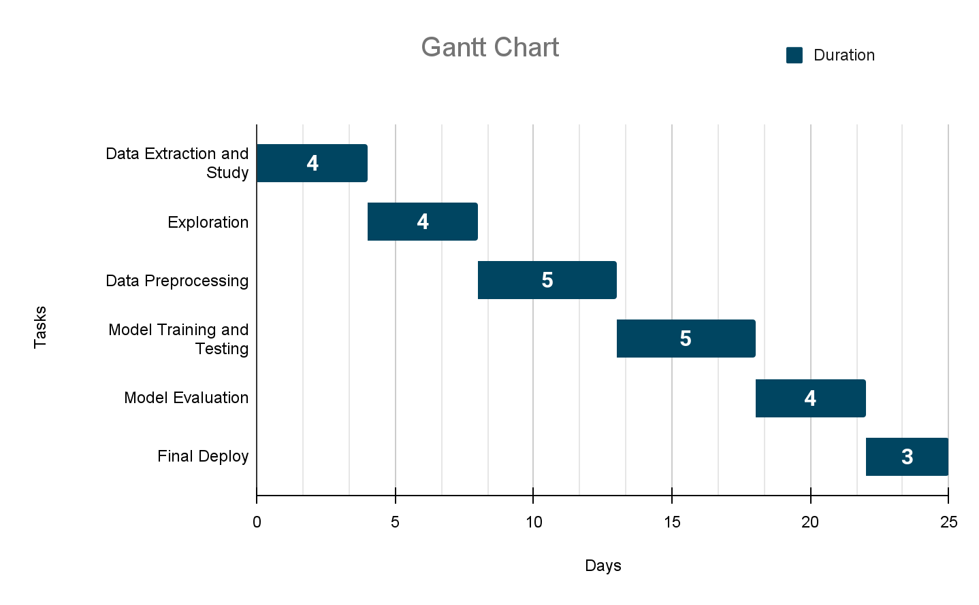
Project Timeline

Slide 10
References
Parkinson's Foundation. 2022. What Is Parkinson's?. [online] Available at: <https://www.parkinson.org/understanding-parkinsons/what-is-parkinsons> [Accessed 9 May 2022].
Mittal, C. and Sharma, A., 2022. Parkinson’s Disease Detection Using Different Machine Learning Algorithms. International Journal of Scientific and Research Publications (IJSRP), 12(2), p.23. Available at: <http://dx.doi.org/10.29322/IJSRP.12.02.2022.p12205>.
Moon, S., Song, H., Sharma, V., Lyons, K., Pahwa, R., Akinwuntan, A. and Devos, H., 2020. Classification of Parkinson’s disease and essential tremor based on balance and gait characteristics from wearable motion sensors via machine learning techniques: a data-driven approach. Journal of NeuroEngineering and Rehabilitation, 17(1). Available at: <https://doi.org/10.1186/s12984-020-00756-5>.
Mei, J., Desrosiers, C. and Frasnelli, J., 2021. Machine Learning for the Diagnosis of Parkinson's Disease: A Review of Literature. Frontiers in Aging Neuroscience, 13. Available at: <https://doi.org/10.3389/fnagi.2021.633752>.
Sakar, C. O., Serbes, G., Gunduz, A., Tunc, H. C., Nizam, H., Sakar, B. E., Tutuncu, M., Aydin, T., Isenkul, M. E., &amp; Apaydin, H. (2019). A comparative analysis of speech signal processing algorithms for parkinson’s disease classification and the use of the tunable Q-factor wavelet transform. Applied Soft Computing, 74, 255–263. <https://doi.org/10.1016/j.asoc.2018.10.022>
Hirschauer, T., Adeli, H. and Buford, J., 2015. Computer-Aided Diagnosis of Parkinson’s Disease Using Enhanced Probabilistic Neural Network. Journal of Medical Systems, 39(11). Available at: <https://doi.org/10.1007/s10916-015-0353-9>.
Vickery, R., 2022. 8 Metrics to Measure Classification Performance. [online] Medium. Available at: <https://towardsdatascience.com/8-metrics-to-measure-classification-performance-984d9d7fd7aa>

