Slide 1

EXPLORATORY DATA ANALYSIS ON - REPAYING THE CREDIT
GOLD ATLANTIS
BY- Shailesh Chandrawanshi

Slide 2

Repaying the Credit
However, there are two types of risks that are associated with the firm's decisions:
If the applicant is likely to repay the loan, then disapproving the loan may result in a loss of business to the firm.
If the applicant is not likely to repay the loan, that is if the applicant is a defaulter, then approving the loan may lead to a financial loss to the firm.

Slide 3

AGENDA
To find pattern of clients who have a higher & lower probability of becoming a defaulter.

Slide 4
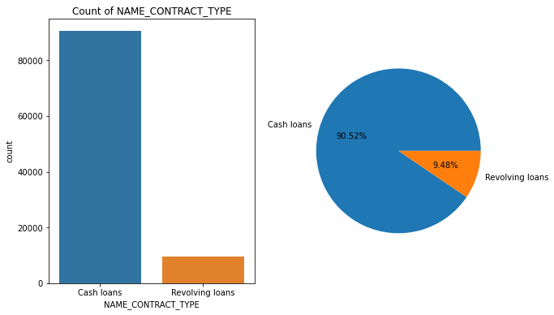
WHAT PERCENTAGE OF PEOPLE TAKES THE LOAN TO REPAY THERE PRIVIOUS LOAN ?
Conclusion :
We can observe that there is 90.52% of cash loans and 9.48 percentage of revolving loans.

Slide 5
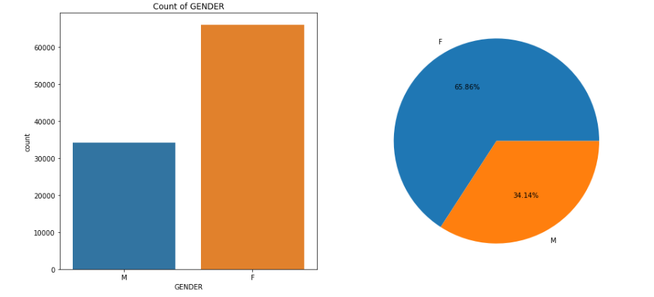

2. ANALYSIS OF GENDER :
Conclusion :
We can observe that gender-wise female has the maximum count and it acquires 65.86 % and male is 34.14%

Slide 6
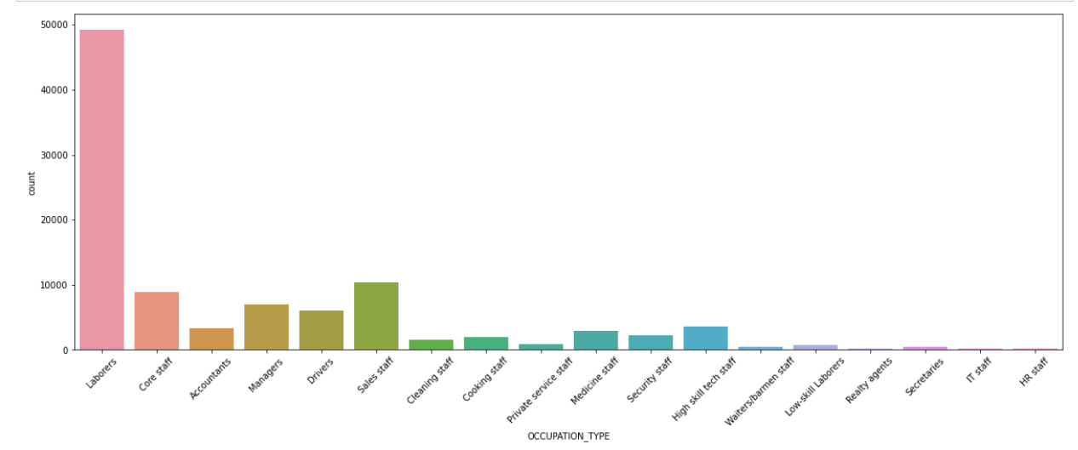
ANALYSIS OF OCCUPATION TYPE :
We can observe that the laborers, sales staff ,core staff are the people who takes the loan maximum time
Conclusion :

Slide 7
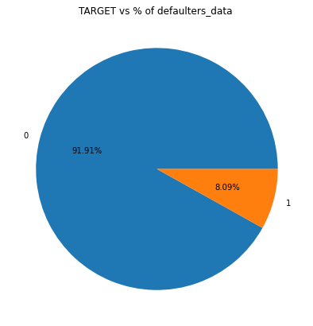
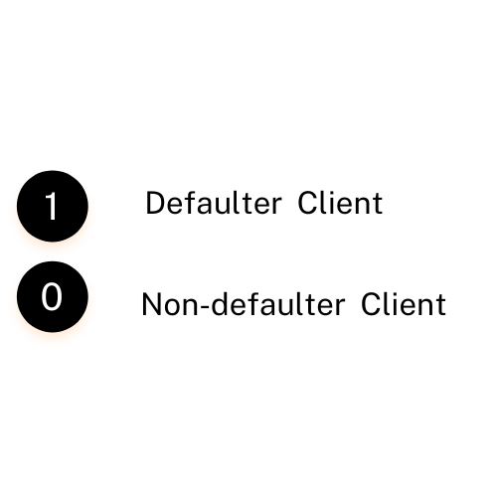
ANALYSIS OF THE DEFAULTERS AND NON DEFAULTERS CLIENTS :
Conclusion :
We can observe that there are 8.09% defaulters clients and 91.91% are non-defaulters clients.

Slide 8
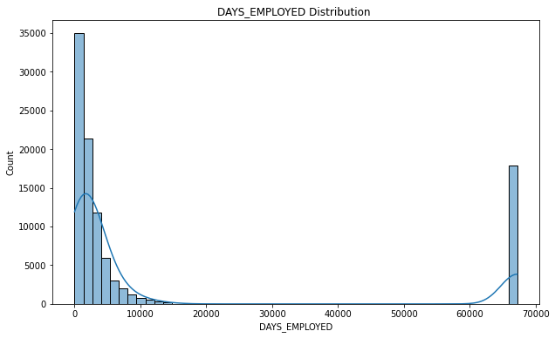
ANALYSIS OF DAYS EMPLOYED : -
Conclusion :
The client taking a loan are average newly employed people.

Slide 9
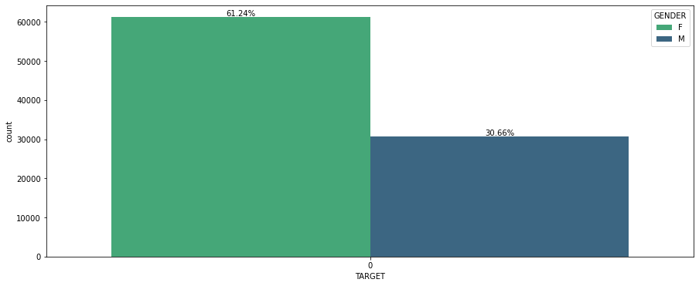
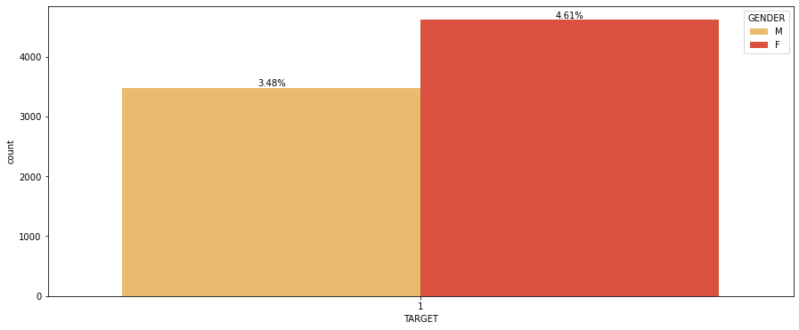
SHOW DISTRIBUTION OF MALE AND FEMALE ON TARGET.

Slide 10
INTERPRETATION:
The female clients applied More than male clients for loan.
61.24 % female clients are non-defaulters while 30.66 % male clients are non-defaulters.
4.61% female clients are defaulters while 3.48% male clients are defaulters.

Slide 11
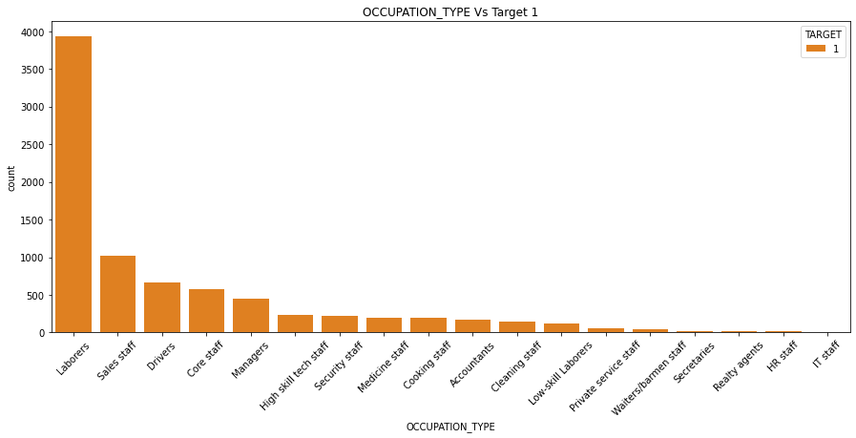
ANALYSIS OF THE DATA ON BASES ON OCCUPATION TYPE: -
Conclusion :
We observed that the maximum number of people who applied for loans is labourers, sales staff, drivers and core staff.

Slide 12
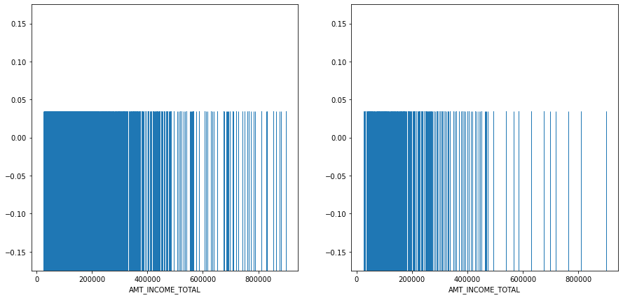
ANALYSIS OF INCOME OF THE CLIENT ON NON DEFAULTERS AND DEFAULTERS.
0
1
Conclusion :
People with defaulters has largely staggered income as compared to non defaulters.

Slide 13
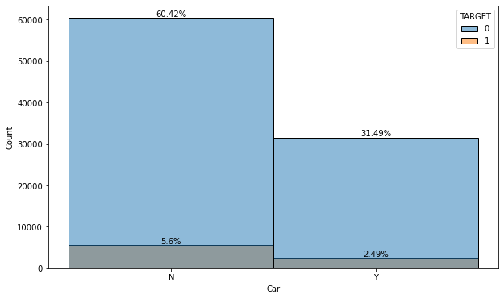
ANALYSIS OF THE CLIENT HAVING A CAR AND ARE DEFAULTERS OR NOT?
Conclusion :
People having car are having more difficulties in paying loans.

Slide 14
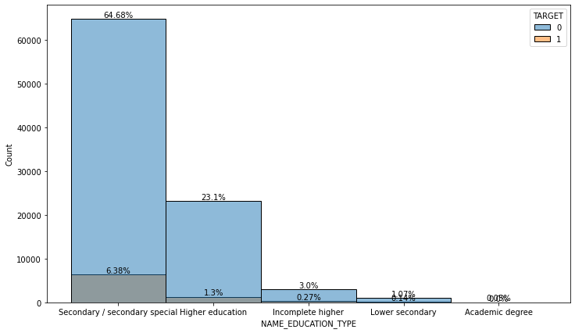
ANALYSIS OF CLIENTS ON THE BASES OF THEIR EDUCATION TYPE.
Conclusion :
We can observe the that people with academic degrees are very less in the count.
We can see that clients having higher education are having more difficulty in paying loan amounts, and second the client who has incomplete education.
The bank should be strict about higher education and incomplete education Client.

Slide 15
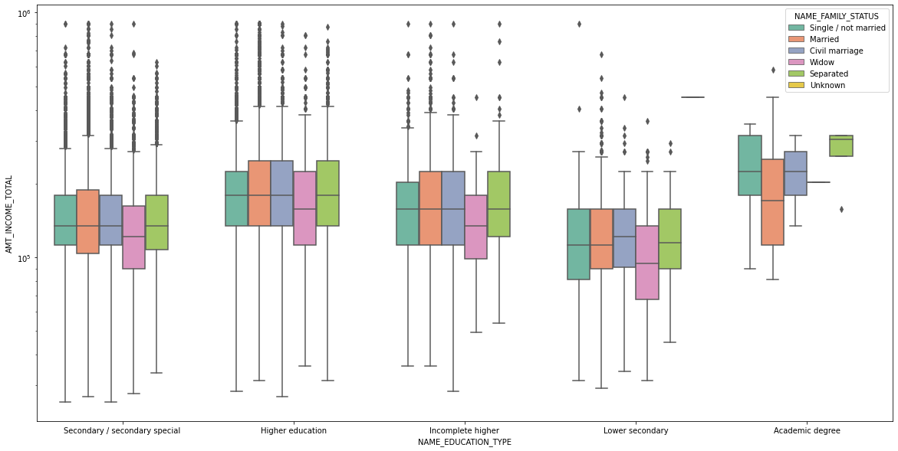
ANALYSIS OF THE EDUCATION AND THERE TOTAL INCOME ALSO CONSIDER THE FAMILY STATUS.

Slide 16
INTERPRETATION:
Clients having higher education, incomplete higher. education, secondary/secondary special have a higher number of outliers.
Widows are have less total income also they have Less outliers.
Married clients with acamadic degree are having Less salaries but also had Less outlier.

Slide 17
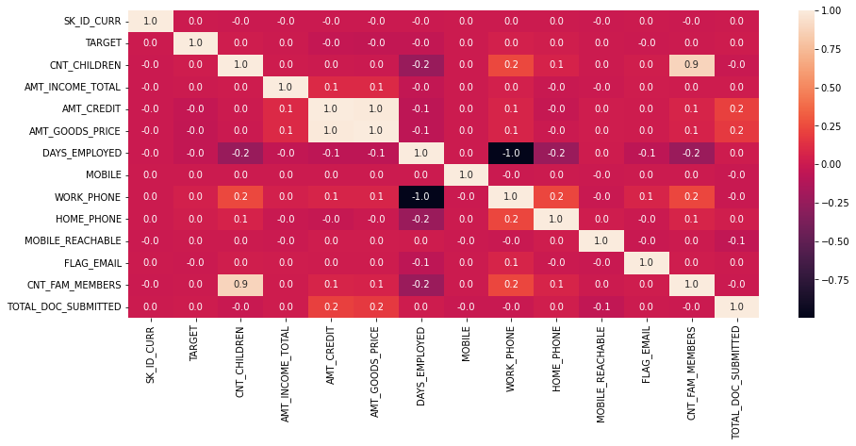
SHOW THE CO-RELATION BETWEEN ALL THE CONTINUOUS DATA PRESENT?
Conclusion :
There are very few columns with correlations between them as we observe in the heatmap.

Slide 18
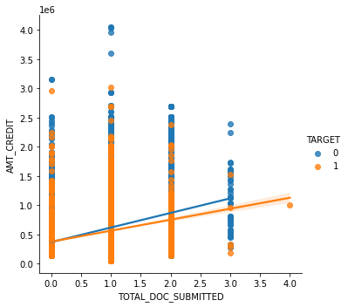

ANALYSIS ON DOCUMENTS SUBMISSION BY THE CLIENT.
Conclusion :
We observe that the defaulters client submits more documents and has less amount credit.
The bank should avoid the customer having less documents and high credit amounts.
Bank should have fix no documents for appling for loan.
We can observe people submitted the null documents still got some high amount credit.
9536 of people got loan without documents.

Slide 19
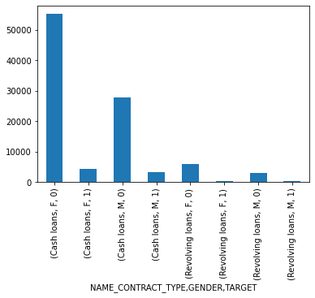
ANALYSIS ON THE NAME CONTRACT TYPE, GENDER ALSO INCLUDE TARGET
Conclusion :
Females having cash loans are more in number in having problem in paying loan.

Slide 20

INTERPRETATION :
The Bank has 8.09% of defaulters Clients.
There is 4.61 % of Female clients are defaulters.
The labourers, sales staff, and core staff are the people who take the loan maximum time.
People having less salary should be avoided.
People having cars have more difficulties in repaying the loan. if a person has only car no home should be avoided.
Banks can focus on clients having academic degrees to take more loans as they are less in target 1.
The bank should avoid clients with fewer documents & high credit amounts.
Banks have to avoid giving cash loan female having less salaries.

Slide 21


